Slide 1
CS489: Applied Software Development Project: Advantis Dental Service

Slide 2
Problem Statement
Login user as Officer, Dentist & Patient.
System should allow maintain the record according to cities.
Patients should be able to sign in to the system and view their appointments.
A system allow to a patient can submit a request for an appointment.
A system allow to a patient can submit a request to change the appointment.
Officer can enroll the patient.
Officer can book the appointment and notify patient by auto generated email
Dentists should be able to sign in to the system and view a listing of all their Appointments.
System allow to stores specialization.
The system should provide information report about each Surgery.
A dentist cannot be given more than 5 appointments in any given week.
System should prevent a patient from a requesting a new appointment if the patient has due.

Slide 3
Use Case
Use Case 1: Office Manager Registers Dentists and Patients
Actors: Office Manager
Description: The Office Manager uses the system to register new Dentists and Patients.
Flow:
Office Manager logs in to the system.
Office Manager navigates to the respective registration forms for Dentists and Patients.
For Dentists, the Office Manager enters First Name, Last Name, Contact Phone Number, Email, and Specialization.
For Patients, the Office Manager enters First Name, Last Name, Contact Phone Number, Email, Mailing Address, and Date of Birth.

Slide 4
Use Case
Use Case 2: Office Manager Books Appointments
Actors: Office Manager
Description: The Office Manager books appointments for Patients to see Dentists.
Flow:
Office Manager logs in to the system.
Office Manager views appointment requests from Patients.
Office Manager checks Dentist availability and schedules appointments for Patients.
System sends confirmation emails to Patients and Dentists for booked appointments.

Slide 5
Use Case
Use Case 3: Dentists Manage Appointments
Actors: Dentists
Description: Dentists view and manage their scheduled appointments.
Flow:
Dentist logs in to the system.
Dentist views a listing of their appointments, including Patient details.
Dentist can view appointment details, reschedule, or cancel appointments as needed.

Slide 6
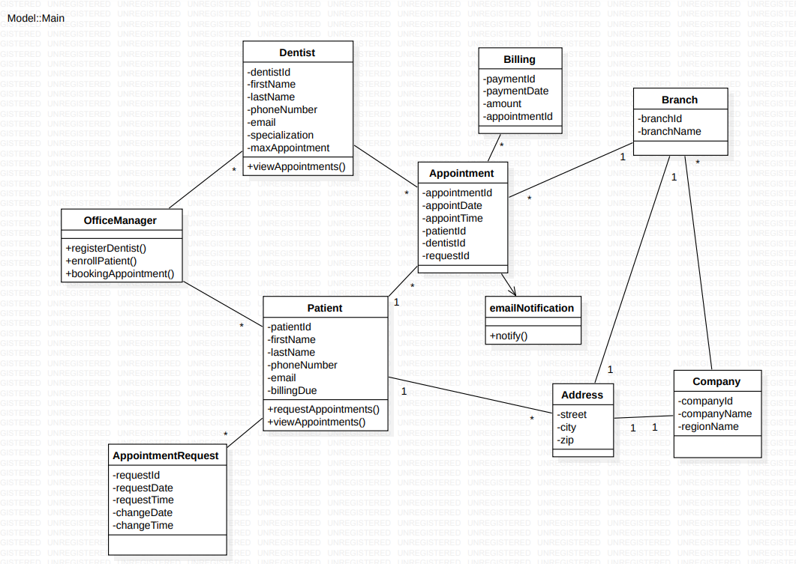
Domain Model Class Diagram

Slide 7
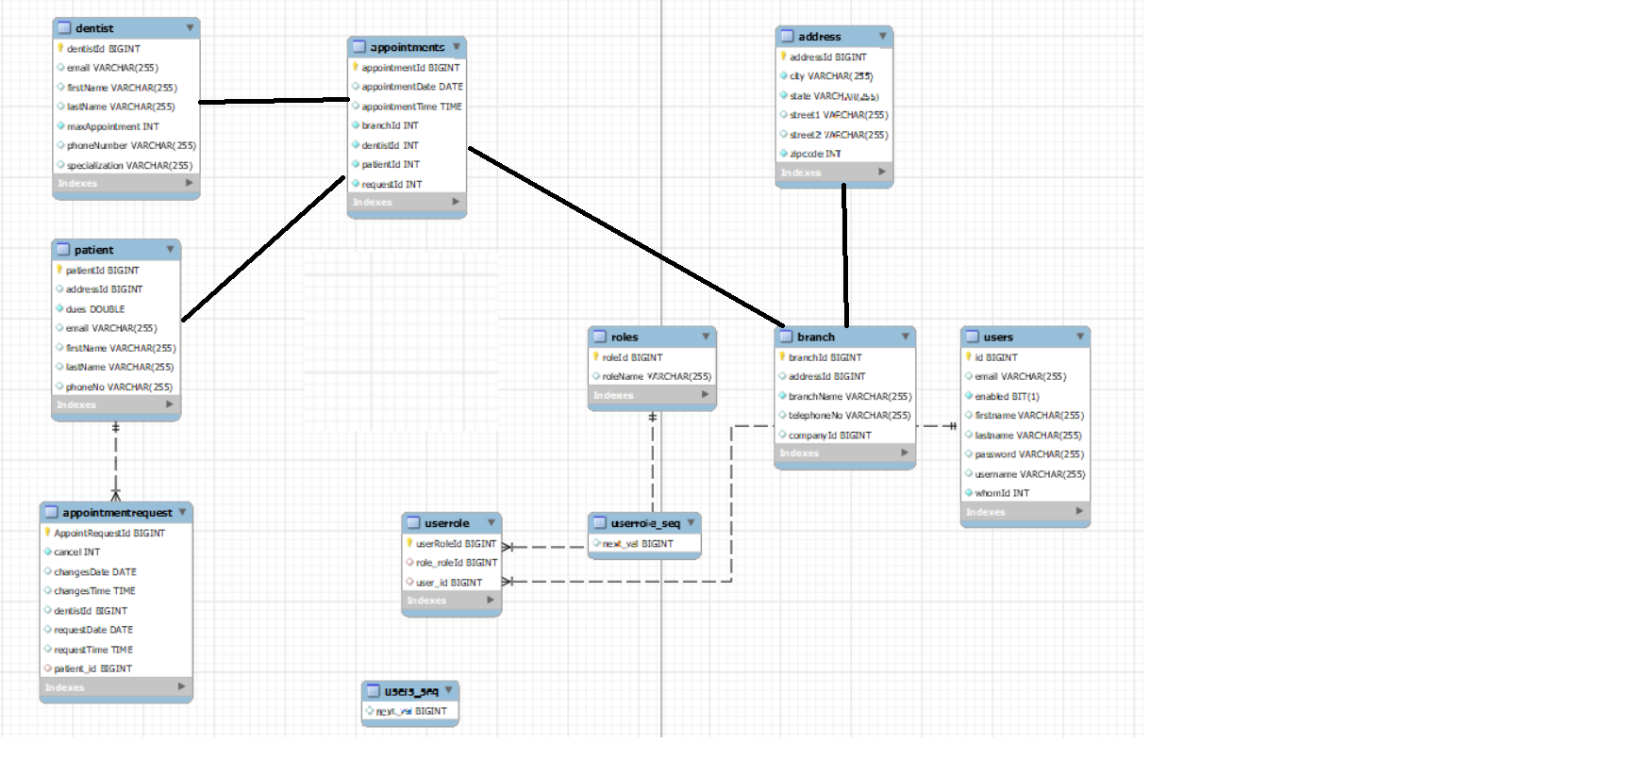
ERD Diagram

Slide 8
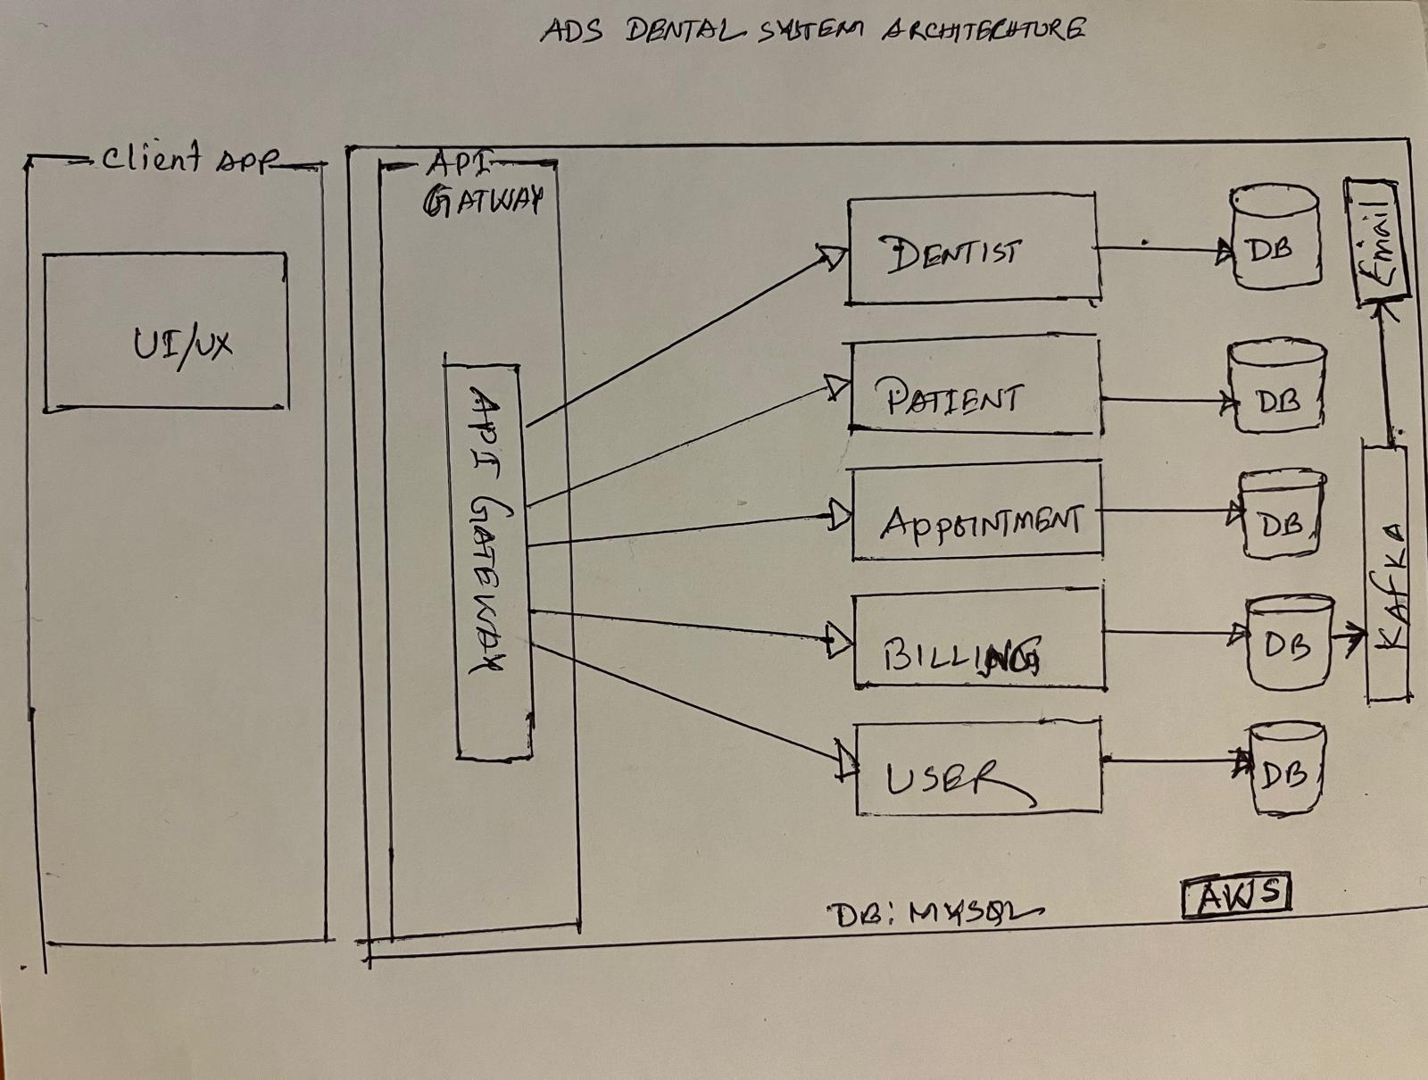
Architecture Diagram

Slide 9
CS489: Applied Software Development

