Slide 1
Customer Engagement & Product
Utilization Analytics
for Retention Strategy
A Behavioral & Relationship-Strength Approach to Customer Retention
Iqra | Unified Mentor — Data Analyst & Data Science Internship | European Bank Dataset (10,000 records)
September 2026

Slide 2
Agenda
01
Why This Matters
The false assumption: balance = loyalty
02
Objectives & Dataset
What we set out to measure, and on what data
03
Methodology
Engagement profiles & the Relationship Strength Index
04
Key Findings
4 statistically validated findings
05
Statistical Rigor & Predictive Model
Chi-square tests, correlations, and an honest model result
06
KPIs & Recommendations
What to track, and what to do next

Slide 3
Why This Matters
Banks assume high balance = loyal customer. Our data says otherwise.
1
2
3
Low Engagement
Limited Product Adoption
Weak Relationship Depth
Customers stop using products actively, even with healthy balances
Single-product customers show no depth of relationship with the bank
No tenure, card, or activity signal tying the customer to the bank
These behaviors — not demographics — determine long-term retention.

Slide 4
Project Objectives
Primary Objectives
Secondary Objectives
Evaluate the relationship between engagement and churn
Support engagement-driven retention strategies
Measure the retention impact of product count and product mix
Improve product bundling decisions
Identify disengaged yet high-value customers
Reduce silent churn among premium customers
Problem Statement
Banks lack quantitative insight into which behaviors drive retention, whether product depth reduces churn, and whether high balances alone ensure loyalty — leading to generic, misaligned retention strategies.

Slide 5
Dataset Overview
10,000
13
3
0
Customer Records
Fields per Record
Geographies (FR / DE / ES)
Missing Values or Duplicates
Key Fields Used in This Analysis
NumOfProducts
IsActiveMember
Product depth (1-4 products held)
Engagement / activity indicator
Balance / EstimatedSalary
Tenure / HasCrCard
Financial commitment tiering
Relationship-strength inputs
Geography
Exited
France, Germany, Spain segmentation
Churn indicator — target variable

Slide 6
Methodology: The Relationship Strength Index
A composite 0-10 score combining four behavioral signals into one retention-strength metric.
2 ×
1.5 ×
1 ×
1 ×
+
+
+
Active
Member
Products
(capped at 4)
Has Credit
Card
Tenure
≥ 5 years
Score ≥ 6 = Sticky Customer Score < 6 = At-Risk Customer
Weights set by reasoned judgment, not data-fit — Slide 11 shows what a data-fit model finds instead.
Other steps: data validation → engagement classification (4 profiles) → product utilization analysis → balance-vs-activity cross-analysis → RSI scoring

Slide 7
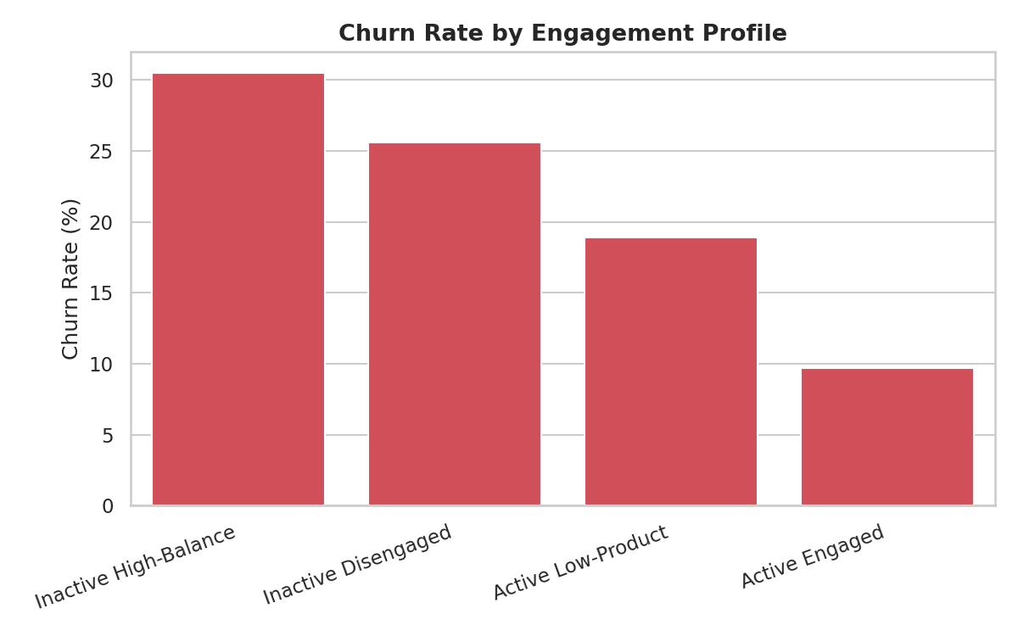
Finding 1: Engagement Beats Wealth
9.7%
churn among Active Engaged customers
30.5%
churn among Inactive High-Balance customers
A 3x churn gap — statistically confirmed (χ² = 325.46, p < 0.001). Balance does not buy loyalty; activity does.

Slide 8
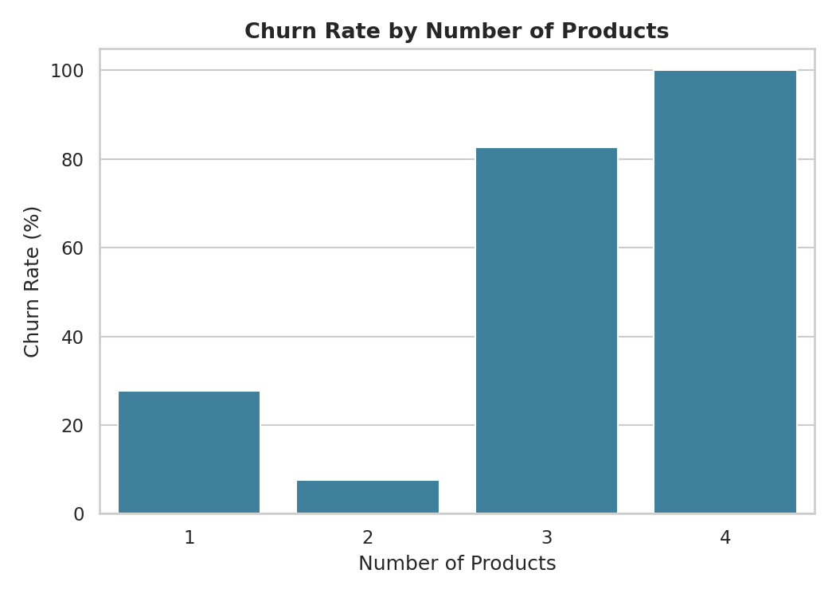
Finding 2: The 2-Product Sweet Spot
53.9%
relative churn reduction — multi-product vs. single-product customers (the Product Depth Index)
⚠ Counter-intuitive Signal
Customers with 3-4 products churn at 82.7% and 100% — far higher than the 2-product group.
This is not loyalty from product depth; it signals aggressive cross-selling without genuine engagement, and customers disengaging shortly after acquiring extra products.

Slide 9
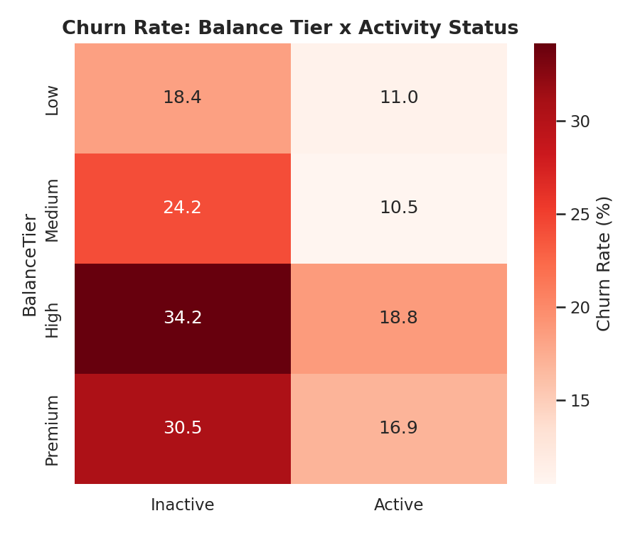
Finding 3: Balance Alone Doesn't Protect Against Churn
1,247
at-risk premium customers — Premium-balance customers who are inactive
Churn rate for this segment: 30.47%
In every balance tier — Low, Medium, High, Premium — inactive customers churn at roughly 2x the rate of active customers in the same tier.
Activity status, not wealth, is the stronger predictor of retention.

Slide 10
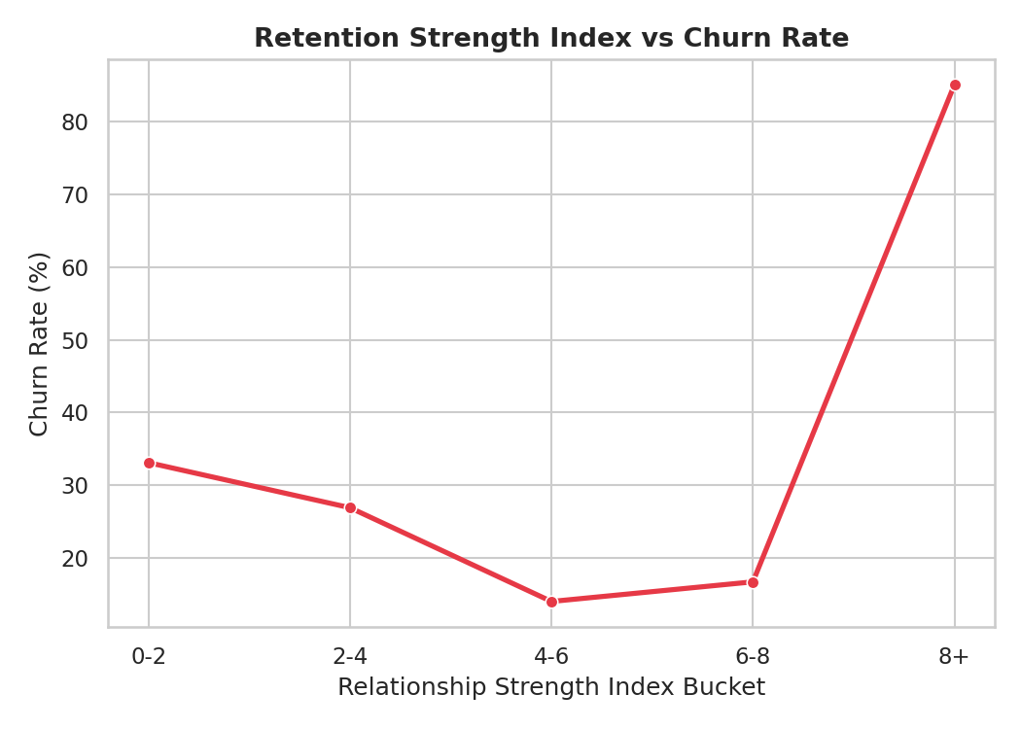
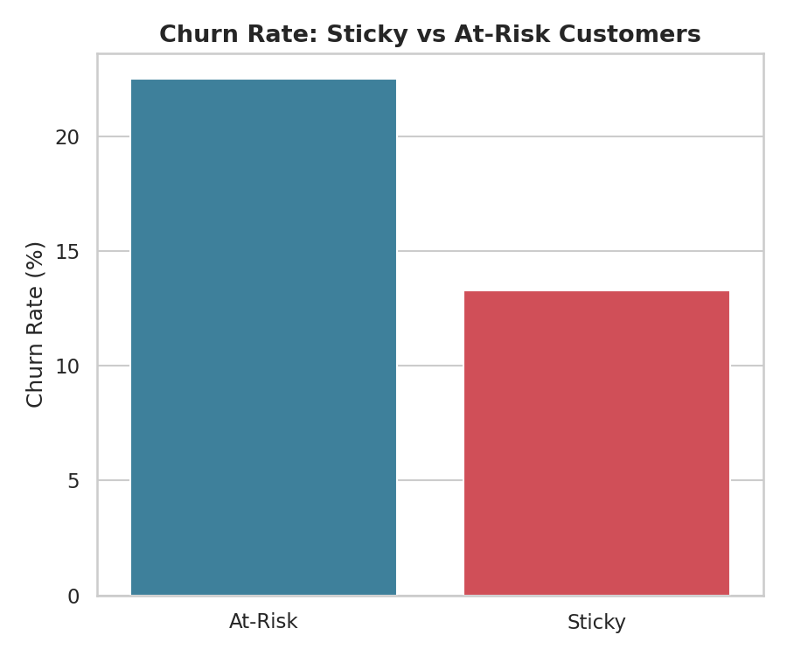
Finding 4: Retention Strength Predicts Loyalty
Sticky customers (RSI ≥ 6) churn at 13.3% — nearly half the 22.5% churn rate of At-Risk customers (χ² = 93.33, p < 0.001), validating RSI as a usable targeting metric.

Slide 11
Statistical Rigor: These Aren't Just Percentages
Every relationship above was tested with a chi-square test of independence — all significant at p < 0.001.
Variable
χ²
p-value
Strongest Correlates of Churn
Engagement Profile
325.46
< 0.001
Age
+0.285
Product Tier
342.98
< 0.001
Relationship Strength Index
−0.140
Geography
301.26
< 0.001
Sticky vs. At-Risk
93.33
< 0.001
Balance
+0.119
Balance Tier
140.10
< 0.001
Number of Products
−0.048
95% Confidence Intervals Don't Overlap: Active [13.3%, 15.2%] vs. Inactive [25.6%, 28.1%] — the engagement gap is real, not sampling noise.

Slide 12
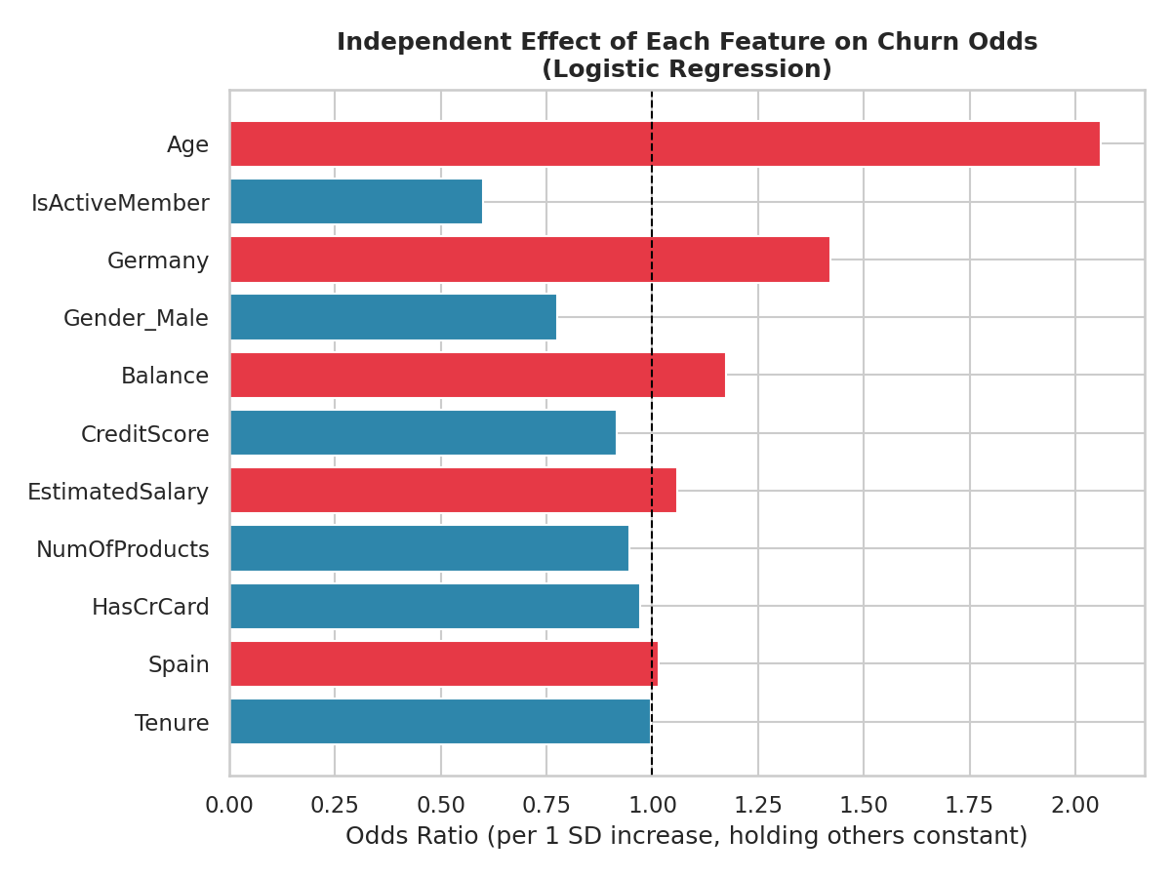
We Also Built a Predictive Model — Honestly Reported
Logistic regression, trained on 7,500 customers, tested on 2,500 it never saw.
80.9% vs. 79.6%
Model accuracy vs. simply guessing “no one churns” — barely better. Recall on actual churners: only 19%.
This is a useful negative result, not a failure: a single linear score can't separate customers as cleanly as our engagement-profile rules do (9.7% vs. 30.5% churn). Rule-based segmentation wins for this use case.

Slide 13
Key Performance Indicators
1.88x
53.9%
49.9%
Engagement Retention Ratio
Product Depth Index
High-Balance Disengagement Rate
3.0%
4.58/10
20.4%
Credit Card Stickiness Score
Avg. Relationship Strength Index
Overall Churn Rate

Slide 14
Recommendations
01
Target by Engagement, Not Balance
02
Redesign Cross-Sell for 3rd/4th Products
Flag inactive customers for retention outreach regardless of balance tier.
Pair any additional product offer with a 60-day relationship check-in.
03
Launch At-Risk Premium Program
04
Use RSI Rules, Not a Predictive Score
Proactively engage the 1,247 high-value inactive customers first.
Track RSI monthly; rely on segmentation, since the linear model underperforms it.

Slide 15
Engagement is the New Loyalty Currency
Design retention strategy around behavior, not balance.
Thank you — Iqra

