Slide 1
⌂
PARCL
BUYER INTELLIGENCE PLATFORM
Machine Learning-Based Buyer
Segmentation & Investment Profiling
Real Estate Market Intelligence for Parcl Co. Limited
Unified Mentor Program | Unsupervised ML: K-Means + Hierarchical Clustering
2,000 Clients
10,000 Transactions
4 Data-Derived Segments
7-Page Live Dashboard

Slide 2
THE CHALLENGE
Parcl Treats All Buyers the Same — And It's Costing Them
Real estate buyers span individual home buyers to institutional investors, with no data-driven way to tell them apart
Without segmentation, this leads to:
THE GOAL
✕
Inefficient marketing spend
Use unsupervised machine learning to discover the buyer segments that actually exist in Parcl's data — not the ones we assume exist — and turn them into an actionable, evidence-based targeting framework.
✕
Generic property recommendations
✕
Poor investor targeting

Slide 3
DATA AUDIT
What We Actually Found in the Files
Not the schema assumed in the brief — the schema verified in the raw data
2,000
10,000
7,305 / 2,695
1 : Many
CLIENTS
PROPERTY LISTINGS
SOLD / AVAILABLE
CLIENT → PROPERTY
Critical structural finding: every client bought 3+ properties (one bought 13). A naive merge would duplicate each client's demographic row once per purchase and corrupt any clustering built on it.
Real-world messiness handled, not assumed away:
date_of_birth mixes DD-MM-YYYY and MM/DD/YYYY formats in the same column
sale_price stored as currency strings ("$300,385.62")
acquisition_purpose values are Home/Investment — not "Personal use" as the brief described

Slide 4
METHODOLOGY
Five-Stage Pipeline
Cleaning → Feature engineering → Clustering → Validation → Robustness testing
01
02
03
04
05
Clean & Aggregate
Feature Engineer
Scale & Cluster
Validate
Stress-Test
Fix dates/currency; aggregate 10K transactions to one behavioral row per client
total_spend, purchase frequency, unit mix, loan/investment/company flags
StandardScaler + K-Means, evaluated k=2..10 via Elbow + Silhouette
Hierarchical (Ward) clustering cross-check via Adjusted Rand Index
6 random seeds, 10x 80% bootstrap resamples, feature-correlation audit

Slide 5
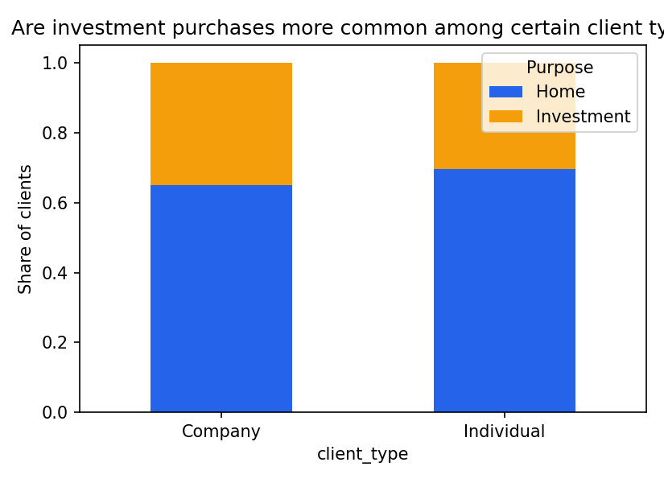
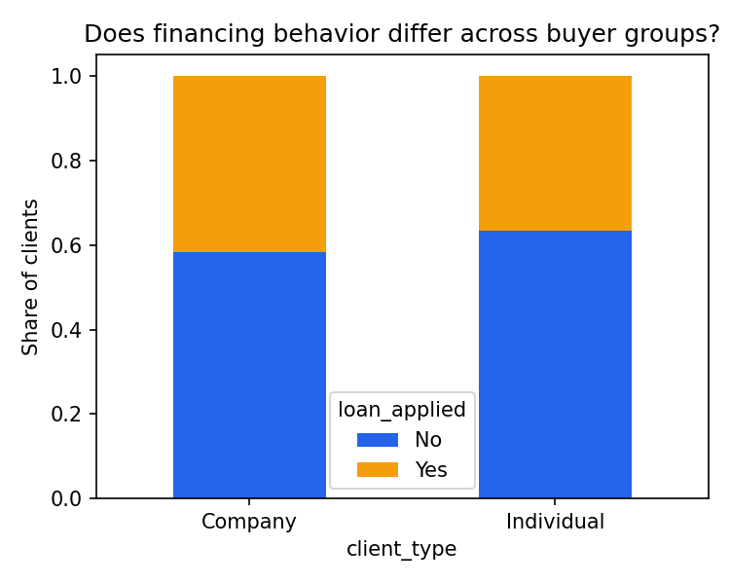
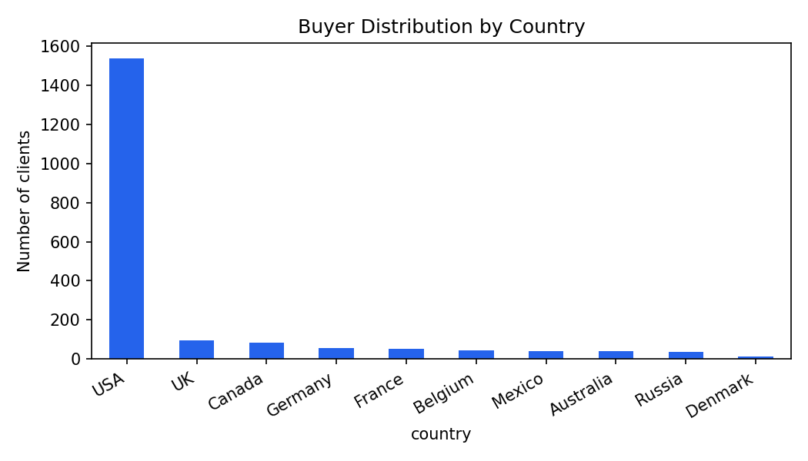
EXPLORATORY DATA ANALYSIS
Every Chart Answers a Specific Business Question
The client base is 76.9% USA (1,538 of 2,000) — country-level comparisons for the smallest markets (Denmark, n=15) are statistically noisy and reported as indicative only, not confident.

Slide 6
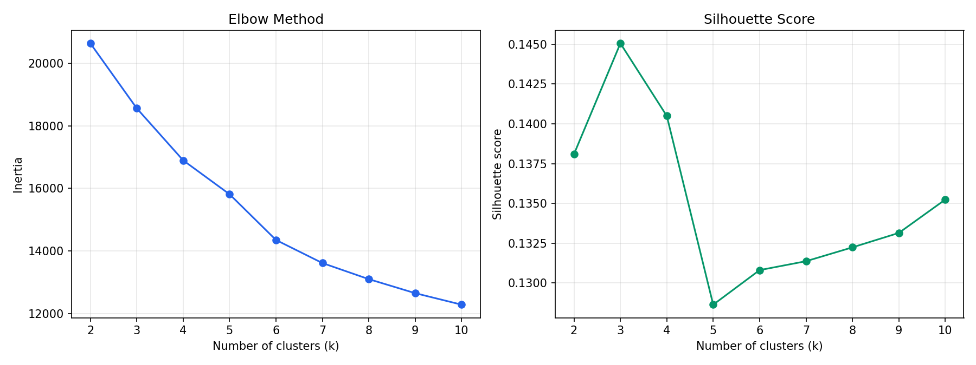
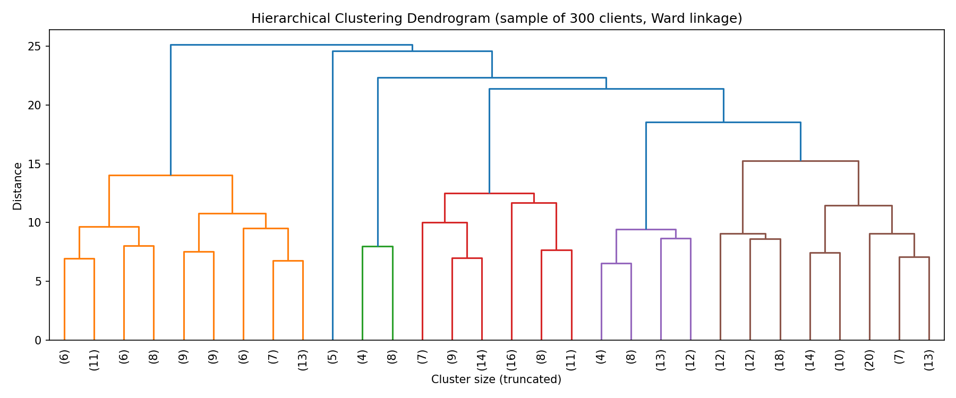
MODEL SELECTION
Choosing K: Elbow, Silhouette & Hierarchical Validation
k=4 selected — not the silhouette-optimal k=3, and here's why
Silhouette peaks at k=3 (0.145)
...but is nearly flat from k=3 to k=8 — no sharp natural cluster structure exists.
k=4 chosen anyway:
Isolates Corporate Buyers as their own distinct segment
A disclosed business-interpretability judgment call
Cross-validated vs Hierarchical: ARI = 0.267

Slide 7
RESULTS
Four Buyer Segments — Derived From the Data
Not forced into the brief's assumed labels (Global Investors / First-Time Buyers / Luxury Investors)
Value-Conscious
Home Buyers
High-Volume /
Frequent Buyers
Premium /
High-Value Buyers
Corporate
Buyers
812
640
446
102
41% of clients
32% of clients
22% of clients
5% of clients
Lowest spend/price among individuals
Highest purchase frequency
Highest average purchase price
Company clients, distinct B2B motion

Slide 8
MODEL INTEGRITY
Robustness & Stability — Tested, Not Assumed
Because a clustering result is only as trustworthy as its stress test
Alternative strategies tested:
a "Balanced behavior" strategy scores higher (0.172 vs 0.140) but merges Corporate Buyers into individuals — rejected despite the better score.
Seed stability (6 random seeds):
bimodal, not uniform — two distinct stable solutions exist (ARI=1.0 within each, ARI≈0.52 between them). Production's seed falls in the 4-of-6 majority group.
80% bootstrap resampling:
ARI ranges from 0.26 to 0.96 vs. the full model — highly variable, disclosed as such rather than hidden behind one mean.
Brief's literal encoding, tested directly:
scores numerically higher (0.41) but its top cluster is a trivial reproduction of the existing client_type column — not real structure.
WHY THIS MATTERS
total_purchases ↔ n_towers correlate at 0.93. avg_purchase_price ↔ avg_floor_area correlate at 0.96. Five of nine clustering features encode the same "transaction scale" dimension — exactly why segments separate by spend/volume, not financing intent.
Reported honestly in the research paper and dashboard rather than optimized away — a defensible model, not a perfect one.

Slide 9
DELIVERY
Interactive Streamlit Dashboard
7 pages — live filtering by country, region, purpose, client type, segment
Executive Overview
Buyer Segmentation
KPI cards, segment distribution, total-spend breakdown
Segment comparison across age, purpose, loan behavior
Geographic Intelligence
Investment Profiling
Country-level choropleth map (ISO-3 coded)
Investment vs home-use, referral-channel analysis
Segment Insights
Customer Explorer
Per-segment KPIs, characteristics, recommended actions
Individual client drill-down with CSV export
Model Information
Methodology, silhouette/ARI, robustness disclosure

Slide 10
BUSINESS IMPACT
Recommendations — Translating Clusters Into a Playbook
1
Corporate Buyers (5%)
Route to a dedicated B2B sales team with bulk/multi-unit packages, not the retail funnel
2
High-Volume Buyers (32%)
Loyalty & portfolio incentives, early access to new listings — outsized transaction volume
3
Premium Buyers (22%)
Lead with exclusivity and white-glove service, not price discounts
4
Value-Conscious Buyers (41%)
Affordability messaging, starter-buyer financing packages — the largest segment
Caveat carried into every recommendation: no campaign-response/ROI data exists — these are testable hypotheses from behavioral clustering, not proven causal claims.

Slide 11
INTELLECTUAL HONESTY
Limitations — Stated Plainly
What a technical interviewer would ask, answered before they ask it
Modest separation
Silhouette 0.12–0.15: buyer behavior varies continuously, not in sharp groups
Bimodal stability
Seed testing found two distinct stable solutions, not one robust answer
Geographic skew
76.9% of clients are USA-based; small-country comparisons are statistically noisy
Feature correlation
5 of 9 clustering features are highly intercorrelated around "transaction scale"
No ROI data
No marketing-response data exists to validate recommendation ROI directly

Slide 12
⌂
PARCL
Thank You
Full pipeline, research paper, Streamlit dashboard, and this deck are all in the project repository — every number here traces back to code you can re-run.
Machine Learning-Based Buyer Segmentation and Investment Profiling | Parcl Co. Limited | Unified Mentor

