Slide 1
Product Line Profitability &
Margin Performance Analysis
Nassau Candy Distributor
Data Scientist Internship Project | Unified Mentor
10,194 transactions analyzed • 15 products • 3 divisions • 5 factories

Slide 2
Business Context & Problem Statement
Sales volume alone is misleading.
Some products sell in high volume but generate low profit, consume disproportionate manufacturing cost, or appear successful while weakening overall margins.
This project answers four questions for Nassau Candy:
Which products truly drive profit?
Which divisions underperform financially?
Where is pricing, sourcing, or rationalization needed?
How concentrated is profit risk across the portfolio?
Dataset at a glance
Records
10,194
Products
15
Divisions
3
Order period
Jan 2024 - Dec 2025
Missing values
0
Duplicate rows
0

Slide 3
Analytical Methodology
1
Data Cleaning & Validation
2
Profitability Metrics
3
Product & Division Analysis
Checked nulls, duplicates, invalid sales/units, and the Sales - Cost = Gross Profit identity.
Gross margin %, profit per unit, revenue & profit contribution per product.
Ranked by profit and margin; flagged high-sales/low-margin risk.
4
Pareto Concentration
5
Cost Diagnostics
6
Factory Correlation
Identified the products driving 80% of revenue and profit.
Cost-vs-sales scatter to flag repricing / renegotiation candidates.
Mapped every product to its factory and location.

Slide 4
Overall Performance KPIs
Full-period results across all products and divisions
$141,783.63
$93,442.80
65.91%
38,654
Total Sales
Total Gross Profit
Overall Gross Margin
Total Units Sold
Highlights
Highest gross profit: Wonka Bar -Scrumdiddlyumptious ($19,357.50)
Highest gross margin: Everlasting Gobstopper (80.00%)
Primary margin risk: Kazookles (7.69% margin)
Concentration: 5 of 15 products generate over 80% of gross profit

Slide 5
Product Gross-Profit Leaderboard
Ranked by total gross profit contribution

Slide 6
Division Performance
Chocolate is the dominant financial engine
Chocolate: 92.88% of revenue and 95.06% of gross profit from a single division.

Slide 7
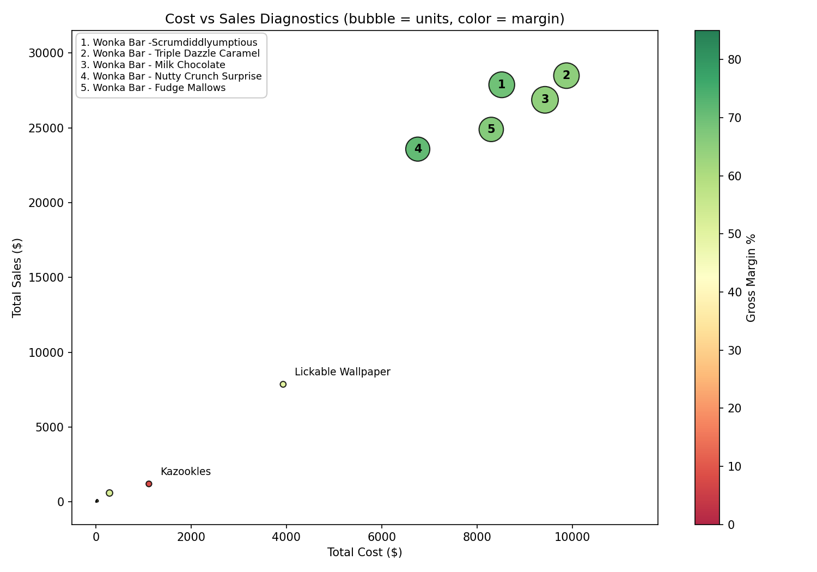
Cost vs Sales Diagnostics
Bubble size = units sold, color = gross margin
Kazookles is the clear outlier: its cost consumes over 92% of sales value, versus 30-36% for the core chocolate bars.

Slide 8
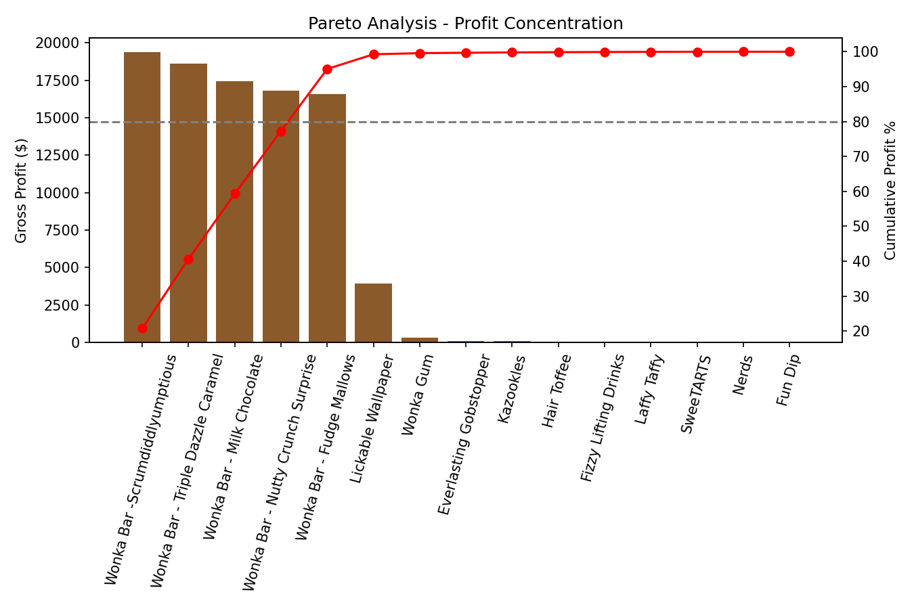
Profit Concentration — Pareto Analysis
How many products drive most of the profit?
5 of 15
products generate over
80% of total gross profit
All five are chocolate bars — a structural dependency risk.

Slide 9
Factory Intelligence
Gross profit and margin by manufacturing factory

Slide 10
Recommendations
Protect the core
Chocolate's five products carry ~95% of gross profit — safeguard pricing, supply and factory capacity at Lot's O' Nuts and Wicked Choccy's.
1
Review Kazookles now
7.69% margin is the clearest risk in the portfolio. Reprice, renegotiate supplier cost, or evaluate discontinuation.
2
Margin-based promotions
Replace sales-volume promotion rules with margin-based rules so low-margin products stop receiving incentives that erode profit.
3
Monitor concentration risk
Track the Pareto ratio monthly — a single chocolate supply disruption has an outsized company-wide impact.
4

Slide 11
Live Streamlit Dashboard
Interactive filters: date range, division, margin threshold, product search.
Modules: Product Profitability, Division Performance, Cost vs Margin, Pareto, Factory Intelligence.
Run locally: pip install -r requirements.txt → streamlit run app.py
Thank you
Nassau Candy Distributor — Product Line Profitability & Margin Performance Analysis

