Slide 1
VELOOP REWARDS
Product Analytics Blueprint
Building the data foundation before the data exists
Data Analyst Internship - Task 01 | Iqra Siddiqui (VLRINT202601918)
All data shown is SIMULATED and is not actual VELOOP data.
Notes:
Introduce the task: VELOOP has no production data yet, so the project designs what to collect, how to structure it and how to trust it.

Slide 2
01 / THE PROBLEM
Start with the data problem, not the dashboard
?
!
~
No production data yet
VELOOP is still in development, so there is nothing real to analyse.
Many unknowns
Events, IDs, wallet ledger and referral rules are unverified.
Simulated data only
Useful for testing the design, never for performance claims.
So the goal is a reliable, traceable foundation: what to collect, how to structure it, how to trust it.
SIMULATED DATA - not actual VELOOP data

Slide 3
02 / THE WORK
What was built: 21 deliverables
42
106
54
proposed events
data dictionary fields
KPIs defined
26
22
44
data-quality issues found
quality control rules
dashboard visuals specified
SIMULATED DATA - not actual VELOOP data
Notes:
Everything is labelled Confirmed, Proposed or To Be Verified. No proposed event is claimed to exist in production.

Slide 4
03 / FINDINGS
What the simulated Users data showed
Two files share user IDs but describe different people: never join them
Audit sheet: 8 duplicate rows, 9 missing values, 1 malformed date
72 users have sessions but no login; 34 have consent Pending but marketing opt-in Yes
No referral link or wallet ledger in the data
SIMULATED DATA - not actual VELOOP data

Slide 5
04 / THE DESIGN
How the system is designed
1 Event naming: object_action (task_completed)
2 Reward credited is not the same as activity occurred
3 Withdrawal lifecycle: requested, review, completed or rejected
4 Referral: created, registered, activated, converted
5 Quality controls placed at every pipeline layer
SIMULATED DATA - not actual VELOOP data

Slide 6
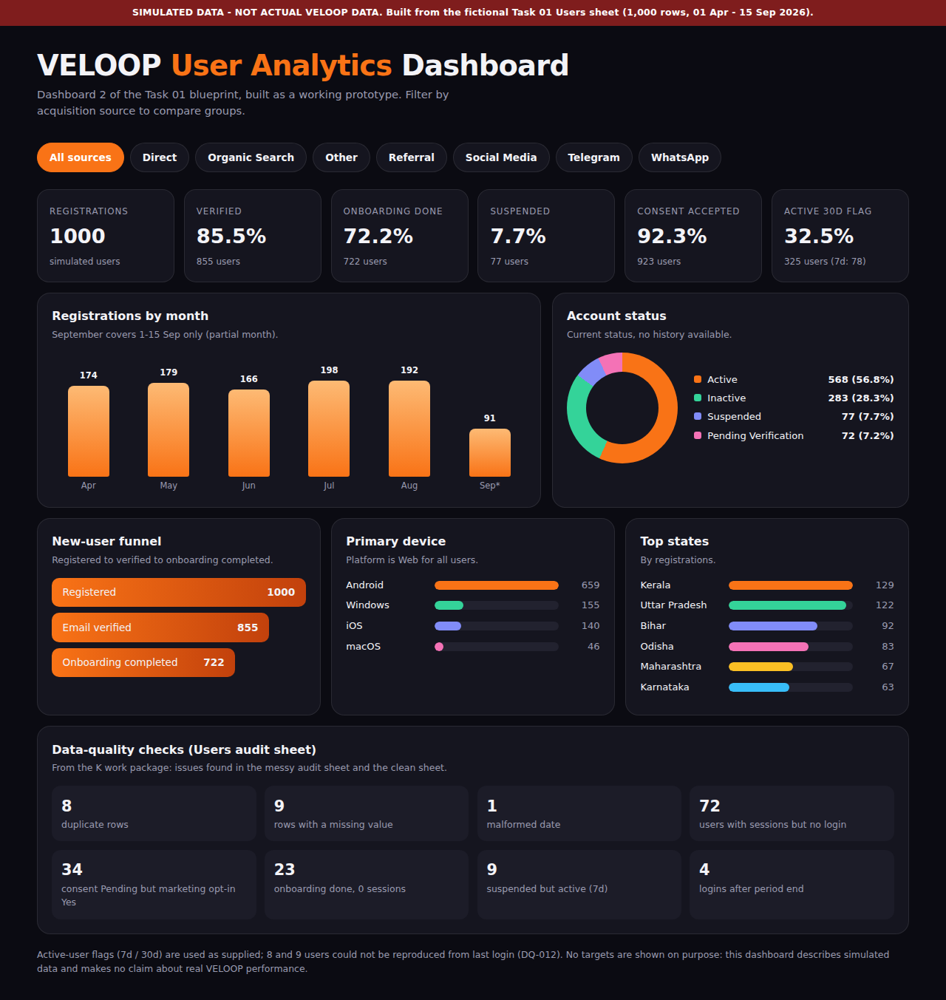
05 / DASHBOARD
Dashboard prototype (simulated data)
Filter by acquisition source
Registrations, verification, onboarding, consent
Status mix, devices, top states
Data-quality panel built in
No targets or success claims
SIMULATED DATA - not actual VELOOP data

Slide 7
06 / WHAT IS NEXT
Limits and next steps
Known limits
Next
Task 01 data had the Users sheet only. Wallet, Withdrawals, Rewards and Referrals KPIs are designed but not tested.
Engineering to verify events and IDs. Re-run profiling when the missing sheets arrive. Replace simulated data with governed production data.
Thank you
SIMULATED DATA - not actual VELOOP data

