Slide 1


Slide 2

AI-Based Smart Waste Management and Classification System

Slide 3
Introduction Of Project
Problem
Manual waste segregation is inaccurate, slow and inefficient
Public lack awareness of correct waste disposal methods
Existing smart solutions are too expensive and hardware dependent
Motivation
Need for a low-cost, software-based and accessible solution
Growing environmental concerns demand smarter waste disposal methods

Slide 4
Project Overview
What This System Does
Captures or uploads waste images for automatic classification
Classifies waste into Organic, Plastic, Glass, Metal, Paper
Displays result with confidence score and disposal recommendation
Admin can upload datasets and retrain the model anytime
Why It Is Different
No special hardware required works on any browser
Simple interface suitable for all age groups

Slide 5
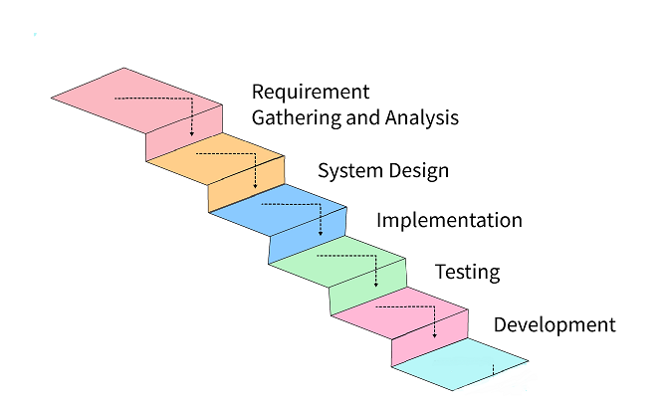
Process Model

Slide 6
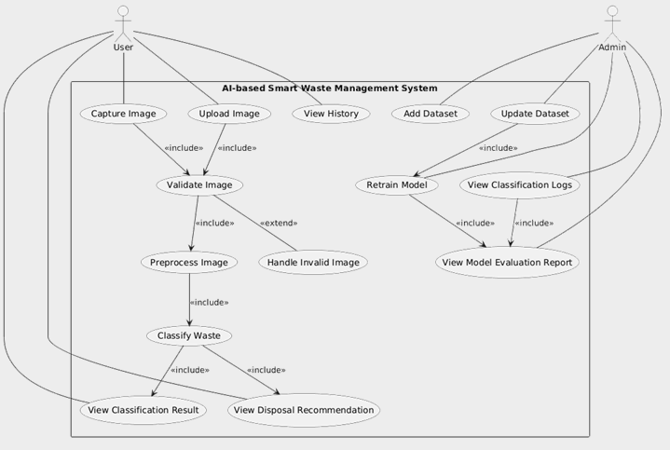
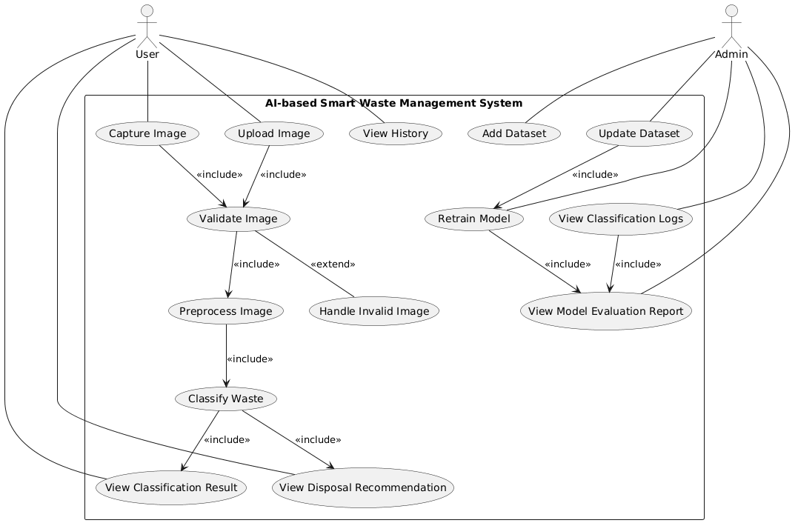
Use Case Diagram

Slide 7
Business Rules Catalog
1.1. The system shall use a pre-collected or custom-built dataset for training and testing the model.
1.2. The model shall be trained offline and integrated into the live application for inference only.
1.3. The system shall accept image input from a camera (e.g., webcam)
1.4. The system shall allow users to upload waste images from local storage.
1.5. The system shall validate that uploaded files are valid image formats.
1.6. The system shall automatically resize and pre-process images before classification.
2.1. The system shall use a trained CNN (Convolutional Neural Network) to classify waste images.
2.2. The system shall classify waste into one of the following categories:
• Organic
• Plastic
• Glass
• Metal
• Paper
• Other

Slide 8
Business Rules Catalog
2.3. The system shall display the classification result along with confidence level or probability score.
2.4. The system shall provide classification results in real-time (≤ 5 seconds).
2.5. The system shall automatically reprocess unclear or low-resolution images and notify the user if input is invalid.
3.1. The system shall provide a user-friendly interface for users to upload or capture images of waste items.
3.2. The system shall display the classification result (e.g., Organic, Plastic, Glass, Metal) after image analysis.
3.3. The system shall display additional information about how to dispose or recycle the identified waste type.
3.4. The system shall allow users to view a history of previously classified waste items.
3.5. The system shall provide visual feedback (e.g., color coding or icons) for different waste categories.
3.6. The system shall prevent users from uploading non-image files.
3.7. The system shall not store any user personal data.

Slide 9
Business Rules Catalog
3.8. The system shall generate appropriate disposal recommendations based on the waste type:
• Compost for organic
• Recycle bin for plastic, glass, metal
• Special disposal for hazardous waste
4.1. The system shall allow admin to add dataset for training model.
4.2. The system shall allow admin to update the dataset or retrain the model.
4.3. The system shall allow logging of classification results for performance monitoring.
4.4. The system shall provide model evaluation reports.

Slide 10
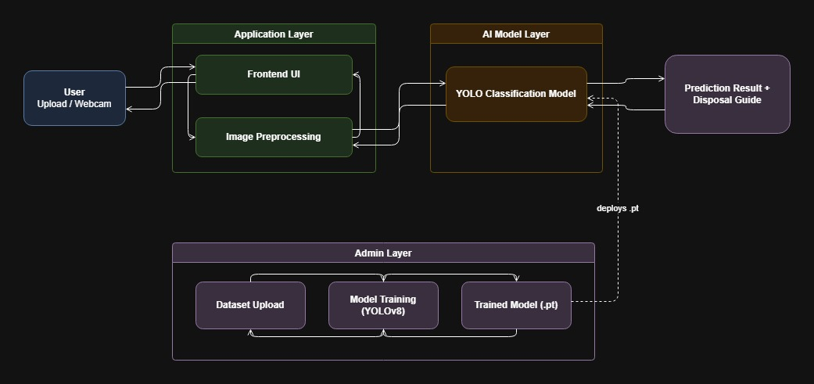
Architectural Design
Provide Architecture Diagram Here

Slide 11
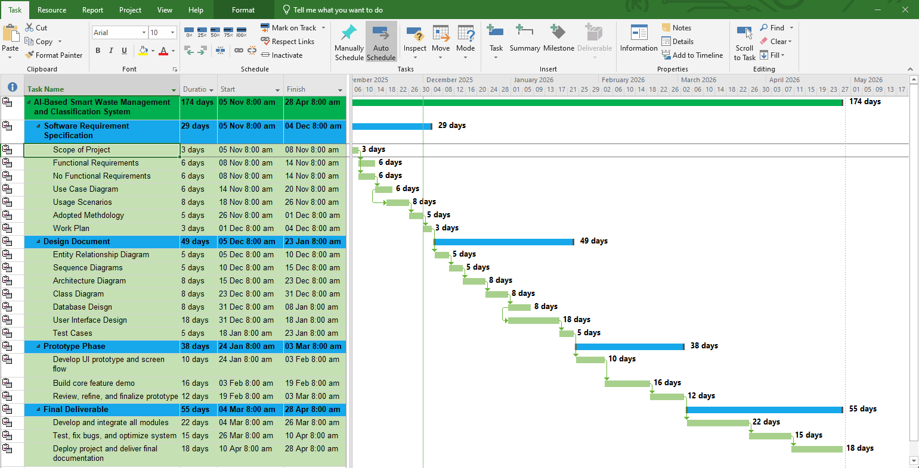
Project Schedule

Slide 12
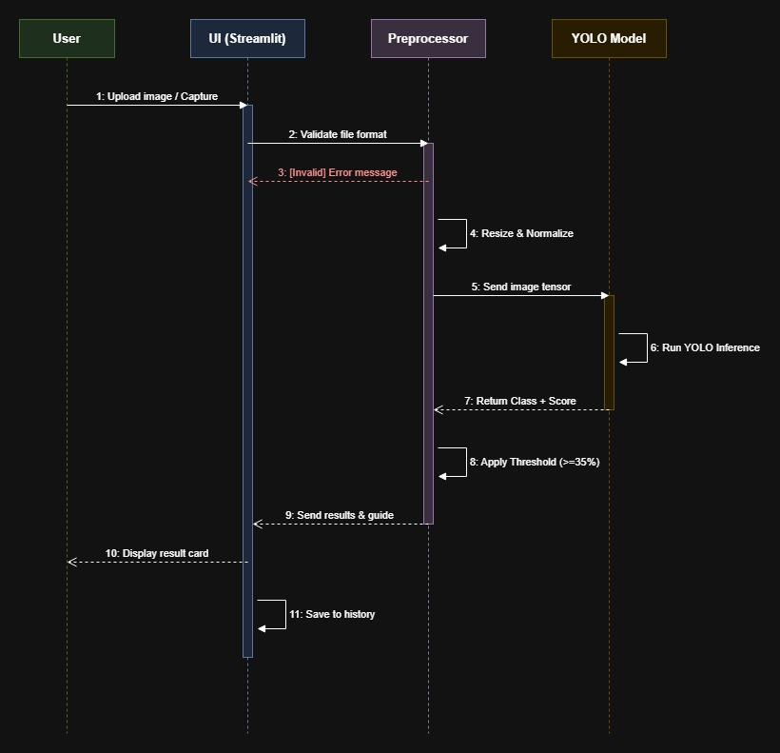
Sequence Diagrams
Figure 1: User Waste Classification Flow

Slide 13
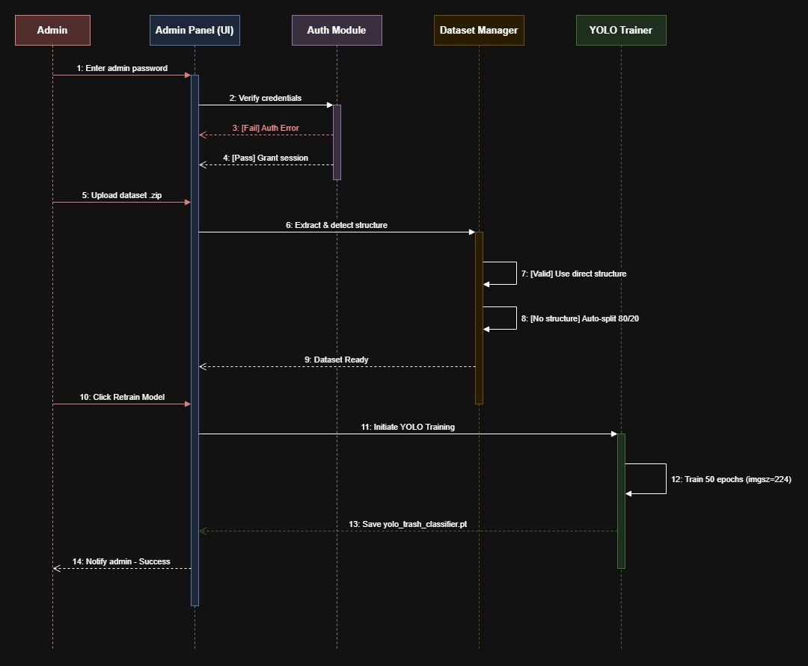
Sequence Diagrams
Figure 2: Admin Panel Flow

Slide 14
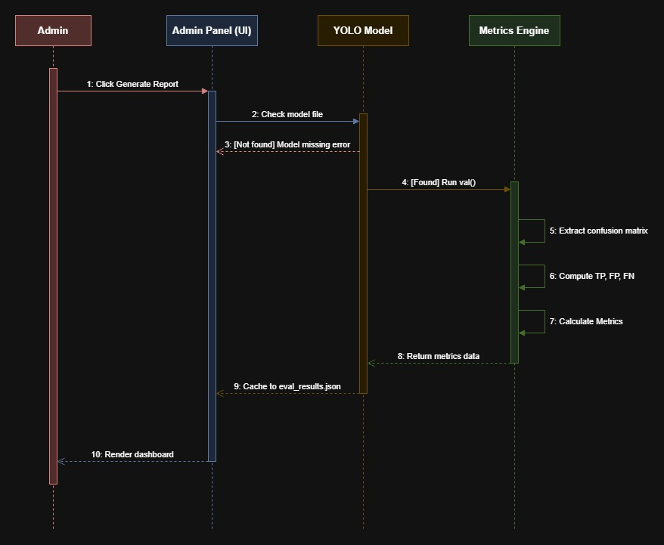
Sequence Diagrams

Slide 15
Sequence Diagram
Figure 3: Model Evaluation Report Flow

Slide 16
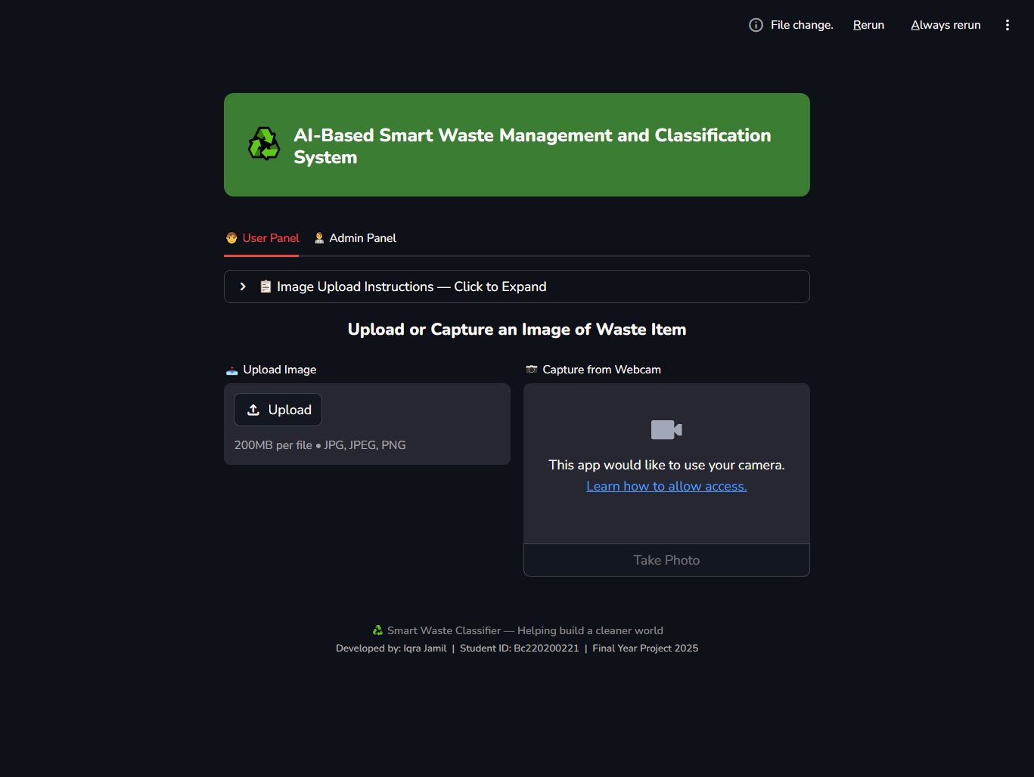
User Interfaces

Slide 17
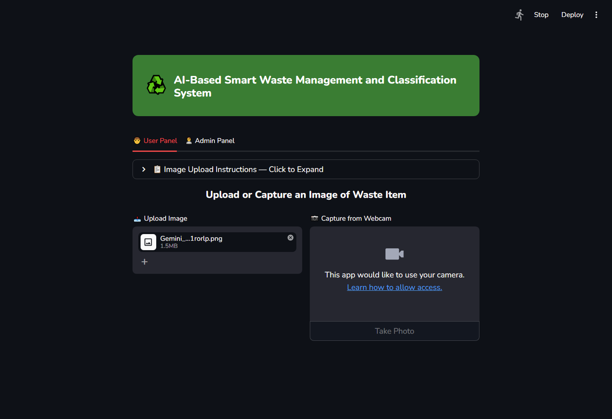
User Interfaces

Slide 18
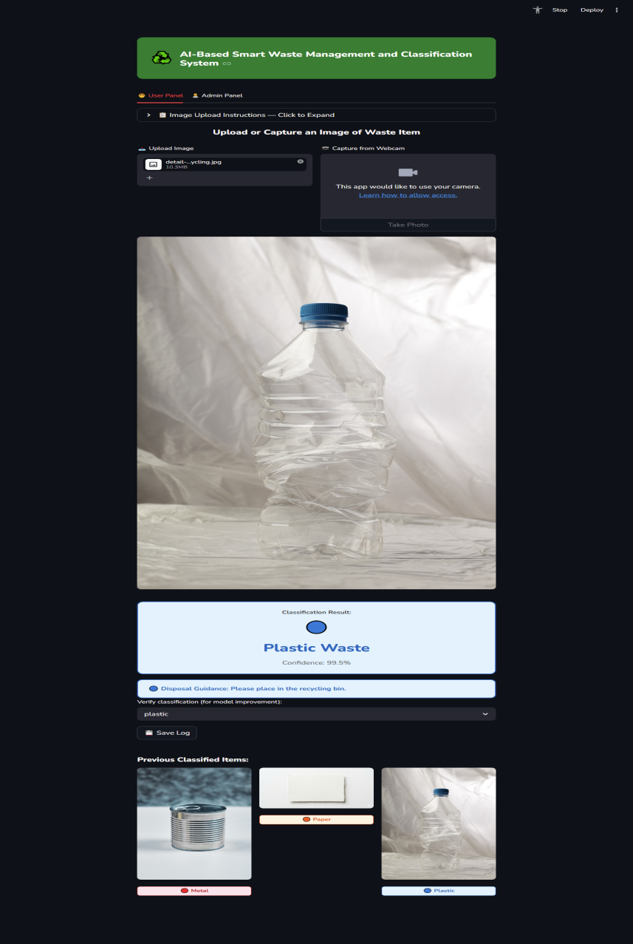
User Interfaces

Slide 19
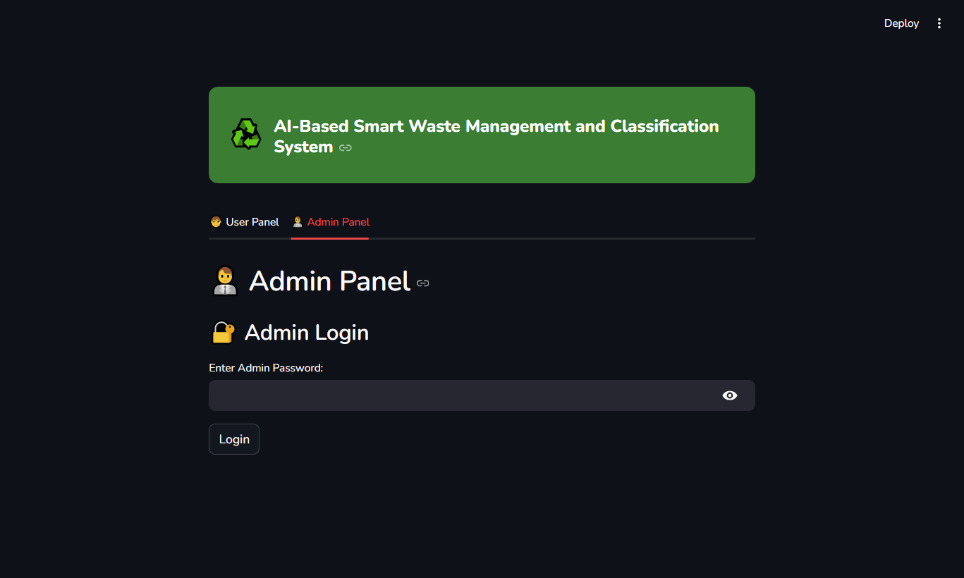
User Interfaces

Slide 20
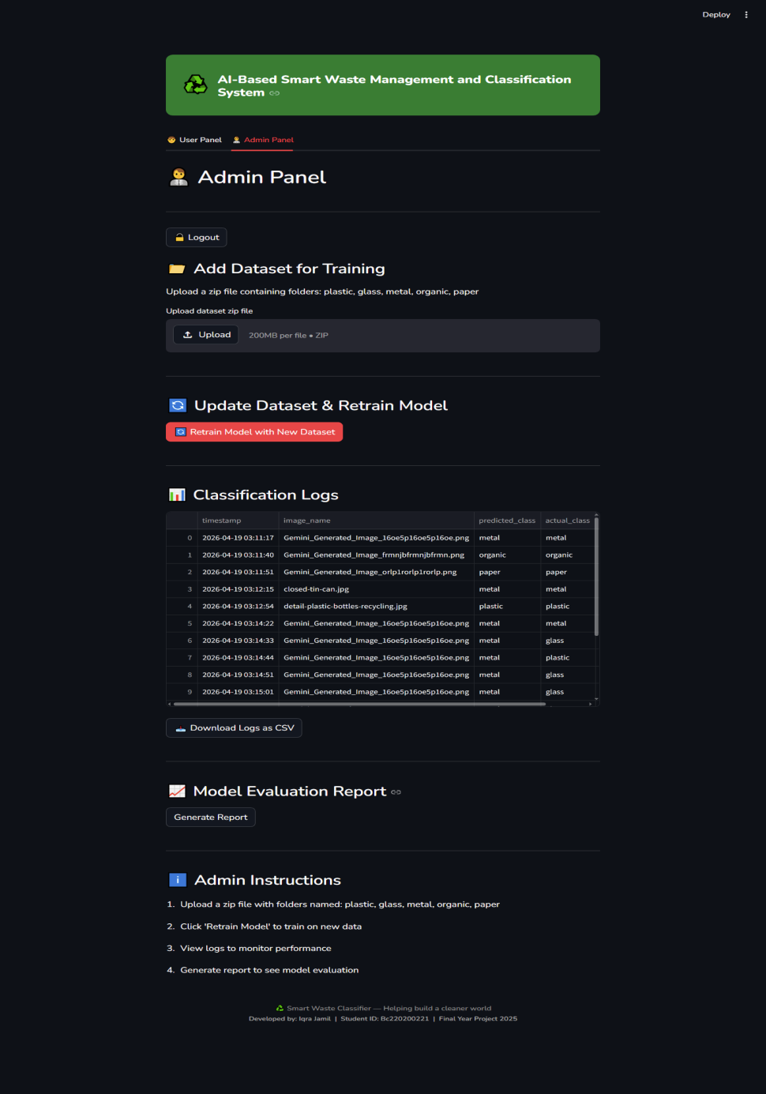
User Interfaces

Slide 21
Tools
Python 3.11
Streamlit (Web UI)
YOLOv11 (AI Model)
PyCharm (IDE)
draw.io (Diagrams)
Google Collab (Model training & evaluation)

