Slide 1
Semester Project (Graph Theory)
2021-CS-675
2021-CS-671

Slide 2
Introduction
Document classification is the process of categorizing documents into predefined classes or categories based on their content.
Document classification is widely used in various applications such as information retrieval, spam detection, sentiment analysis, and content organization.
It enables management of large volumes of textual data
Classical / NLP Based Methods for Document Classification:
Classical methods: Naive Bayes Classifier, SVM, Decision Tree, Random Forest, KNN.
NLP based methods: deep learning, transfer learning.

Slide 3
Introduction
Graphs can be used for document classification by:
Word Co-occurrence Graphs:
Nodes represent words, edges represent co-occurrence relationships.
Extract meaningful features to capture word relationships.
Document Similarity Graphs:
Nodes represent documents, edges represent document similarity.
Use graph algorithms to identify similar documents.
Knowledge Graphs:
Nodes represent entities like documents or concepts, edges represent semantic relationships.
Utilize knowledge graph embeddings for inference.
Graph-based approaches provide effective ways to represent and analyze text data. For Our Project we have use Word Co-occurrence Graphs for Documents Classification.

Slide 4
Problem Statement
Our project aims to develop an efficient document classification system leveraging web scraping, graph based representation, and machine learning methodologies.
Methodology
Web Scraping:
Retrieve data of specific topics via web scraping from different URLs.
Data Preprocessing:
Perform data cleaning to refine scraped content, including text normalization and removal of irrelevant information.
Graph Construction:
Construct graphs from preprocessed data, where nodes represent words/entities and edges denote relationships.

Slide 5
Methodology
Training Data Preparation:
Manually assign labels to a subset of the dataset to create a labeled training set.
Testing Data Preparation:
Partition the remaining dataset into a separate testing set for evaluation purposes.
Maximum Common Subgraph (MCS):
Calculate MCS between each testing graph and training graph to quantify similarity.
Classification:
Utilize the K-Nearest Neighbors (KNN) algorithm to classify testing data based on similarity scores derived from graph comparisons.
Confusion Matrix:
Generate a confusion matrix to assess the classification system's performance, providing insights into accuracy, precision, recall, and F1-score metrics for each class.

Slide 6
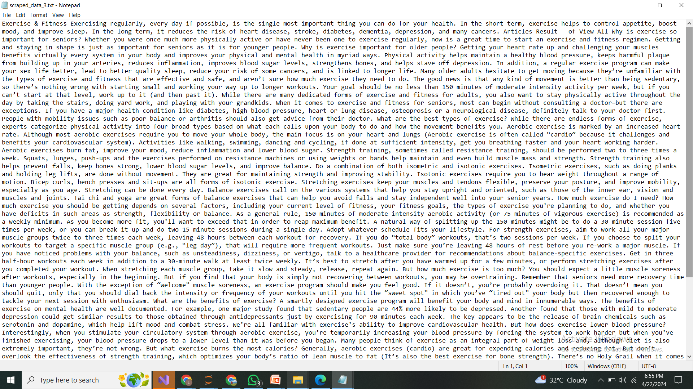
Web Scraping

Slide 7
Reading URLs from File:
Read URLs from the specified text file (url_links.txt) containing website URLs line by line.
Fetching HTML Content:
For each URL, send an HTTP GET request using the requests.get() method to fetch the HTML content of the webpage.
Parsing HTML Content:
Utilize BeautifulSoup to parse the HTML content and extract relevant information such as titles and paragraphs (<p> tags) from the page.
Extracting Information:
Find all <p> tags in the parsed HTML content.
Extract text from each <p> tag and remove extra whitespaces using regular expressions.
Combining Text:
Join the text extracted from all <p> tags to create a single combined text for each webpage.
Storing Scraped Data:
Create a directory to store scraped data files, appending "_scraped_data" to the original file path.
Write the scraped data into separate text files, with each file containing the combined text from the paragraphs of the corresponding webpage.

Slide 8
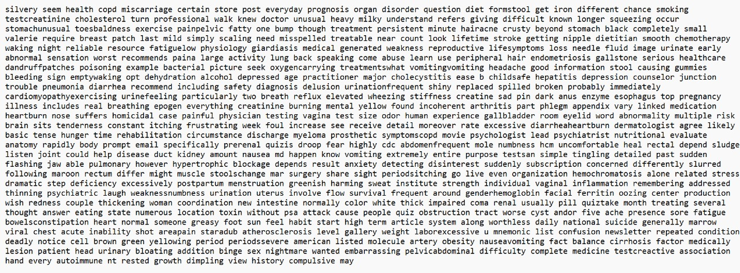
Data Cleaning

Slide 9
Text Preprocessing:
Tokenization and Normalization:
Tokenize the text into individual words and convert them to lowercase.
Normalize the text by removing punctuation and numerical values using regular expressions (re module).
Removing Stopwords:
Utilize the NLTK library to remove common English stopwords from the tokenized text.
Lemmatization:
Apply lemmatization to reduce words to their base or dictionary form using NLTK's WordNetLemmatizer.
File Processing:
Iterating through text files in the input folder, focusing on .txt files.
Cleaning and Truncation:
Reading, preprocessing, limiting to the first 500 words, and updating files accordingly.

Slide 10
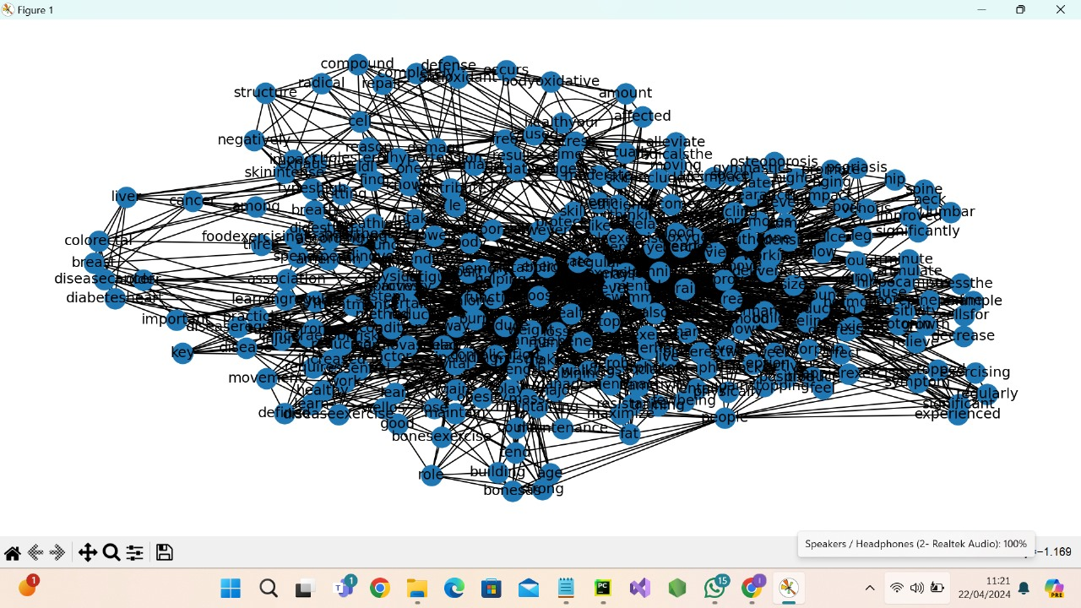
Graph Creation
Graph Initialization:
Begin by initializing a directed graph using the NetworkX library, specifically nx.DiGraph(), to represent the relationships between tokens.
Node Addition:
Add nodes to the graph based on the tokens obtained from the tokenization process. Each token serves as a node in the graph.
Edge Creation:
Iterate through the tokens to establish edges between adjacent tokens within the text data.
For each pair of adjacent tokens:
Check if an edge already exists between them.
If an edge exists, increment the weight of the edge by 1 to reflect the frequency of occurrence.
If no edge exists, create a new edge between the tokens with an initial weight of 1.
Directed Graph Representation:
Return the constructed directed graph, which encapsulates nodes representing tokens and weighted edges indicating the relationships between tokens. This graph serves as a comprehensive representation of the token relationships within the text data.

Slide 11
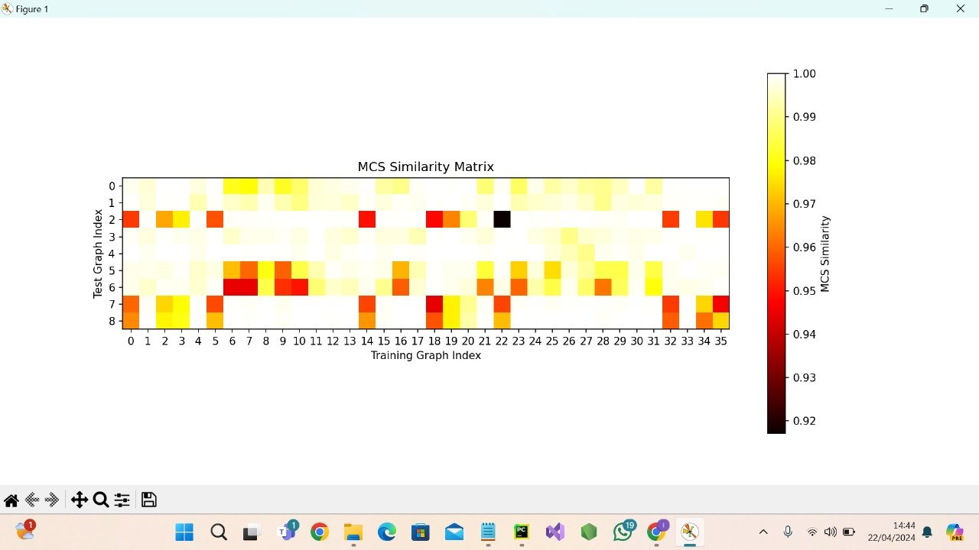
Maximum Common Subgraph (MCS)
Check for Graph Pairs:
Ensure the availability of at least two graphs for comparison.
Iterate Through Graph Pairs:
Use nested loops to compare each pair of graphs.
Computing Similarity Based on Common
Edges:
It computes the similarity
based on the number of common edges
between the graphs.
MCS Calculation Process:
Identify common edges between two graphs.
Extract the largest connected component as the MCS.

Slide 12
K-Nearest Neighbor (KNN)
Compute Distances:
Calculate and store the distances between each test graph and training graph using the Maximum Common Subgraph (MCS) similarity.
Pick Nearest Distances:
Select the 5 nearest distances for each test graph, considering K=5 in the KNN algorithm.
Assign Labels:
Assign labels to the test graphs based on the closest training graphs using the KNN algorithm.
Evaluate Performance:
Compute evaluation metrics such as Accuracy, Precision, Recall, and F1 Score to assess the model's performance.

Slide 13
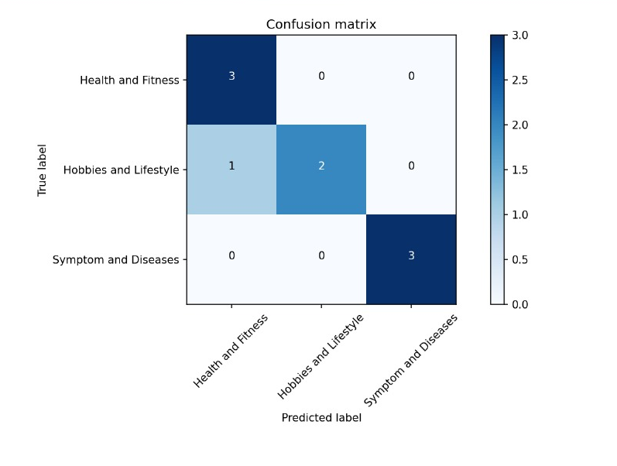
Results
Precision:91.66666666666666
Recall: 88.88888888888889
F1-score:88.57142857142857
Accuracy: 88.88888888888889

Slide 14
Future Work
Parameter Optimization:
Fine-tune KNN parameters for better classification accuracy.
Experiment with different K values and distance metrics.
Graph Enhancement:
Improve graph representation with weighted edges based on word importance.
Explore advanced graph algorithms for feature extraction.
Deep Learning Integration:
Integrate CNNs or RNNs for enhanced classification.
Utilize pre-trained word embeddings or graph neural networks.
Multi-Modal Classification:
Incorporate multi-modal data sources like images or audio.
Explore fusion techniques for effective integration.

Slide 15
Q & A

