Slide 1
ESC 113:
Computer Aided Analysis for Engineering
Topics:
Data-driven Computer Aided Analysis
:
Machine-learning Model
BMCC / CUNY
Date: Oct 22, 2025
Instructed by: Iqram Hussain, PhD

Slide 2
Data-driven Computer Aided Analysis
Regression Model
&
Classification Model

Slide 3
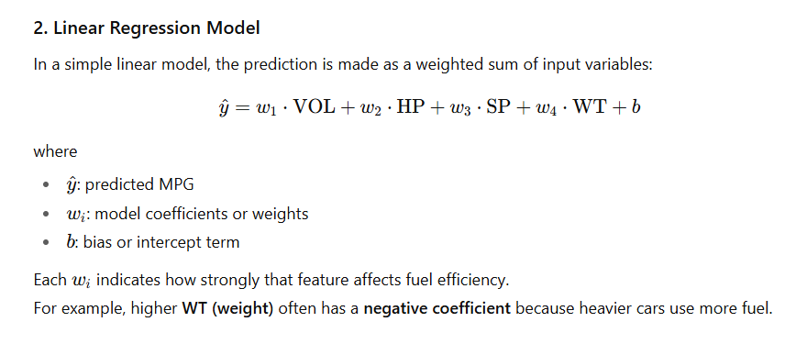
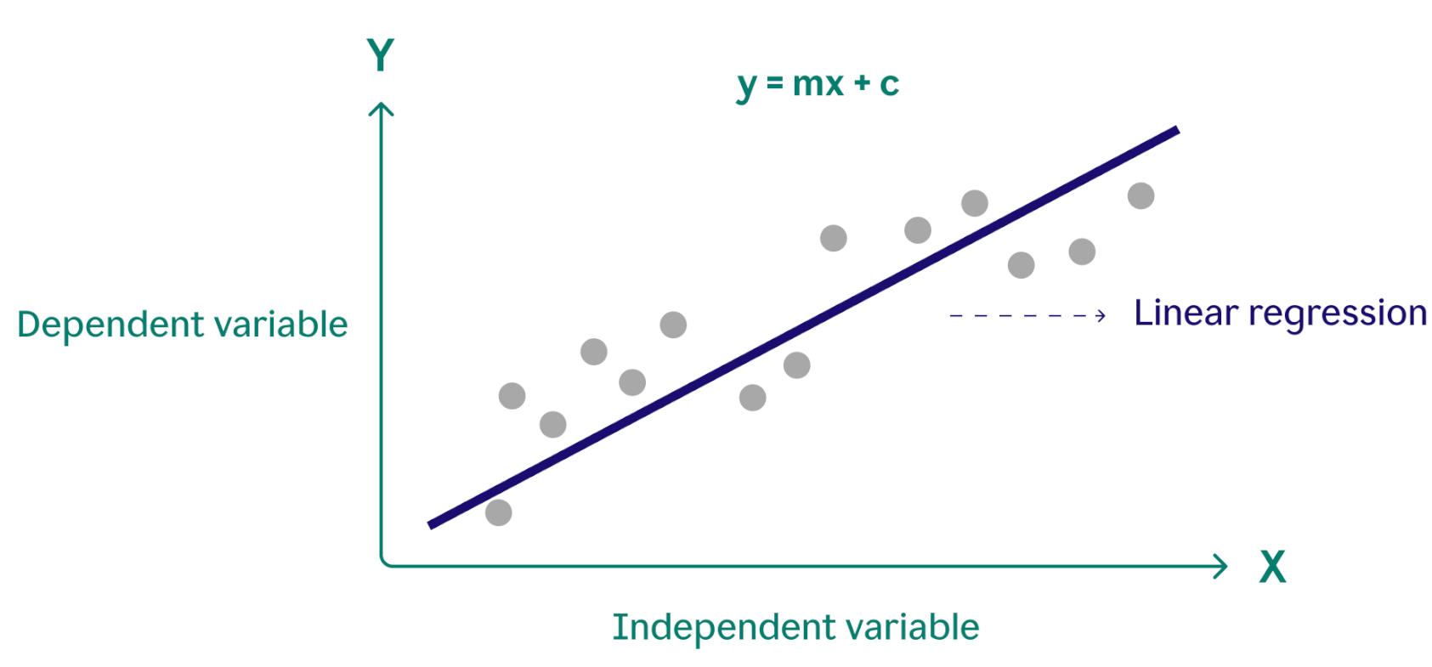
Data Engineering: Regression Model

Slide 4
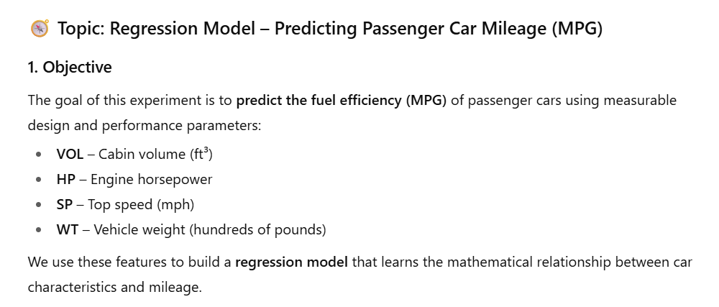
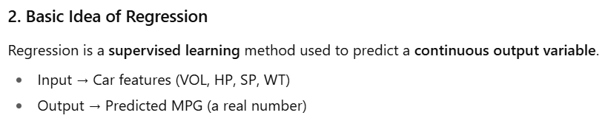
Data Engineering: Regression Model

Slide 5
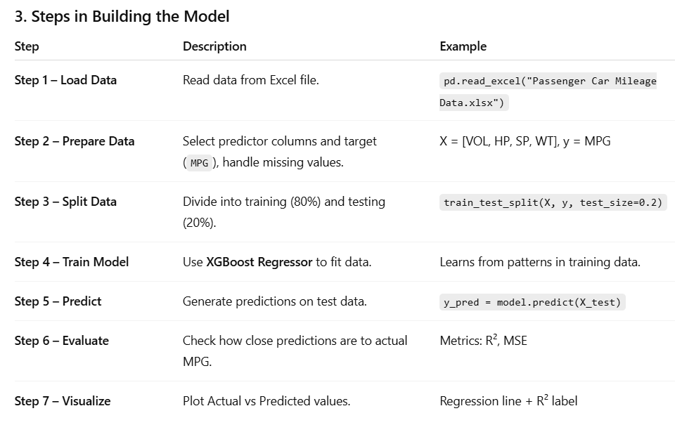
Data Engineering: Regression Model

Slide 6
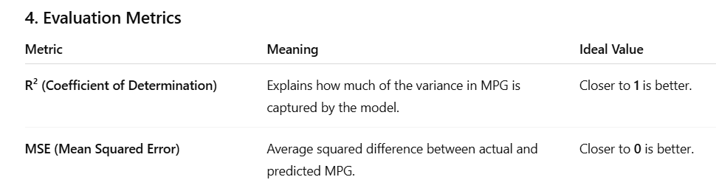
Data Engineering: Regression Model

Slide 7
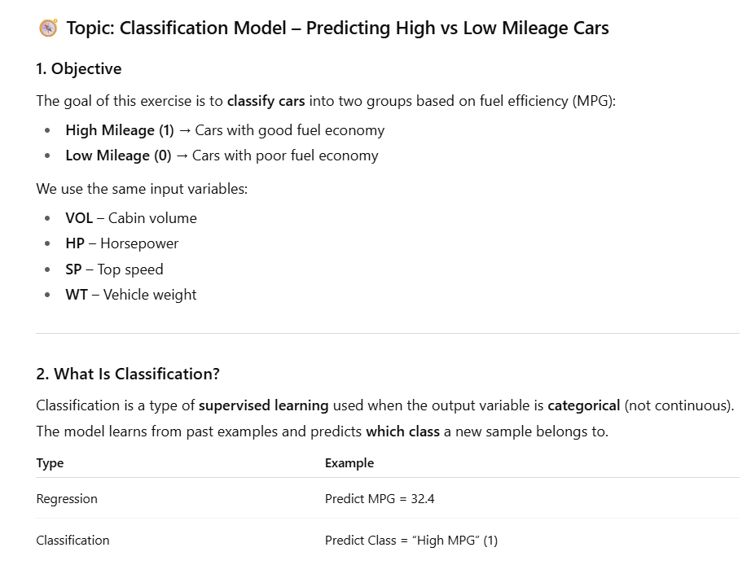
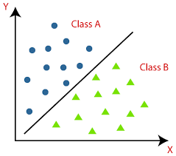
Data Engineering: Classification Model

Slide 8
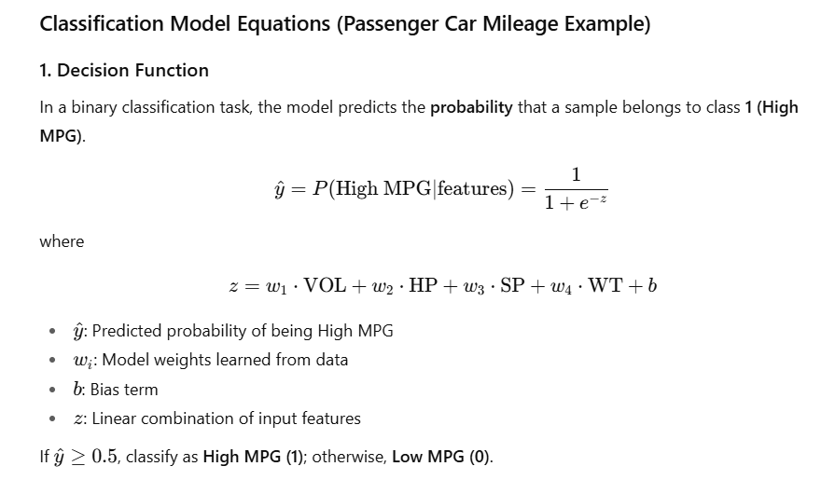
Data Engineering: Classification Model

Slide 9
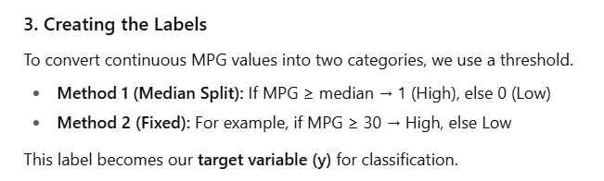
Data Engineering: Classification Model

Slide 10
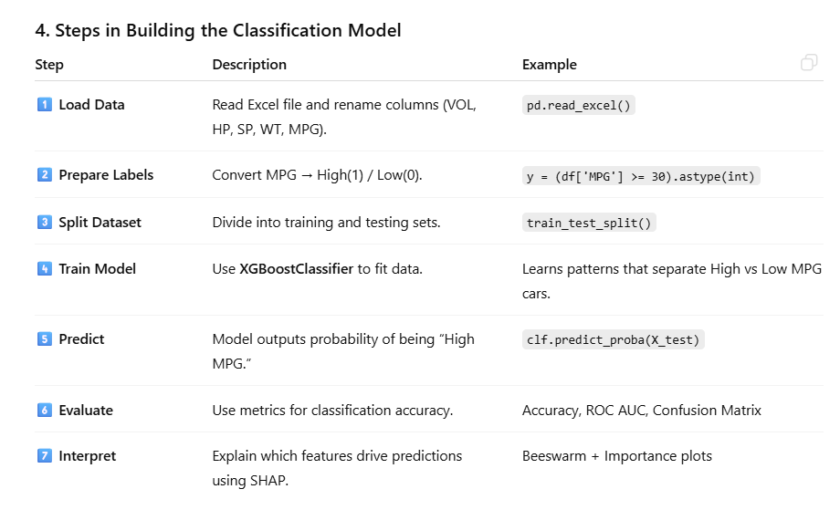
Data Engineering: Classification Model

