Slide 1

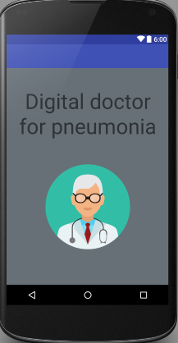
Digital Doctor for Pneumonia
Your health assistant
We enable Pneumonia patients to detect their disease and also let them know what doctors say about it while reducing their visits to doctors

