Slide 1
Stethoscope digitization
Aaira Suhail bscs13015
Iqra shahzad bscs13060
Syed m. hassan bscs13073
Sheryar Zahid bscs13042

Slide 2
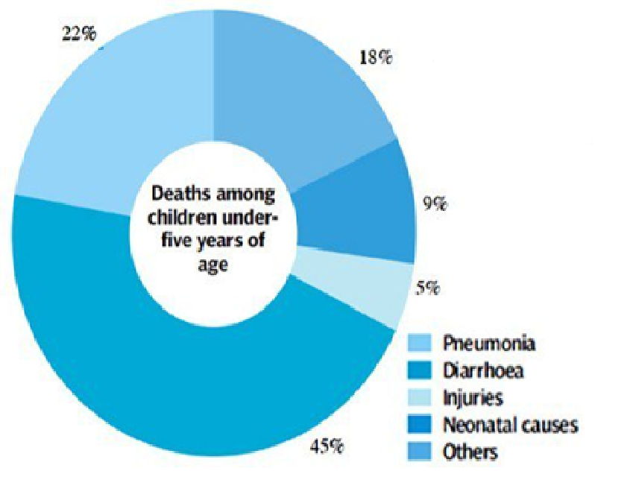
Introduction
Health related problem
Stethoscope digitization
Detection of pneumonia

Slide 3

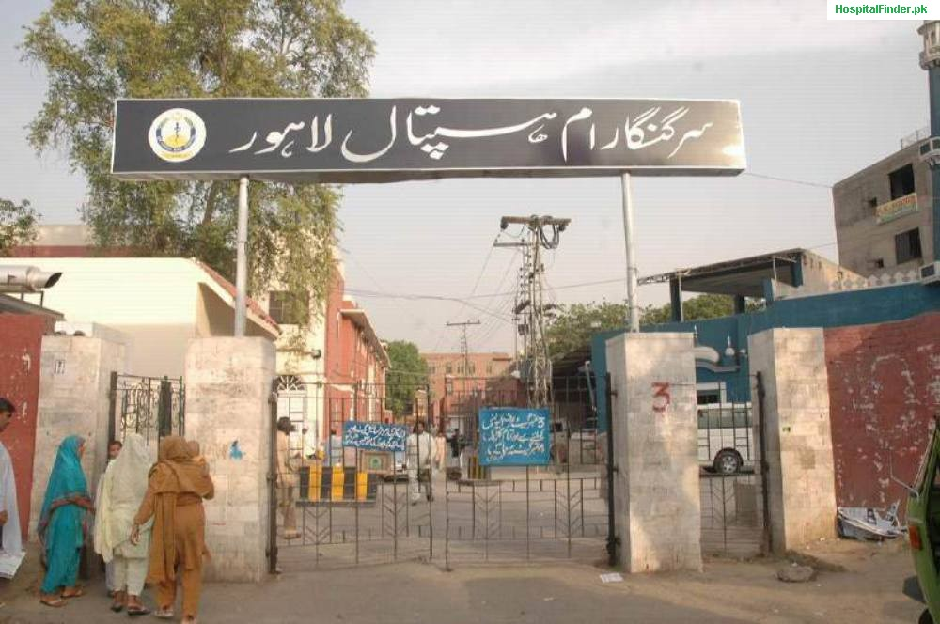
Interviews
Paediatrician
Ganga Ram Hospital
Interviewed 5 doctors
We are working on the detection of pneumonia in children hence we selected child specialists

Slide 4
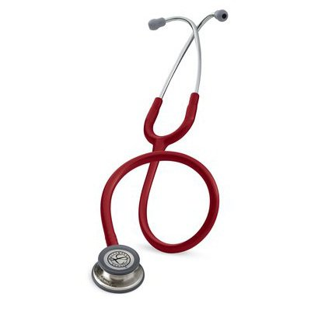
Questions
Uses of stethoscope?
How they detect different diseases?
How much time does it require?
Symptoms of different diseases?
Which diseases can be detected?
Without stethoscope judgement?

Slide 5

Interview results
Used to check blood pressure and respiration
Different diseases have different sounds
Crepes mean patient is suffering from asthma/pneumonia
Usually one minute in taken to auscultate
Detection without stethoscope becomes very difficult
Patients history plays an important role in the detection

Slide 6
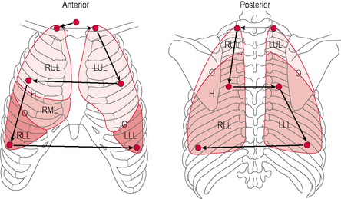
Interesting insights
Auscultation points and sounds are same universally
Size of diaphragm for adult and children is different
Good quality stethoscope (Littmann) lets your hear sound clearly
If a patient is unconscious then your diagnoses completely depends on stethoscope
Novice doctors find it difficult to distinguish between sounds
Some sounds are quite similar

Slide 7
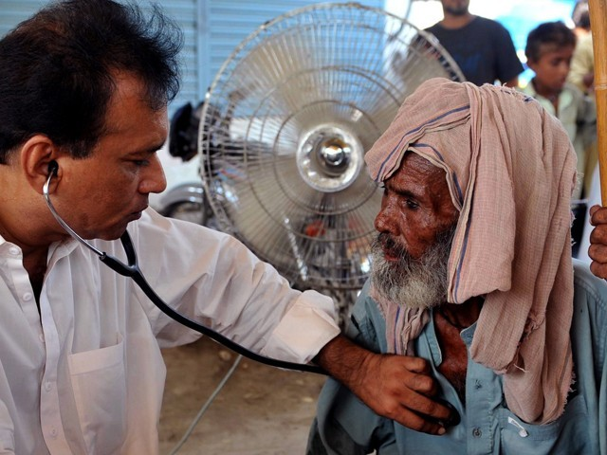
Inference
Our device will help the new doctors
They find it difficult to hear and recognize sounds
It may help experienced doctors too and save their time
We can amplify the sounds so doctors can hear them clearly
Amplification will help in distigushing sounds that are similar

Slide 8
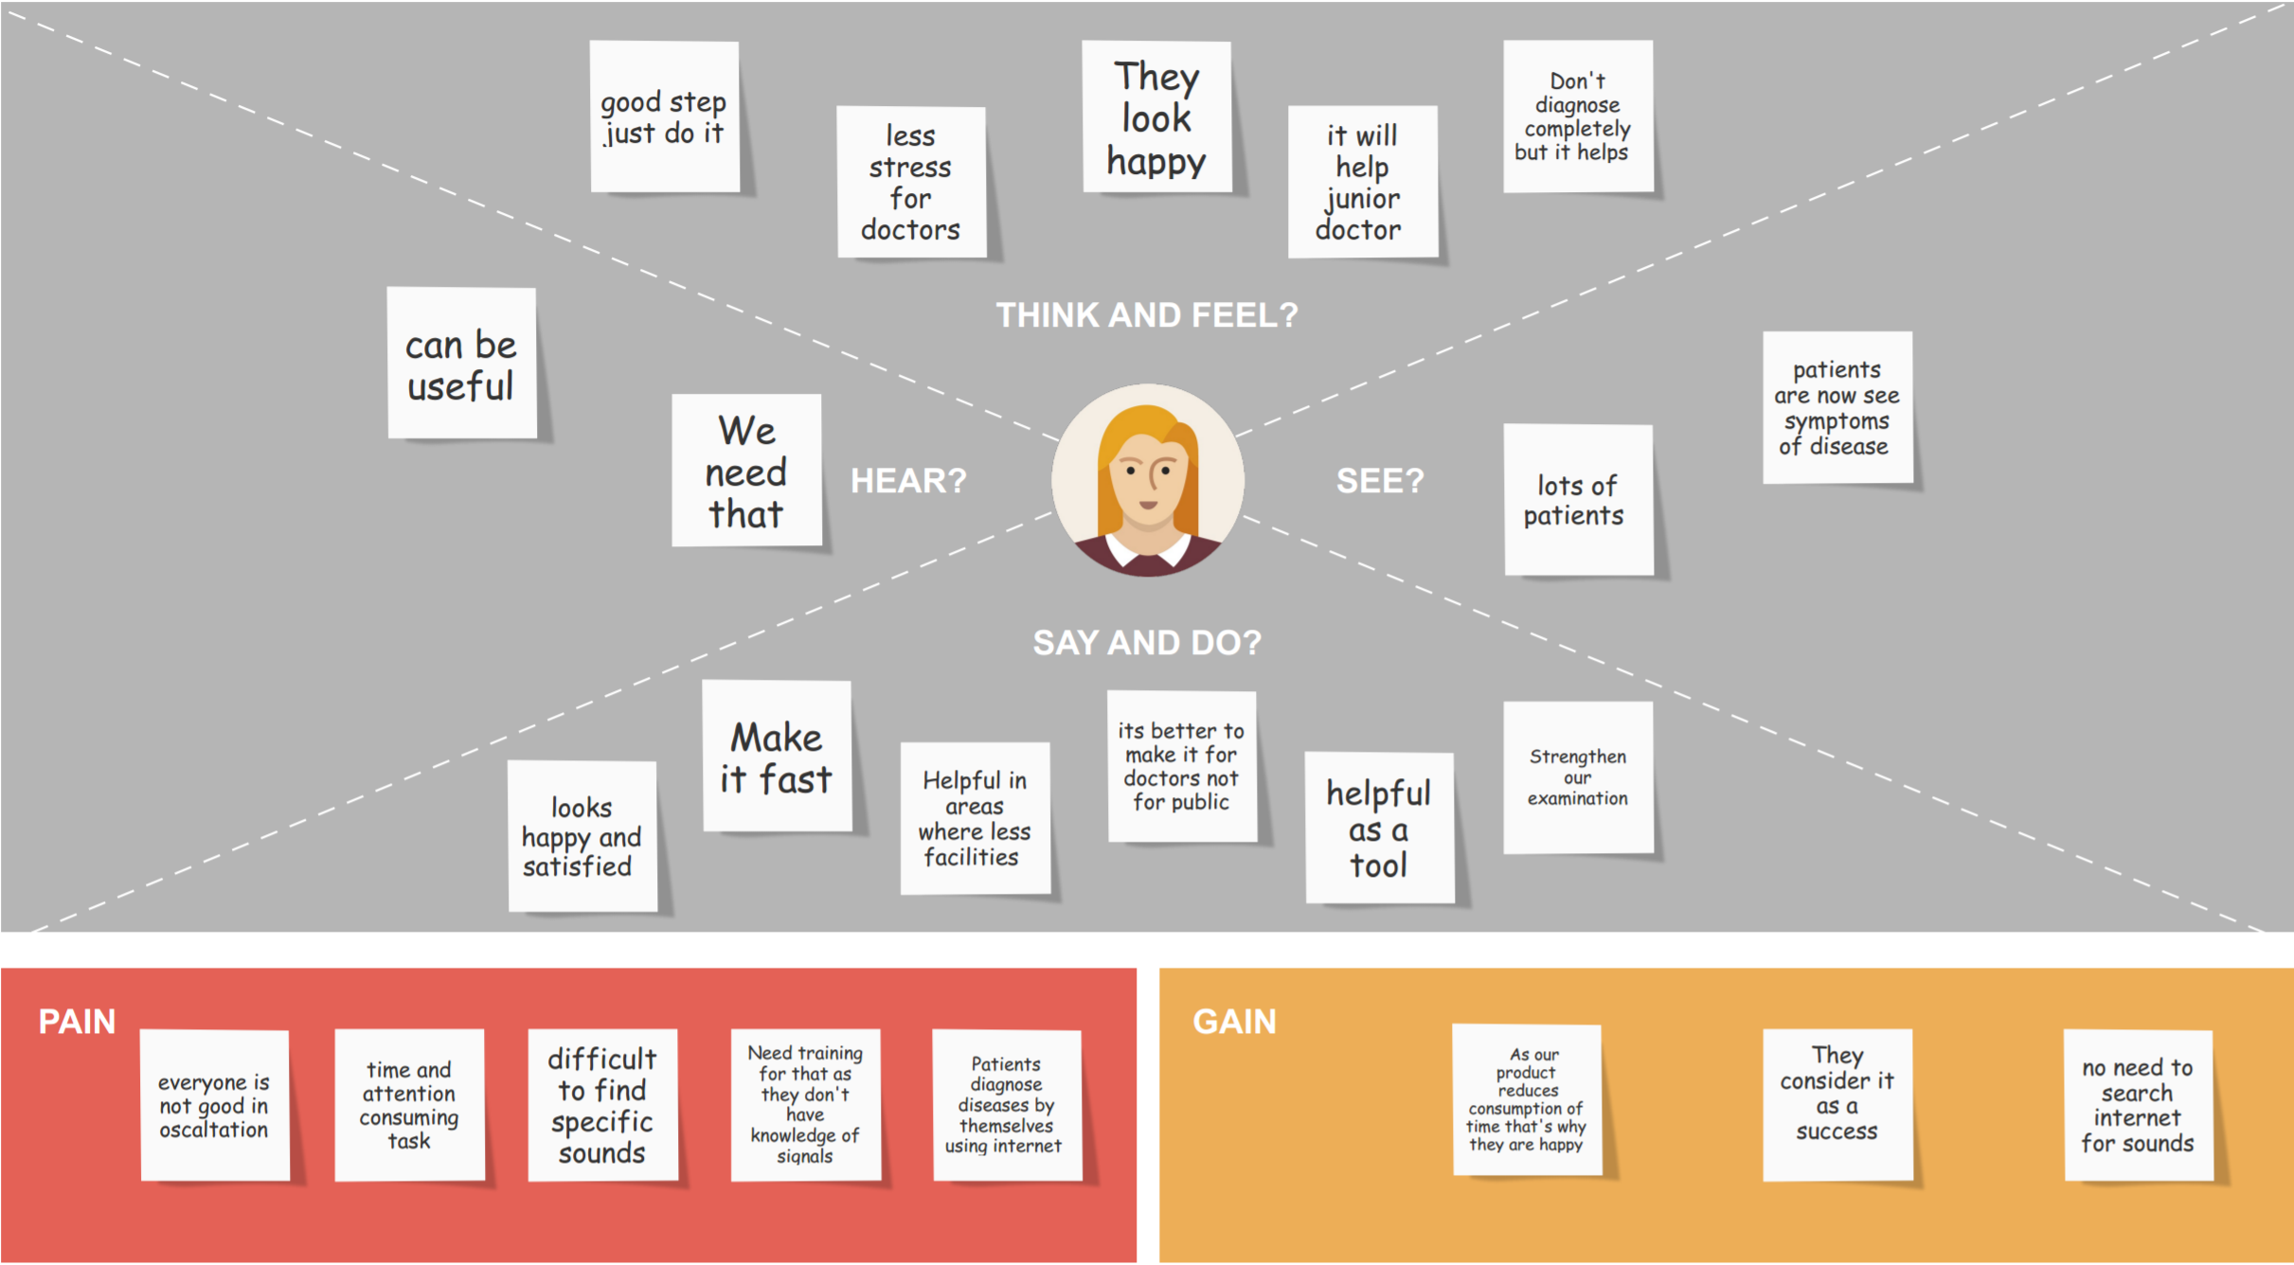
Empathy map

Slide 9
Summary
New doctors need a device like this
Can also be used in remote areas where there a no doctors

Slide 10
Thank you!

