Slide 1
MANDI PRICE WATCH
Indian Agricultural Market Intelligence
A three-page Power BI project on crop prices, volatility and seasonality: 175 crops, 2002–2026
Notes:
Introduce yourself and the project in 30 seconds: dataset, three pages, and what the dashboard helps a buyer decide.

Slide 2
Business problem
Agricultural prices swing with weather, arrivals and festivals; the latest price alone hides the risk.
Buyers need to know which crops are expensive, which are risky, and when prices tend to be high or low.
Public Agmarknet data exists, but not in a form a procurement team can explore quickly.
Notes:
Frame it from the buyer’s point of view.

Slide 3
Project objectives
Compare price levels across crops in a common unit (₹ per quintal and ₹ per kg).
Quantify price risk with a simple, explainable measure: coefficient of variation.
Show seasonal behaviour and year-over-year movement by season.
Turn patterns into procurement recommendations, and state what the data cannot prove.

Slide 4
Dataset overview
19,680
crop-month records
175
crops
2002–2026
Feb 2002 to Nov 2026
₹2,391
overall median price per quintal
Price = median across markets of each market’s monthly average modal price.
No blanks or duplicate crop-month pairs; history ranges from 1 to 298 months per crop; 17 categories were added in the Power BI model.
Notes:
Source: Agmarknet via data.gov.in, compiled by Today Market Rates. One row = one crop in one month.

Slide 5
Data cleaning and preparation
Month converted to a date field (Period); price column renamed Median Price.
Quality checks: blanks, duplicates, units, extreme values (real, high-value products such as jasmine and mentha oil).
Findings: 25 crops have under 12 months of data; 6 have a single record; Nov 2026 is a partial month.
Season, Season Category, Season Year and Median Price Per Kg columns added for analysis.
Notes:
[Adapt] to the Power Query steps you actually used.

Slide 6
Data model and relationships
Flat mandi fact table (19,680 rows) with crop, Median Price, Period and calculated season columns.
MEASURES (2) holds the KPI and insight measures; Power BI’s hidden auto date tables support the Period field.
Season Year adds 1 to December so one winter (Dec–Feb) stays in one season-year.
Next step: a proper calendar table for standard time-intelligence functions.

Slide 7
DAX measures and KPIs
Price Volatility %
STDEV.P ÷ Average Price (coefficient of variation)
Seasonal YoY %
(Selected − Prior season-year average) ÷ Prior, via SELECTEDVALUE + CALCULATE
Median Market Price
MEDIAN of Median Price (₹ per quintal)
Insight cards
VAR + TOPN + CONCATENATEX + FORMAT, so sentences update with slicers

Slide 8
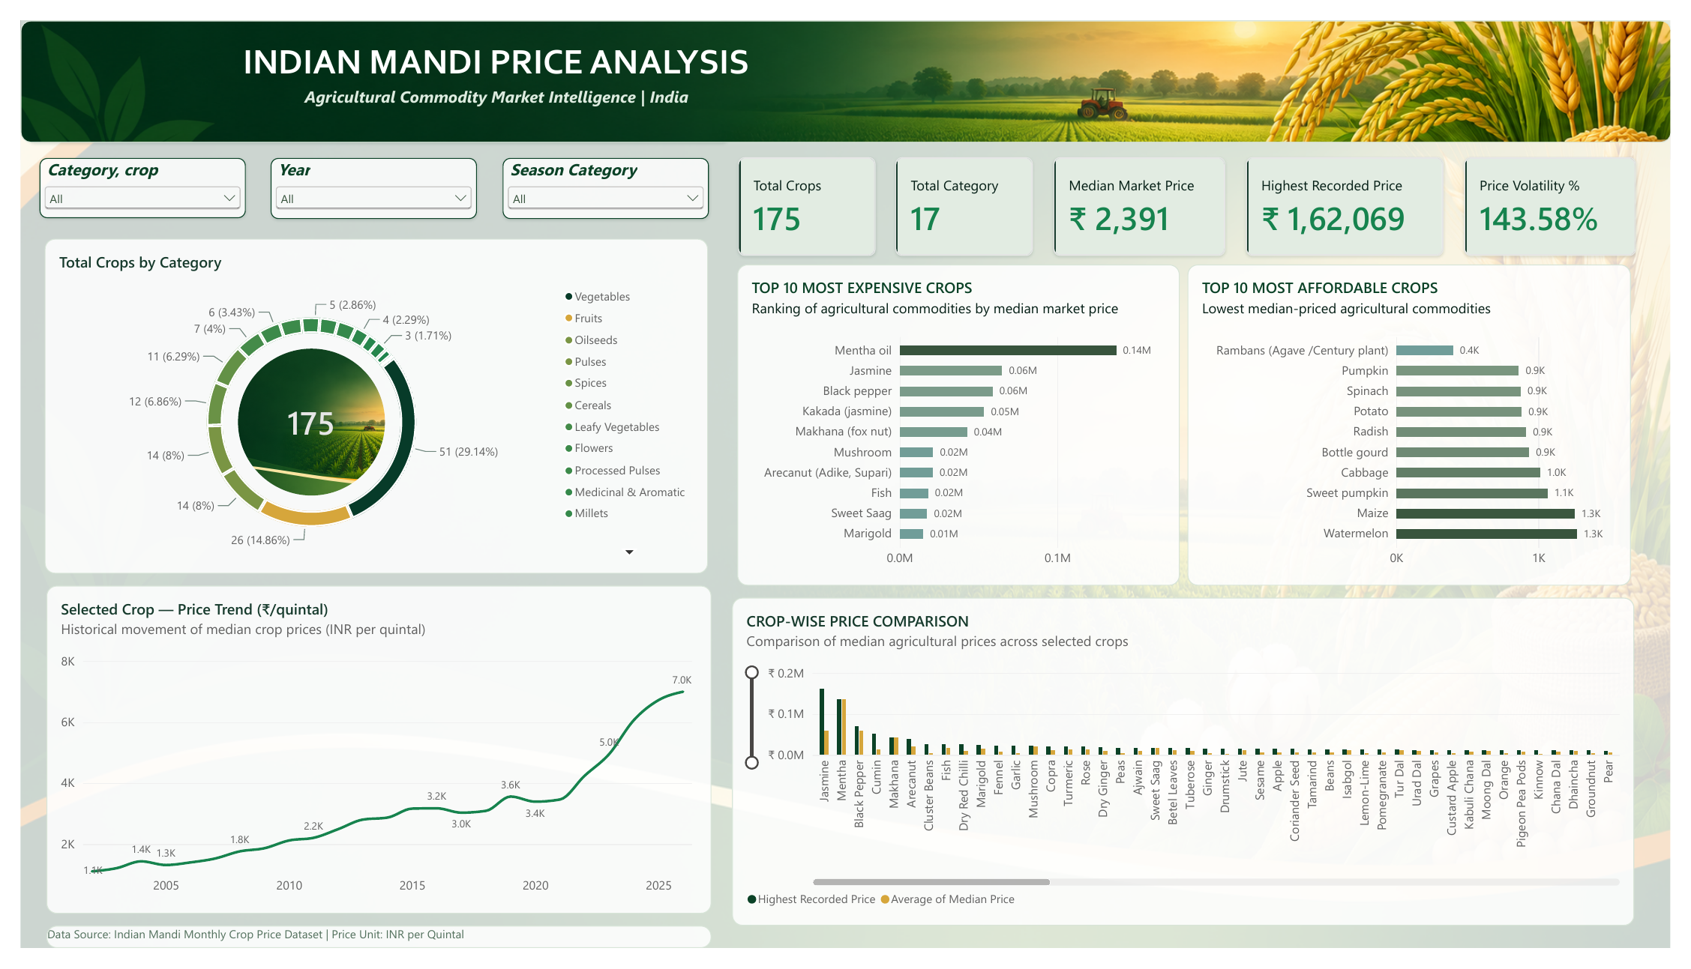
Page 1 — Mandi Price Analysis
KPIs: 175 crops, 17 categories, median ₹2,391, highest ₹1,62,069, volatility.
Crops by category (donut), Top 10 expensive and affordable, selected-crop price trend.
Slicers: Category/crop, Year, Season Category.
Notes:
Screenshot from your Power BI report export.

Slide 9
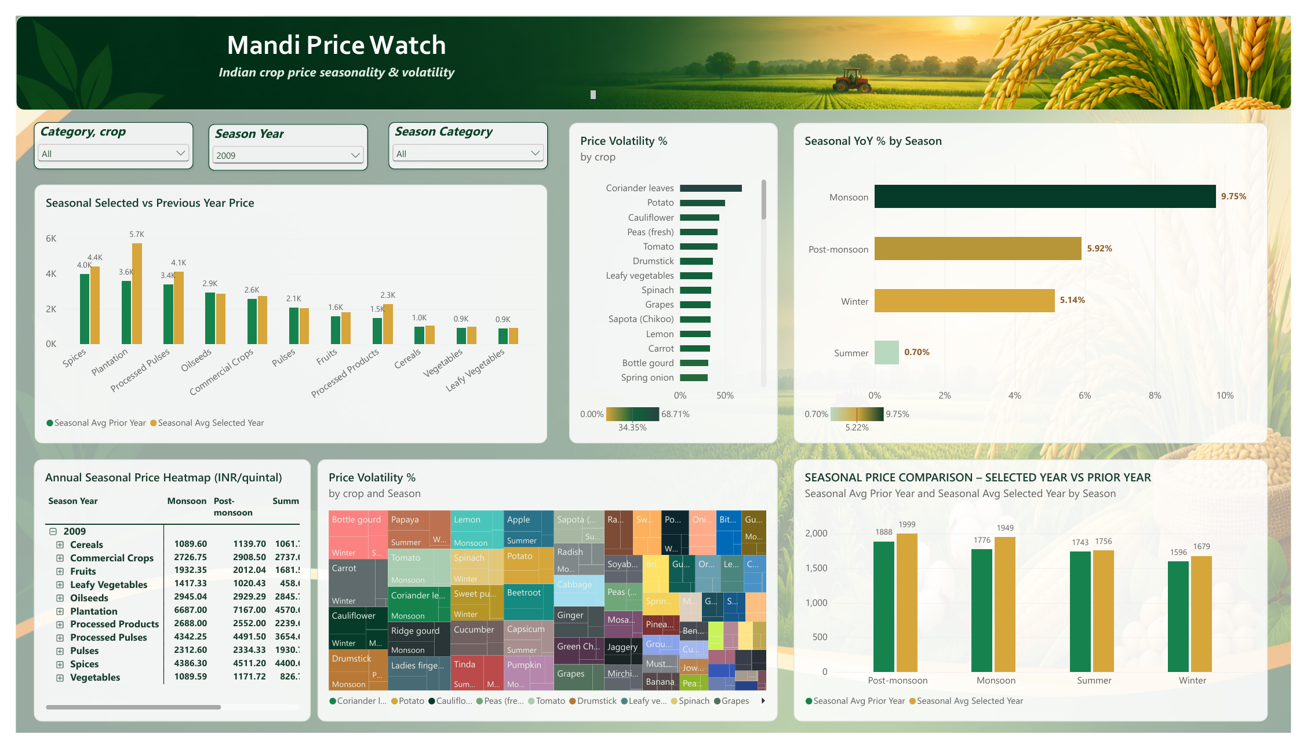
Page 2 — Seasonality and Volatility
Seasonal selected vs previous year price, by category and by season.
Volatility by crop, treemap and Seasonal YoY % by season.
Season Year slicer drives the comparison (2009 shown).
Notes:
Screenshot from your Power BI report export.

Slide 10
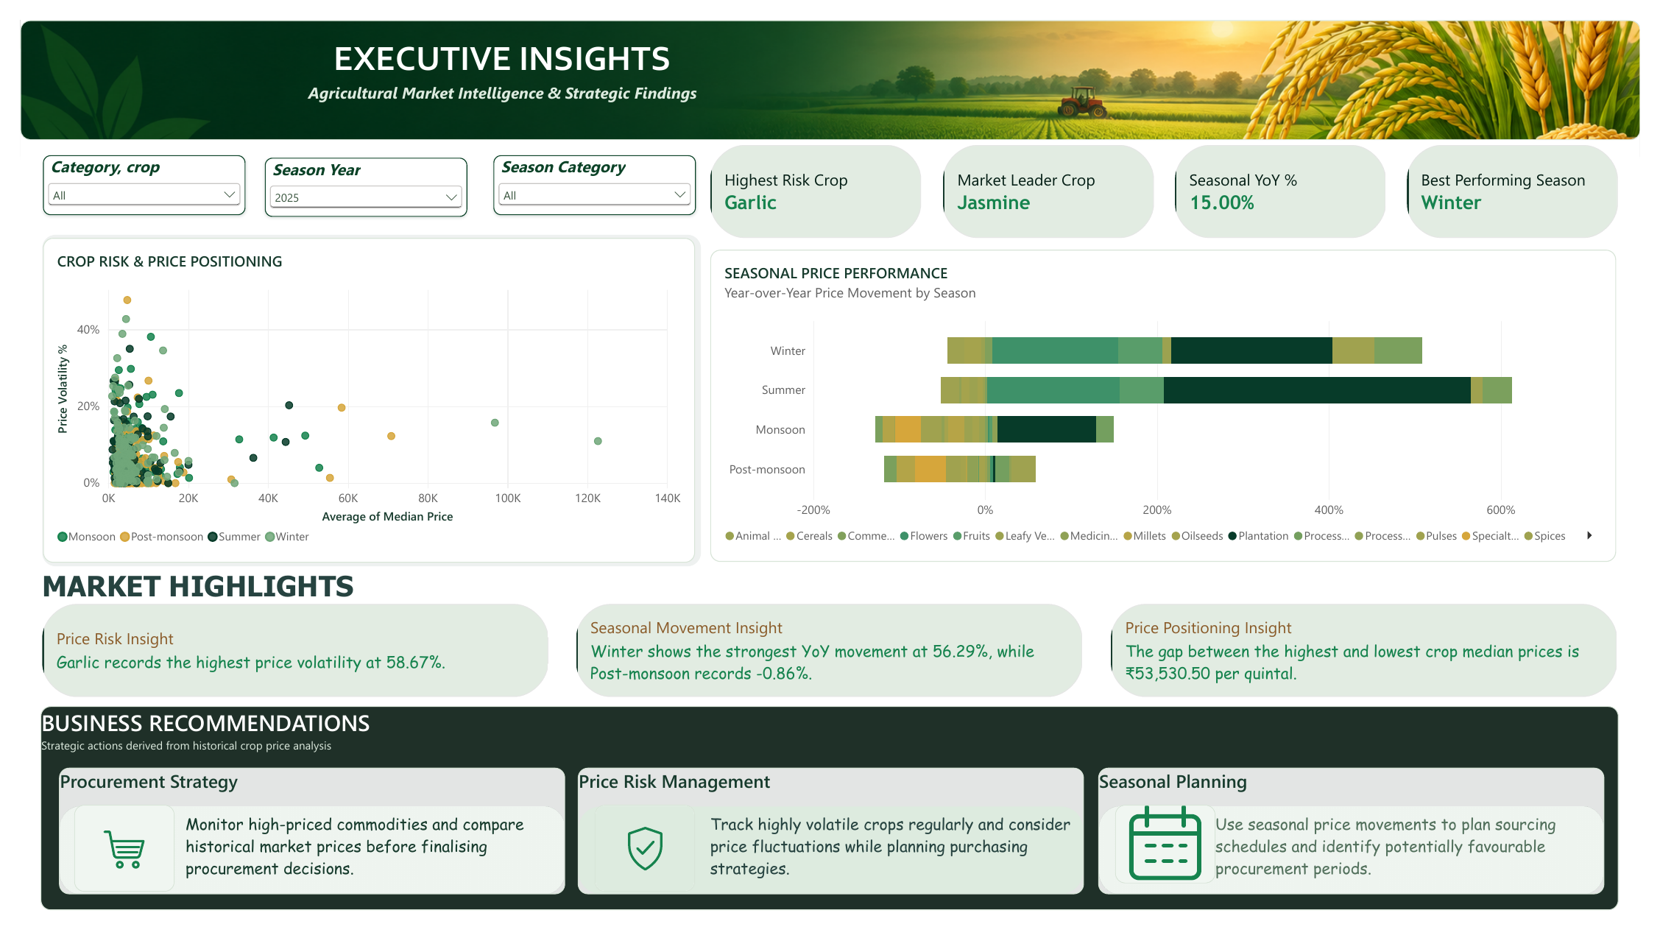
Page 3 — Executive Insights
Cards: highest-risk crop, market leader, seasonal YoY, best season.
Risk vs price scatter and seasonal performance by category.
Insight sentences and 3 recommendation cards (2025 shown).
Notes:
Screenshot from your Power BI report export.

Slide 11
Important patterns discovered
Cheap perishables are most volatile: carrot 82.1%, kinnow 81.4%, radish 77.9%.
Higher-priced crops tend to be steadier (ρ = −0.44): an association, not a proven cause.
Median seasonal swing is about 29% across 81 long-history crops.
Notes:
Rank correlation between median price and volatility: −0.44 across 150 crops with at least 12 months.

Slide 12
Crop price risk analysis
Top risks: carrot, kinnow, radish, drumstick, onion.
Measure includes long-run price growth; a detrended view reshuffles the ranking.
Ranks only crops with 12+ months of data.
Notes:
Volatility = standard deviation ÷ average. Includes long-run trend: about +6.8% a year for typical crops.

Slide 13
Seasonal price behaviour
Post-monsoon is the peak season for 41 of 81 crops.
Strongest: fresh peas, methi leaves, drumstick, kinnow.
Post-monsoon is only 2 months, so it is the least reliable season.

Slide 14
Business recommendations
Procurement strategy
Phase buying or lock prices for high-volatility, high-spend crops; spot-buy steady ones.
Price risk management
Monitor volatility with a 12-month minimum history; read YoY like-for-like.
Seasonal planning
Buy around the low season for strongly seasonal crops; avoid last-minute peak buying.
Combine with purchase volumes and regional knowledge before acting.

Slide 15
Limitations
Coverage grew from about 81 crops (2015) to 175 (2026), so YoY can be inflated by new crops.
Prices are national medians; regional and quality differences are hidden.
Thin history: 25 crops under 12 months; Mentha oil has one record.
Nov 2026 is partial; seasons are uneven in length.
Notes:
Winter 2025: +56.29% unadjusted vs about +12% for the 79 crops present in both years.

Slide 16
Conclusion and future scope
The dashboard turns raw mandi prices into risk, seasonality and action.
Key caution: validate headline YoY and rankings against data sufficiency.
Next: minimum-history rule, like-for-like YoY, rolling volatility, proper calendar table.
Extend with arrival volumes, weather and state-level prices; forecast only after validation.

