Slide 1
Hospital Information Management System - HIMS
Qasim MSCS13001
Ahmad MSCS13004
Iqra MSCS13012
Noman MSCS13056
Ambreen MSCS13057

Slide 2
What it does
Login
Patient Registration
Patient Check-In
Doctor’s Appointments
Prescription Generation
Patient Check-Out
Patient’s History
Resource Addition/ Deletion
Asset Addition/Deletion
Account Management
Search
Payroll

Slide 3
Document Flow Diagram

Slide 4
DFD Level 1

Slide 5
Use Case

Slide 6
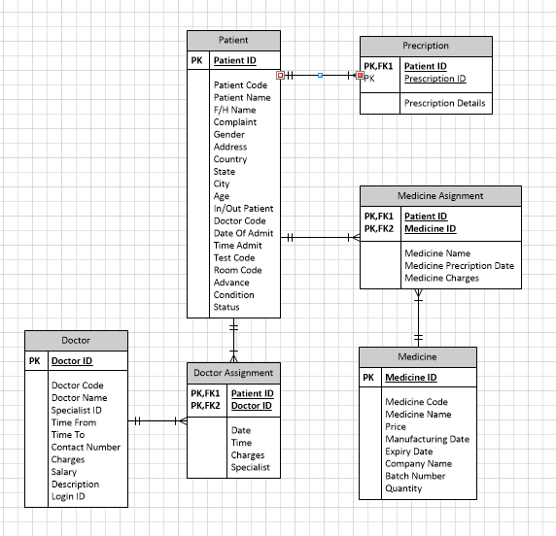
ERD

