Slide 1


















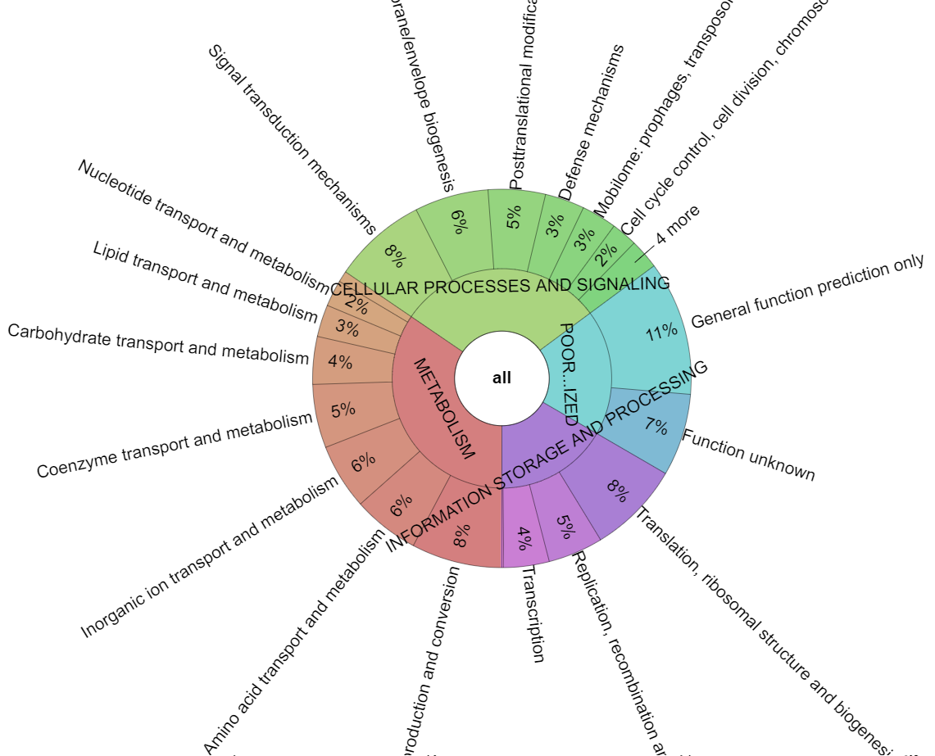
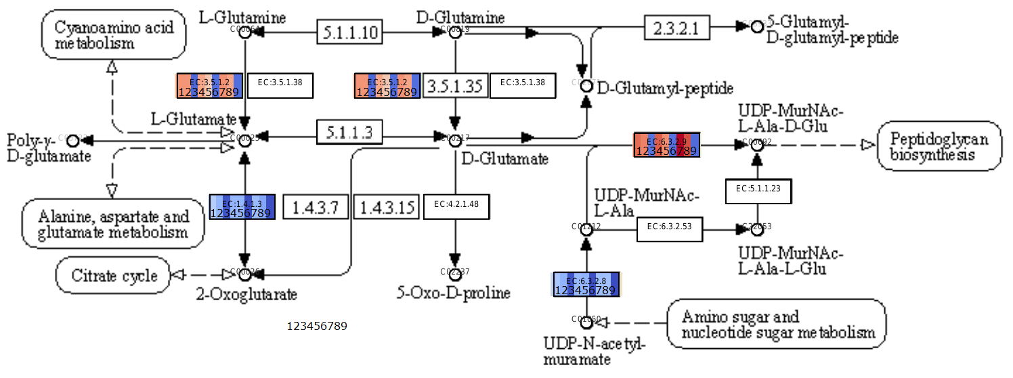
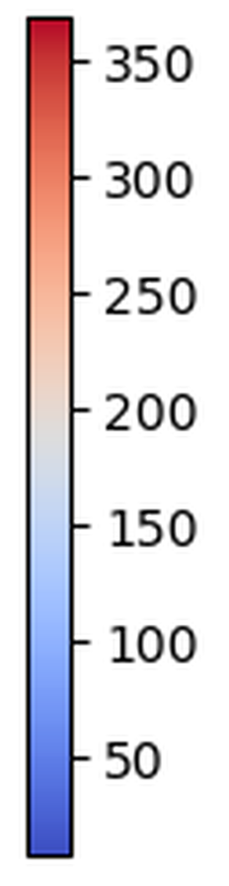
Meta-omics Analyzes
Functional Annotation
Representation in Metabolic Maps
Complex microbial communities
UPIMAPI
reCOGnizer
KEGGCharter

