Slide 1
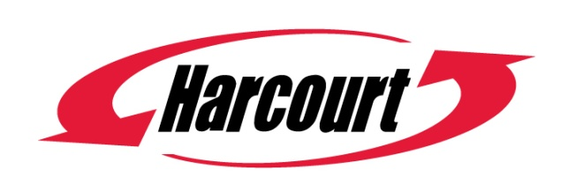
6 WHY
“your tooling component
supplier for the 21st century”
REASONS
TOOL DESIGNERS SPECIFY HARCOURT
www.harcourtind.com
Harcourt Industrial, Inc. | 1100 East Whitcomb | Madison Heights, MI | 48071 | USA

Slide 2
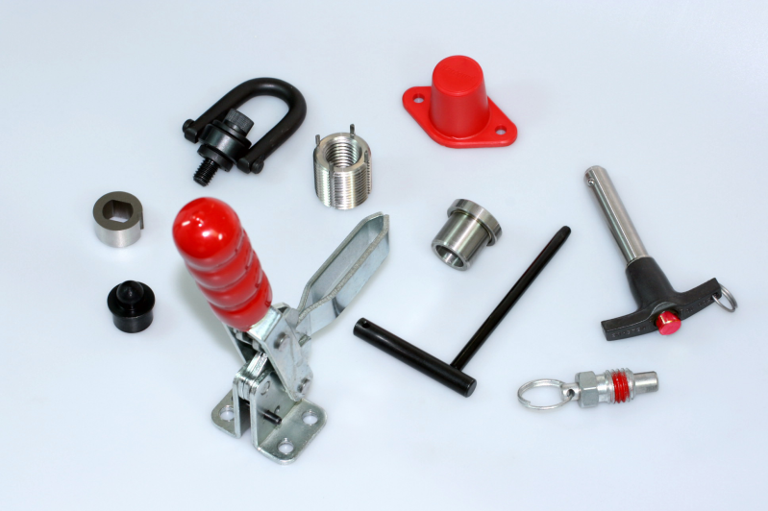
1
“your tooling component
supplier for the 21st century”
PRODUCT RANGE
Designed for the aerospace tooling industry our range is comprehensive,
innovative and relevant. A few points to remember;
  Vast selection of components
    Unique items (cases, cast angles, handle bushings, etc.)
    Standards & Specials (to your spec’s)
    Designed for you!
2
WEBSITE
  Online catalogs and product data
  One stop design suite
  Latest Harcourt news
    Market leading technology
www.harcourtind.com
www.harcourtind.com
Harcourt Industrial, Inc. | 1100 East Whitcomb | Madison Heights, MI | 48071 | USA

Slide 3
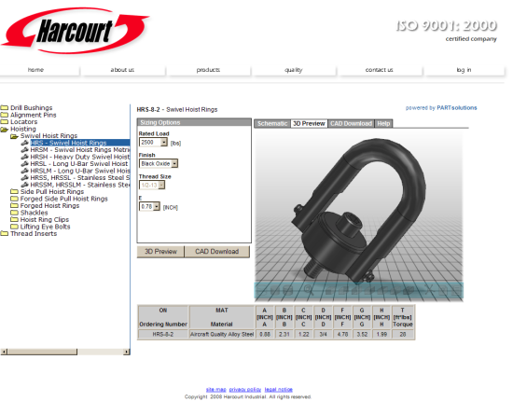
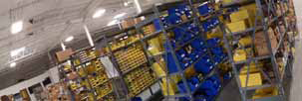
3
“your tooling component
supplier for the 21st century”
    Click the image to access CAD library
CAD LIBRARY
Our digital, online, CAD library incorporates the latest technology
and gives you the following features at your fingertips;
  Very comprehensive selection of models
    Models available in Catia, Unigraphics, PRO/E, etc.
    Native CAD in these formats and others
    Online model configuration to exact size
    Models are detailed but minute in file size
4
QUALITY & SERVICE
  ISO 9001:2008 certified
  Huge inventory
  Aerospace approved products
  C of C supplied with every shipment
  100% final inspection
    99.62% on-time score
    Job sequencing and labeling
    Worry free shipping!
www.harcourtind.com
Harcourt Industrial, Inc. | 1100 East Whitcomb | Madison Heights, MI | 48071 | USA

Slide 4





5
“your tooling component
supplier for the 21st century”
EXPERIENCE
With over a decade of experience in the aerospace industry, Harcourt
understands your needs and requirements. The benefits are;
  Experts on OEM standards
  Ability to assist design in product selection
    Approved supplier to many OEMs
    Preferred supplier to many of the largest
    aerospace tooling manufacturers.
6
SUPPORT
  We are a global company with locations in three countries and customers around the world.
  Whatever your needs , contact us.
P: 800/888-5033
F: 866/432-9442
E: sales@harcourtind.com
www.harcourtind.com
www.harcourtind.com
Harcourt Industrial, Inc. | 1100 East Whitcomb | Madison Heights, MI | 48071 | USA

