Slide 1
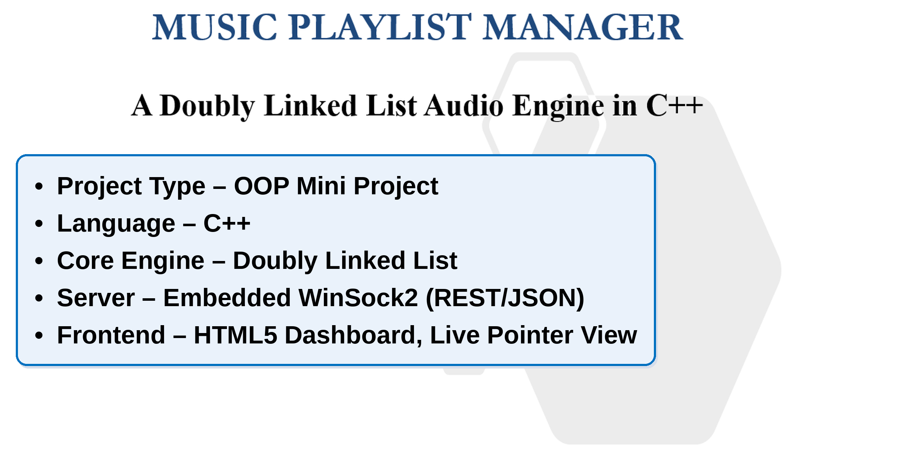
MUSIC PLAYLIST MANAGER

Slide 2
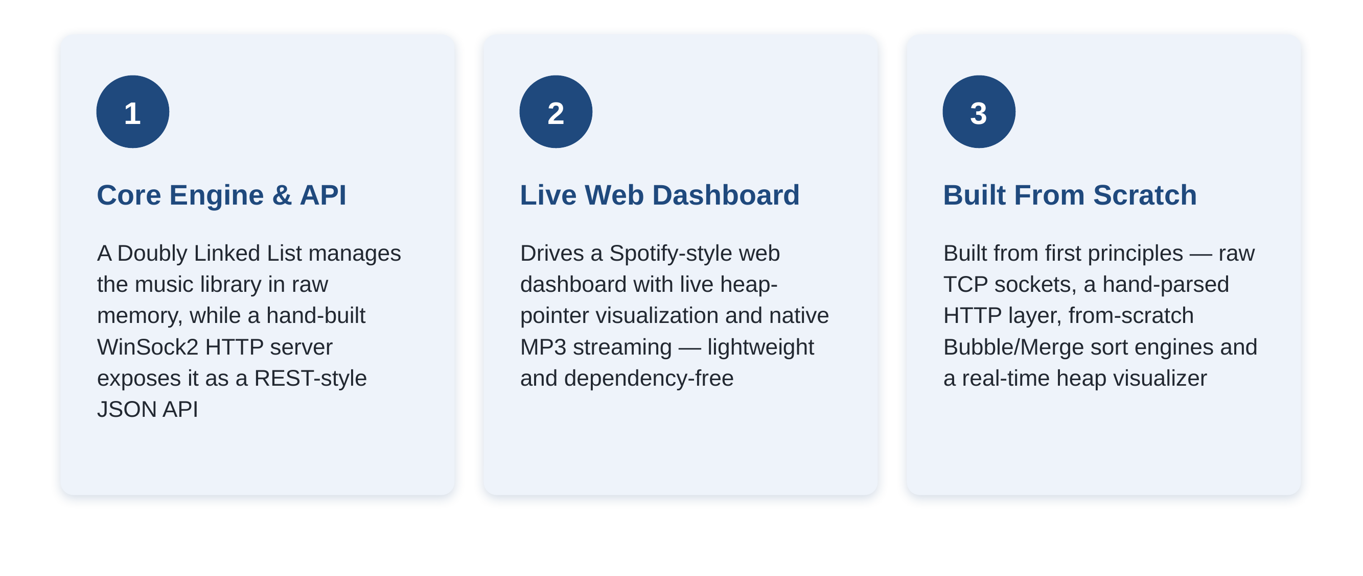
MUSIC PLAYLIST MANAGER

Slide 3
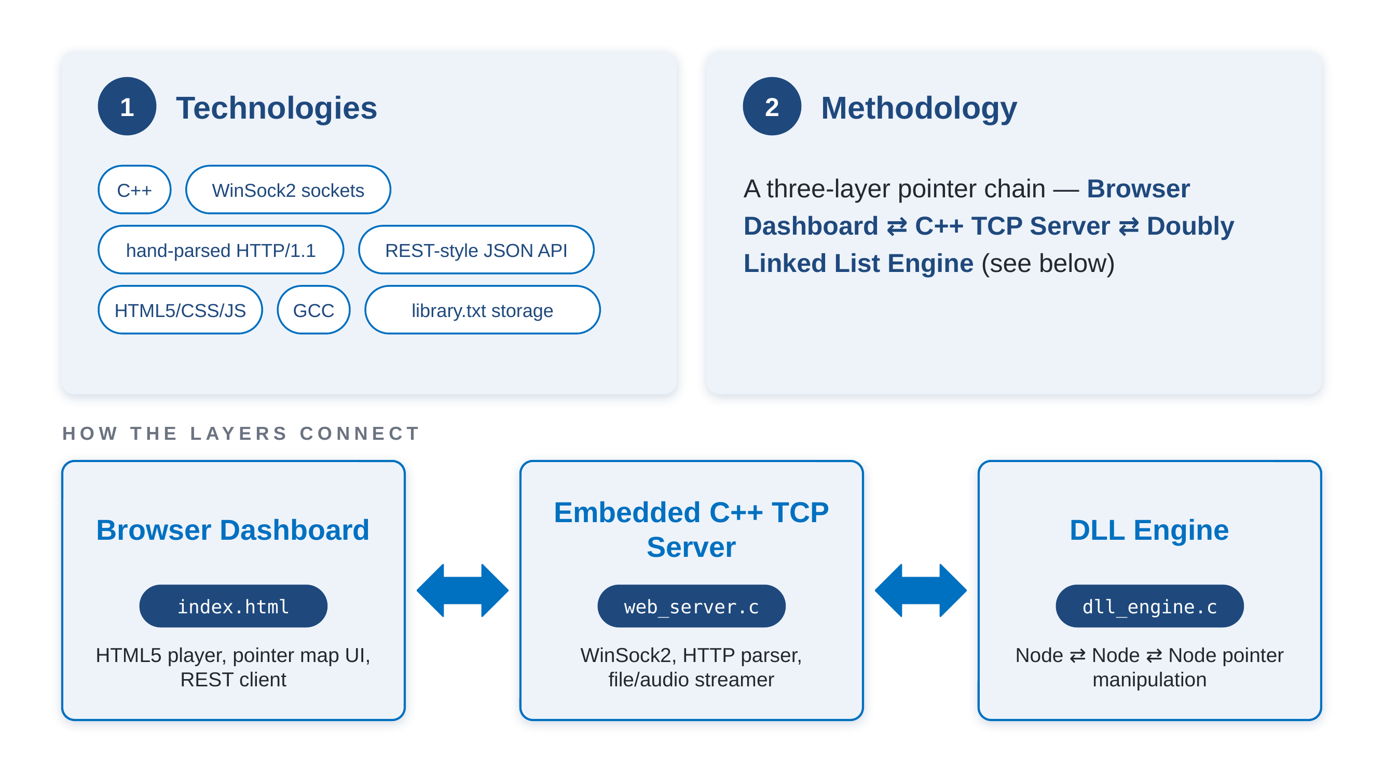
TECHNICAL APPROACH

Slide 4
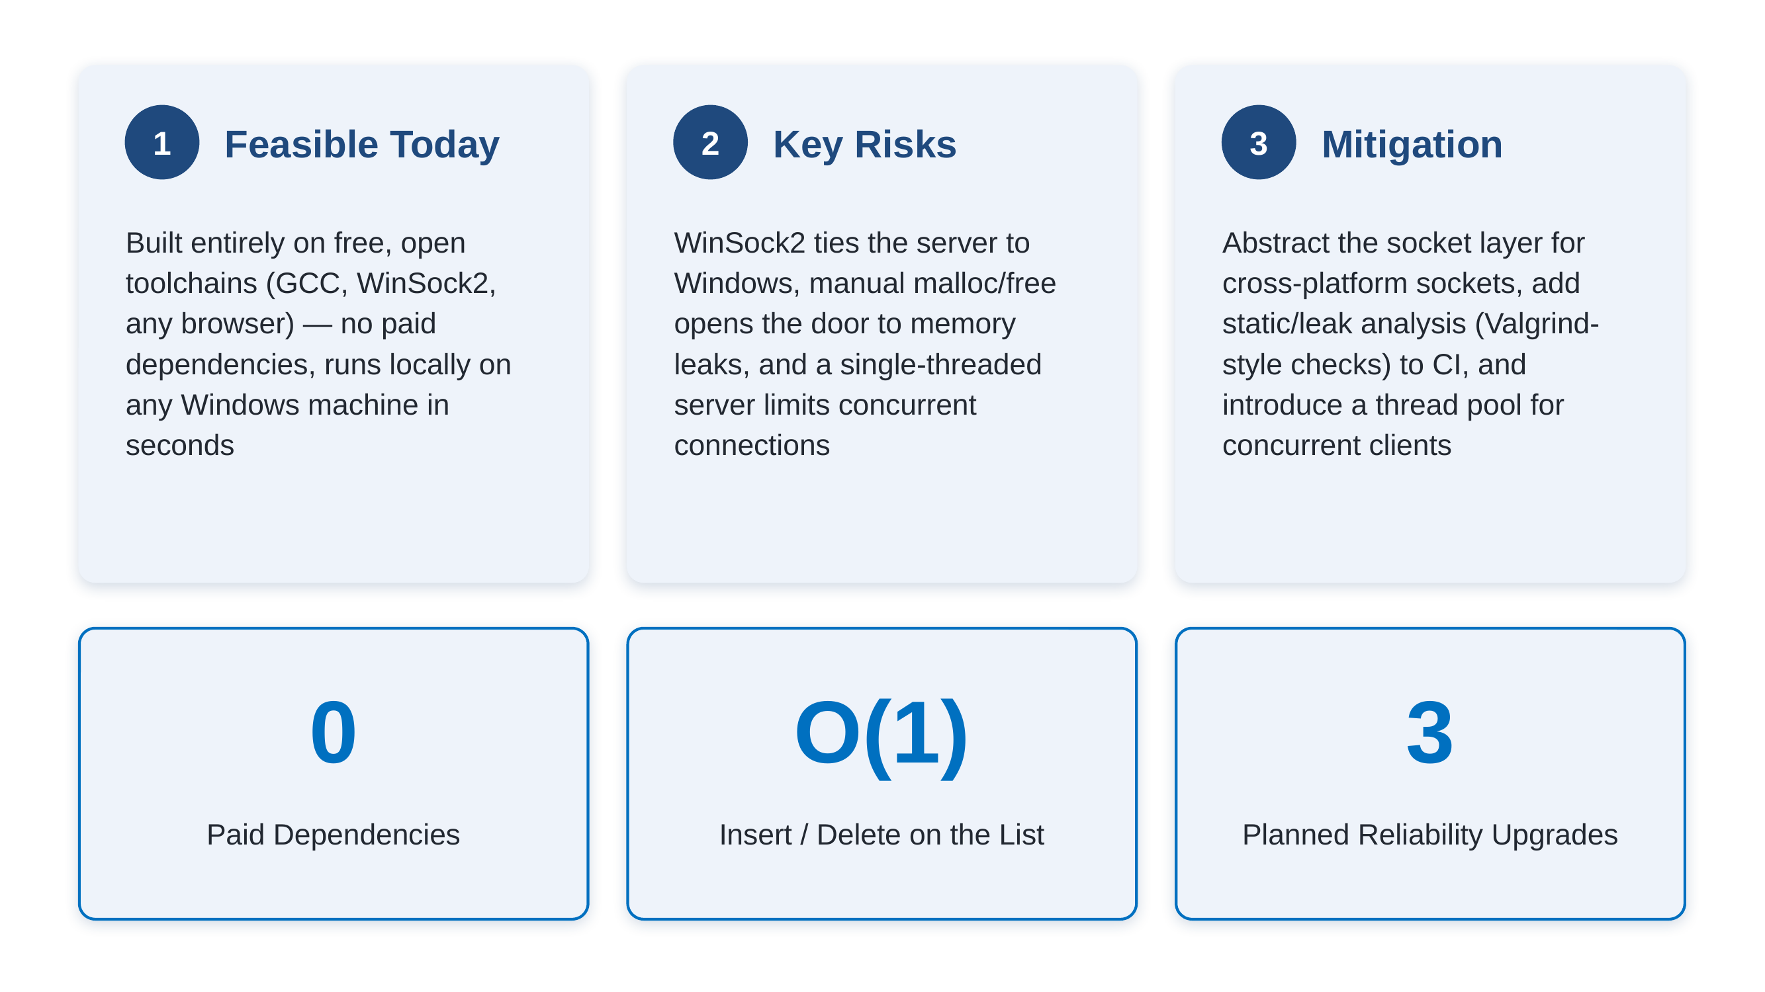
FEASIBILITY AND VIABILITY

Slide 5
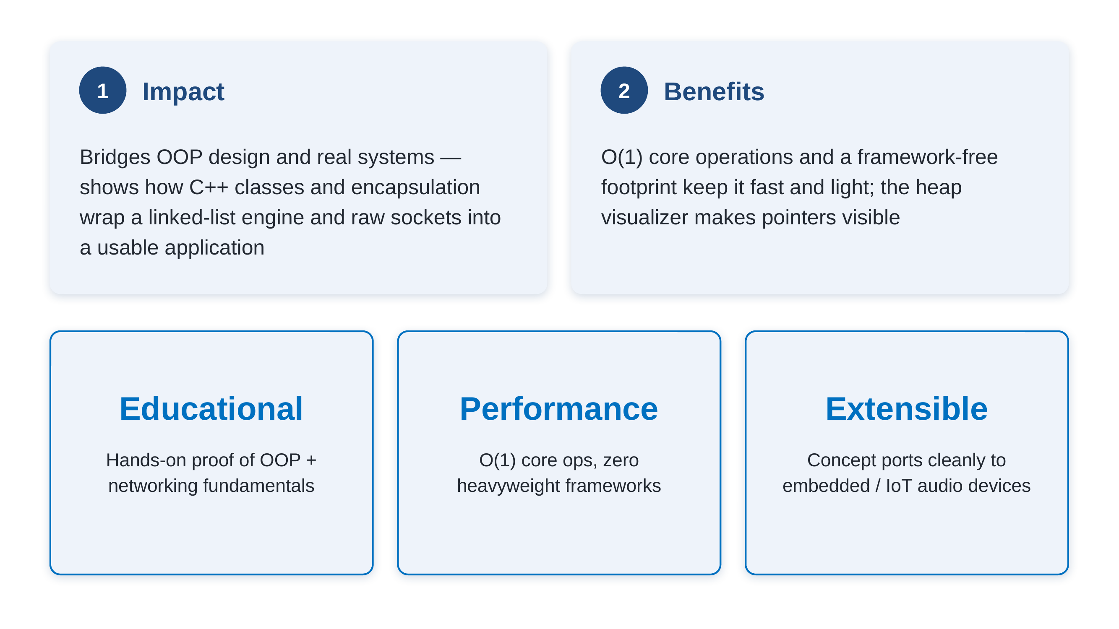
IMPACT AND BENEFITS

Slide 6
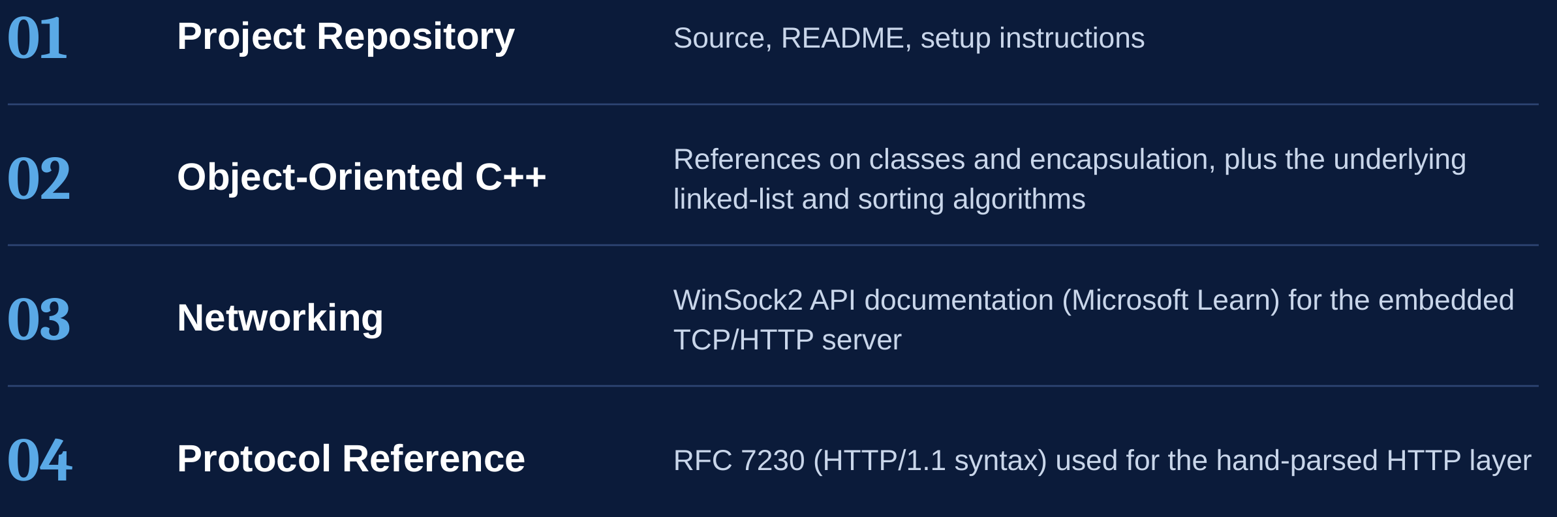
RESEARCH AND REFERENCES

