Slide 1
Homelessness in San Jose, California
COURSERA IBM DATA SCIENCE
CAPSTONE PROJECT for PYTHON
IRA DE GUZMAN, CALIFORNIA

Slide 2
For WEEK 1: [1] Description of the problem and a discussion of the background.
INTRODUCTION San Jose has consistently landed among the most expensive housing markets in the US. One unmissable downside is the ever surging rise of the homeless population. “The reasons for homeless are many and varied.” said Joe Simitian, President of the Santa Clara County Board of Supervisors. “The high costs and shortage of housing are making a bad problem worse.”

Slide 3
For WEEK 1: [1] Description of the problem and a discussion of the background.
CONTINUATION This presentation offers a glimpse of what the City of San Jose is doing to curb the seemingly inexorable increase in homelessness. Sam Liccardo, the Mayor of San Jose, wants to “double down on homeless prevention, and in turn, alleviate the human misery.”

Slide 4
For WEEK 1: [1] Description of the problem and a discussion of the background.
CONTINUATION
“Homelessness” is Councilman Raul Peralez’s number one priority. According to him, and others from San Jose Housing and the Santa Clara County Supportive Housing, they have “solutions for almost 100% of the homeless on the streets.”
“But the problem is far from over.” Peralez admits. San Jose voters approved of almost a billion dollars for affordable housing.

Slide 5
For WEEK 1: [2] A description of the data and how it will be used to solve the problem
DESCRIPTION
Affordable housing is one of my long-term solutions the City of San Jose is embarking on. According to Peralez, “we need more of these units, and we need them to get in the pipeline.” There are already projects in the San Jose downtown, and several more interspersed in the city.”

Slide 6
For WEEK 1: [2] A description of the data and how it will be used to solve the problem
HOW DATA WILL BE USED
*Information from data extracted from the City of San Jose public website will be discussed using Python and Github. Because the addresses that were extracted from the website were (1) not businesses, but considered “residences,” this category does not fall among the usual entities that one would find in social-driven map apps such as Foursquare. (2) Furthermore the addresses obtained were incomplete, i.e. there is no city and zip codes provided.

Slide 7
For WEEK 1: [2] A description of the data and how it will be used to solve the problem
HOW DATA WILL BE USED
I have considered using a Visual-Basic macro in Excel (see sample of the coding below), but that too demands complete addresses (number, street, city, zip code). The other option is to input these incomplete addresses to a location finder, that will generate the corresponding coordinates (latitude, longitude, and even elevation). But that too requires inputting the data manually, and individually. An arduous task. (Nonetheless, it was completed for this project!)

Slide 8
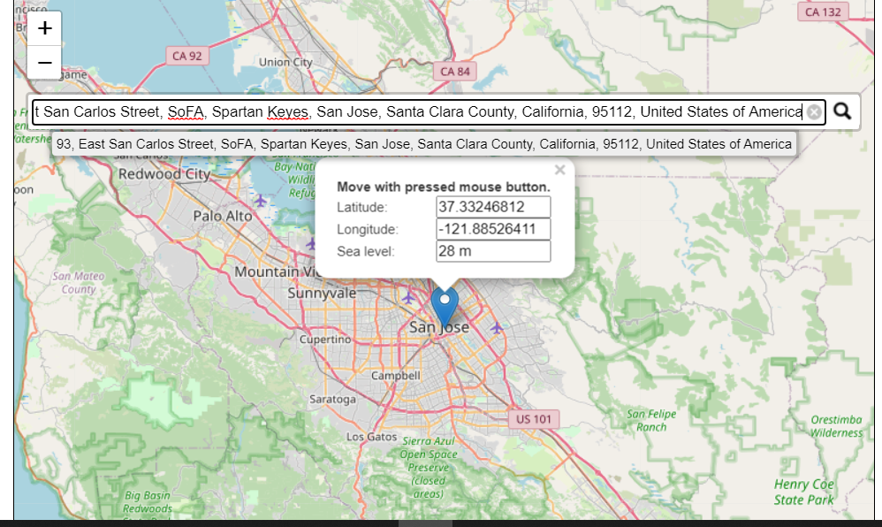
For WEEK 1: [2] A description of the data and how it will be used to solve the problem
HOW DATA WILL BE USED: the website webcoordinates.net

Slide 9
For WEEK 2: [2] A full report consisting of the following components
A) INTRODUCTION: WHERE YOU DISCUSS THE BUSINESS PROBLEM, AND WHO WOULD BE INTERESTED IN THE PROJECT
The data presented here are public information. The created maps derived from these data could be of interest to contractors and architects who may wish to study the distribution of the current (and future) affordable housing units interspersed more equally, so they could plan accordingly.
But the recipients who will most benefit, of course, are the non-profit organizations whose focus is homelessness.

Slide 10
For WEEK 2: [2] A full report consisting of the following components
B) DESCRIBE THE DATA THAT WILL BE USED TO SOLVE THE PROBLEM; AND THE SOURCE OF THE DATA.
The data was obtained from an accessible website data.sanjoseca.gov. Of the 42 datasets available to the public, none contains any latitude- and longitude coordinates. Foursquare, albeit a functional resource, does not emphasize non-business entities, much less affordable-housing units. The coordinates (for the addresses of the aforementioned units) were in fact obtained manually, using Google-driven mapcoordinates.net. The latitudes and longitudes are then logged into a separate table that was later merged with the public-accessed dataset.

Slide 11
For WEEK 2: [2] A full report consisting of the following components
C) METHODOLOGY: DISCUSS AND DESCRIBE ANY EXPLORATORY DATA ANALYSIS, ANY INFERENTIAL STATISTICAL TESTING (IF ANY), AND WHAT MACHINE LEARNING WERE USED AND WHY.
The usual methodology of using Foursquare may not have been the most efficient as Foursquare’s cornerstone (pardon the pun) is mainly businesses and other attractions, such as restaurants, bars, shops, parks, and most importantly, their auxiliary comments. Residential areas are not included in the listings.

Slide 12
For WEEK 2: [2] A full report consisting of the following components
C) METHODOLOGY: DISCUSS AND DESCRIBE ANY EXPLORATORY DATA ANALYSIS, ANY INFERENTIAL STATISTICAL TESTING (IF ANY), AND WHAT MACHINE LEARNING WERE USED AND WHY.
As mentioned earlier, obtaining the coordinates of affordable housing units from Foursquare is nonviable. The other option, albeit arduous, is to acquire the pertinent information from websites that generates the coordinates of specific, non-business addresses. The site that I chose for this project was mapcoordines.net.

Slide 13
For WEEK 2: [2] A full report consisting of the following components
D) RESULTS SECTION WHERE YOU DISCUSS DETAILS
Once the coordinates of the addresses were obtained and placed into a proprietary table, that table is then merged into a dataset obtained from data.sanjoseca.gov (“Affordable Family Housing Units-2020”). The resulting merged dataframe is then mapped and clustered using FOLIUM. *See GITHUB link for Python results

Slide 14
For WEEK 2: [2] A full report consisting of the following components
E) DISCUSSION SECTION WHERE YOU DISCUSS ANY OBSERVATIONS YOU NOTED AND ANY RECOMMENDATIONS YOU CAN MAKE BASED ON THE RESULTS. The affordable housing units are mostly converted apartments, the majority of which are built around San Jose. A few are nestled on the west of San Jose, in the city of Campbell. But none in the more affluent, adjacent cities of Santa Clara, Los Gatos, Saratoga, and Cupertino.

Slide 15
For WEEK 2: [2] A full report consisting of the following components
F) CONCLUSION There are no silver bullets in solving the challenges that surround homelessness. Long-term solutions will alleviate these challenges in the future, but the more pressing need stresses to be in the present. Short-term solutions, like building the de-rigueur ‘tiny homes’ proved to be expeditious; albeit the practice of converting and repurposing old apartments seems to be the sound choice because it bypasses new construction to be undertaken.

Slide 16
For WEEK 2: [3] CHOICE OF PRESENTATION
PRESENTATION OR BLOGPOST My choice for presentation is through (this) Powerpoint, and Folium-generated maps.
*See Github link for Python codes and Folium maps.

