Slide 1

How to help photographers to create more profitable content?
Iryna Mishiev
May 2022

Slide 2
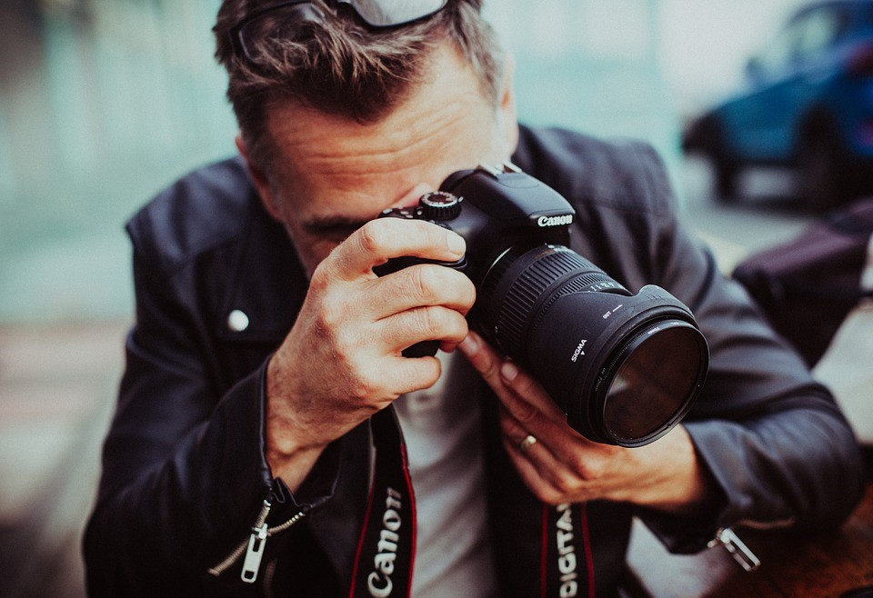
Identifying business problem
Has library of over 477 million assets.
Price is ranging between $0.5 till tens of thousand dollars
The higher price of photo the higher profit of the company.
How to motivate photographers to create more profitable content?

Slide 3
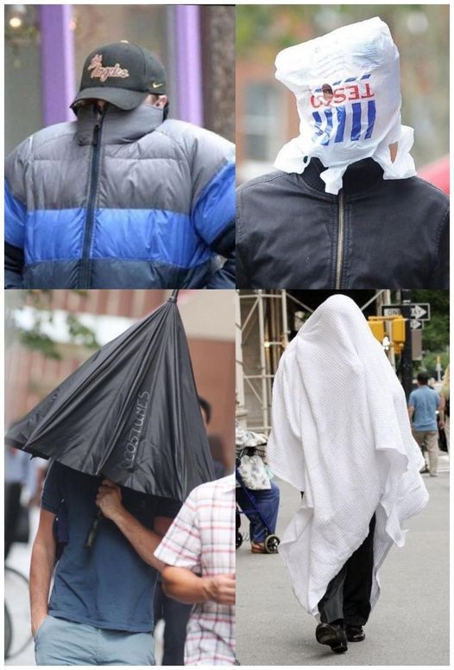
Impact hypothesis
If photographers have access to comprehensive data analytical tools that will show what kind of content values, they will be motivated to create this kind of content.
Risk and assumption
Making photo is creative and unpredictable process.
If make the same recommendations for all photographers in specific location, the content can be similar.
*Leonardo DiCaprio hiding from the Paparazzi

Slide 4
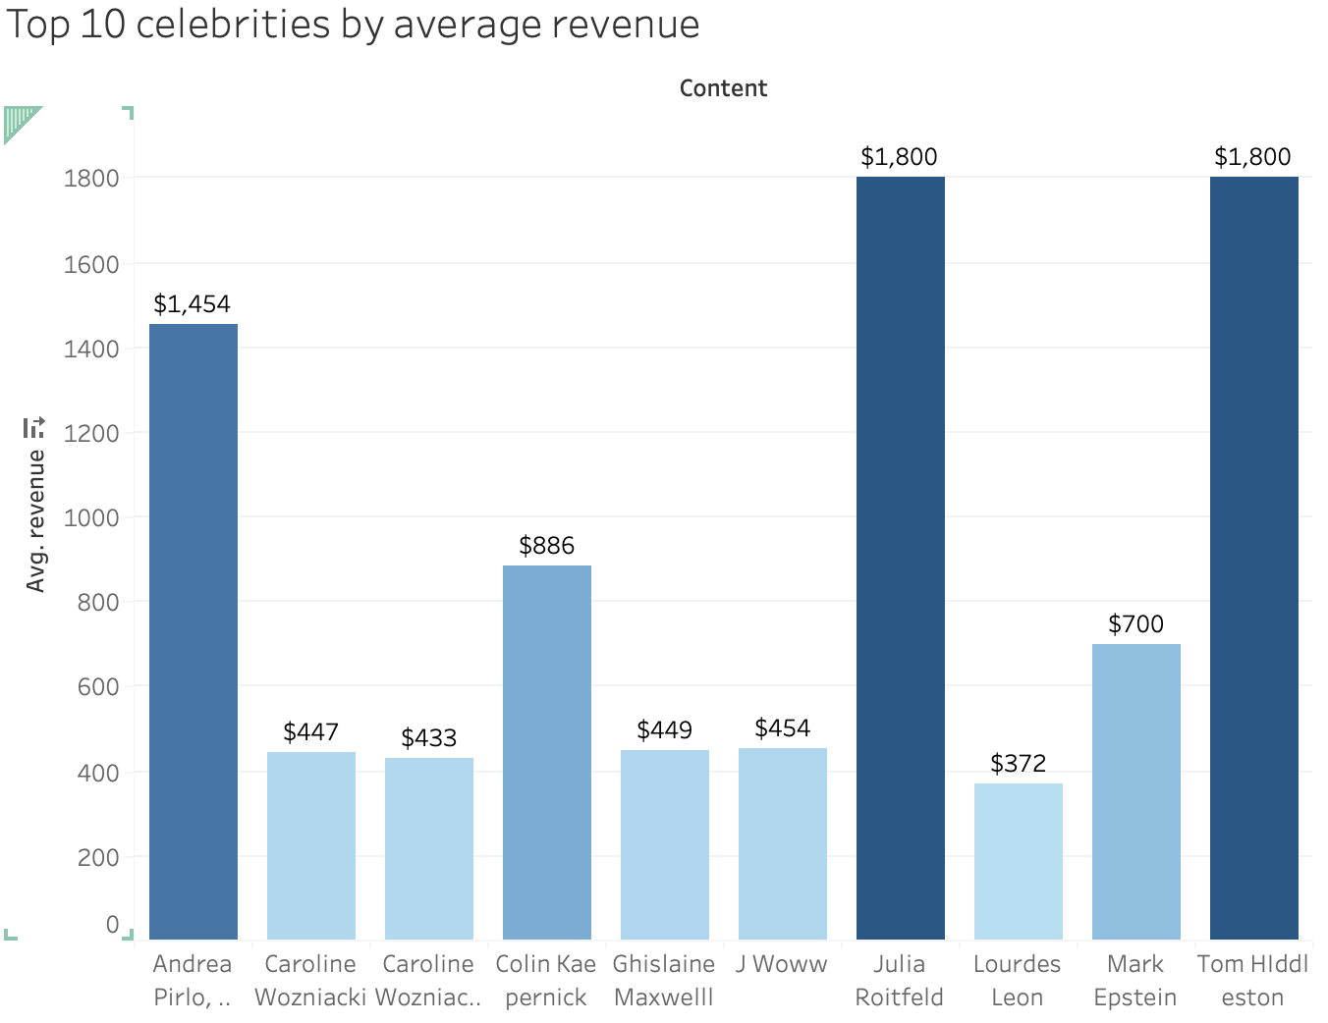
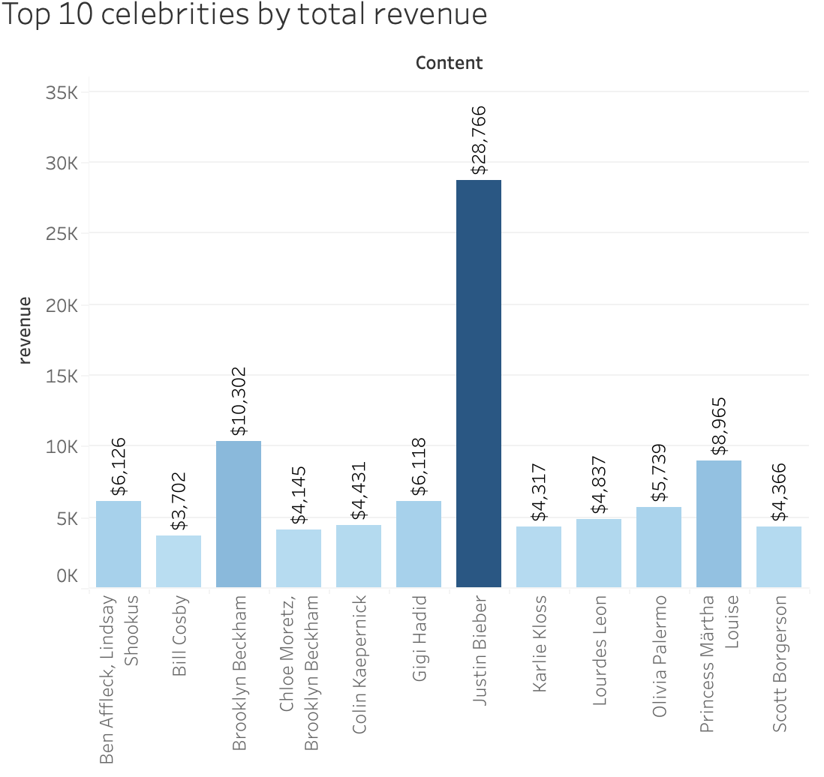
Data Analysis. Content

Slide 5
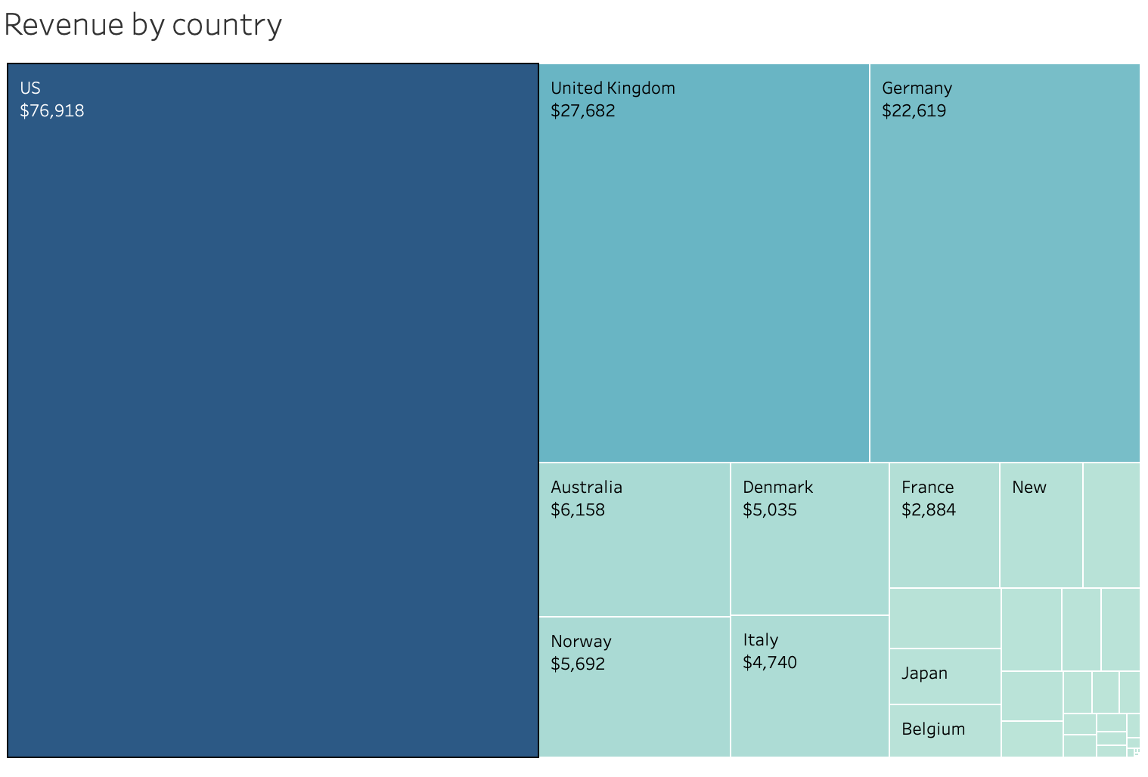
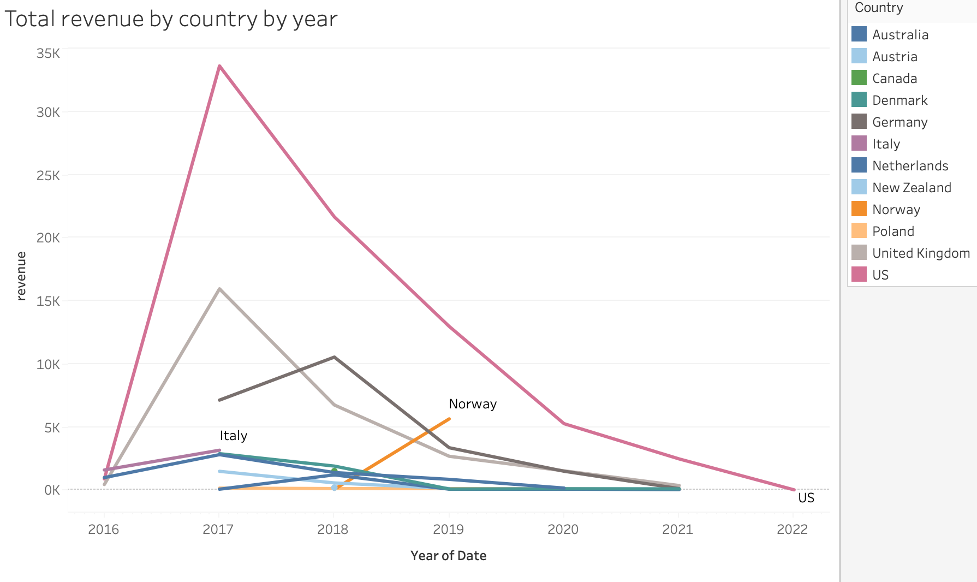
Data Analysis. By Country

Slide 6
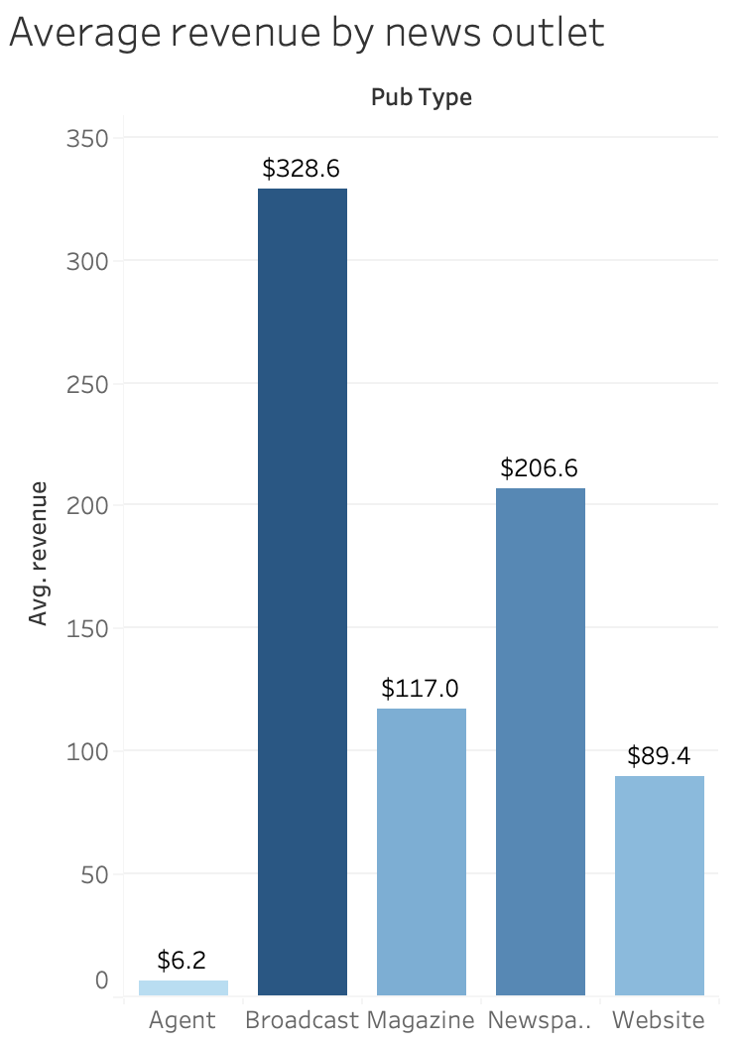
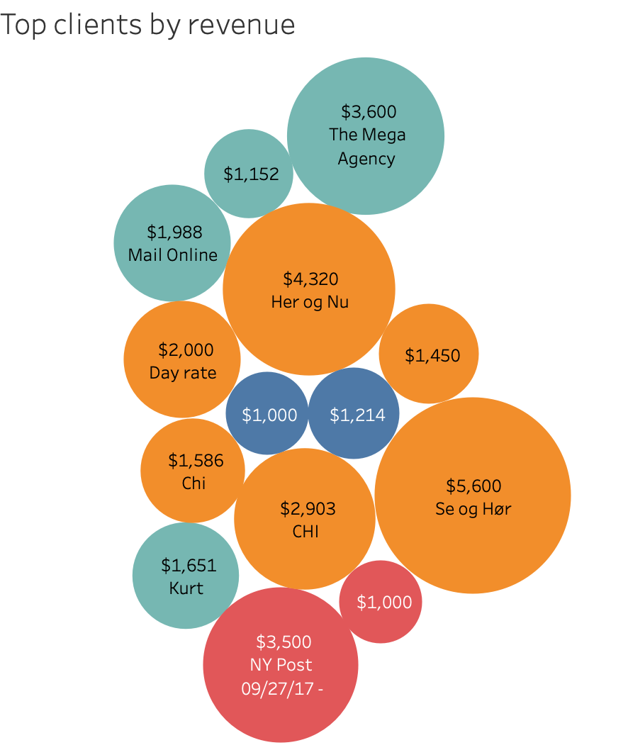
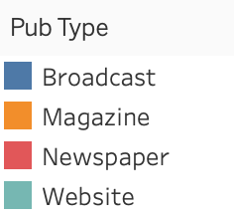
Data Analysis. By News Outlet

Slide 7
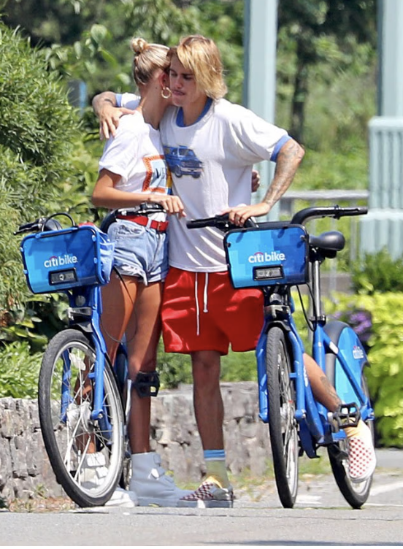
Recommendations. What to do
Criteria | Recommendations
Whom to photograph? | Justin Bieber Brooklyn Beckham Princess Märtha Louise Caroline Wozniacki
Where to sell? | USA, United Kingdom , Denmark, Germany, Norway
To what kind of outlet to promote? | Broadcast, Magazine
Which clients to prioritize? | NY Post 🇺🇸, Daily Mail 🇬🇧, Se og Hør 🇳🇴, Her og Nu 🇩🇰
Total Revenue $28,766
Number of sales 389

Slide 8
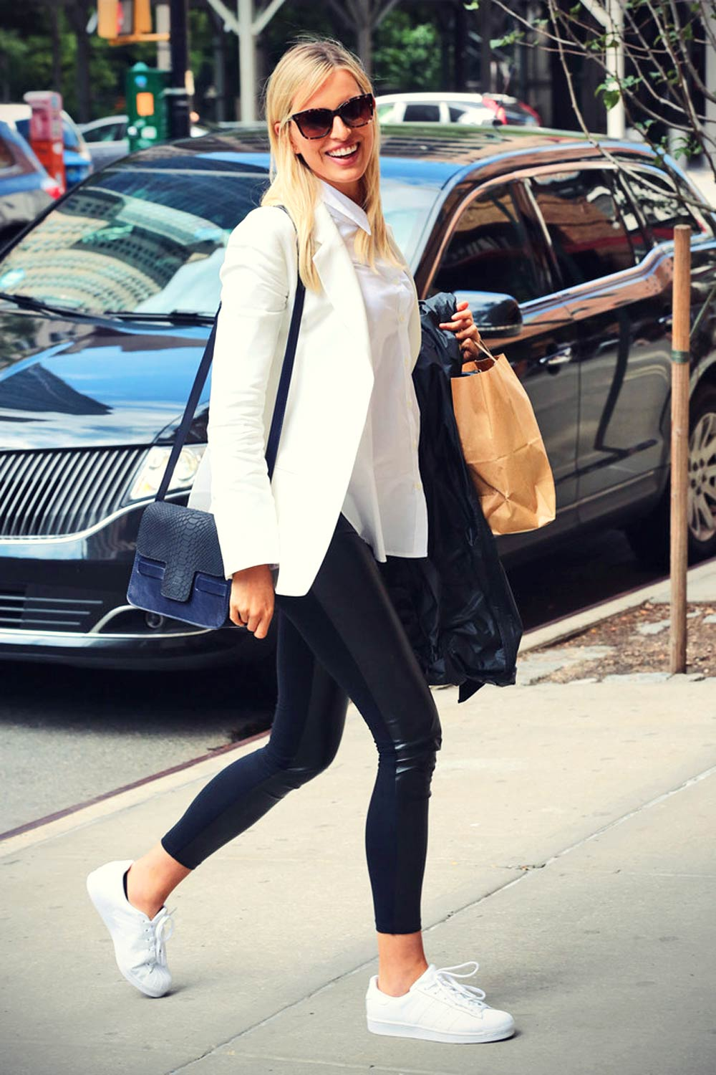
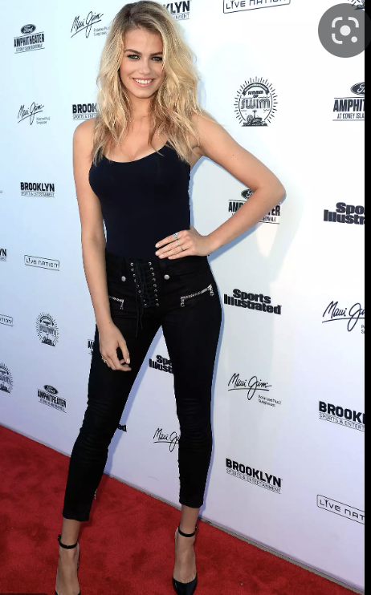
Recommendations. What NOT to do
Criteria
Whom to not photograph? | Hailey Clauson, Karolina Kurkova, Kris Jenner Sidney Royel Selby lll Jim Parsons, Todd Spiewak
Where not to sell? | Estonia, Croatia Serbia, Romania Slovenia
To what kind of outlet to not promote? | Agent (subscriptions)
Which clients to not prioritize? | Agent - East News Russia Agent - East News s.p.z. oo Agent - Forum
Total Revenue $0,6
Number of sales 1
Total Revenue $0,47
Number of sales 1

Slide 9
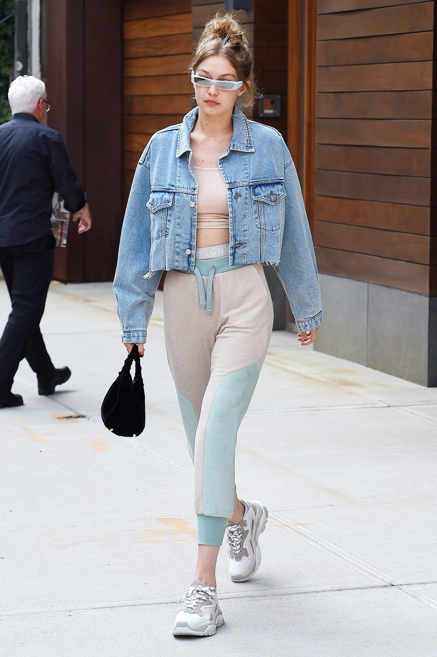
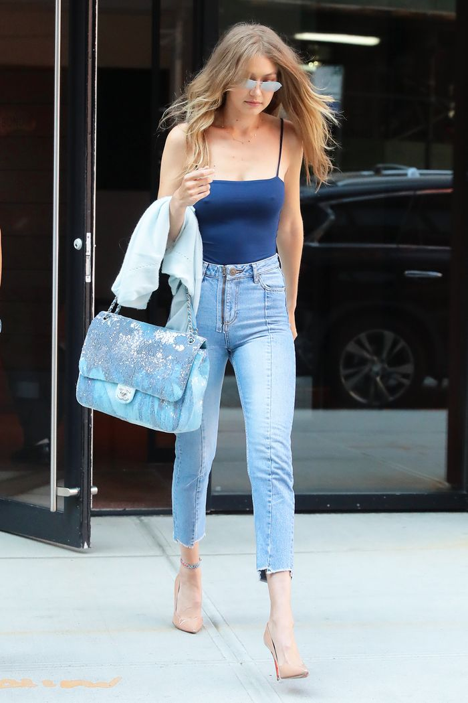
Future data science steps
Next step :
by using NLP techniques to work deeper with text descriptions of photos and retrieve additional information. New topics may be used as new features for the following analysis; thereby, recommendations will be more specific toward the content of images.
Gigi Hadid
Gigi Hadid with Chanel bag

Slide 10
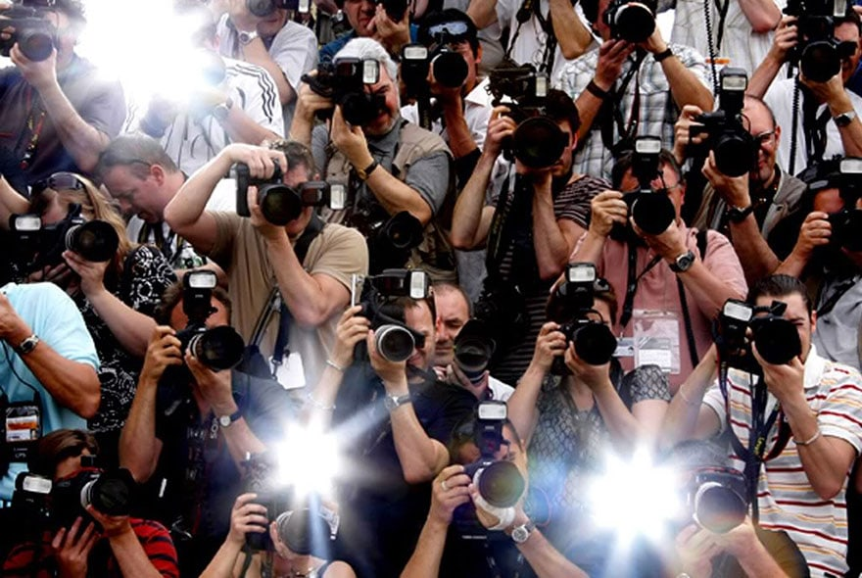
Thank you!

