Slide 1

Identifying patients with a risk of cardio disease
Iryna Mishiev
February 2021

Slide 2

Opportunity
Objective:
Alert the medical practitioners about patients with a high risk of having heart diseases.
Practical impact:
By highlighting patience with a high or medium-high risk of having the cardio disease, doctors will have an opportunity to prevent the development of the disease or put additional attention to this patient's condition.

Slide 3

Process and Tools
Data:
Data from Kaggle consists of 70000 reports with patient notes, including physical exam findings, analysis reports, and diagnoses.
Methodology:
EDA and data cleaning,
Feature engineering,
Baselining - model Linear Regression,
Modeling - kNN, Random Forests, Extra Trees, GBMs, Naive Bayes.
Final Model selection and turning.

Slide 4
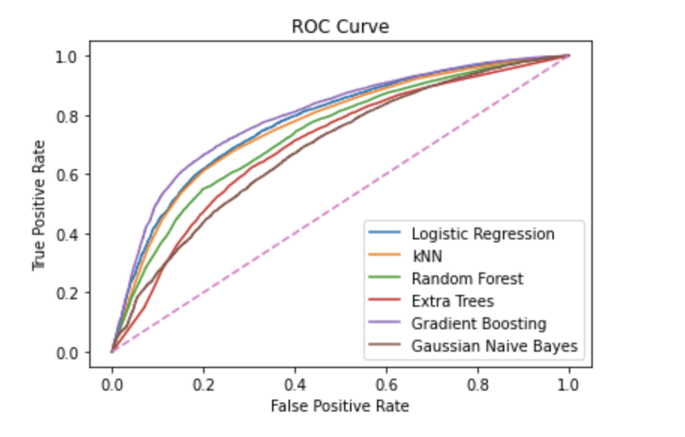
Final Model Selection
Recall from different models
Logistic Regression 62.45% | kNN: 69.50% | Random Forest: 69.69% | Extra Trees: 66.69% | Gradient Boosting: 68.36% | Naive Bayes: 29.56%
62.45%
Random Forest start point
Training accuracy: 98.45%
Val accuracy: 65.65%
Precision: 0.6671
Recall: 0.6969
F1: 0.6619

Slide 5
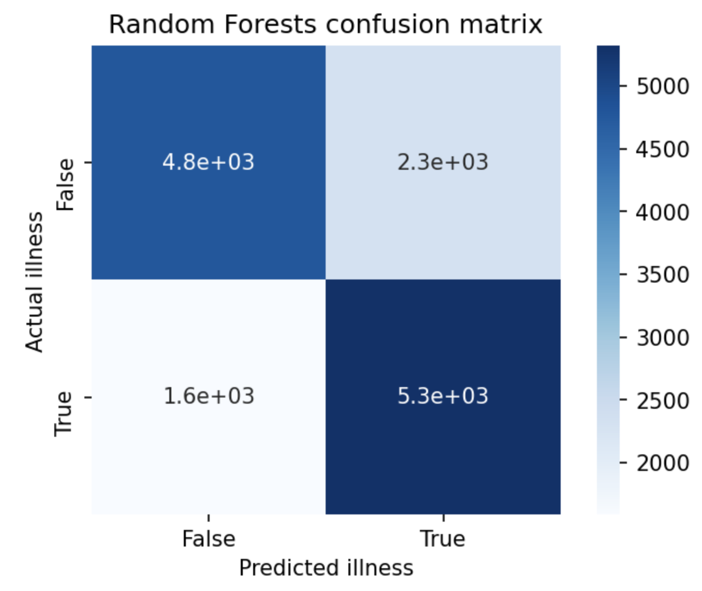
Random Forest. Summary Metrics
Random Forest accuracy after tune hyperparameters: Training: 76.04% Test set: 72.96%
Recall score with threshold 0.4: 77.03%
ROC AUC score with threshold 0.4 = 0.72

Slide 6
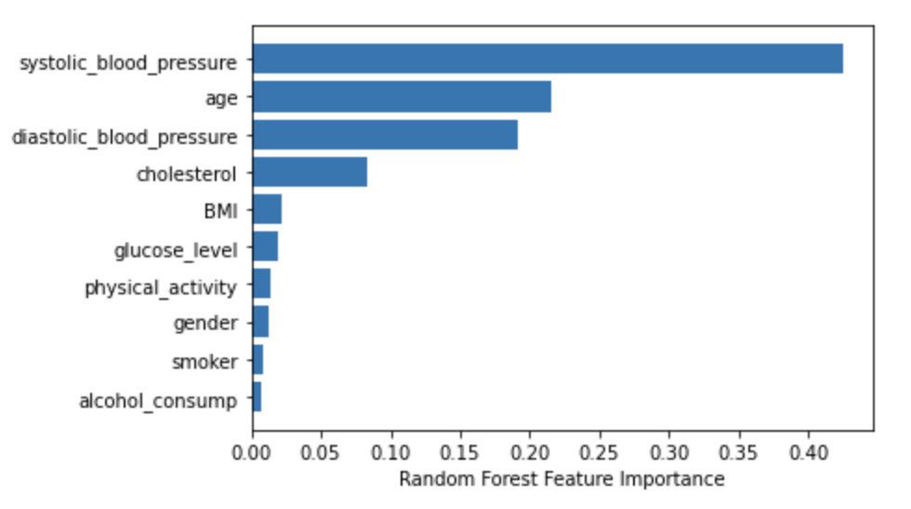
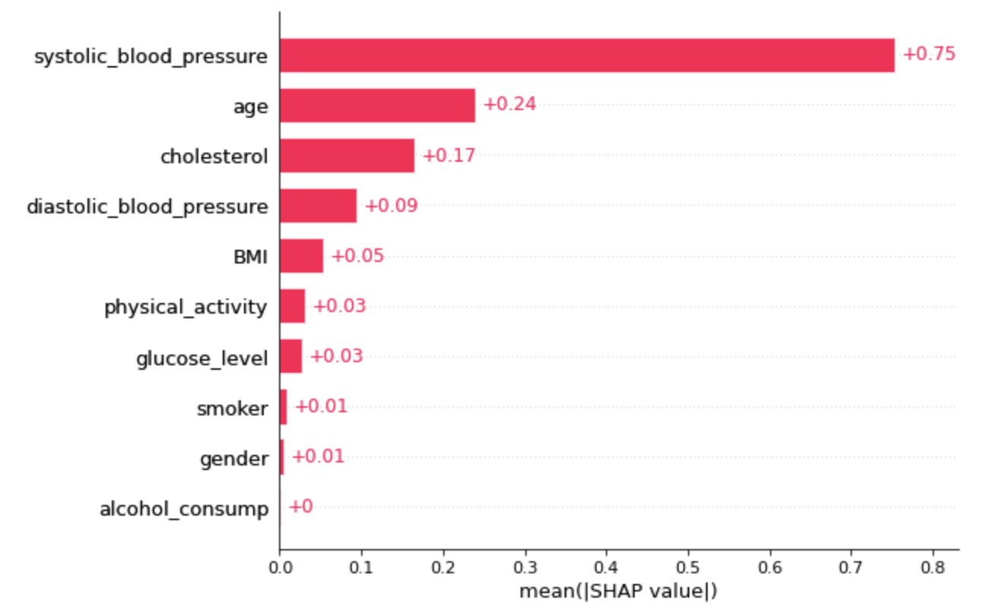
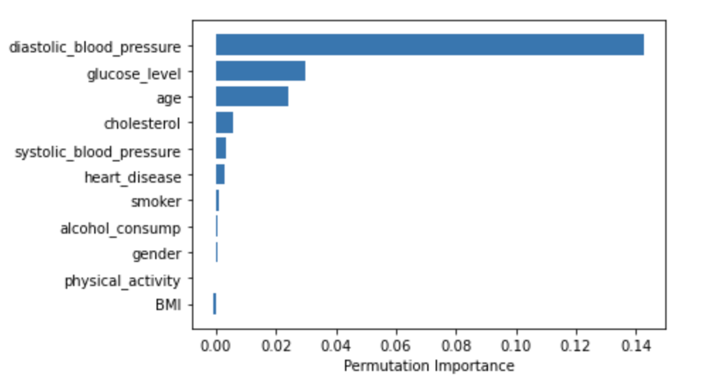
Feature importance and Permutation importance
Systolic_blood_pressure
Age
Cholesterol
Diastolic_blood_pressure
Glucose level

Slide 7

High and Medium Risk Groups
Gender Women Age 60-65
Systolic_blood_pressure 140-150
Diastolic_blood_pressure 90
Glucose level normal
Cholesterol level above normal
Body index overweight

Slide 8

Thank you!

