Slide 1
Before you begin…
Please take some time to view the CATT Assessment Syllabus.
Please read the welcome letter from me so you can “meet” your instructor.
Both of these resources are located in D2L when you click on “Content” and then “Assessment”

Slide 2
Basic Principles of Assessment
CATT Program:
Created by Dr. Eddy White: CESL Assessment Coordinator
Adapted by Tara Chandler: Assessment Module Instructor

Slide 3

What is assessment?

Slide 4
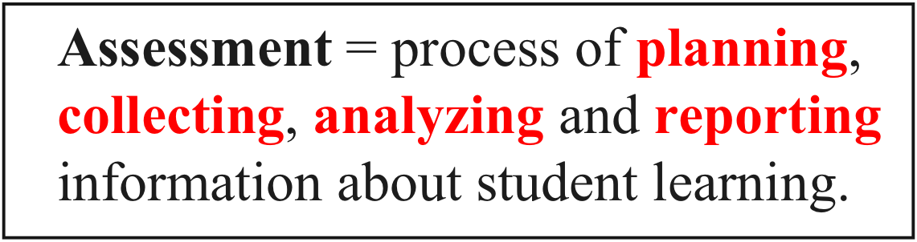
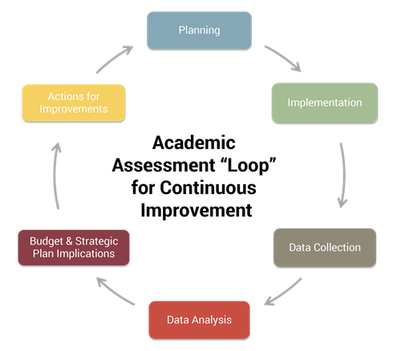

Slide 5
What is the PURPOSE of Assessment?

Slide 6
Purpose of Assessment
Identify strengths and weaknesses of individual students,
Adjust instruction to build on students’strengths and alleviate weaknesses,
Monitor the effectiveness of instruction,
Provide feedback to students (sponsors, parents, etc.), and
Make decisions about the advancement of students

Slide 7
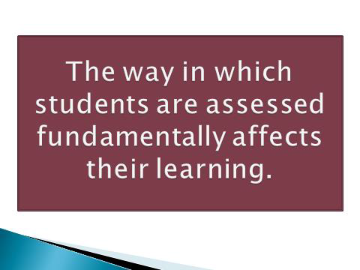

Slide 8
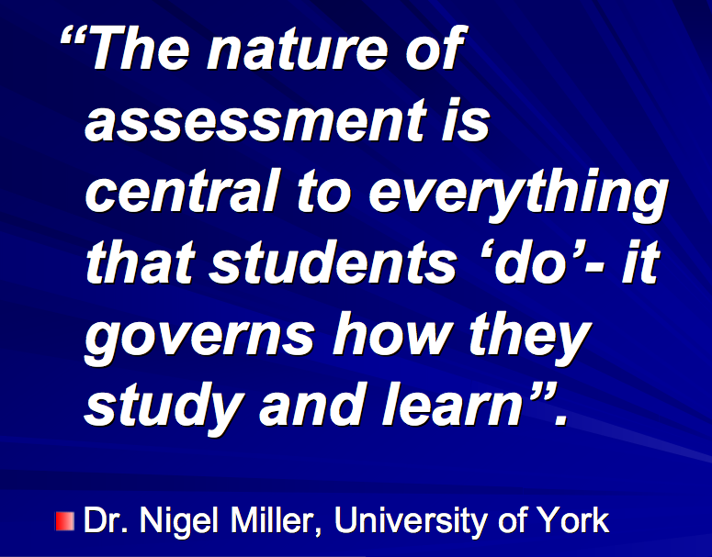


Slide 9
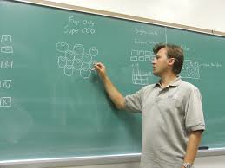
Problem…
Research suggests that teacher spend from one-quarter to one-third of their professional time on assessment-related activities. (Stiggins, 2007)
Are we trained and prepared to
use this time advantageously?

Slide 10

Teachers learn how to teach without learning much about how to assess. (Heritage, 2007)

Slide 11
Assessment literacy
Assessment literacy is the kinds of assessment know-how and understanding that teachers need to assess their students effectively
Assessment literate educators should have knowledge and skills related to the basic principles of quality assessment practices.
(SERVE Center, University of North Carolina, 2004)

Slide 12
Assessment-literate teachers come to any assessment knowing . . .
what they are assessing,
why they are doing so,
how best to assess the achievement of interest,
how to generate sound samples of performance,
what can go wrong,
and how to prevent these problems before they occur.
Assessment literacy for the 21st Century (Stiggins, 1995)

Slide 13
Fill in the blank…
______________ is perhaps the most critical of all teaching skills.

Slide 14


Slide 15

__________ is perhaps the most critical of all teaching skills.
Decision-making

Slide 16
Since the 1970’s, there has been a group of educators and researchers who have argued that the key to being a good teacher lies in the decisions that teachers make.
Anderson, 2003

Slide 17
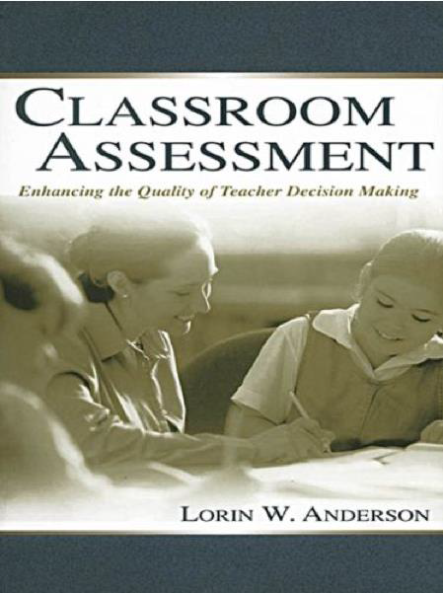
Good assessments lie at the core of good decision making.

Slide 18
1. What are some assessment-related challenges you face as a content teacher using English as a medium of instruction? 2. How do you deal with these challenges?

Slide 19
The Basic Principles of Assessment:
The Five Cardinal Criteria

Slide 20

The Basic Principles of Assessment
What are the ‘five cardinal criteria’ that can be used to design and evaluate all types of assessment?

Slide 21
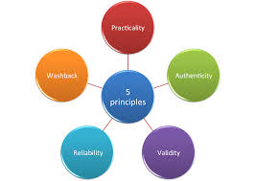
Five key assessment principles
Validity
Reliability
Practicality
Washback
Authenticity

Slide 22

Five key assessment principles
The principles can be expressed in question form.

Slide 23
Key Assessment Principles
1. Validity - Does the assessment measure what we really want to measure?
2. Reliability- Is all work being consistently marked to the same standard?
3. Practicality - Is the procedure relatively easy to administer?
4. Washback - Does the assessment have positive effects on learning and teaching?
5. Authenticity - Are students asked to perform real-world tasks?

Slide 24
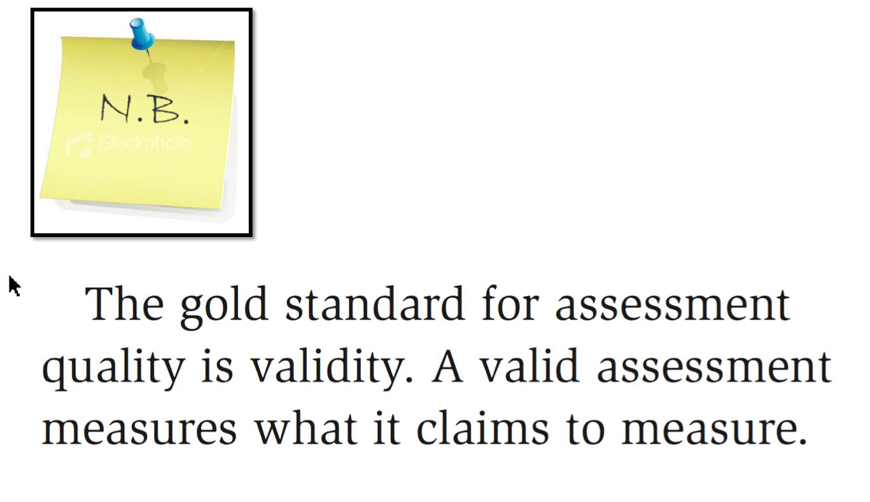
Validity

Slide 25

Most significant cardinal principle of assessment evaluation.
If validity is not established, all other considerations may be rendered useless.

Slide 26
Reliability
Student reliability- Making sure students have adequate test-taking strategies to demonstrate their “true” score
Rater reliability- Making sure that assessments are given consistent scores with as few errors as possible
Test reliability- Focusing more on objective tests with clear answers and a reasonable length

Slide 27

In the future..
Validity and reliability will be addressed in more depth in the following weeks when we look at reflecting on a test you have created and evaluating a rubric.

Slide 28

Practicality
Principle: To wisely make use of time and other resources available to the teacher
Example: With a class of 35+ students, it is impractical to administer an assessment where the teacher interviews each student individually.

Slide 29

Washback
Providing ample feedback, both praise to build motivation and constructive criticism to encourage further learning, builds positive washback

Slide 30
Authenticity
Principle: Assessing students on tasks that will be used in the “real world” later on
Example: Building a machine based on formulas learned in class

Slide 31
Summing it up…
Stop and consider the answers to the following questions:
What is assessment?
What is the purpose of assessment?
What is assessment literacy?
What are some of the important decisions you will make in your classroom about assessment?
What are the basic principles of assessment?
What is the most important principle of assessment?

Slide 32
Questions?
Do you have a question?
Please email me at chandlet@email.arizona.edu
Please allow me at least 24 hours to respond to your email. Thanks!

Slide 33
Thanks!
Thanks so much for viewing this lesson. I look forward to discussing with you in the Week 1 Discussion Board!

