Slide 1
Receipt Data Extraction and Item Classification
Albert IRADUKUNDA

Slide 2
Goals
Extracting Data
Receipt Items Classification
Finding similar Items

Slide 3
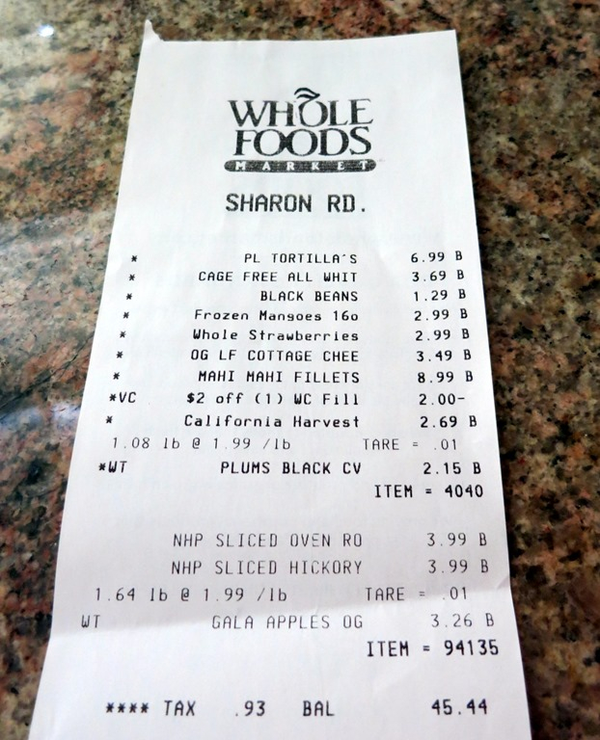
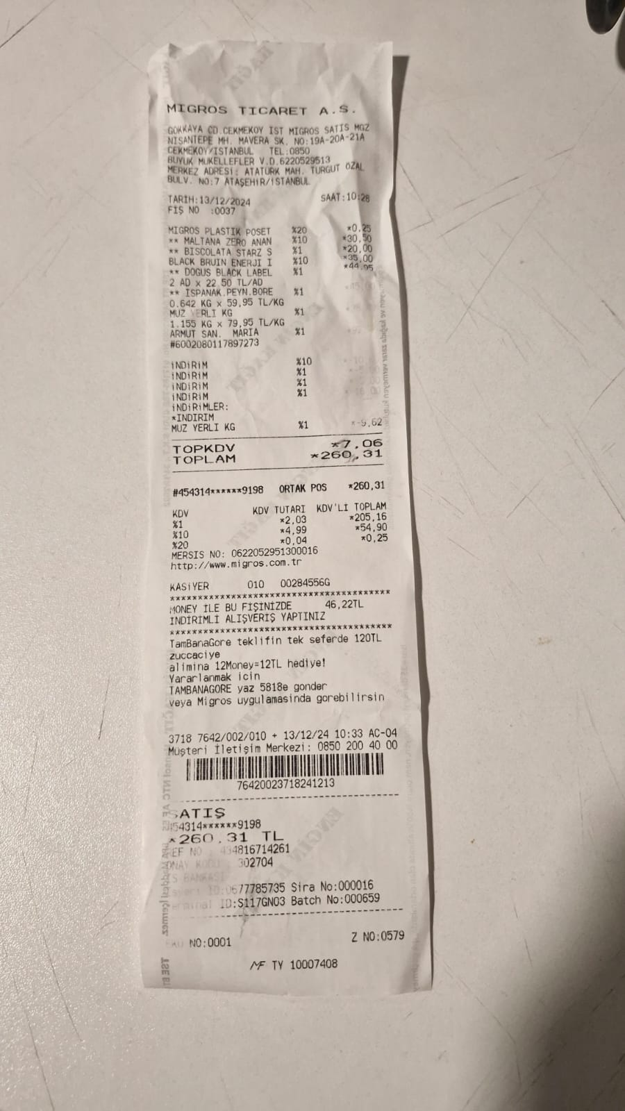
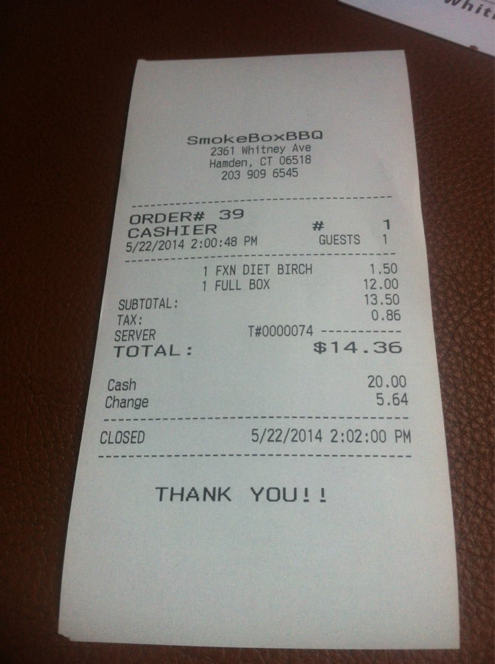
Data used in the Project
34 Groceries Receipt Imges
200 Restaurant Receipt Images

Slide 4
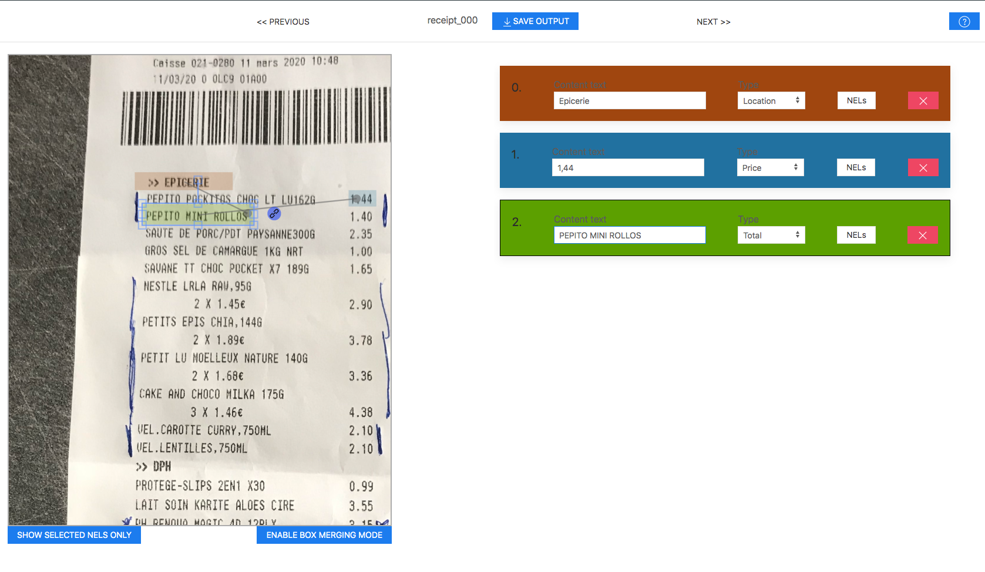
Pre-processing
Receipt Picture Annotation
{
"id": 0,
"text": "2001 Greenville Ave, Dallas, TX 75206",
"label": "location",
"box": [
100,
200,
400,
220
],
"linking": []
}

Slide 5
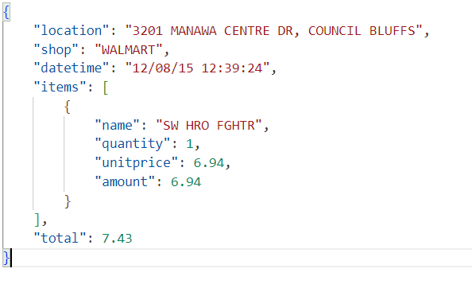
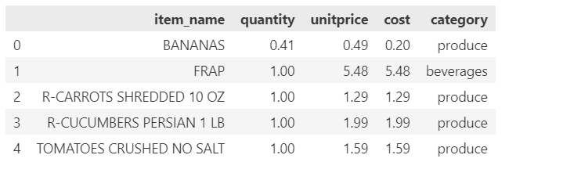
Pre-processing
Annotation and Item Labeling

Slide 6
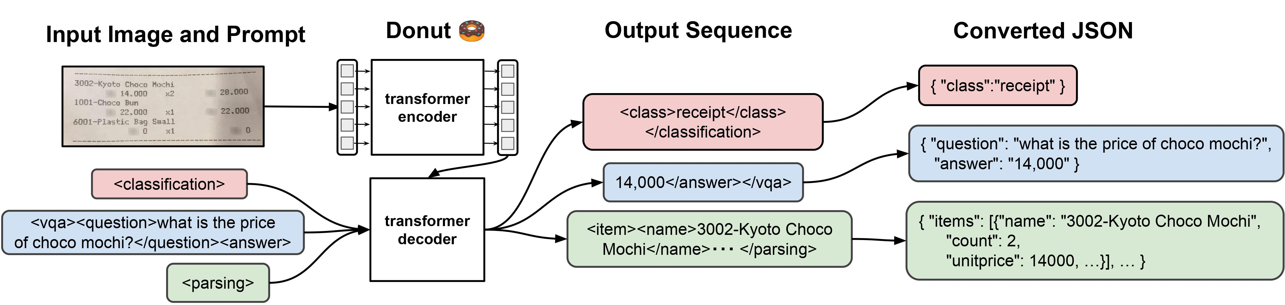
Data Extraction with Donut Model
Donut is a pretrained model OCR-free Document Understanding Transformer
Capabilities:
Image Classification
Visual question and answering
OCR Document Understanding

Slide 7
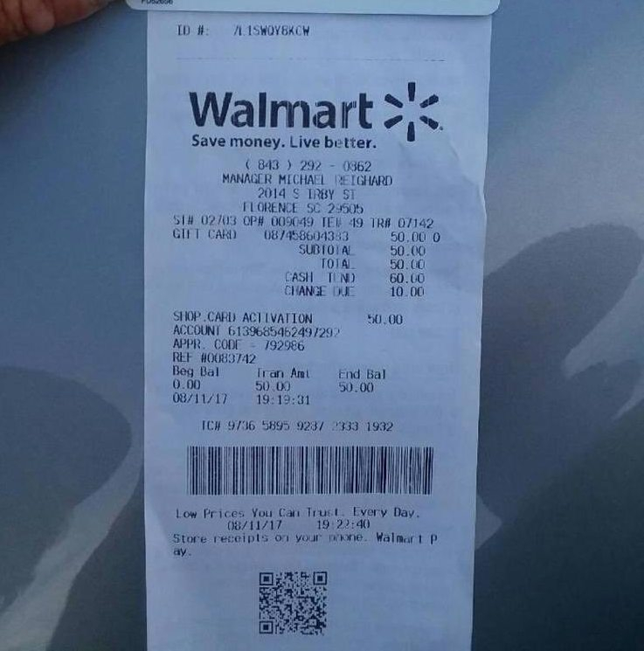
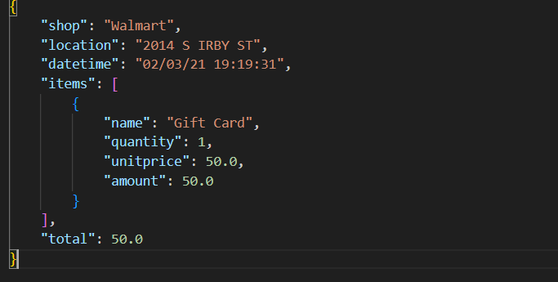
Fine-tuning Donut Model with Hugging Face Transformers library
Input
Ouput

Slide 8
Training and Results
Calculation of Accuracy
Compare the predicted value for each key in the dictionary to check if they are equal.
Only exact string matches are considering as truthy
Accuracy of 75% is quite good
Accuracy: 75%

Slide 9
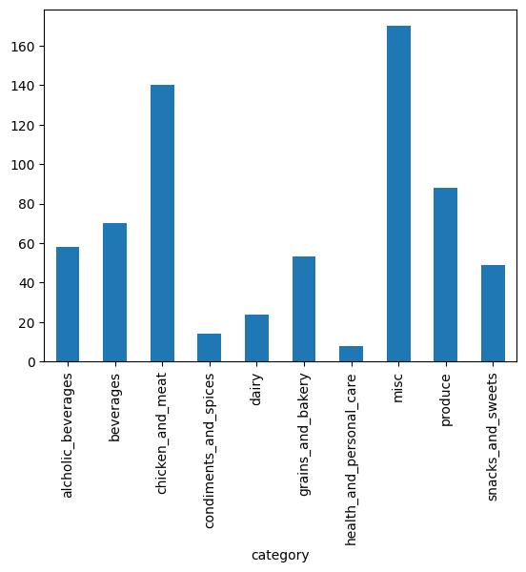
Receipt Item Classification
Classify receipt items into 9 categories: Produce, Dairy, Beverages , etc
Classification Algorithms
K-Nearest Neighbors
Logistic Regression(RNN)
Dataset Size
Training: 540
Testing/Validation: 135

Slide 10
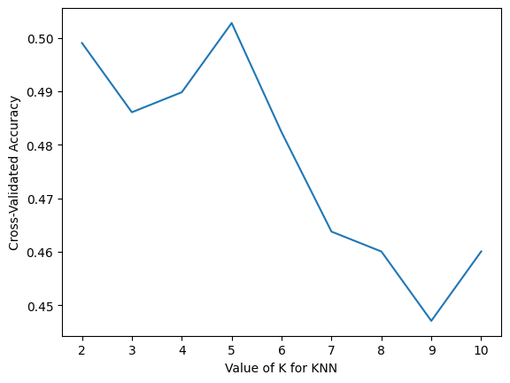
Classification With K-NN Algorithm
Results on Test Data
Optimal K: 5 Neighbors
Accuracy: 55.6 %
Precision: 59.6% %
Recall: 55.6 %
F1-Score: 54.24 %

Slide 11
Classification with RNN
Training
Results
Number of Epochs: 50
Learning: 0.01
Number of Hidden Layers: 2
Accuracy: 48.2 %

Slide 12
Clustering: Retrieving Similar Receipts
K-Means

Slide 13
Retrieving Similar Items
Given an item, retrieve similar items

