Slide 1
Receipt Data Extraction and Classification
Albert IRADUKUNDA

Slide 2
Goals
Extracting Data
Receipt Items Classification
Finding similar Items

Slide 3
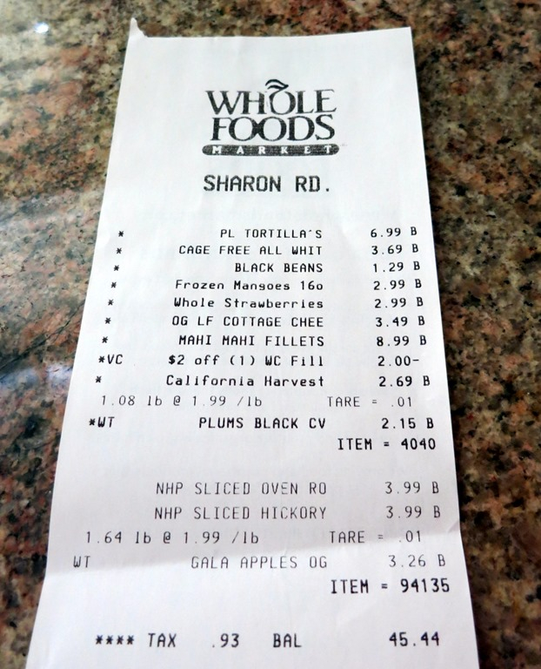
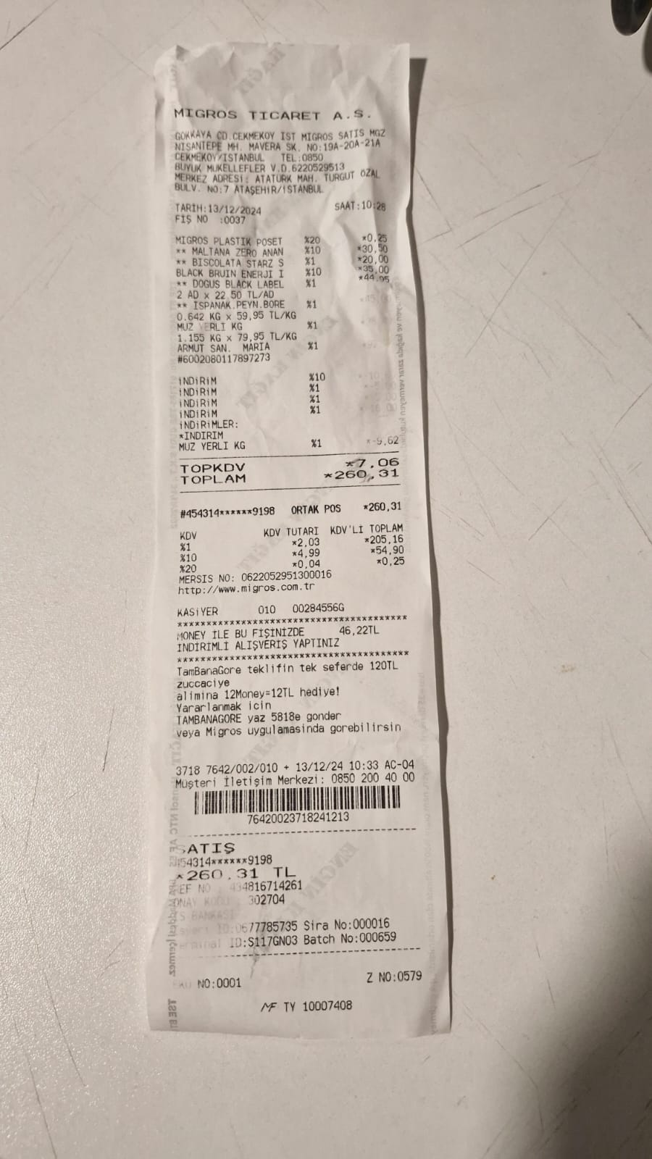
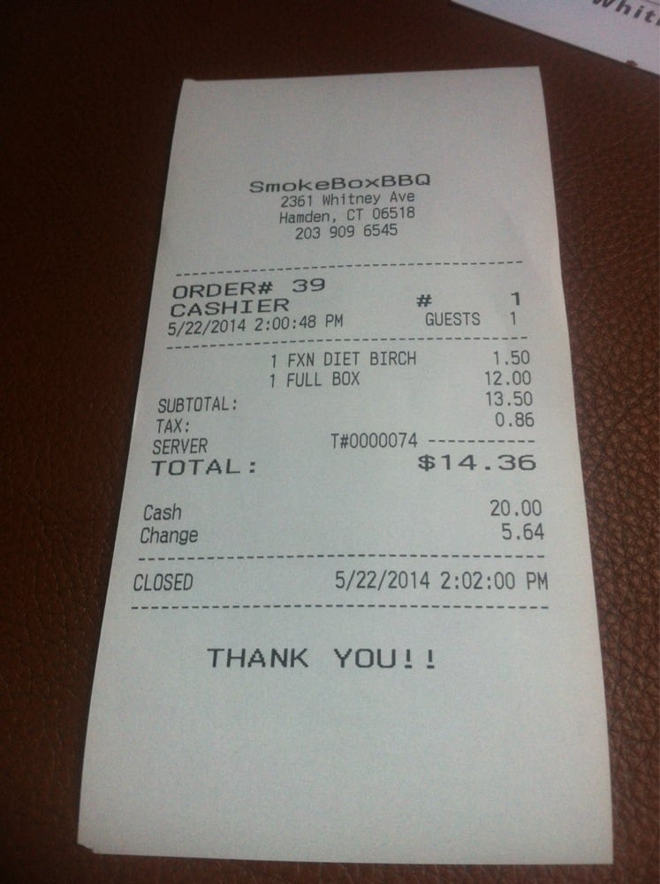
Data used in the Project
34 Groceries Receipt Imges
200 Restaurant Receipt Images

Slide 4
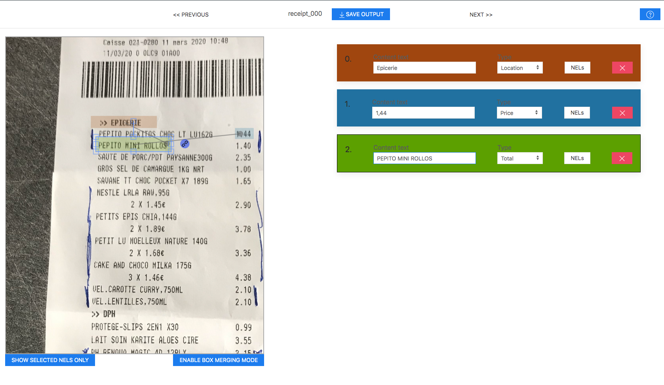
Pre-processing
Receipt Picture Annotation
{
"id": 0,
"text": "2001 Greenville Ave, Dallas, TX 75206",
"label": "location",
"box": [
100,
200,
400,
220
],
"linking": []
}

Slide 5
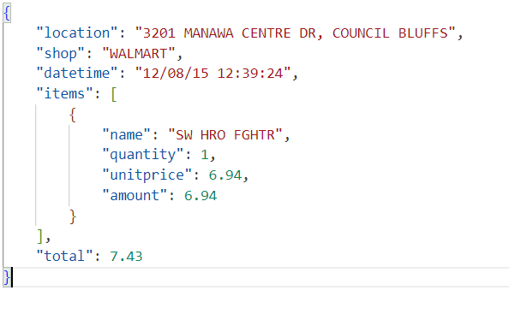
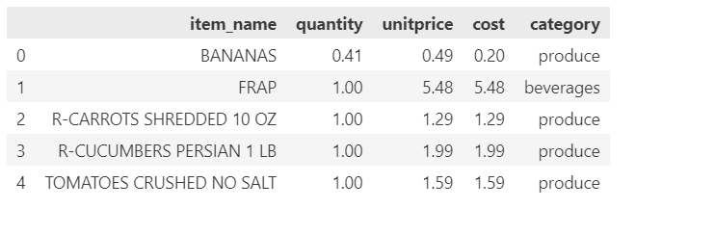
Pre-processing
Annotation and Item Labeling

Slide 6
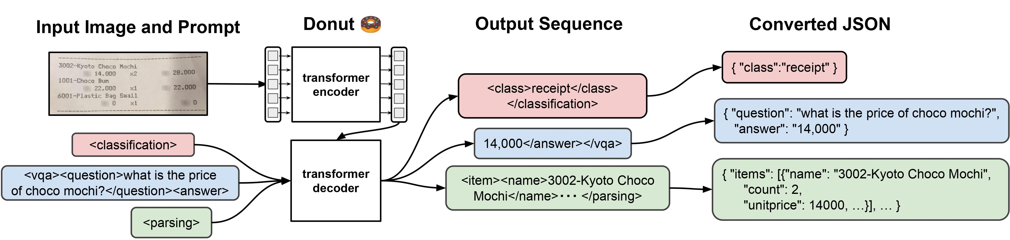
Data Extraction with Donut Model
Donut is a pretrained model Document Understanding Transformer
Capabilities:
Image Classification
Visual question and answering
OCR Document Understanding

Slide 7
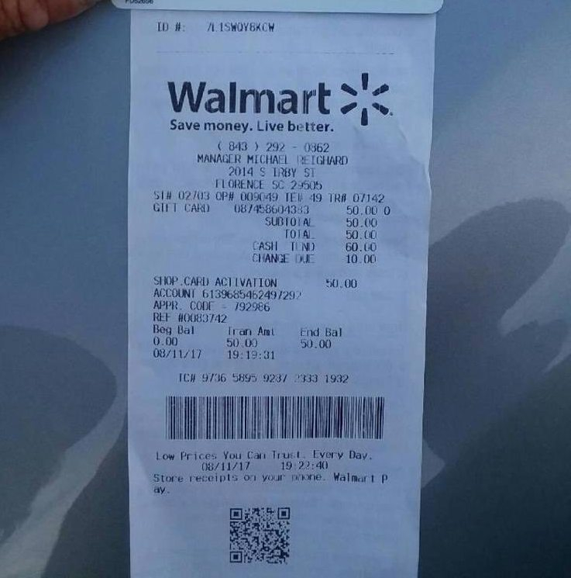
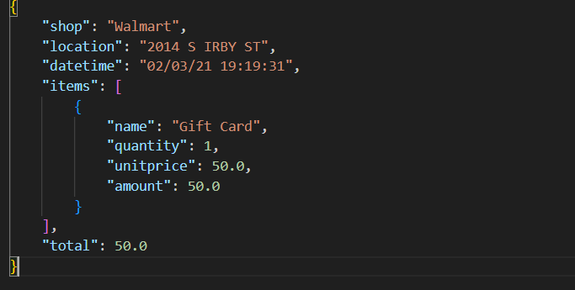
Fine-tuning Donut Model with Hugging Face Transformers library
Input
Ouput

Slide 8
Training and Results
Calculation of Accuracy
Compare the predicted value for each key in the dictionary to check if they are equal.
Only exact string matches are considering as truthy
Accuracy of 59.33% is quite good since only string matches is considered
Accuracy: 59.33%

Slide 9
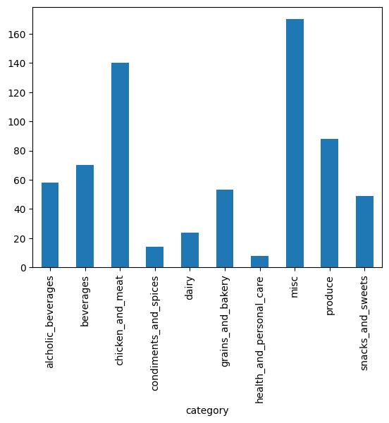
Receipt Item Classification
Classify receipt items into 9 categories: Produce, Dairy, Beverages , etc
Classification Algorithms
K-Nearest Neighbors
Logistic Regression(RNN)
Dataset Size
Training: 540
Testing/Validation: 135

Slide 10
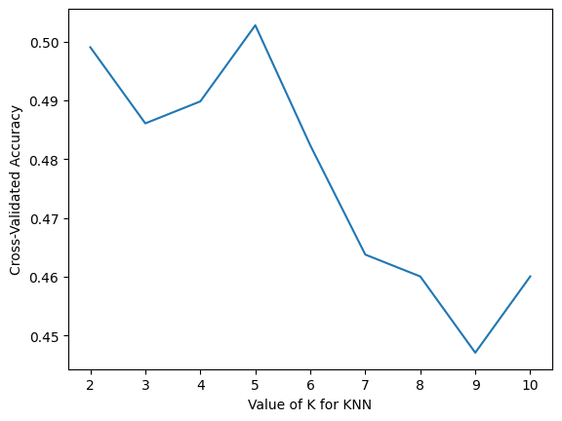
Classification With K-NN Algorithm
Results on Test Data
Optimal K: 5 Neighbors
Accuracy: 55.6 %
Precision: 59.6% %
Recall: 55.6 %
F1-Score: 54.24 %

Slide 11
Classification with RNN
Training
Results
Number of Epochs: 50
Learning: 0.01
Number of Hidden Layers: 2
Accuracy: 48.2 %

Slide 12
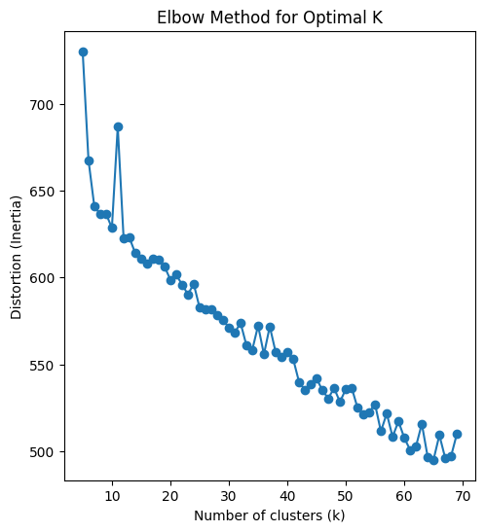
Clustering all Items with K-Means
Number of Clusters and total average distance
Chosen K: 40 clusters
Finding Similar Items
Calculate the cluster of the Item
Get Items in that cluster

Slide 13
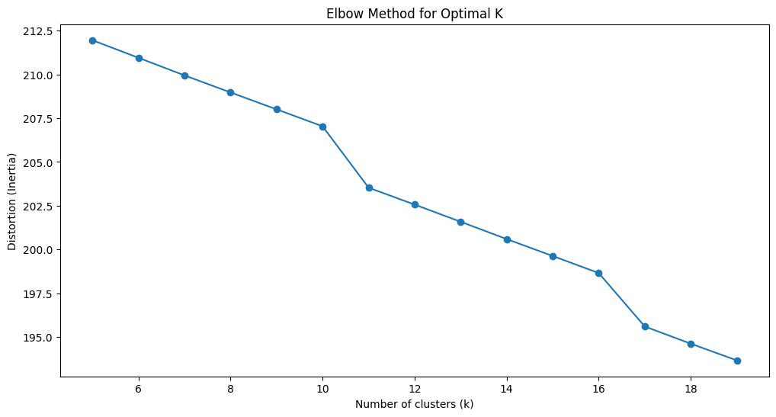
Clustering Receipt Images
Extract the text from receipts
Vectorize them
Cluster the vectorized texts with K-means
K: 11 Clusters
Find similar receipt given an Image or Text extracted from the receipt

