Slide 1
Receipt Data Extraction and Classification
Albert IRADUKUNDA

Slide 2
Goals
Data Extraction with Vision
Receipt Items Classification (K-NN & NN)
Finding similar Items using K-means clustering

Slide 3
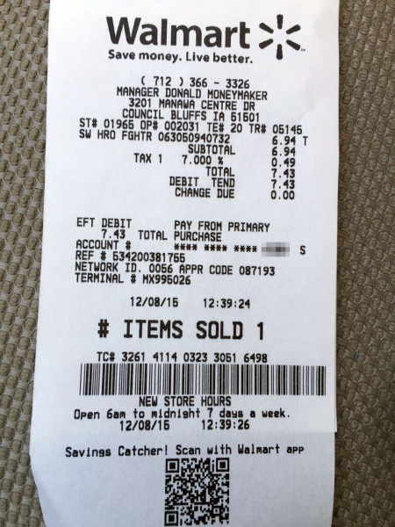
Data Annotation
{
"id": 0,
"text": "2001 Greenville Ave, Dallas, TX 75206",
"label": "location",
"box": [
100,
200,
400,
220
],
"linking": []
}

Slide 4
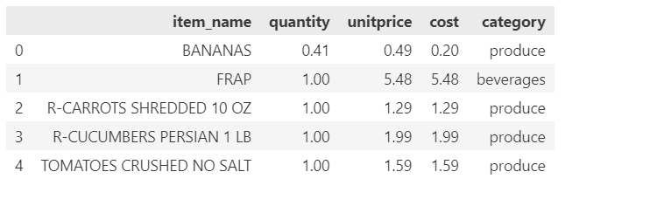
Pre-processing
{
"location": "3201 Manawa Centre Dr, Council Bluffs, IA 51501",
"shop": "WALMART",
"datetime": "12-08-15 12:39:24",
"items": [
{
"name": "ST# 01966 OP# 002033 TE# 20 TR# 05145",
"quantity": 1,
"unitprice": 6.94,
"amount": 6.94,
"category": "misc"
}
],
"total": 7.43
}

Slide 5
Feature Extraction using a Pretrained CV Model
Fune-Tuning pytorch vision model for data extraction

Slide 6

Receipt Item Classification
Classify receipt items into 9 categories: Produce, Dairy, Beverages , etc
Logistic Regression
Training Data
K-nearest Neighbors

Slide 7
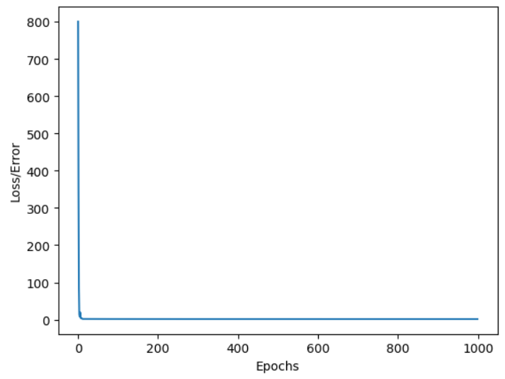
Logistic Regresssion NN without Text Processing
Model Description
No. of Hidden Layers: 64
Learning Rate: 0.01
No of Epochs: 100
Performance
Accuracy: 40%
Precision:
Recall:

Slide 8
Classification With K-NN Algorithm

Slide 9
Finding Similar Items with K-means Clustering

