Slide 1
ADVENTIST UNIVERSITY OF CENTRAL AFRICA · MSc BIG DATA ANALYTICS
People Analytics:
Who's a Flight Risk?
Employee attrition prediction and segmentation
GROUP 8 Shimwa Uwase Sylvie · Ishimwe Divin Claudel · Mpayimana Iradukunda Robert · Hirwa Fabrice
Machine Learning · Lecturer: Dr. Lema Logamou Seknewna · September 2026
Notes:
Good morning. We are Group 8. Our project asks a simple HR question: using information a company already has, can we tell who is likely to leave — and explain why the model thinks so?

Slide 2
THE PROBLEM
Why attrition is worth modelling
1
Operational disruption
Work stalls when a role sits empty.
OUR BUSINESS QUESTION
2
Recruitment cost
Which employee characteristics and segments are associated with attrition — and can machine learning usefully predict who is likely to leave?
Sourcing, interviewing and onboarding a replacement.
3
Knowledge loss
Experience and client relationships walk out the door.
4
Pressure on the team
Remaining staff absorb the extra workload.
Notes:
Turnover is expensive and disruptive. HR usually learns about it only when the resignation arrives. Our question is whether the data already sitting in the HR system carries an earlier signal.

Slide 3
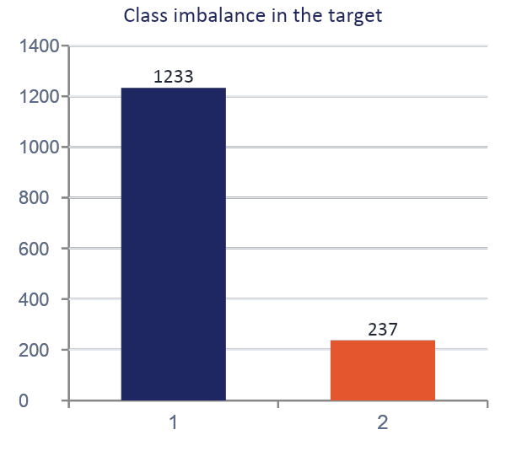
THE DATA
1,470 employees, 35 variables
1,470
35
16.12%
employee records
original variables
left the company
IBM HR Analytics Employee Attrition & Performance — a public, synthetic dataset covering demographics, job information, satisfaction ratings, compensation, workload and tenure.
Target: Attrition (0 = Stayed, 1 = Left)
Notes:
Only 237 of 1,470 employees left — about one in six. That imbalance drives every modelling decision that follows.

Slide 4
DATA PREPARATION
What we checked before modelling
Missing values
Duplicate rows
None found
None found
Constant columns
Identifier
EmployeeCount, Over18, StandardHours — dropped
EmployeeNumber dropped: a tag, not a characteristic
Outliers
Encoding
Investigated, then kept — extreme is not the same as wrong
Text categories converted to numbers: 31 → 45 columns
All scaling and encoding for the predictive models runs inside a pipeline fitted on the training data only — so the test set never leaks into training.
Notes:
Note the outlier decision: a 30-year employee or a very high salary is unusual but legitimate. Deleting those rows would have biased the analysis.

Slide 5
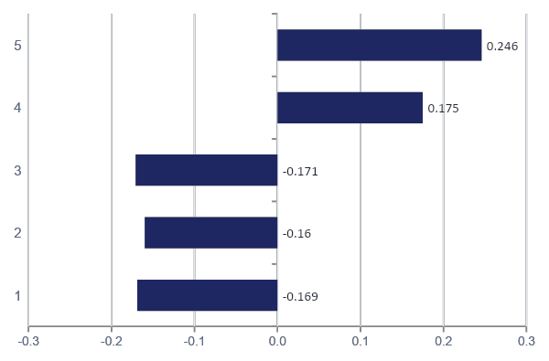
EXPLORATORY ANALYSIS
No single factor explains attrition
Reading the heatmap
Every correlation sits below 0.3 in absolute value.
OverTime is the strongest single signal at +0.246.
Being single, junior, newer and lower-paid also lean toward leaving.
Attrition is a combination of pressures, not one cause.
Correlation is association, not causation.
Notes:
The important message here is that there is no silver bullet variable. That is exactly why a model that combines many weak signals is useful.

Slide 6
UNSUPERVISED LEARNING
Building employee personas
Engagement
Satisfaction
JobInvolvement
JobSatisfaction · EnvironmentSatisfaction · RelationshipSatisfaction · WorkLifeBalance
Workload
Tenure
OverTime
TotalWorkingYears · YearsAtCompany · YearsInCurrentRole · YearsSinceLastPromotion · YearsWithCurrManager
11 features · Attrition deliberately excluded. The algorithm never saw who left, so the personas are built independently of the outcome. All features standardised before PCA and K-Means.
Notes:
This is the key design choice of the unsupervised section: hide the answer, then check afterwards whether the groups differ in attrition.

Slide 7
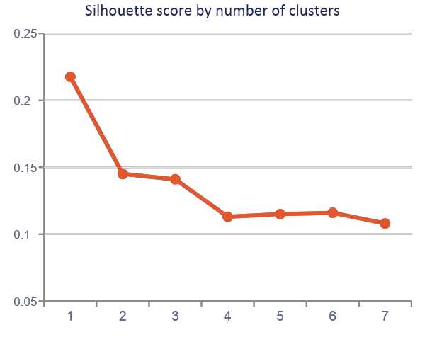
UNSUPERVISED LEARNING
PCA and choosing the number of clusters
PCA — what varies between employees
85.39%
of total variance captured by the first 7 components (first two: 40.67%).
PC1 — tenure and experience
YearsAtCompany 0.505 · YearsInCurrentRole 0.468 · YearsWithCurrManager 0.464
PC2 — workload and satisfaction
OverTime 0.688 · EnvironmentSatisfaction 0.560 · RelationshipSatisfaction 0.449
K = 2 scored highest (0.2176) — but a low score means broad, overlapping segments, not sharply separate employee types.
Notes:
We tested K from 2 to 8 using inertia and silhouette. K=2 won, but we are honest that 0.2176 is a weak separation.

Slide 8
THE RESULT
Two employee personas
Persona 1 — Early tenure
Persona 2 — Experienced, long tenure
957 employees (65.1%)
513 employees (34.9%)
Avg. total working years
8.56
Avg. total working years
16.35
Avg. years at company
3.73
Avg. years at company
13.13
Observed attrition rate
18.81%
Observed attrition rate
11.11%
A 7.70 percentage-point gap — found without ever showing the algorithm who left. Descriptive, though: short tenure is not proven to cause leaving.
Notes:
The clustering split the workforce by tenure, not by satisfaction. And the early-tenure group leaves at nearly twice the rate.

Slide 9
SUPERVISED LEARNING
How we set up the prediction task
1
Binary target
0 = Stayed, 1 = Left
WHY NOT ACCURACY?
2
Stratified split
A model that predicts "nobody ever leaves" is already 83.9% accurate — and completely useless.
80% train / 20% test, class proportions preserved
3
Class weighting
class_weight = 'balanced' so leavers are not ignored
4
5-fold CV + grid search
We judge models on precision, recall, F1 and PR-AUC, with F1 as the decision criterion.
Tuned on the training set only, optimising F1
5
Test set locked away
Never touched during preprocessing, CV or tuning
Notes:
Because the class is imbalanced, accuracy flatters lazy models. F1 balances catching leavers against raising false alarms.

Slide 10
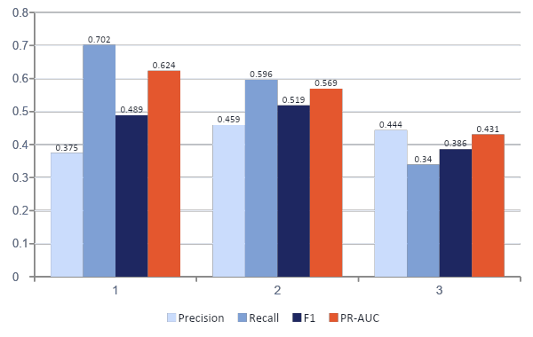
RESULTS
Three models compared on the held-out test set
The accuracy trap
Random Forest has the highest accuracy (0.827) and the worst F1 (0.386) — it catches only 34% of leavers.
Logistic Regression catches the most leavers (recall 0.702) but flags far more people wrongly.
SVM gives the best balance: F1 = 0.519.
Notes:
Look at Random Forest: the best accuracy on the slide belongs to the weakest model for our actual job. That is the imbalance problem made visible.

Slide 11
MODEL SELECTION
Final model: Support Vector Machine
0.823
0.459
0.596
0.519
0.569
Accuracy
Precision
Recall
F1-score
PR-AUC
What these numbers mean in HR terms
Recall 0.596 — of the employees who actually left, the model flagged about 6 in 10 in advance.
Precision 0.459 — of the employees it flagged, a little under half actually left; the rest are false alarms.
Logistic Regression had a better PR-AUC (0.624). It would be the better pick if an organisation decided missed leavers cost far more than false alarms — a business trade-off, not a technical one.
Notes:
We chose SVM on F1 because our stated objective was balance. We name the alternative openly, because the right choice depends on what HR wants to optimise.

Slide 12
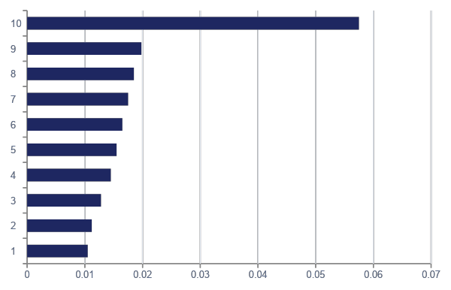
INTERPRETATION · SHAP
What drives the model's predictions
Why SHAP?
An SVM has no built-in feature importance, so we used a SHAP KernelExplainer.
Encoded categories were aggregated back to the original HR variables so the output is readable.
OverTime dominates — but SHAP explains the model, not the world. This is not proof that overtime causes people to quit.
Notes:
OverTime has by far the largest average contribution, roughly three times the next feature. We repeat the causal caveat every time we show this.

Slide 13
INTERPRETATION · INDIVIDUAL
Explaining one employee: #357
What pushed the prediction up
93.1%
OverTime
Age
Yes
21
predicted probability of leaving
EnvironmentSatisfaction
TotalWorkingYears
1 (lowest)
3
BusinessTravel
JobRole
Predicted outcome: Left
Actual outcome: Left
Travel_Frequently
Sales Representative
StockOptionLevel
MonthlyIncome
0
2,174
A young, junior, frequently-travelling employee with low satisfaction and no equity stake. A manager can act on that sentence — they cannot act on "0.931".
Notes:
This is the point of the interpretation work: turning a probability into a profile a human being can actually respond to.

Slide 14
BEING HONEST
Limitations, ethics and HR implications
Imbalanced data
Only 16.12% of employees left — minority-class prediction stays hard.
USE IT AS
An early-warning signal that prompts a conversation, a check-in, or a look at workload in a team.
The model is wrong often
It misses roughly 4 in 10 leavers and raises false alarms on more than half of the people it flags.
Overlapping personas
A silhouette of 0.2176 means broad tendencies, not clean employee types.
NEVER AS
A label on an individual, or a basis for pay, promotion or termination decisions.
No causation
SHAP explains model behaviour. It does not prove that overtime, or age, makes anyone leave.
Notes:
A false positive here is a real person quietly written off by a machine on the strength of a near coin-flip prediction. That is why the human stays in the loop.

Slide 15
What we found
1
Two personas
Early-tenure staff are 65.1% of the workforce and leave at 18.81%, against 11.11% for long-tenure staff.
2
One model
SVM, chosen on F1 = 0.519, catches about 60% of leavers at 46% precision.
3
One explanation per person
SHAP turns each score into a readable profile — OverTime leading overall.
Machine learning gives HR an earlier question to ask — not an answer about a person.
Notes:
To close: the value of this project is an earlier question, asked of the right group of people, with a reason attached.

Slide 16
THANK YOU
Group 8 contributions
Mpayimana Iradukunda Robert
20251MBI029
Data & Cleaning Lead
Ishimwe Divin Claudel
20251MBI017
Unsupervised Learning Lead
Shimwa Uwase Sylvie
20251MBI007
Supervised Learning Lead
Hirwa Fabrice
20251MBI050
Story & Interpretation Lead — SHAP, report, slides
Questions?
Notes:
Thank you. We are happy to take questions on the modelling choices or the interpretation.

