Slide 1

SMALL AI FOR DEVELOPMENT · RWANDA
AMR-Edge
Small AI that reads the existing mechanical water meters.
0
0
4
2
7
6
1
.
m³
Automatic meter reading, done on the meter itself
Jean Claude Iradukunda
MSECE student | CMU-Africa
Notes:
[0:00–0:08] Hello, I am Jean Claude Iradukunda. AMR-Edge is small AI that reads the water meters Rwanda already has, automatically, on the meter itself.

Slide 2
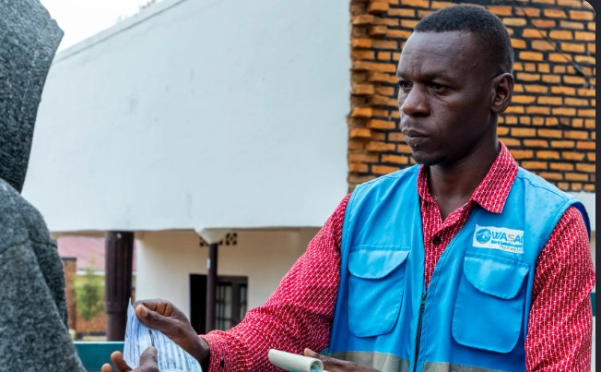
Nearly 4 in 10 litres of treated water earn nothing
THE PROBLEM
37.8%
of WASAC’s treated water brings in no money (as of June 2025)
Source: JICA Project Brief Note, “The Project for WASAC Utility Turnaround with Kaizen Approach” (Jul 2025), p. 1
Government target: cut losses to 25% by 2029
Source: The New Times, “Major water projects to double supply by 2029” (Jul 2026)
WASAC water connections: 336,956, each read by hand
Source: RURA, Water Statistics Quarterly Report, Q4 2023
Today: a site visit, a look at the dials, a paper slip
1
Read by hand
2
Time-consuming
3
Revenue waits
4
Higher cost
Agents travel to every meter, home by home, every billing cycle
One visit per meter, every cycle, before the bills can go out
Customers pay only after the bill arrives, so slow reading delays WASAC’s cash
Staff time and transport for every visit raise operating costs
Notes:
[0:08–0:30] Nearly four in ten litres of WASAC’s treated water bring in no money: 37.8 percent as of June 2025, according to JICA’s WASAC Utility Turnaround project brief. The government wants that down to 25 percent by 2029. Leaking pipes are WASAC’s biggest loss, and JICA is already helping fix them. We focus on a different gap: about 337,000 connections are still read by hand. An agent must travel to every meter, every billing cycle, before bills can go out. That takes time; customers pay only after the bill arrives, so revenue waits; and the staff time and transport for every visit add to operating costs.

Slide 3
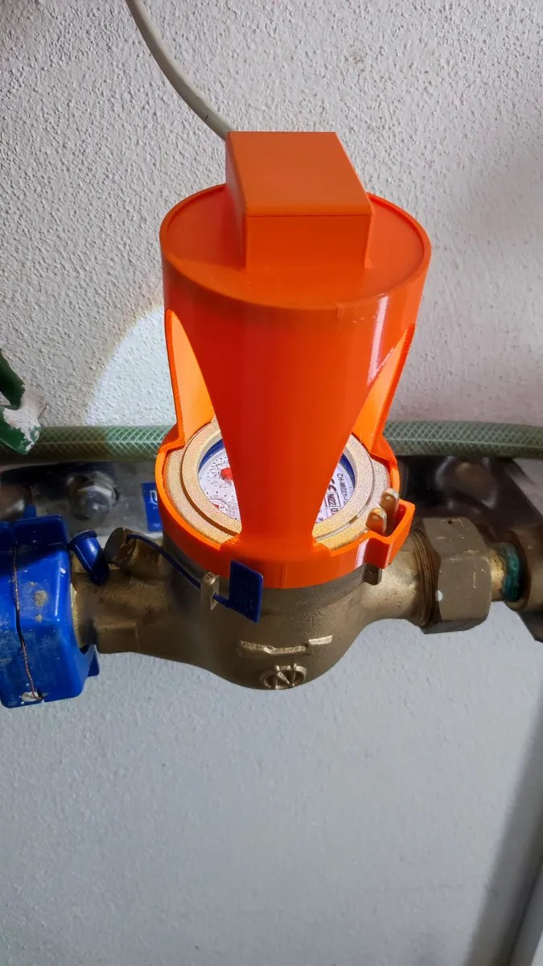
A clip-on AI reads the meters already installed
THE SOLUTION
ON THE METER · ESP32-S3 + 20KB INT8 MODEL
MOBILE NETWORK → WASAC
1
2
3
4
5
6
Capture
Locate
Read
Seal
Send
Act
Camera takes a picture of the meter
Finds where the digits are
Small AI reads each digit, on the device
Only the number is kept, then locked and signed
Sent once a day over the mobile network
WASAC bills, spots leaks, texts the customer
Non-invasive
Low power
Private
Inclusive
Clips over the existing meter. No pipe cutting, no new meter
Wakes once a day to read, then sleeps. Built for battery power
No photos leave the house: the AI reads on the device and sends only the number
Readings and leak alerts by SMS, on any basic phone
TAMPER-AWARE
BUILT
PILOT
WITH WASAC
Cheating is spotted within a day
Each reading is locked and signed; copied or backwards readings are flagged
Seal on the clip; alert if the camera is covered or removed
Area supply meter vs. its homes’ total exposes bypass pipes
Clips on. No plumbing.
Notes:
[0:30–1:00] AMR-Edge clips over the meter WASAC already installed: no plumbing, no new meter. Once a day a camera takes a picture of the dials, and a small AI on the device reads each digit. No photo ever leaves the house: only the number is sent, locked and signed, over the mobile network. WASAC bills it, spots leaks, and texts the customer on any basic phone. It is also tamper-aware: copied or backwards readings are already flagged, the pilot adds a seal and a covered-camera alert, and comparing an area’s supply meter with its homes exposes bypass pipes.

Slide 4
Billing without the walk, proven side by side
WHY WASAC · AND HOW WE GET THERE
Bills out sooner
Revenue comes in faster
Lower reading cost
Keeps today’s meters
Readings arrive automatically, so bills can go out the day the cycle closes
Earlier bills mean earlier payments and steadier cash flow for WASAC
No trip to every meter; staff time goes to repairs and customers
Clips onto installed meters; billing stays postpaid and water keeps flowing
ROADMAP · TARGET DATES
1
2
3
4
5
Validate
Side-by-side trial
Prove
Paid pilot
Scale
Nov–Dec 2026
Q1 2027 · 3 months
Q2 2027
H2 2027
2028 onward
Test on real meters; learn from WASAC the cost and time of manual reading, and meter models
50 meters in one branch. Agents keep reading; we compare every reading
Pass if ≥ 99% of reads match manual and ≥ 95% arrive daily
500 accounts linked to WASAC billing; measure days saved per cycle
Branch by branch, priced below the cost of a manual read
Notes:
[1:00–1:30] Why would WASAC care? Readings arrive automatically, so bills can go out the day the cycle closes. Earlier bills mean earlier payments and steadier cash flow. No trip to every meter lowers reading cost, and staff time goes to repairs and customers. And it clips onto the meters WASAC already owns: billing stays postpaid and the water keeps flowing. We are not asking WASAC to trust us. First we validate on real meters and learn what a manual reading costs. Then a three-month side-by-side trial on 50 meters, where agents keep reading and we compare every reading. If we match at least 99 percent and deliver 95 percent of daily readings, we move to a paid pilot, and scale only if we cost less than a manual read. Thank you.

