Slide 1


Slide 2
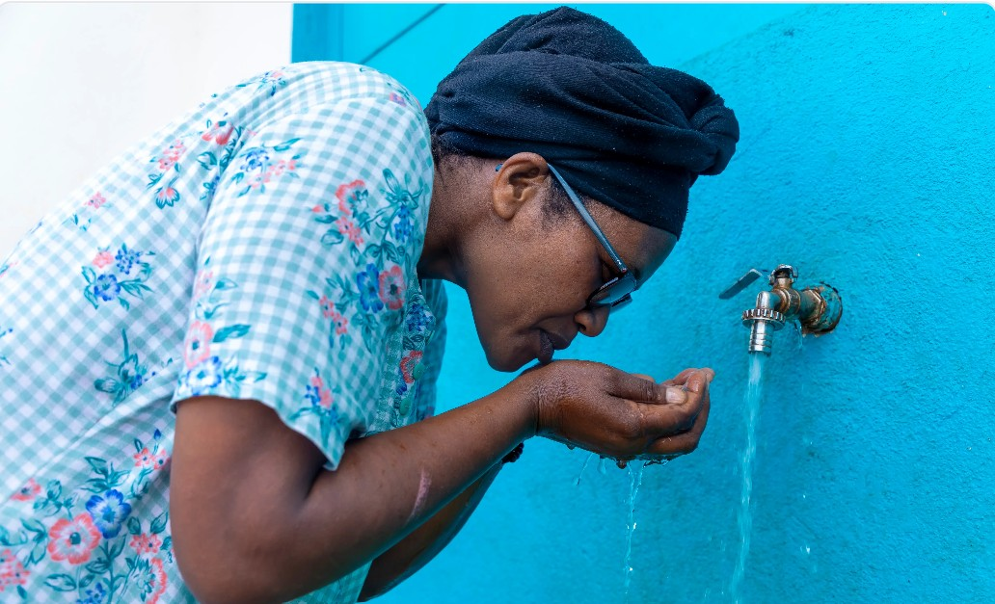
HEALTH TRACK · SMALL AI FOR DEVELOPMENT
Water is life.
Every lost litre is lost health.
Clean, affordable piped water is the first line of public health: hygiene, nutrition, safe childbirth and disease prevention all depend on a tap that keeps running.
Hygiene
Children
Clinics
handwashing stops diarrhoeal disease
school time, not water fetching
safe care needs reliable supply
AMR-Edge Rwanda
amr-edge.zolilabs.com
Notes:
Open with people, not technology. Safe, continuous piped water underpins health: hygiene, nutrition, maternal and child health. In Rwanda that water is delivered by WASAC, and the way it is metered today quietly undermines access.

Slide 3
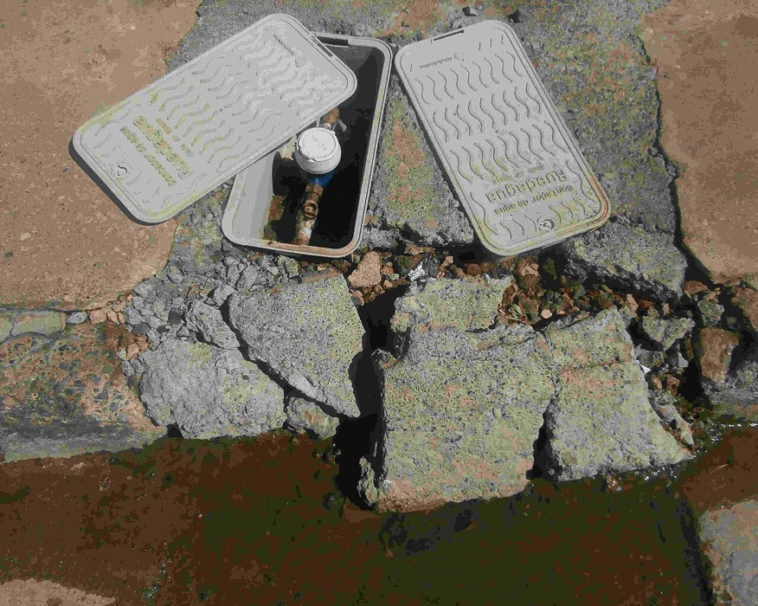
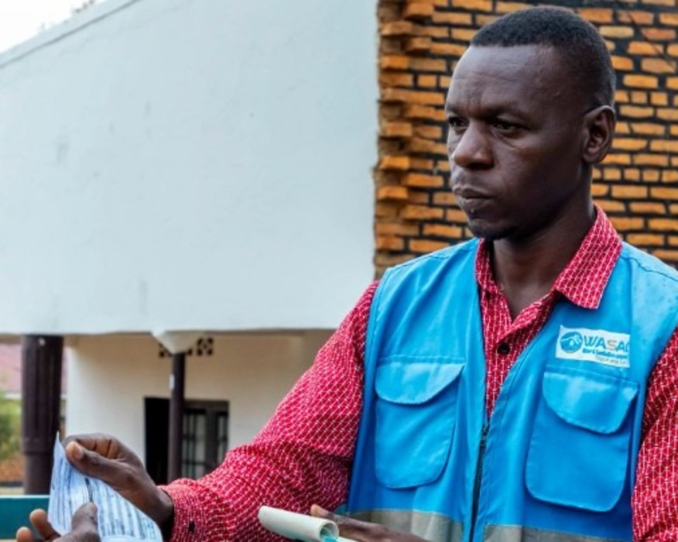
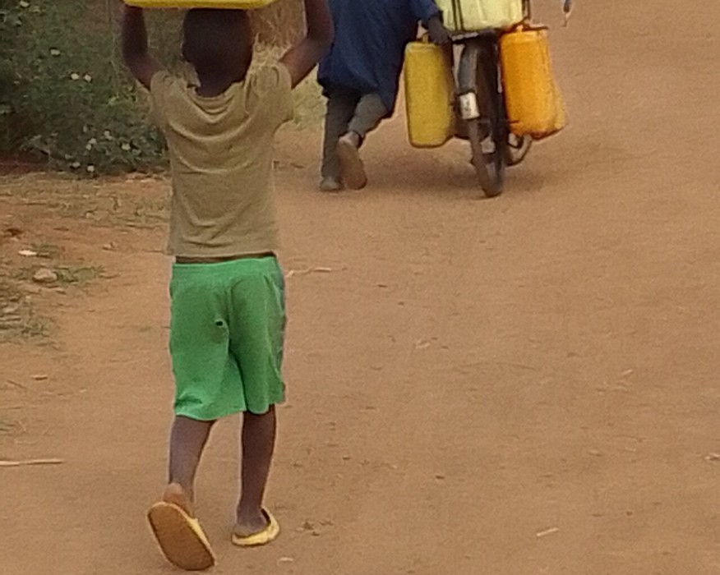
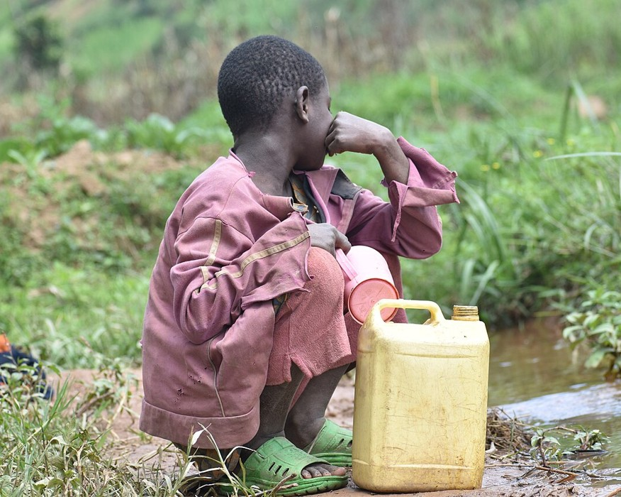
THE PROBLEM
Health starts at the tap: how one hidden leak ends in disease
AMR-Edge stops it here
Waterborne disease
Health cost
paid by the poorest households
1
Hidden leak
2
Huge bill
3
Disconnected
4
Unsafe water
5
Disease
A pipe breaks behind the meter. Nobody sees it for weeks.
Read by hand every 30 to 90 days, the leak arrives as one unpayable bill.
The family cannot pay. The tap is cut and children fetch water.
Swamps, open wells and vendors replace treated piped water.
Diarrhoea, typhoid and cholera, hardest on children under five.
Root cause
38–40%
30–90 days
Less reach
!
No automated, real-time metering: agents read every meter by hand
of treated water lost or never billed
before revenue is collected
fewer new pipes to clinics and schools
Photos: Sarang (public domain); NDNT (CC0); Joseph Lionceau, Rugezi Swamp, Rwanda (CC BY-SA 4.0), via Wikimedia Commons. Bill photo: web.
Notes:
Read the chain left to right. One: a pipe breaks behind the meter and nobody sees it. Two: meters are read by hand every 30 to 90 days, so the leak arrives as one unpayable bill. Three: the family cannot pay, the tap is disconnected, and children fetch water. Four: they turn to swamps, open wells and vendors. Five: waterborne disease, diarrhoea, typhoid, cholera, hardest on children under five. The root cause is that there is no automated, real-time metering. The same gap costs WASAC 38 to 40 percent non-revenue water and delays the revenue that would extend safe water to clinics and schools. AMR-Edge breaks the chain at step one.

Slide 4
THE SOLUTION
Small AI at the meter, real-time alerts over cellular
EDGE NODE · ESP32-S3, clips onto the existing meter
CELLULAR
WASAC
1
2
3
4
5
6
Dashboard
billing, alerts
Camera
Find digits
INT8 CNN
Seal 20 B
LTE / 3G
WASAC cloud
Grayscale frame of the meter face
Locates the register wheels (CV)
20 KB model reads each wheel
AES-CTR encrypted, CMAC signed
MQTT over TLS via cell tower
Verify, decrypt, check ledger, leak rules
SMS
basic phones
Night reads at 02:00 and 04:00: flow while the household sleeps triggers an immediate leak alert.
< 24 h
0
20 bytes
SMS
Leak detection
Meter replacements
Per daily reading
Basic phones
instead of the next 30 to 90 day manual visit
reads the mechanical meters already installed
images never leave the home; works on weak coverage
no smartphone, app or data plan needed
Notes:
Walk the diagram left to right. 1: the camera on the existing meter captures a grayscale frame. 2: classical computer vision finds the row of digit wheels. 3: a 20 KB INT8 neural network reads each wheel, with an extra class that rejects marks like CE. 4: the reading is packed into 20 bytes, encrypted with AES-CTR and signed with AES-CMAC. 5: an LTE or 3G modem publishes it with MQTT over TLS through the cell tower. 6: WASAC verifies, decrypts, checks it against the account ledger and applies leak rules, then updates the dashboard and sends the customer an SMS.

Slide 5
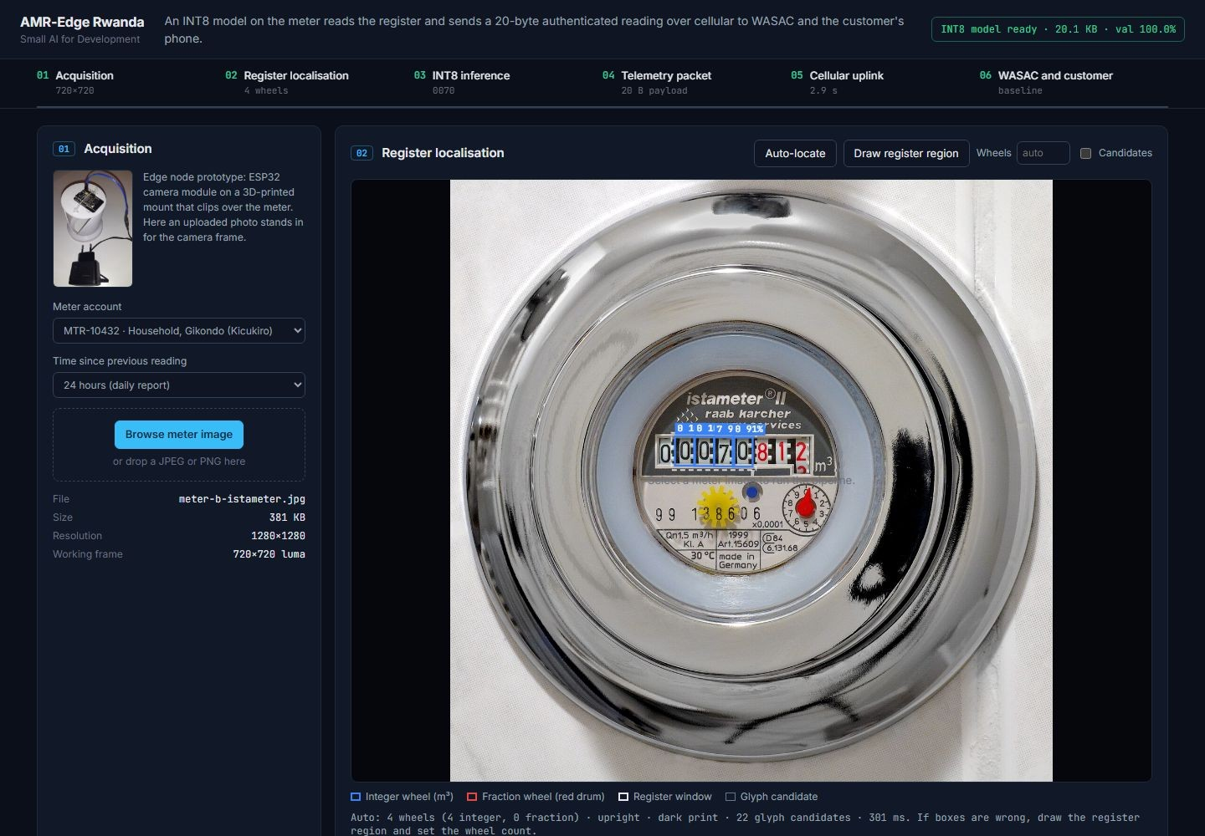
WORKING PROTOTYPE
Built and verified end to end, live today
20.1 KB
INT8 model, 7,867 parameters, 493k MACs per wheel
100%
INT8 accuracy on 3,183 held-out real meter crops
22 / 22
tests pass: bit-exact with TensorFlow Lite, RFC 4493 crypto, MQTT
50 B
MQTT frame per reading, vs 60–100 KB to upload a photo
Live demo amr-edge.zolilabs.com
github.com/iradukunda3546nj/amr-edge-rwanda
Notes:
Everything shown is running code. Upload a photo and the dashboard runs the full pipeline: register localisation, the INT8 model in the browser, the 20-byte encrypted payload, the simulated cellular and MQTT session, and the WASAC decision with the SMS. The browser engine is tested bit-exact against TensorFlow Lite. The cellular network and the WASAC back end are simulated.

Slide 6
IMPACT AND NEXT STEP
Recovered water, recovered revenue, protected access
For a family
Partnership ask
~29 m³ vs ~2,600 m³
We are looking to partner with WASAC Group to take AMR-Edge from prototype to field
A 1.2 m³/h leak caught in one day, instead of running for a 90-day reading cycle. No bill shock, no disconnection.
1
Retrain on real meters
For WASAC
collect images of the meter types installed in Rwanda and retrain the model
≈ RWF 310 M / year
Each 1 percentage point of NRW recovered on 100,000 m³/day of supply, at 852 RWF/m³ (illustrative).
2
Run a supervised pilot
about 200 meters in Gasabo, Kicukiro and Nyarugenge for 90 days
For the network
3
Integrate
Reinvested
WASAC billing and an approved SMS short code
Revenue collected on time funds new distribution lines to underserved homes, schools and clinics.
Figures are illustrative estimates, to be validated in the pilot.
amr-edge.zolilabs.com
Notes:
Close on value. For a family, a leak caught in one day costs about 29 cubic metres instead of about 2,600 over a 90-day cycle, so there is no bill shock and no disconnection. For WASAC, each percentage point of non-revenue water recovered on 100,000 cubic metres a day is roughly 310 million francs a year at 852 francs per cubic metre, an illustrative figure. That revenue funds expansion. Our ask: partner with WASAC Group to retrain the model on the meters actually installed in Rwanda, run a supervised pilot, and integrate billing and SMS.

