Slide 1

Financial Analytics

Slide 2

Team Members
1. Harsh Balani
2. Jalpa Tank
3. Megha Chaudhari
4. Rahil Pancholi
5. Siddharth Mahidhar

Slide 3
Agenda
Introduction
Company Valuation
Competitors
Market Share
Balance Sheet
Ratio Analysis
Recommendation

Slide 4

Introduction
Established in 1886, Johnson & Johnson is a global healthcare company.
A portfolio including a variety of medications, medical equipment, and consumer healthcare products.
A large presence in North America with shares that are traded on the NYSE.
Consistently paid dividends in the last three years (2020, 2021, 2022).
Commitment to innovation, R&D, and bettering global health outcomes.

Slide 5
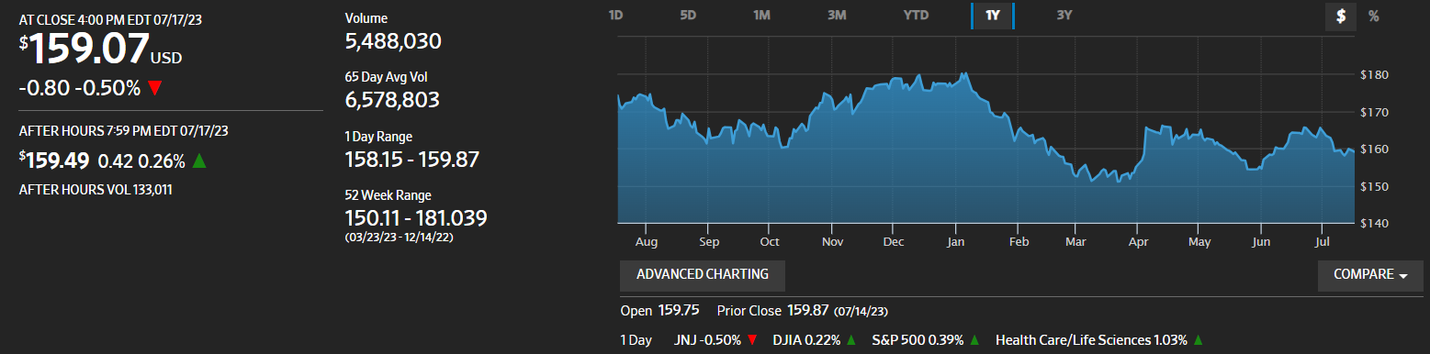
Market Summary

Slide 6
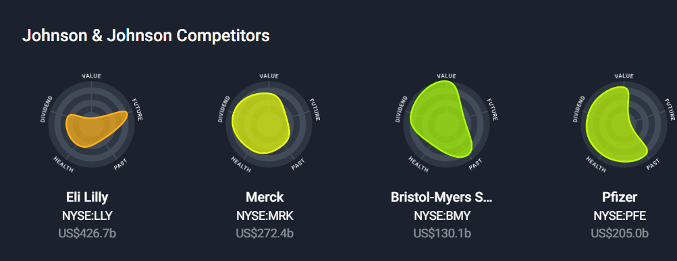
Competitors

Slide 7

Market Share
Johnson & Johnson has an overall market share of approximately 8.44%.
40% of the company's revenue comes from Consumer Health.
35% of the business's revenue is generated by the pharmaceutical sector.
In the United States, Johnson & Johnson has a market share of
42.9% of companies in the OTC acne treatment manufacturing sector
37.2% ,In the contact lens manufacturing sector
32.8% in the cough and cold medicine manufacturing OTC industry
Notes:
https://www.macrotrends.net/stocks/charts/JNJ/johnson-johnson/market-cap

Slide 8
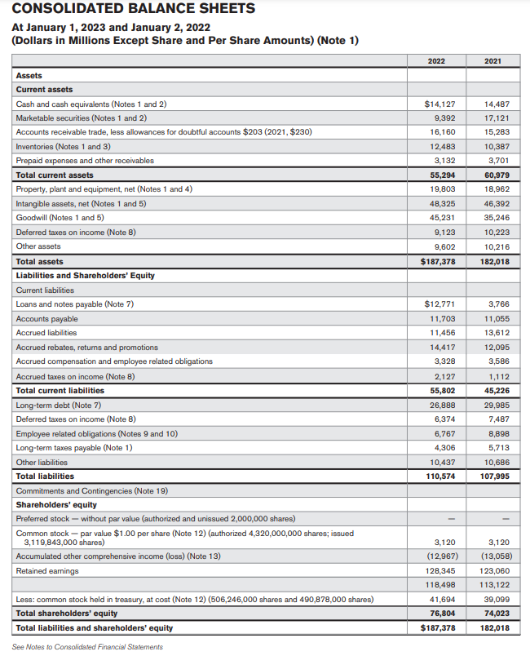
Balance Sheet
https://www.investor.jnj.com/asm/2022-annual-report

Slide 9
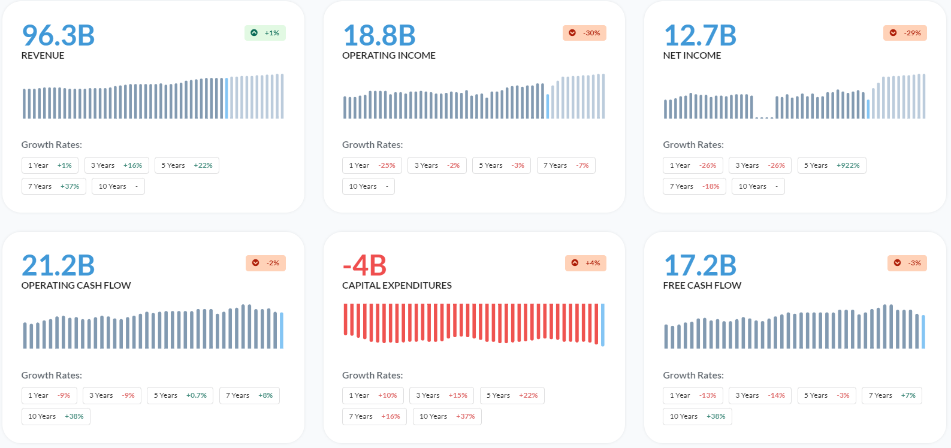
Fundamental Analysis

Slide 10
Ratio Valuation
Current Ratio:0.99
Quick Ratio:0.77
Cash Ratio:0.25
Gross Profit Margin: 67.26%
Return on Asset:9.57%
Return on Equity: 23.36%
Return on Sales:24.97%
P/E Ratio:32.93

Slide 11
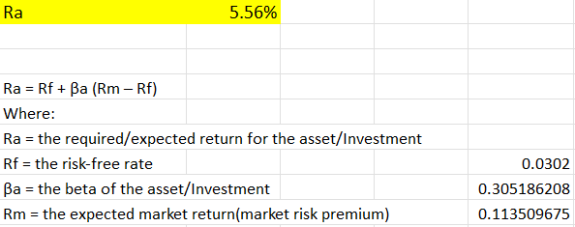
Valuation using CAPM

Slide 12
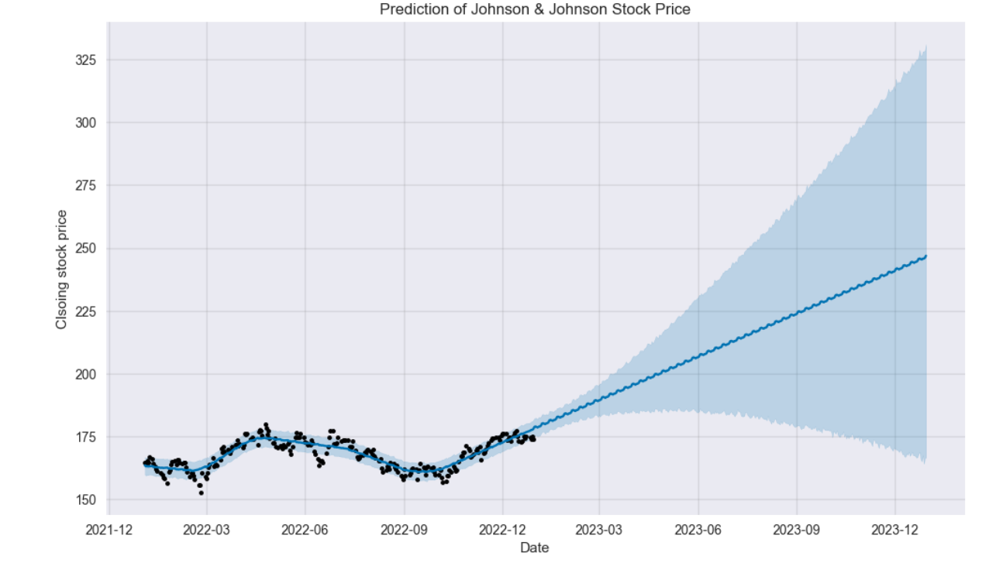
Forecasting using Facebook Prophet

Slide 13

Recommendations
JNJ has a proven track record of success and a diversified business plan.
JNJ stock may be appropriate for long-term investors.
Investors can hold or buy JNJ stocks. According to analysis, JNJ may be a good option for individuals looking to buy and hold for the long term.

Slide 14
References
https://www.alphaspread.com/security/nyse/jnj/summary
https://www.investor.jnj.com/asm/2022-annual-report
https://finance.yahoo.com/quote/JNJ?p=JNJ
https://www.macroaxis.com/performance/JNJ/Johnson-Johnson

Slide 15
Thank You!

