Slide 1
Snake Game
A Ruby Terminal Application
Irah Rosete
19 December 2020

Slide 2
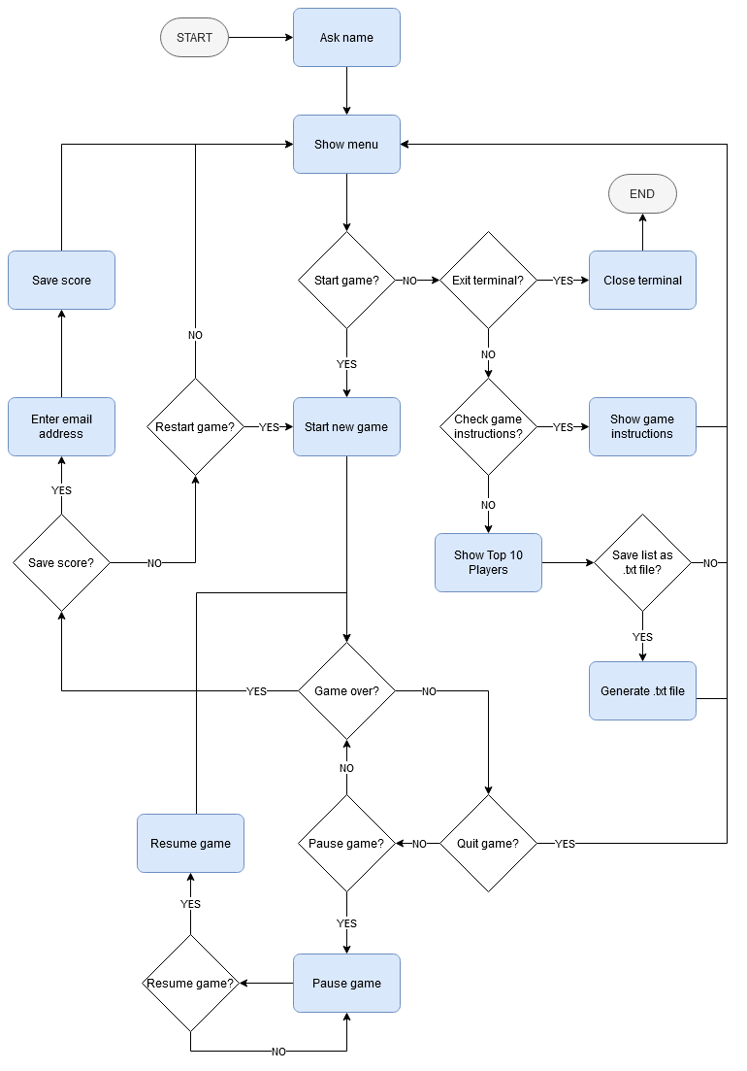
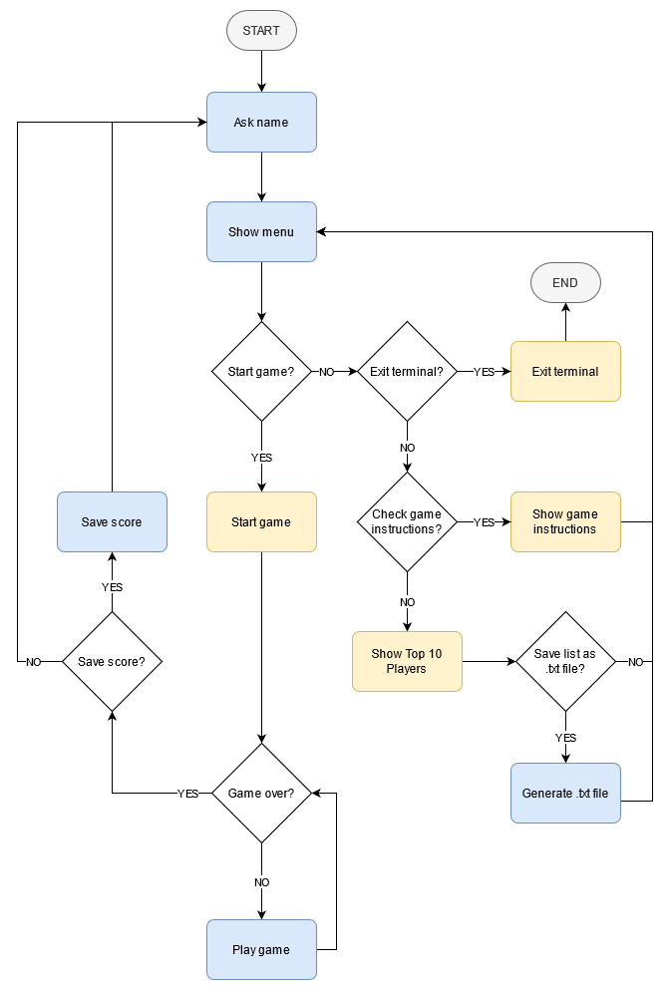
Flow

Slide 3
Features
Menu
Game
User Control
Scoring System
Pause / Resume / Quit
Play Instructions
Top 10 Players
File Output
Notification
Exit

Slide 4
Process
Planning
Initial Code
Blocker
README file
Flow Chart
Implementation Board
Menu - easiest
Hard code:
How to Play instructions
Top 10 Players list
Ruby2D does not work on WSL
Sidetrack: ASCII Art
Plan B: Create the game raw
Notes:
process:
- wrote the README except for the installation section
- flow chart
- implementation board
- created all the menus - easiest part
- finished the how to instructions and started on the top 10 players list
- had to install ruby2d but was not working
- did the ascii art
- ruby2d still not working
- plan B: do it right on the terminal
- created board class - manual
- created snake class - it won't work because the manual board is there
- squares make up the board
- squares make up the snake
- squares make up the prey
- recreated board
- created snake!
- finalised the top 10 players list - used File class
- created the prey class - used Random class
- created the score logic and a final score print
- cannot make new prey to regenerate. had to figure out how to control the snake
- used yaml to create a database of scores. - used File class. read about serialising data
- io class and getch using 'wasd' (daniel's help)
- this allowed me to test that the prey is regenerating
- formatted the .txt output for the top 10 (also daniel's help)
- catch new score and player name to determine new top 10

Slide 5
Process
Serious Code
Another Blocker
Unresolved Blockers
Board class
Snake class
Used File class to the Top 10 Players list
Prey class and Random class
Scoring system logic
User control
Sidetrack: YAML to create a database for Top 10 Players
Assistance on:
IO/console getch
.txt content format
Regenerate prey
Make the snake move
Catch new score and player name to determine new Top 10
Notes:
process:
- wrote the README except for the installation section
- flow chart
- implementation board
- created all the menus - easiest part
- finished the how to instructions and started on the top 10 players list
- had to install ruby2d but was not working
- did the ascii art
- ruby2d still not working
- plan B: do it right on the terminal
- created board class - manual
- created snake class - it won't work because the manual board is there
- squares make up the board
- squares make up the snake
- squares make up the prey
- recreated board
- created snake!
- finalised the top 10 players list - used File class
- created the prey class - used Random class
- created the score logic and a final score print
- cannot make new prey to regenerate. had to figure out how to control the snake
- used yaml to create a database of scores. - used File class. read about serialising data
- io class and getch using 'wasd' (daniel's help)
- this allowed me to test that the prey is regenerating
- formatted the .txt output for the top 10 (also daniel's help)
- catch new score and player name to determine new top 10

Slide 6
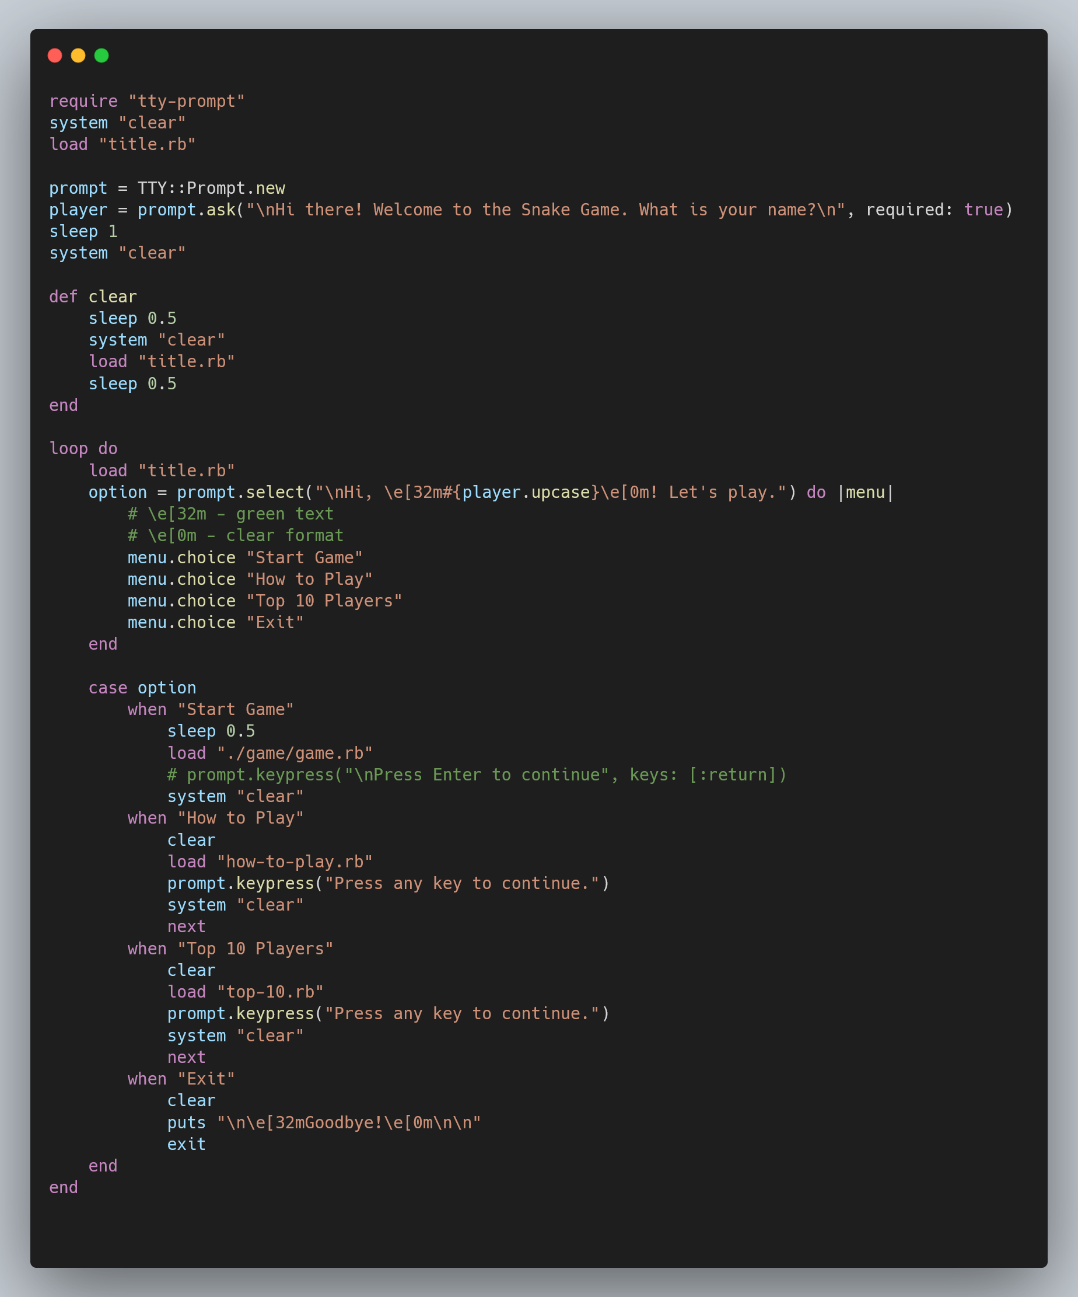
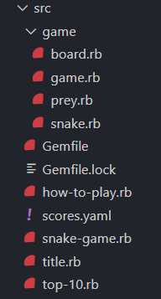

Slide 7
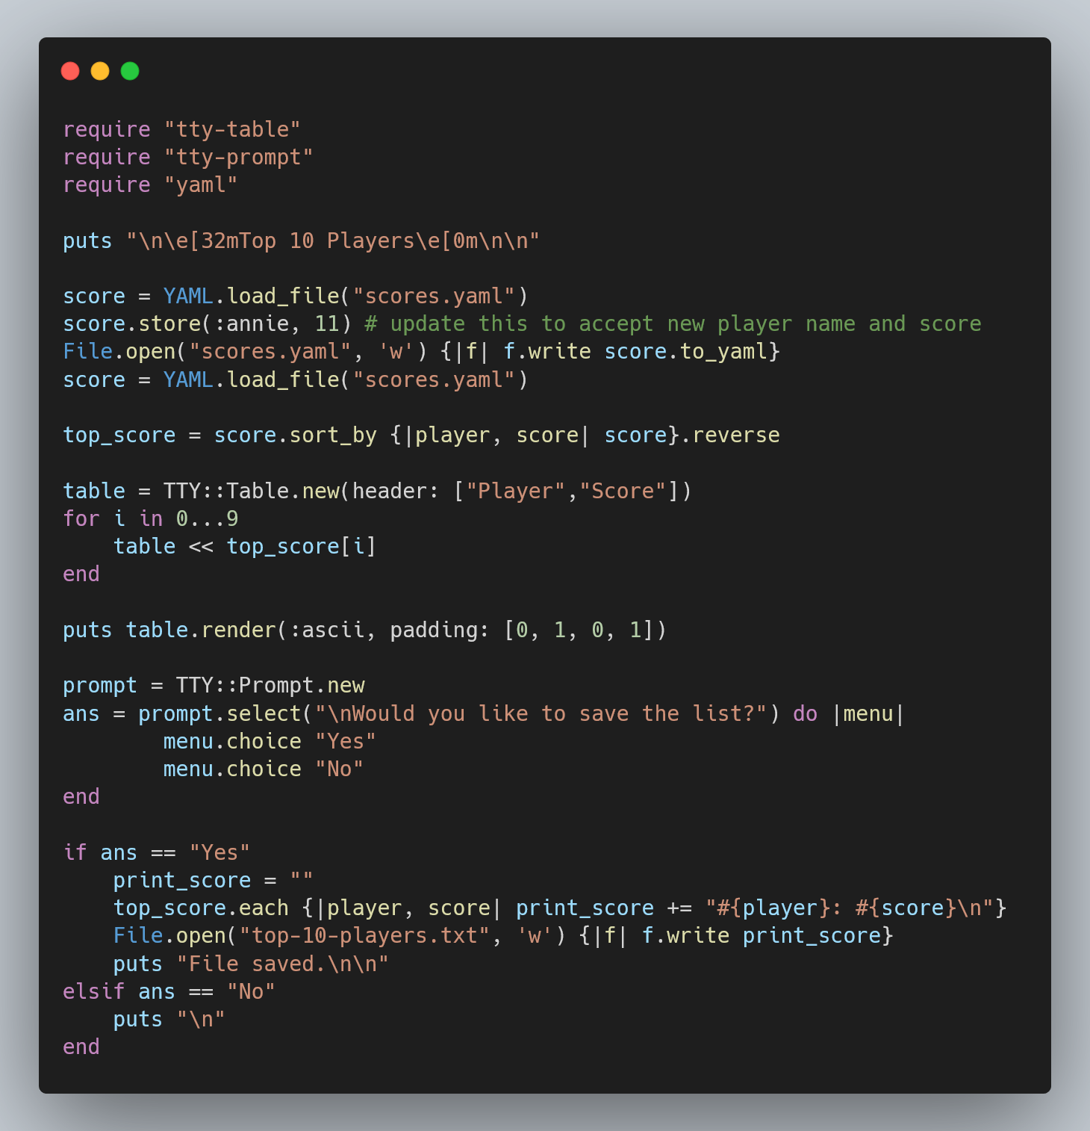

Slide 8
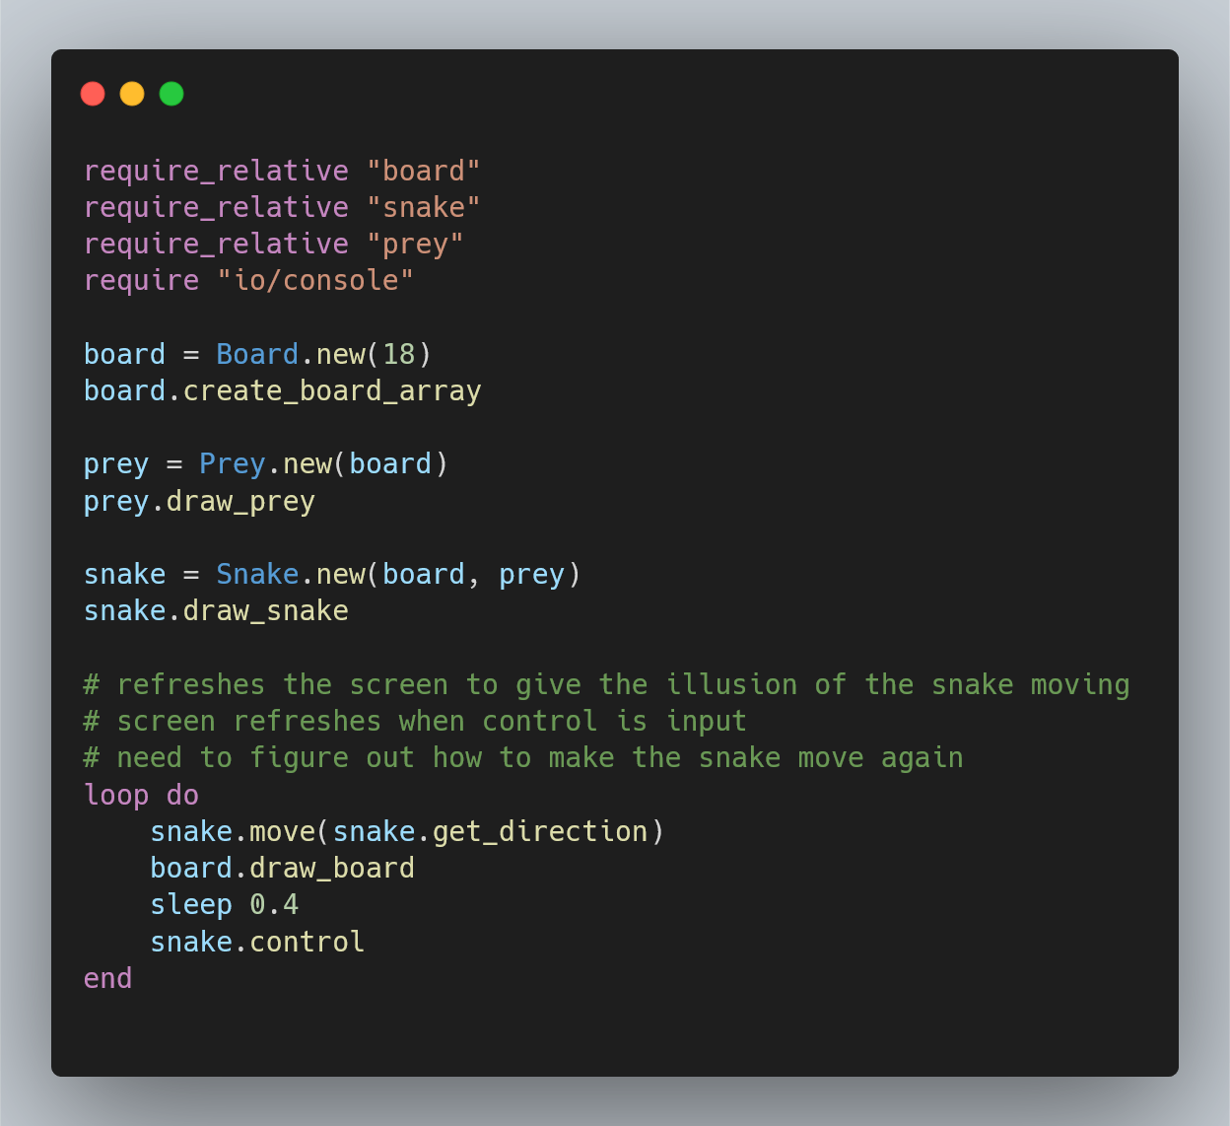

Slide 9
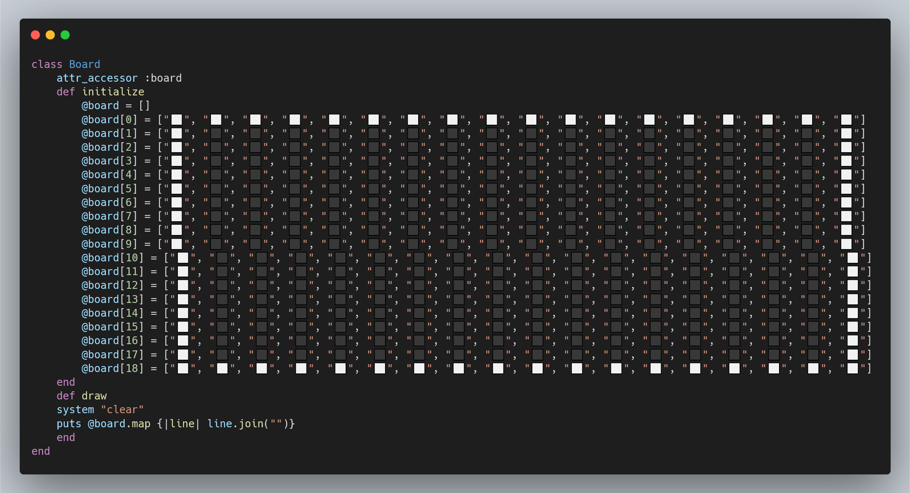

Slide 10
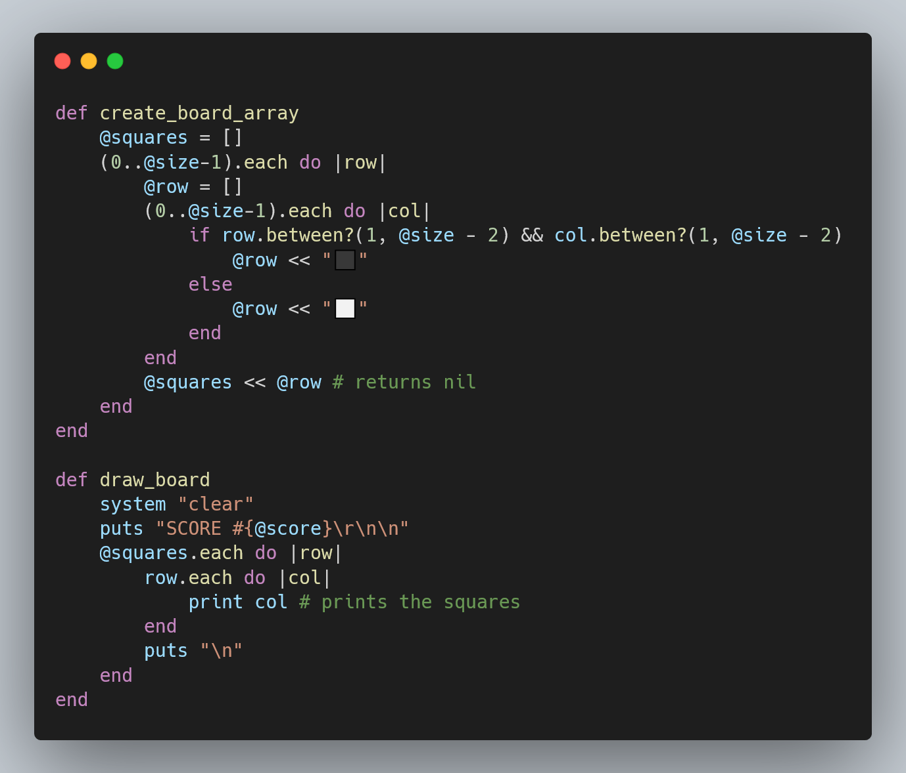

Slide 11
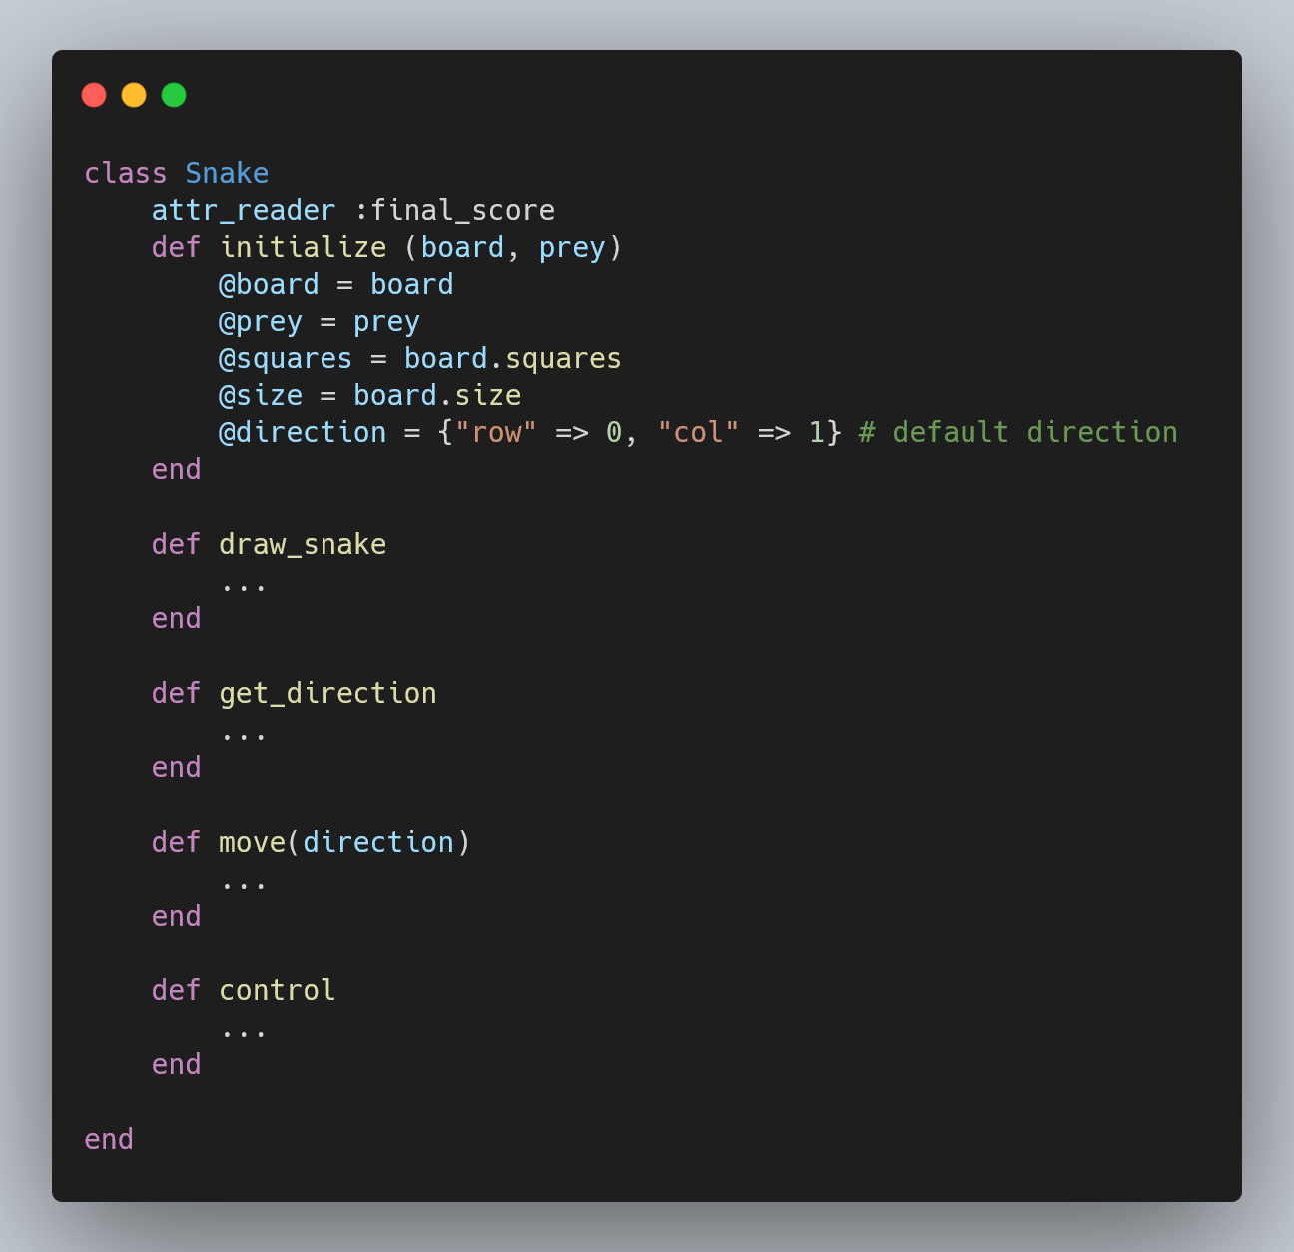
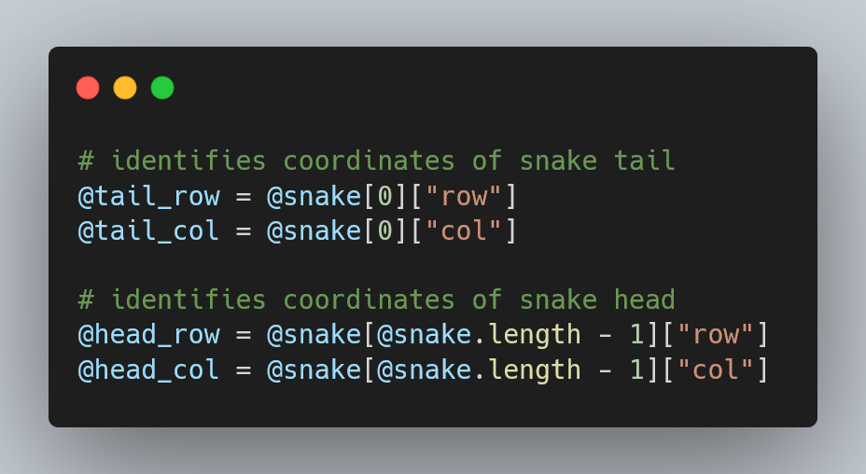
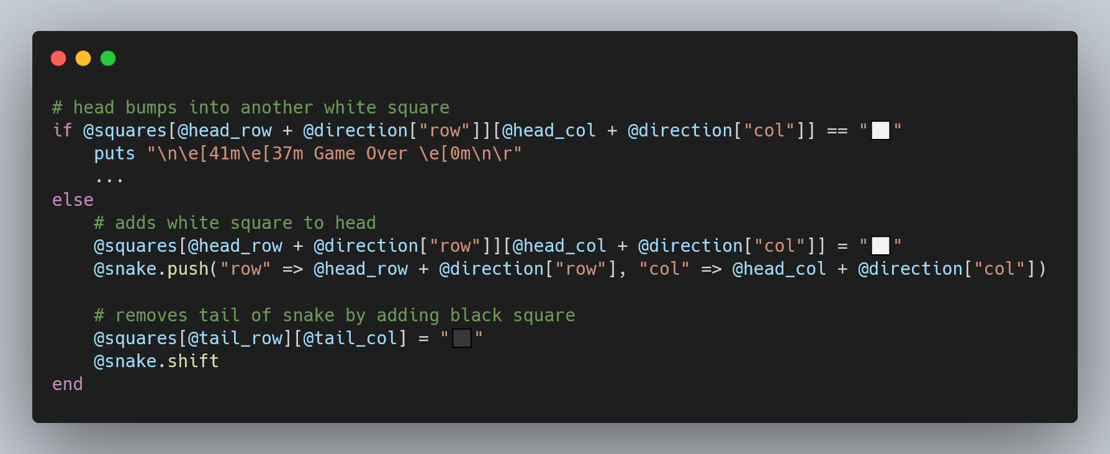

Slide 12
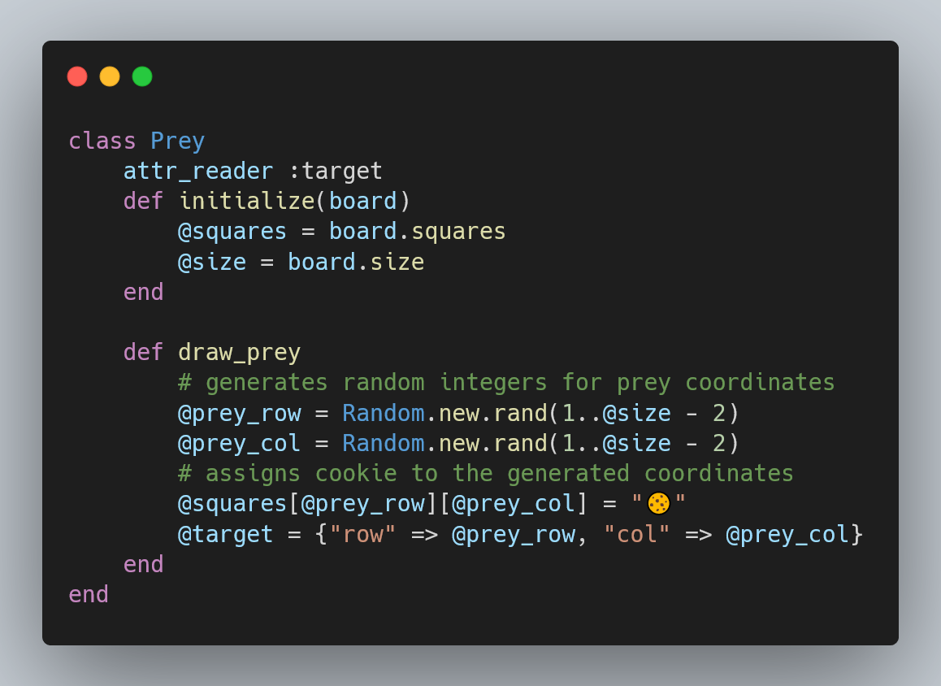

Slide 13
Demo

Slide 14
Challenges
Dependencies
Ruby2D
Had to force a Plan B
Re/Learning
Grids
Coordinates (x, y)
Scaling down
Had to remove features to make project achievable
Then look to add when basic functions are done
Research
Never ending research

Slide 15
Learnings
RoRo Sydney
Attending the meet up taught me about being able to use emojis as string!
Ruby Public classes
File
Random
Key Variable
@square
More than just Ruby
Planning, organising files and classes
Visualising what needs to happen & working backwards

Slide 16
Thank You!

