Slide 1

Booktique
(Library Management System)

Slide 2
Objective Of LMS:
To automate the Library Management System so that employees/non-employees can issue and return book easily without any hassle.
To generate the reports(like bar chart, pie chart) for finding for getting in depth knowledge about the learning curve of employee and motivate them to learn more.

Slide 3
Approach Adopted:
Initially, thought to develop it as a standalone application based on Java and MySQL.
However after the discussion with mentors, I am able to conceive the project in JSP, MySQL, Ajax and JSON(in progress).

Slide 4
Tools and Technology Used:
HTML 5/ CSS/ Javascript
JSP
MySQL
Ajax

Slide 5
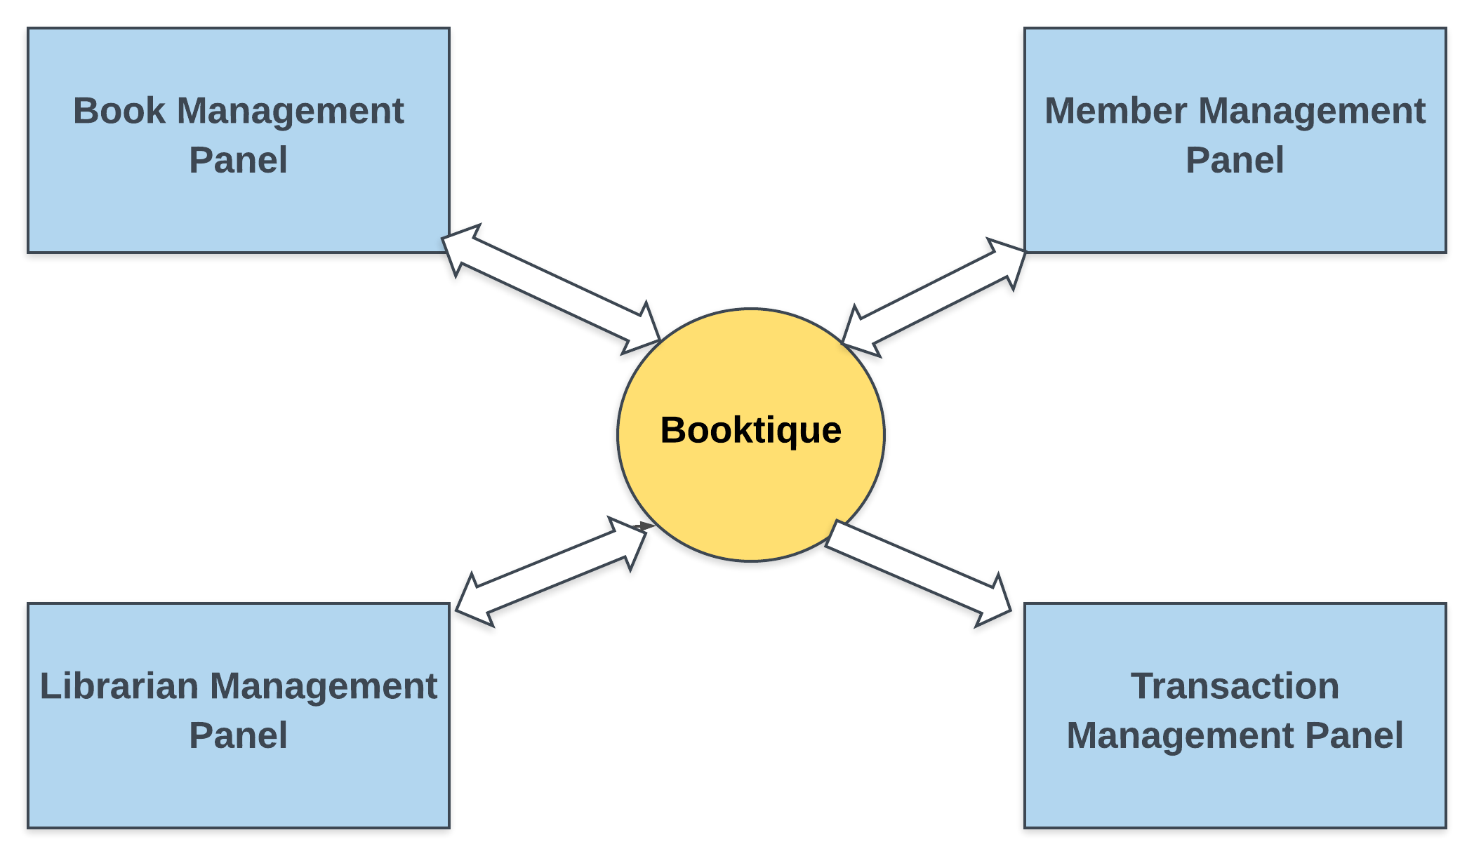
System Flow Diagram

Slide 6
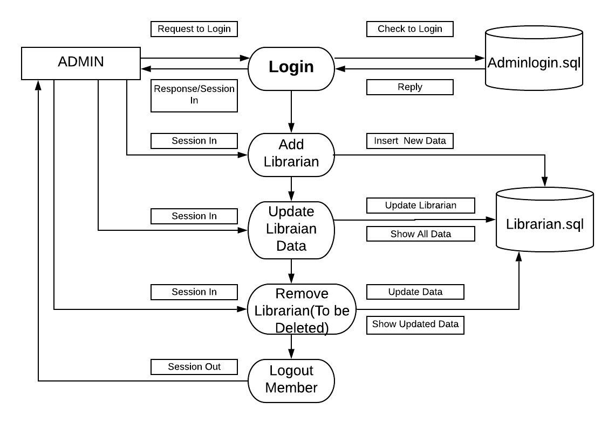
Admin Panel(Librarian) DFD – 1st Level

Slide 7
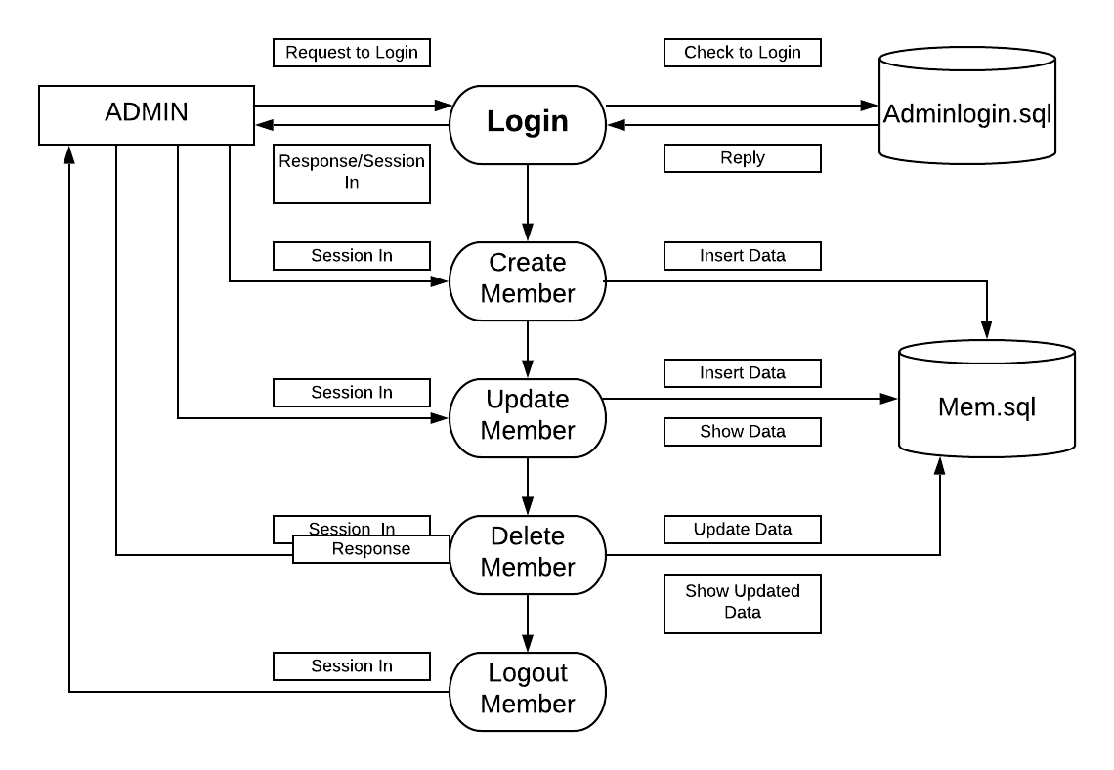
Admin Pane(Member) DFD 1st Level

Slide 8
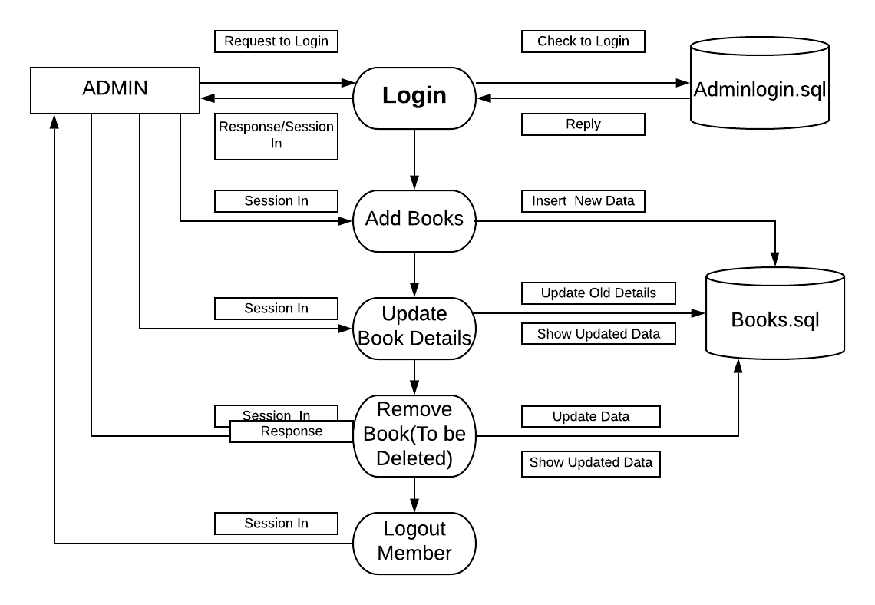
Admin Panel(Books) DFD – 1st Level

Slide 9
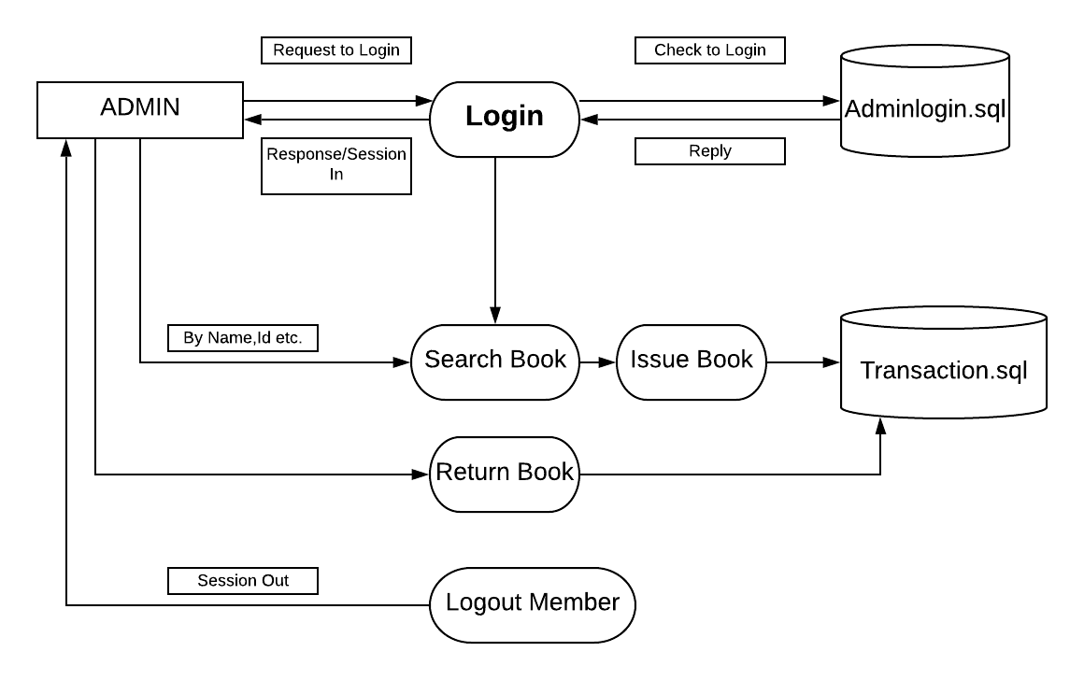
Admin Panel(Transaction) DFD – 1st Level

Slide 10
Admin Panel(Librarian) DFD – 1st Level

Slide 11
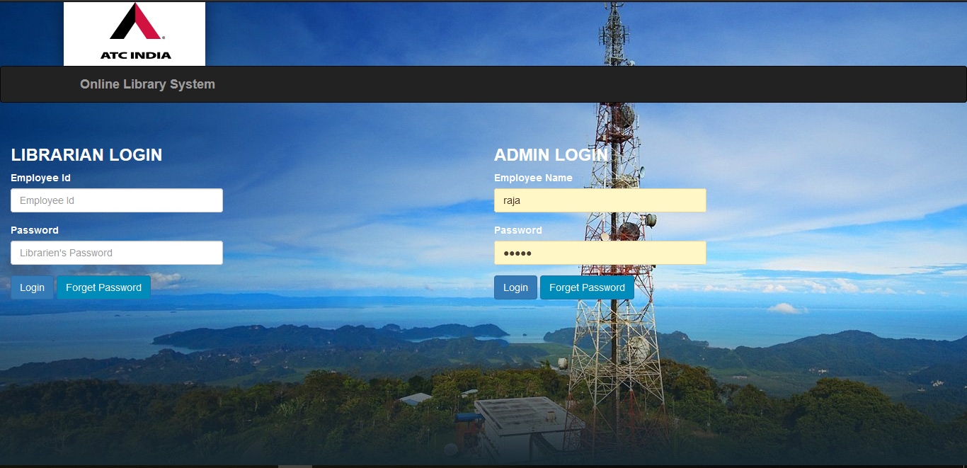
Overview Of LMS: 1.Login Page:

Slide 12
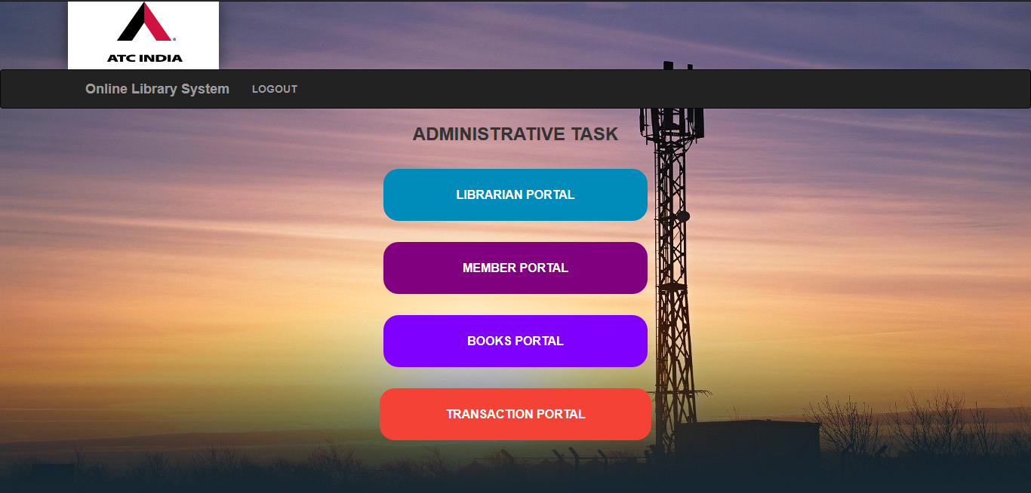
2. Admin Working Panel:

Slide 13
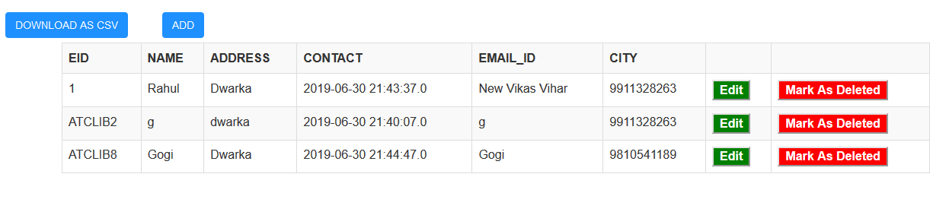
3.1. Librarian Panel:

Slide 14
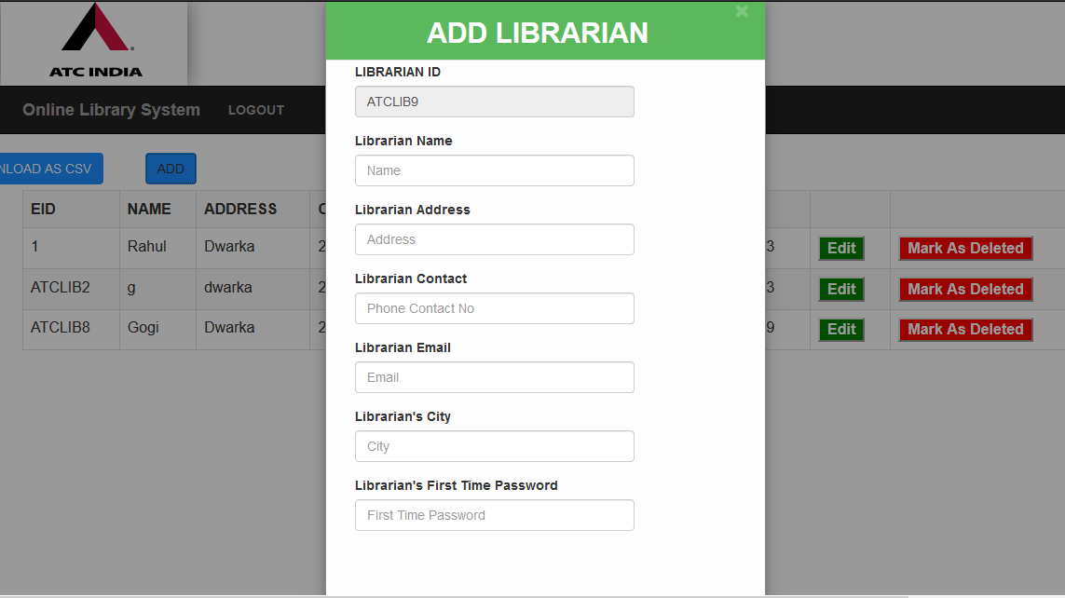
3.2.Add Librarian(Pop Up Window):

Slide 15
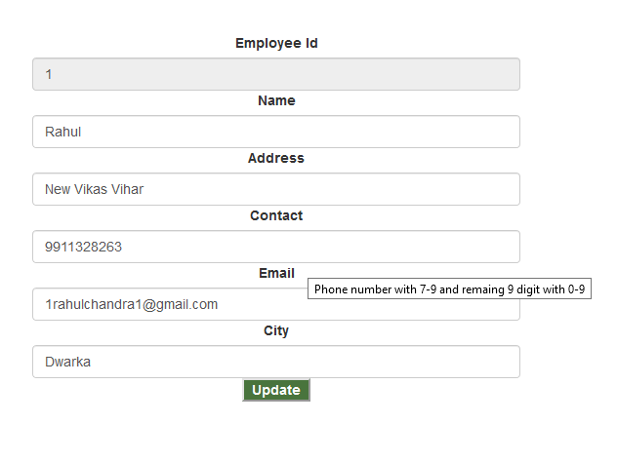
3.3. Librarian Edit Panel:

Slide 16
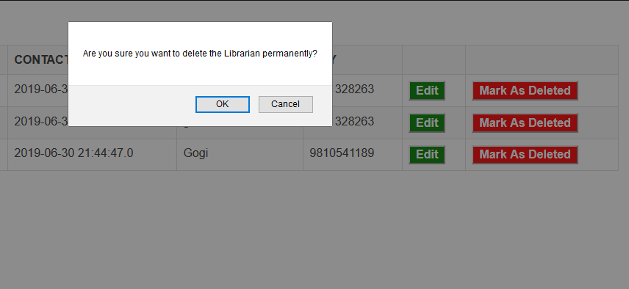
3.4. To Be Delete Librarian Confirmation:

Slide 17
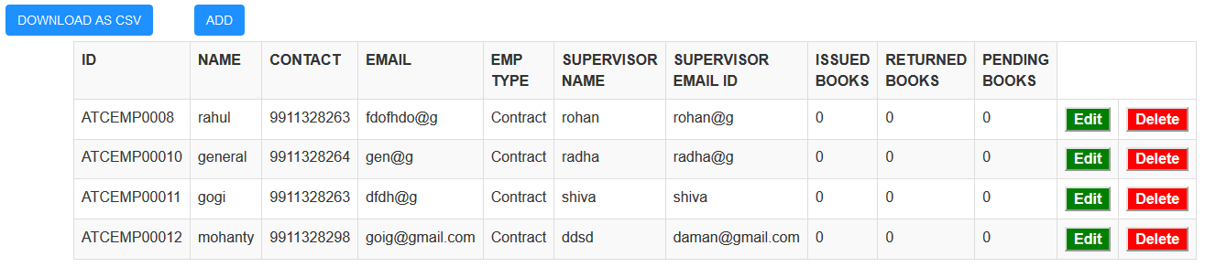
4.1. Member Panel:

Slide 18
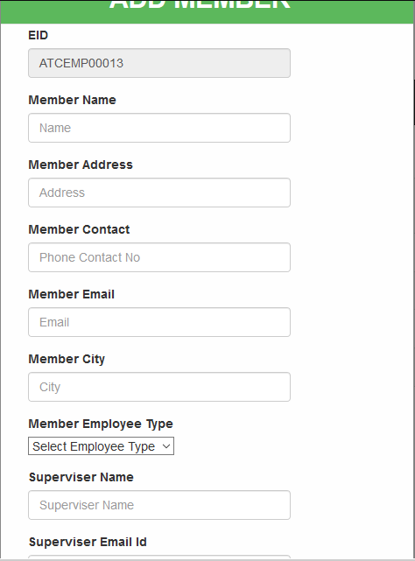
4.2.Add Member( Pop Up Screen)

Slide 19
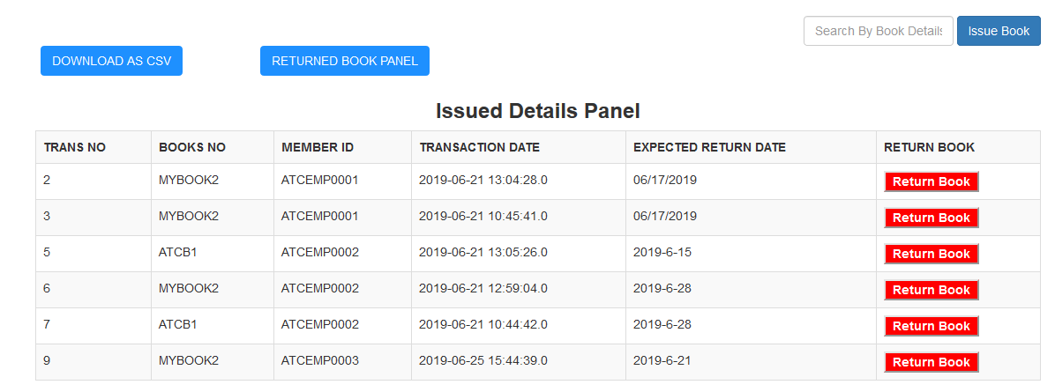
5.1. Transaction Panel:

Slide 20
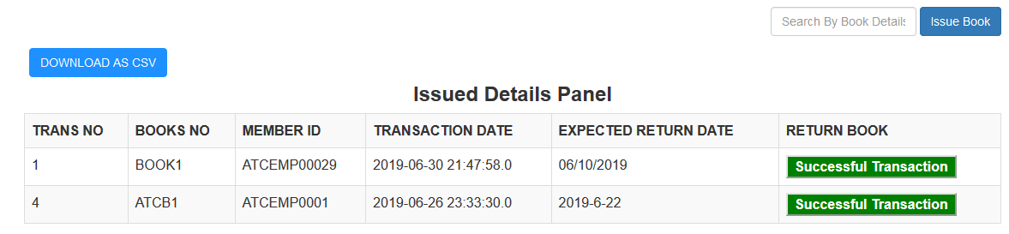
5.2. Returned Book Panel:

Slide 21
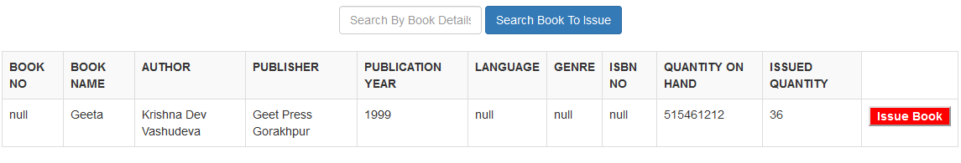
5.3. Issue Book Section:

Slide 22
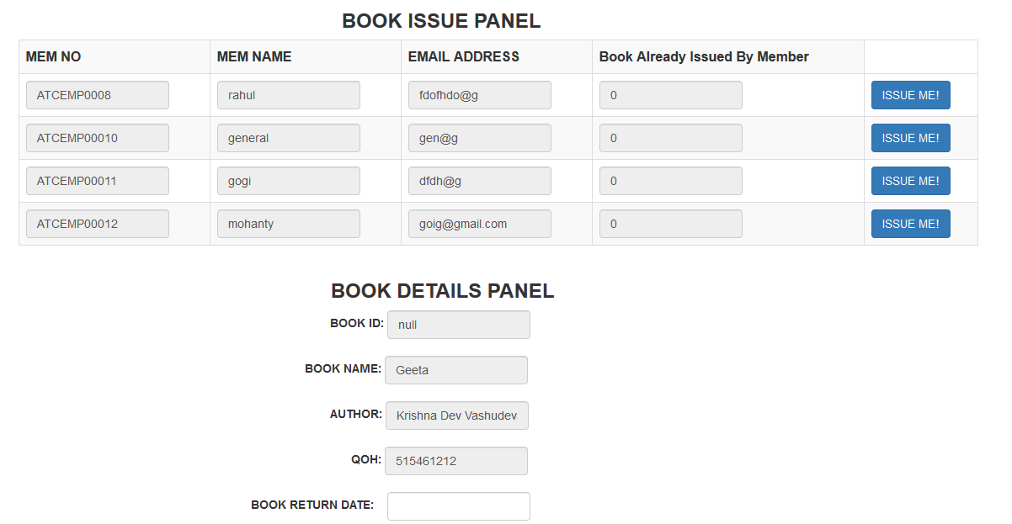
5.4. Issue Book Section 2:

