Slide 1


Filter

Slide 2

Topics Covered
What is a filter?
Syntax of filter
Common Filter functions
Combining multiple filters

Slide 3
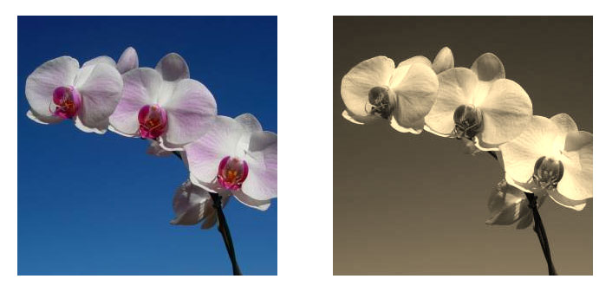
What is a filter?
Apply various graphical effects such as colour shift or blur to an element

Slide 4
Syntax of filter
To apply filters, we use following syntax,
filter : <filter-function>
where, filter-functions are predefined functions used to apply various visual effects to elements on a web page.

Slide 5

Filter functions - Blur
Duration of the transition in seconds or milliseconds.
HTML
CSS
Output
<!DOCTYPE html>
<html lang="en">
<head>
<title>Filter</title>
</head>
<body>
<div>
<img
src="./assets/css.png"
alt="image"
width="100%"
/>
</div>
</body>
</html>
div {
border: 1px solid black;
width: 200px;
height: 200px;
}
img {
filter: blur(10px);
}

Slide 6

Filter functions - Brightness
Duration of the transition in seconds or milliseconds.
HTML
CSS
Output
<!DOCTYPE html>
<html lang="en">
<head>
<title>Filter</title>
</head>
<body>
<div>
<img src="./assets/css.png" alt="image" width="100%"
/>
</div>
</body>
</html>
div {
border: 1px solid black;
width: 200px;
height: 200px;
}
img {
filter: brightness(0.4);
}

Slide 7

Filter functions - Grayscale
Duration of the transition in seconds or milliseconds.
HTML
CSS
Output
<!DOCTYPE html>
<html lang="en">
<head>
<title>Filter</title>
</head>
<body>
<div>
<img src="./assets/css.png" alt="image" width="100%" />
</div>
</body>
</html>
div {
border: 1px solid black;
width: 200px;
height: 200px;
}
img {
filter: grayscale(0.8);
}

Slide 8

Filter functions - Hue Rotate
Duration of the transition in seconds or milliseconds.
HTML
CSS
Output
<!DOCTYPE html>
<html lang="en">
<head>
<title>Filter</title>
</head>
<body>
<div>
<img src="./assets/css.png" alt="image" width="100%" />
</div>
</body>
</html>
div {
border: 1px solid black;
width: 200px;
height: 200px;
}
img {
filter: hue-rotate(90deg);
}

Slide 9

Filter functions - Drop Shadow
Duration of the transition in seconds or milliseconds.
HTML
CSS
Output
<!DOCTYPE html>
<html lang="en">
<head>
<title>Filter</title>
</head>
<body>
<div>
<h1>Filter is Easy</h1>
</div>
</body>
</html>
h1 {
color: rgb(71, 76, 167);
filter: drop-shadow(30px 30px 0 rgb(103, 97, 97));
}

Slide 10

Combining Multiple Filters
Duration of the transition in seconds or milliseconds.
HTML
CSS
Output
<!DOCTYPE html>
<html lang="en">
<head>
<title>Filter</title>
</head>
<body>
<div>
<img src="./assets/css.png" alt="image" width="200px" />
</div>
</body>
</html>
img {
filter: drop-shadow(30px 10px 2px #3fb1e2)
hue-rotate(90deg)
drop-shadow(30px 10px 2px #3fb1e2);
}

Slide 11
THANK YOU

