Slide 1
Dijkstra Algorithm: Finding shortest paths in order
Find shortest paths from source s to all other destinations
w'
w'
z
w
x
x
s
z'
w"
w"
x'

Slide 2
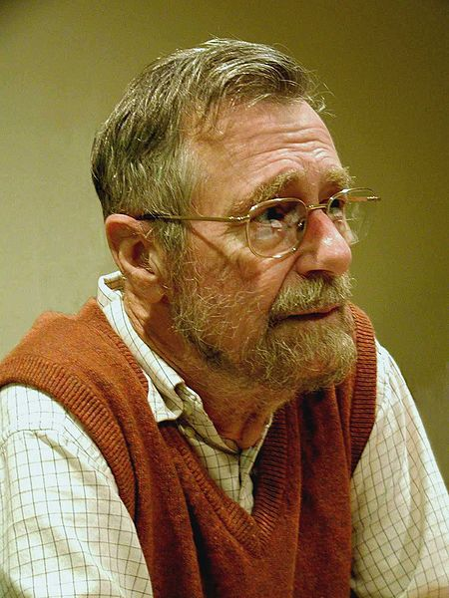
Djikstra's algorithm (named after its discover, E.W. Dijkstra) solves the problem of finding the shortest path from a point in a graph (the source) to a destination.

Slide 3
Suppose we want to find a shortest path from a given node a to other nodes in a network (one-to-all shortest path problem)
It finds the shortest path from a given node a to all other nodes in the network
Node a is called a starting node or an initial node

Slide 4
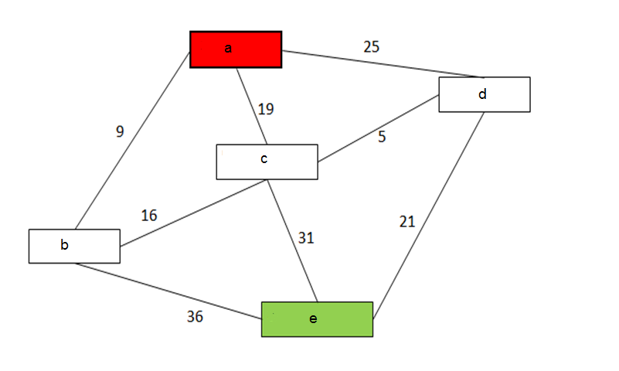
we will find the shortest path from a to e.

Slide 5
Dijkstra's algorithm keeps two sets of vertices: Set P : The set of vertices whose shortest paths from the source have already been determined and Set T : The remaining vertices.

Slide 6
So here initially P = {} i.e. Empty T = {a,b,c,d,f}

Slide 7
Step 1:
Label a with 0 and all others with ∞.
Labels are shortest paths from a to vertices.
So we have
P = { a }
T = { b, c, d, e}
L(a) = 0
L(b) = ∞
L(c) = ∞
L(d) = ∞
L(e) = ∞

Slide 8
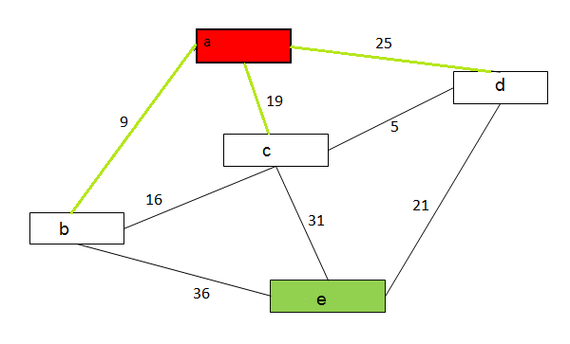
Step 2:
Nodes b, c, and d can be reached from the current node a
• Therefore by using
L( i ) = min { L( n ), L( j ) + w( i , j ) }
Where L(i) = label we are Updating.
L(j) = Current Label
Update distance values
for these nodes

Slide 9
So we get
L ( b ) = min { L( b ) , L( a ) + W ( a , b ) }
= min { ∞ , 0 + 9 }
= min {∞ , 9 }
Selecting the minimum we get
L (b) = 9
Smilarly calculating for L(c) and L(d) we get
L(c) = min {∞ , 19}
= 19
L(d) = min {∞ , 25}
= 25

Slide 10
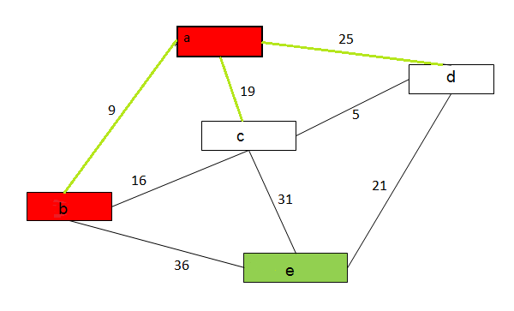
Now, among the nodes b, c, and d, node b has the smallest distance value.
So the status label of node b changes to permanent, while the status of c and d remains temporary

Slide 11
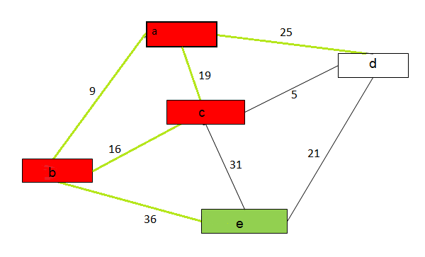
Step 3:
P = { a, b}
T = { c, d, e}
Node b becomes the current node Operation
Nodes c, and e can be reached from the current node b. So, updating values for c, d, e
We get
L (c)= min { 19 , 9+16 }
= min { 19 , 25}
= 19
Similarly ( e ) = 45
Now label c has the smallest value. Therefore it changes to permanent.

Slide 12
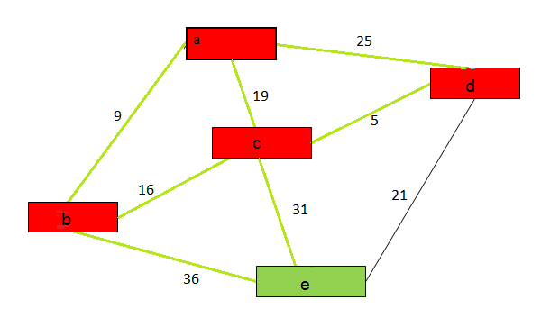
Step 4:
P = {a , b, c}
T = { d, e }
Updating labels for d and e, we get
L (d) = 24 and L (e) = 50

Slide 13
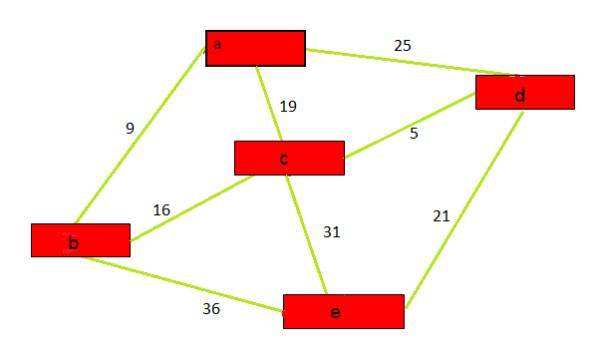
Step 5 :
P ={ a,b,c,d } , T = {e}
Updating label e , we get L (e) = 45
So 45 is the shortest value which can be travelled to reach node e.

Slide 14
Applications
Telephone Network
The vertices represents switching station, the edges represents the transmission line, and the weight of edges represents the BW.
Flight Agenda
To determine the earliest arrival time for the destination given an origin airport and start time.

