Slide 1
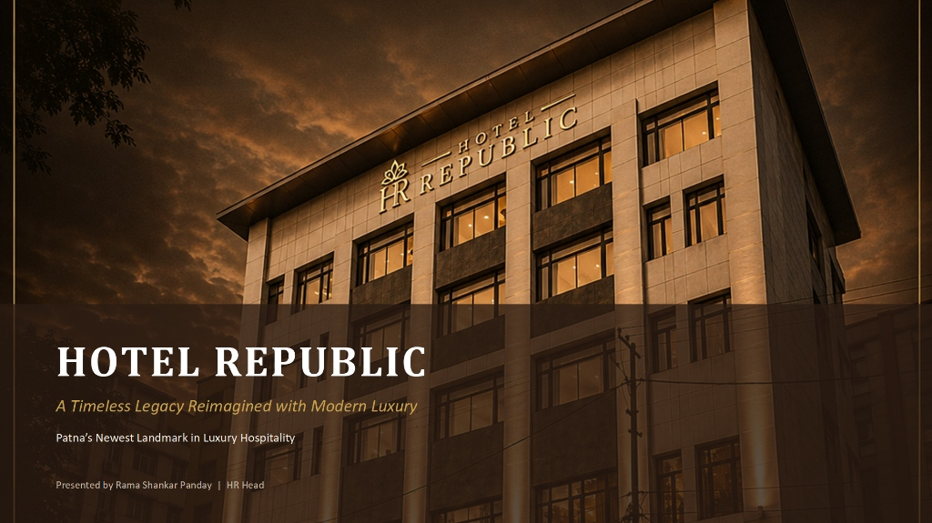
HOTEL REPUBLICA
Timeless Legacy Reimagined with Modern Luxury
Patna's Newest Landmark in Luxury Hospitality
Presented by Hotel Republic Team

Slide 2
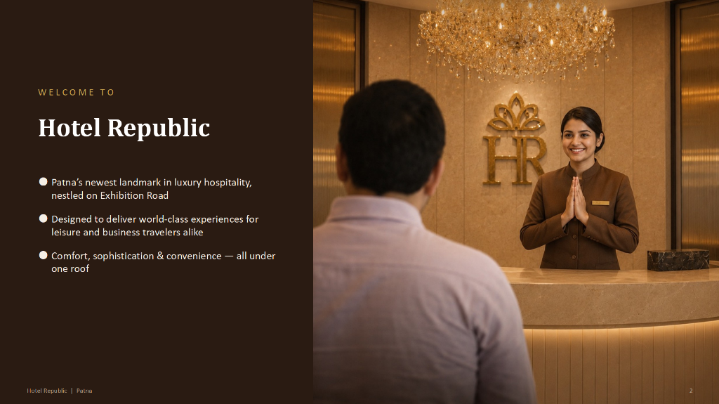
Welcome to Hotel Republic
Patna's newest landmark in luxury hospitality, nestled on Exhibition Road. Designed to deliver world-class experiences for leisure and business travelers alike. Comfort, sophistication & convenience — all under one roof.

Slide 3
AT A GLANCE — Everything Under One Roof
• 40 Elegantly Furnished Rooms
• 3 Versatile Banquet Halls
• 1 Dedicated Boardroom
• 1 Fine-Dining Restaurant
Address: Exhibition Rd, South Gandhi Maidan, Raja Ji Salai, Indira Nagar, Patna, Bihar 800001

Slide 4
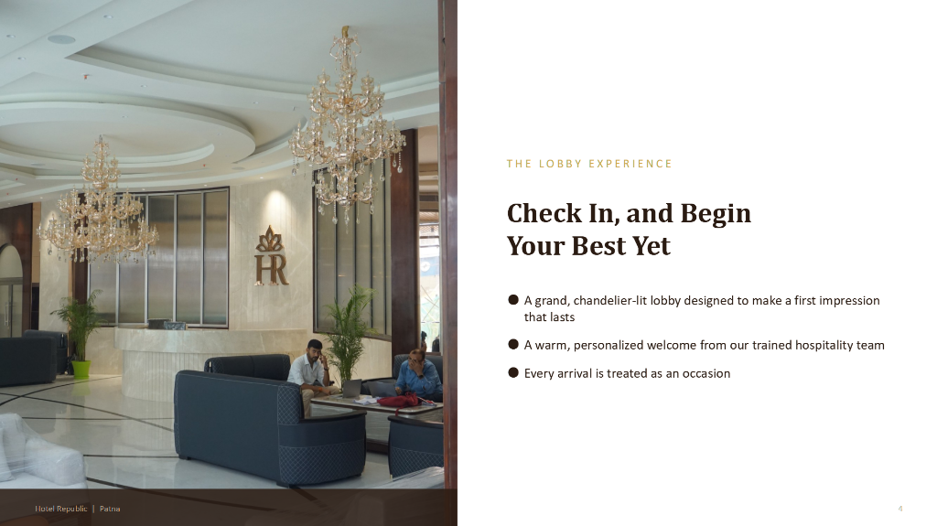
THE LOBBY EXPERIENCE — Check In, and Begin Your Best Yet
A grand, chandelier-lit lobby designed to make a first impression that lasts, complemented by a warm, personalized welcome from our trained hospitality team where every arrival is treated as an occasion.

Slide 5
GUEST ROOMS — 40 Rooms, Designed for Comfort
"Behind every restful stay is a touch of thoughtful service."
Elegantly furnished rooms blending modern design with restful comfort, complete with premium bedding and thoughtful housekeeping touches.

Slide 6
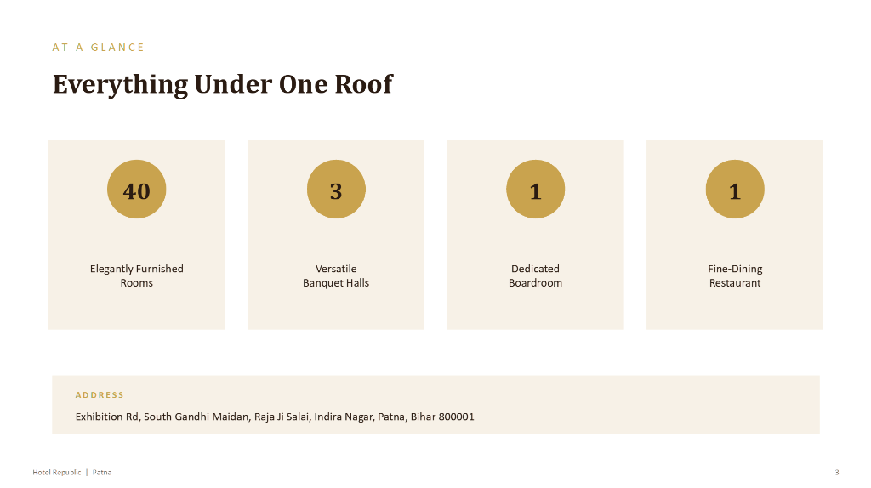
TWIN BED ROOMS — Modern Design & Restful Comfort
Designed for maximum comfort, featuring premium twin mattresses, individual bed styling, warm wood paneling, and sophisticated mood lighting.

Slide 7
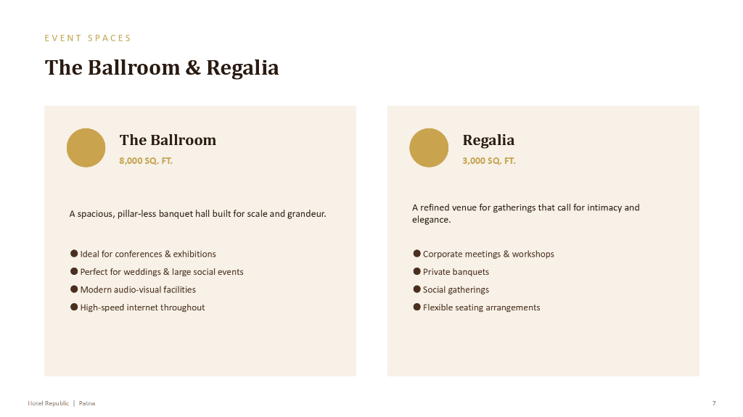
MASTER SUITES & KING ROOMS — Elegance in Every Detail
Featuring artistic towel arrangements, luxury headboards, plush seating benches, and ample wardrobe space tailored for discerning travelers.

Slide 8
EVENT & BANQUET SPACES — Spaces That Bring Every Occasion to Life
3 Banquet Halls + 1 Boardroom — engineered for every scale of event
• The Ballroom
• Regalia
• Forum
• Evoria

Slide 9
THE BALLROOM — Scale and Grandeur
An 8,000 SQ. FT. pillar-less banquet hall built for high-scale events, mega-conferences, large-scale exhibitions, weddings, and grand social celebrations.

Slide 10
THE BALLROOM — Modern Infrastructure & Technology
Equipped with state-of-the-art audio-visual facilities, high-speed internet throughout, customizable lighting grids, and flexible high-capacity seating configurations.

Slide 11
REGALIA — Intimate & Refined
A 3,000 SQ. FT. refined venue meticulously crafted for gatherings that call for intimacy, elegance, and focused attention.

Slide 12
REGALIA — Corporate & Private Gatherings
Ideal for high-level corporate meetings, specialized workshops, private banquets, and exclusive social gatherings with flexible seating arrangements.

Slide 13
FORUM — Versatile & Contemporary
A 3,000 SQ. FT. elegant venue uniquely suited to seamlessly transition between high-energy celebrations and formal corporate functions.

Slide 14
FORUM — Conferences & Seminars
Perfectly outfitted for business conferences, professional seminars, corporate milestones, and social celebrations supported by modern presentation setups.

Slide 15
EVORIA BOARDROOM — Executive Privacy
A 1,000 SQ. FT. executive space located on the 1st Floor, designed as a sophisticated café-lounge setting for high-level discussions.

Slide 16
EVORIA BOARDROOM — Refresh & Unwind
Features freshly brewed coffee, premium teas, curated beverages, and light refreshments, providing a calm environment for informal meetings and unwinding.

Slide 17
HOSPITALITY AT ITS FINEST — Every Stay is Designed for You
Luxury Stay | Fine Dining Restaurant | Comfort & Safety | High-Speed Wi-Fi

Slide 18
COMING SOON — An All-New Avatar
Hotel Republic relaunches soon with a refreshed design, elevated service standards, and a completely reimagined guest experience.

Slide 19
CAREER OPPORTUNITY — A Launchpad for IHM Hajipur Students
Students from IHM Hajipur get an exclusive opportunity to start their career in hospitality by learning real skills from top staff, working across diverse departments, and accelerating professional growth.
Program Focus: (1) Learn guest service basics, (2) Build daily operations skills, (3) Work hands-on with expert staff, (4) Grow fast professionally.

Slide 20
THANK YOU — Hotel Republic
Address: Exhibition Rd, South Gandhi Maidan, Patna, Bihar 800001
Presented By: Hotel Republic Team

