Slide 1


→ Custom Acceleration of Large Language Model Primitives (2025)
Ravi Patel
B.Tech ECE
Indian Institute of Information Technology Guwahati, India

Slide 2
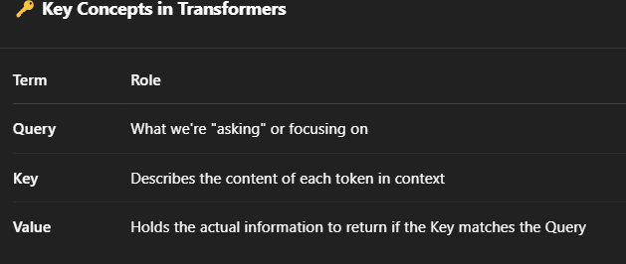
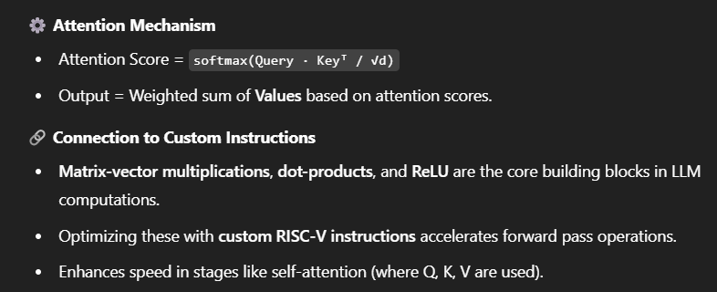
🔍 What are LLMs?
Large Language Models (LLMs) like GPT use deep learning
(specifically Transformers) to understand and generate human-like text.
They process sequences of tokens and learn complex patterns using multihead attention mechanisms.

Slide 3
Optimizing Transformer Encoder Using Custom RISC-V Instructions
Challenge: Standard RISC-V implementation lacks hardware acceleration
Goal: Improve performance by reducing cycle counts for critical operations
Solution: Design and integrate up to 5 custom RISC-V instructions

Slide 4
Identifying Bottlenecks in Transformer Workload
Transformer operations are compute-intensive
Dot product
Matrix-vector multiplications
ReLU activations
Saturation and scaling
These are repeatedly invoked in loops
Need hardware acceleration to reduce latency

Slide 5
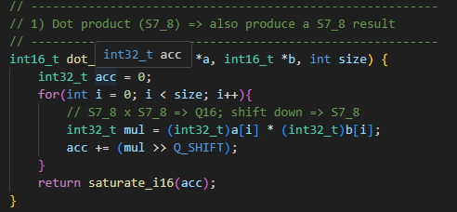
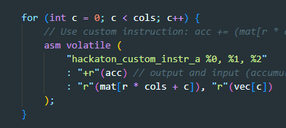
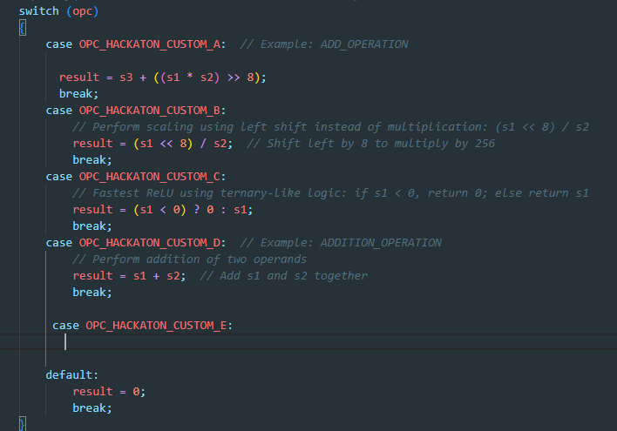
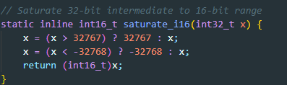
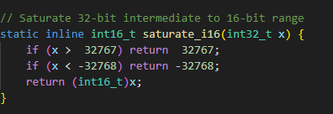
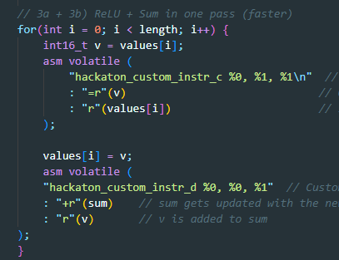
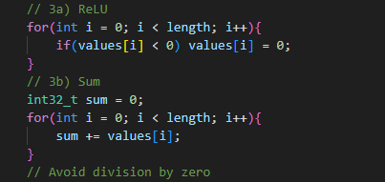

Slide 6
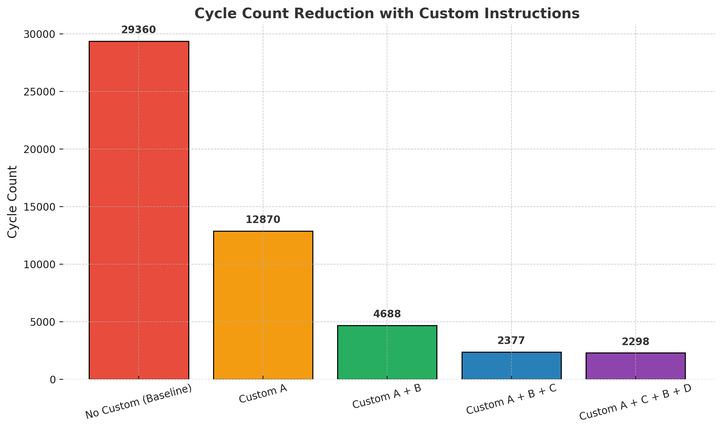
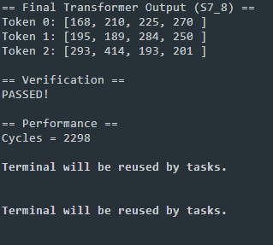
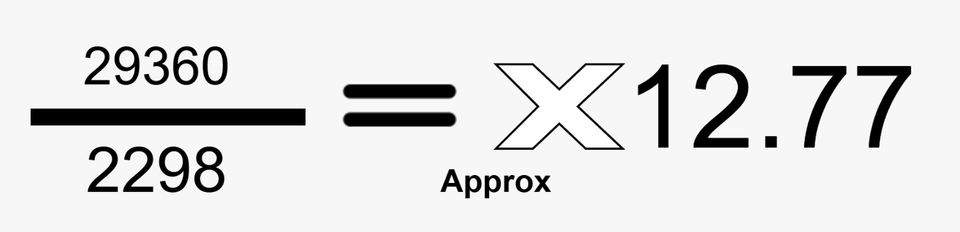
Performance Analysis with custom instruction

Slide 7
Thanks you !

