Slide 1
A Quick Introduction to Processing
Ira Greenberg, Deepak Kumar and Dianna Xu

Slide 2
Web Sites
www.processing.org
www.openprocessing.org

Slide 3
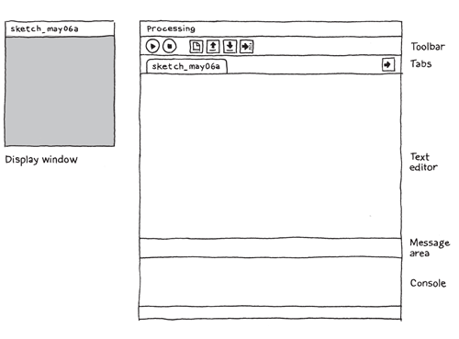
The Processing IDE

Slide 4
Hello, World!, V1
line(15, 25, 70, 90);

Slide 5
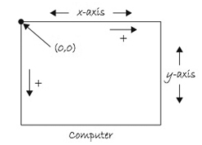
Coordinate System

Slide 6
Hello, World!, V1.1
size(400, 400); // 0..width-1 x 0..height-1
background(192, 64, 0); // rgb values
stroke(255); // monochrome 0..255
line(150, 25, 270, 350);

Slide 7
Hello, mouse!
void setup() {
size(400, 400);
stroke(255);
background(192, 64, 0);
}
void draw() {
line(150, 25, mouseX, mouseY);
}

Slide 8
Static vs. Active Program Modes
// declarations
void setup() {
// initial setup
// size, smoothing
// frame rate
// etc
}
void draw() {
// the stuff that loops
//at frame rate
}
size(X, Y);
size(X, Y, JAVA2D/P2D/P3D/OPENGL); smooth(); frameRate(n); etc.

Slide 9
Mouse Events
void mousePressed () {
do something
}
void mouseDragged () {
do something
}

Slide 10
Try
void setup() {
size(400, 400);
stroke(255);
background(192, 64, 0);
}
void draw() {
// nothing here
}
void mousePressed(){
line(150, 25, mouseX, mouseY);
}

Slide 11
Try, V2
void setup() {
size(400, 400);
stroke(255);
}
void draw() {
background(192, 64, 0);
}
void mousePressed(){
line(150, 25, mouseX, mouseY);
}

Slide 12
Exercise 1
Whenever mouse is pressed and dragged, draw lines from mouse location to the four corners of the screen.

Slide 13
Hint
void mouseDragged() {
line(0, 0, mouseX, mouseY);
line(width, 0, mouseX, mouseY);
line(0, height, mouseX, mouseY);
line(width, height, mouseX, mouseY);
}

Slide 14
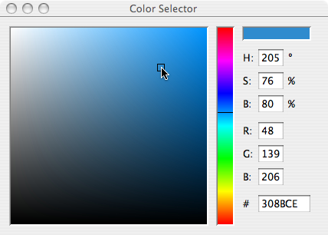
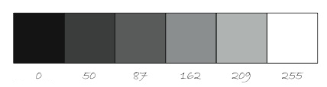
Basic shapes, strokes, color
point(x, y);
line(x1, y1, x2, y2); triangle(x1, y1, x2, y2, x3, y3);
rect(Xtopleft, Ytopleft, W, H);
quad(x1, y1, … , x4, y4);
ellipse(Xcenter, Ycenter, W, H);
stroke(R, G, B); noStroke();
strokeWeight(n);
fill(R, G, B);
noFill();

Slide 15
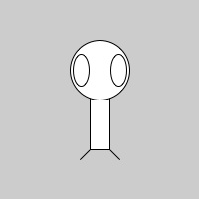
Example 1
size(200,200);
rectMode(CENTER);
rect(100,100,20,100);
ellipse(100,70,60,60);
ellipse(81,70,16,32);
ellipse(119,70,16,32);
line(90,150,80,160);
line(110,150,120,160);

Slide 16
Example 2
int x, y;
void setup() {
size(400, 400);
smooth();
x = 0;
y = height/2;
}
void draw() {
background(255);
fill(255, 0, 0);
stroke(255, 0, 0);
ellipse(x, y, 50, 50);
x++;
}
Draw a red ball and make it move
across the screen.
Add to setup:
frameRate(10);

Slide 17
Exercise 2
Extend to:
Vary both x and y coordinates.
Ensure the ball stays within bounds.

Slide 18

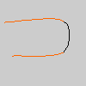
Arcs & Curves
arc(x, y, width, height, start, stop);
start, stop are angles in radians 0 is due east angles increase in clockwise direction
curve(x1, y1, x2, y2, x3, y3, x4, y4);
x1, y1 and x4, y4 are anchor points

Slide 19
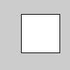
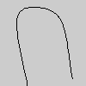
More Shapes
beginShape(); vertex(30, 20); vertex(85, 20); vertex(85, 75); vertex(30, 75); endShape(CLOSE);
noFill(); beginShape(); curveVertex(84, 91); curveVertex(84, 91); curveVertex(68, 19); curveVertex(21, 17); curveVertex(32, 100); curveVertex(32, 100); endShape();

Slide 20
Images
// Declaring a variable of type PImage
PImage img;
void setup() {
size(320,240);
// Make a new instance of a PImage by loading an image file
img = loadImage("mysummervacation.jpg");
}
void draw() {
background(0);
// Draw the image to the screen at coordinate (0,0)
image(img,0,0);
}

Slide 21
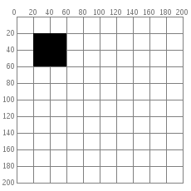
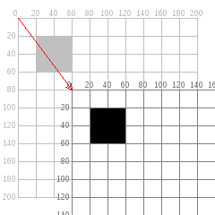
2-D Transformations translate(x, y)
fill(0); translate(60, 80); rect(20, 20, 40, 40);
fill(0); rect(20, 20, 40, 40);

Slide 22

push/pop Matrix
void house(int x, int y) { pushMatrix(); translate(x, y); triangle(15, 0, 0, 15, 30, 15); rect(0, 15, 30, 30); rect(12, 30, 10, 15); popMatrix(); }
for (int i = 10; i < 350; i = i + 50) { house(i, 20); }

Slide 23
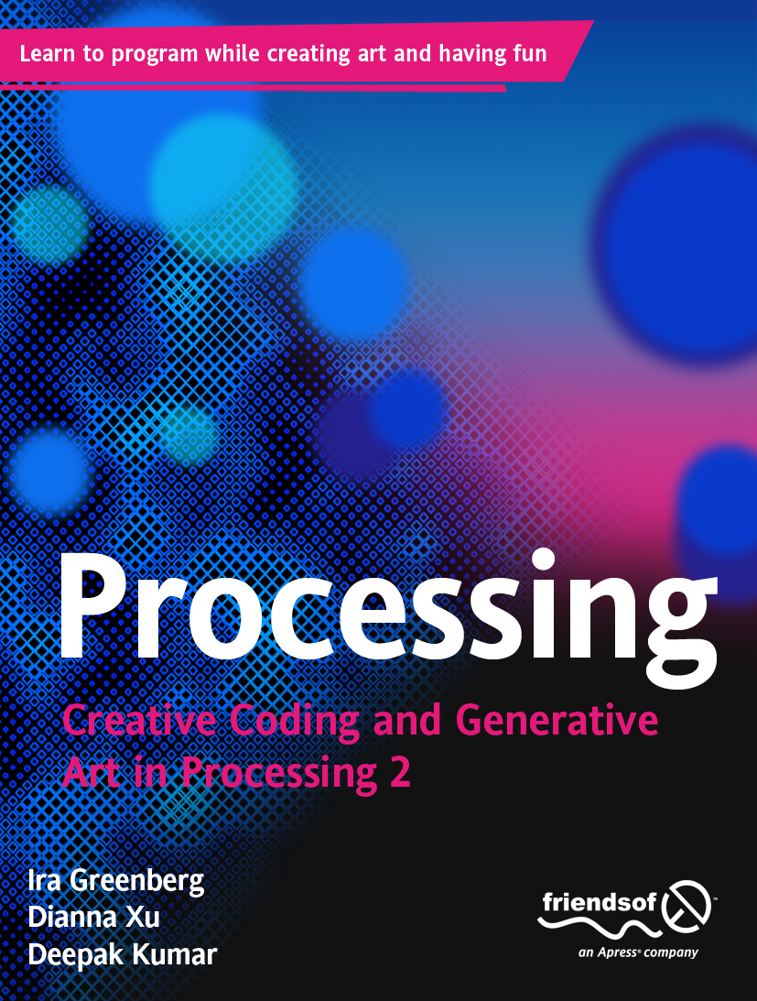

Slide 24
Web Sites
cs.brynmawr.edu/content/processing
www.processing.org
www.openprocessing.org

