Slide 1
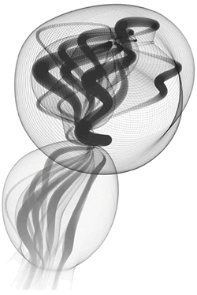
Computational Art and Creative Coding: teaching CS1 with Processing
July 9-12
Bryn Mawr College, PA
Presented by
Aaron Cadle
Ira Greenberg
Deepak Kumar
Ursula Wolz
Dianna Xu

Slide 2



Introduction
Bridging the divide between the arts and sciences
Teaching computing foundations with the visual arts
Emphasis on curricular development
Blend flexibly into traditional Java-based CS1
NSF CCLI-I (2010-2013)
NSF TUES-II

Slide 3
CS1 Curriculum
Teach the core CS1 topics as we would in any average traditional Java-based CS1
Show applications with contemporary, diverse examples of computing in a modern context
Physics-based simulations
Fractals and L-systems
Image processing
Emergent systems
Cellular automata
Data visualization

Slide 4
Links
www.cs.brynmawr.edu/visual

