Slide 1
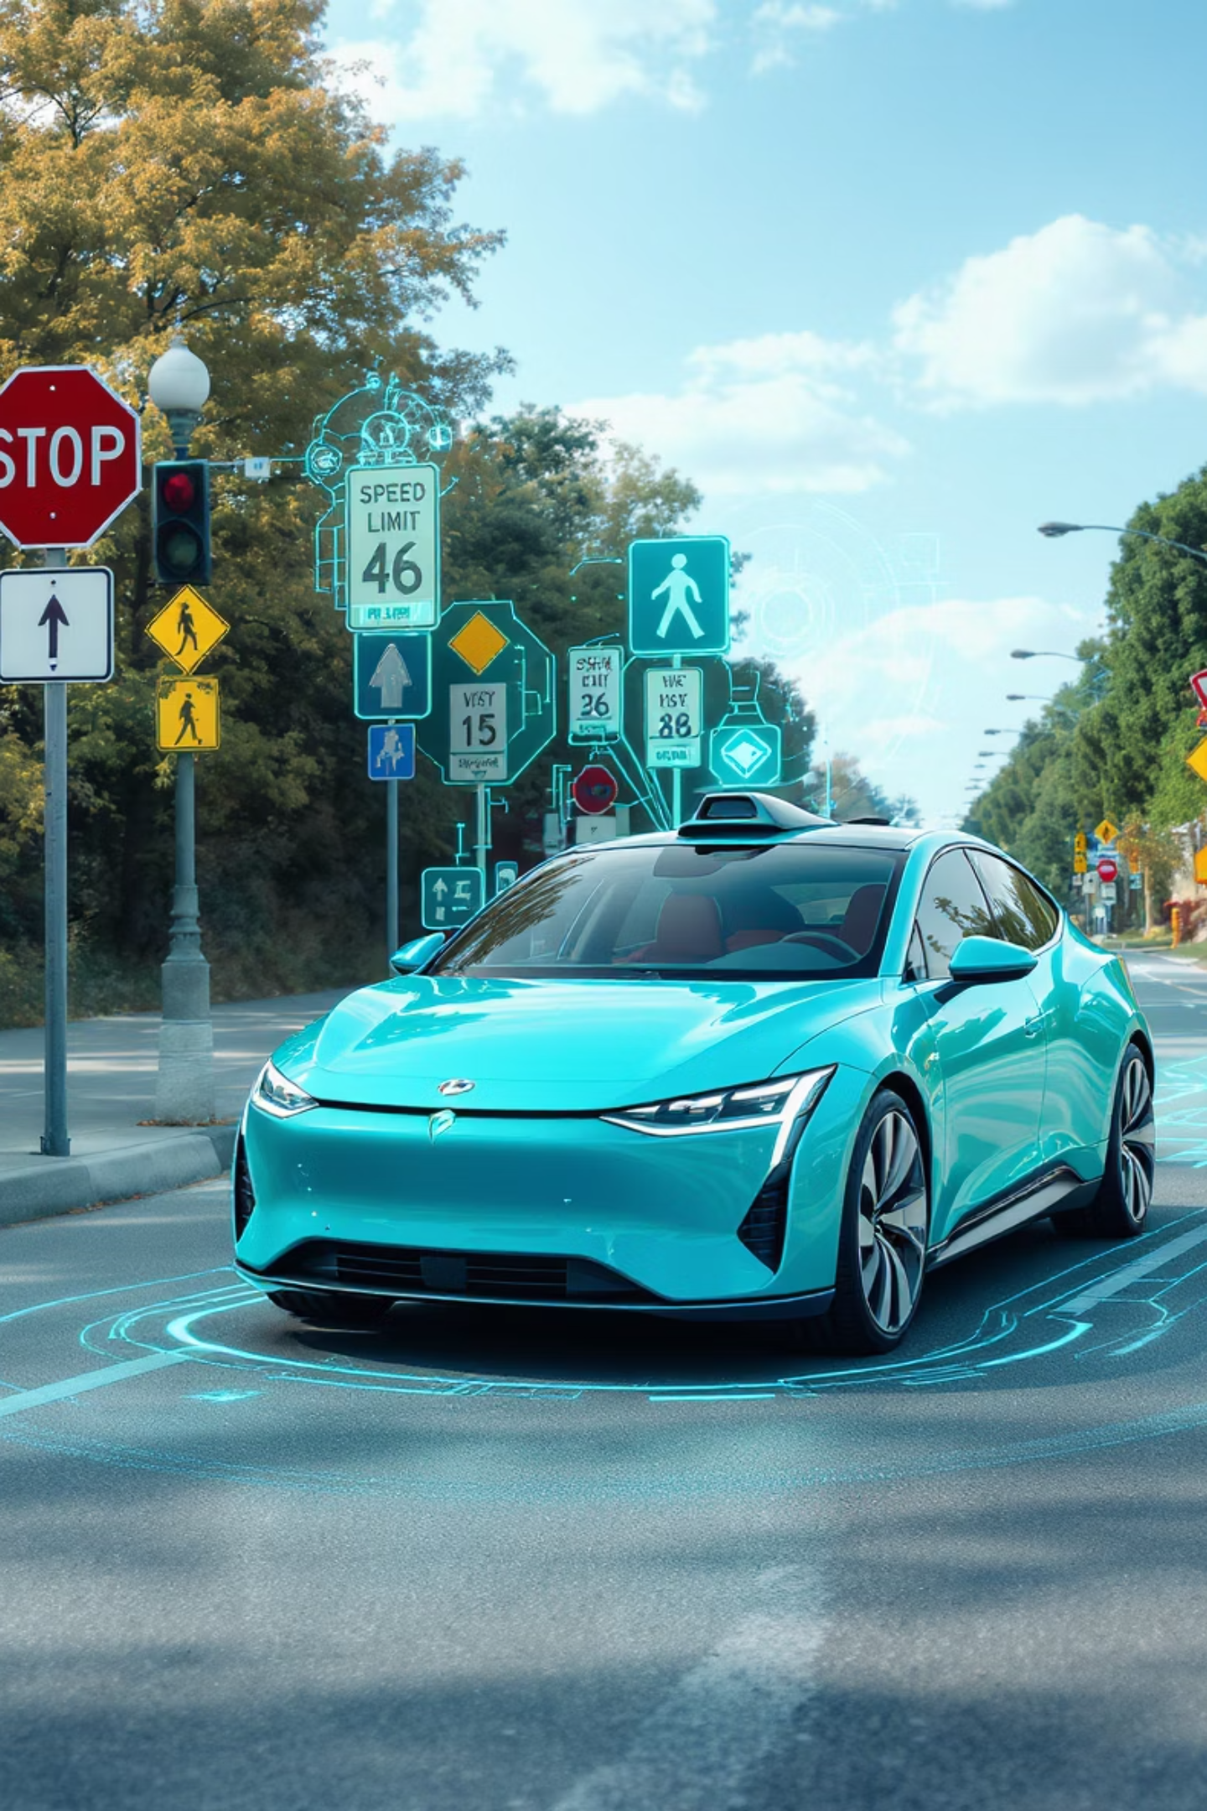
Traffic Sign Recognition for Autonomous Driving
COMP9444_
Ashwin Sudhir Jamgade (z5392534)
Xiangyu Dou (z5607625)
Ishu Rajput (z5611182)
Shashwat Pasari (z5623301)

Slide 2
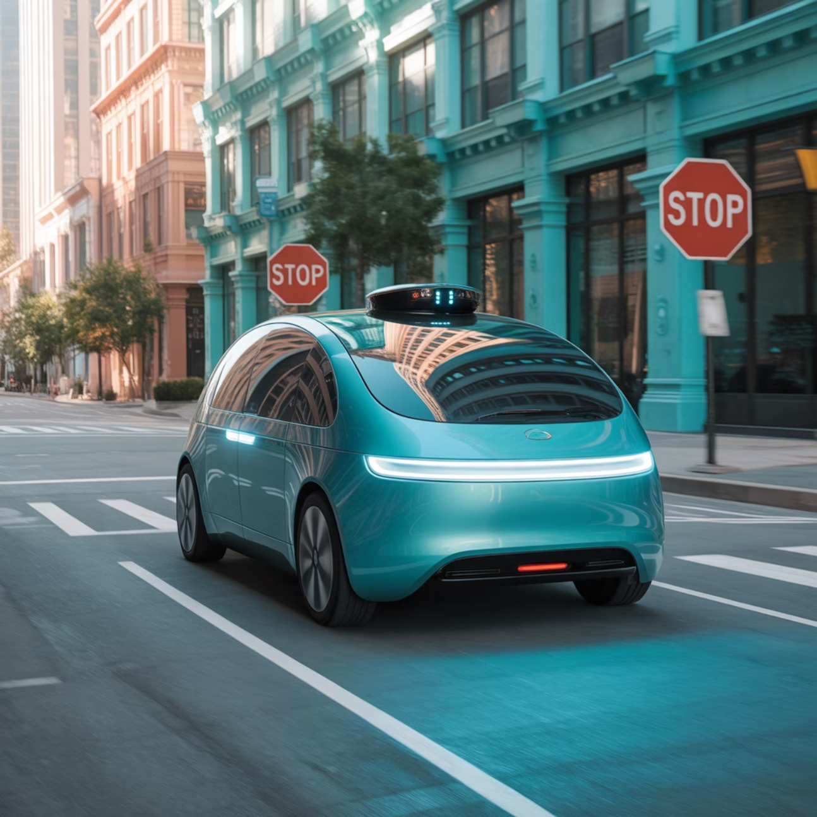
Motivation
The core instruction for any self-driving car is simple: "Don’t crash.”
To achieve this, the vehicle must not only avoid obstacles but also understand and follow traffic rules.
Traffic signs carry critical instructions—speed limits, stops, warnings—that guide safe navigation.
Ignoring or misreading these signs can cause accidents, traffic violations, or unsafe driving behavior.
Our goal is to build a system that allows autonomous vehicles to see, read, and interpret traffic signs as reliably as a human driver.
Applications:
Autonomous Vehicles
Advanced Driver Assistance
Fleet & Public Transport Safety
Smart Traffic Monitoring
HD Mapping & Mao Refresh
Navigation Systems

Slide 3
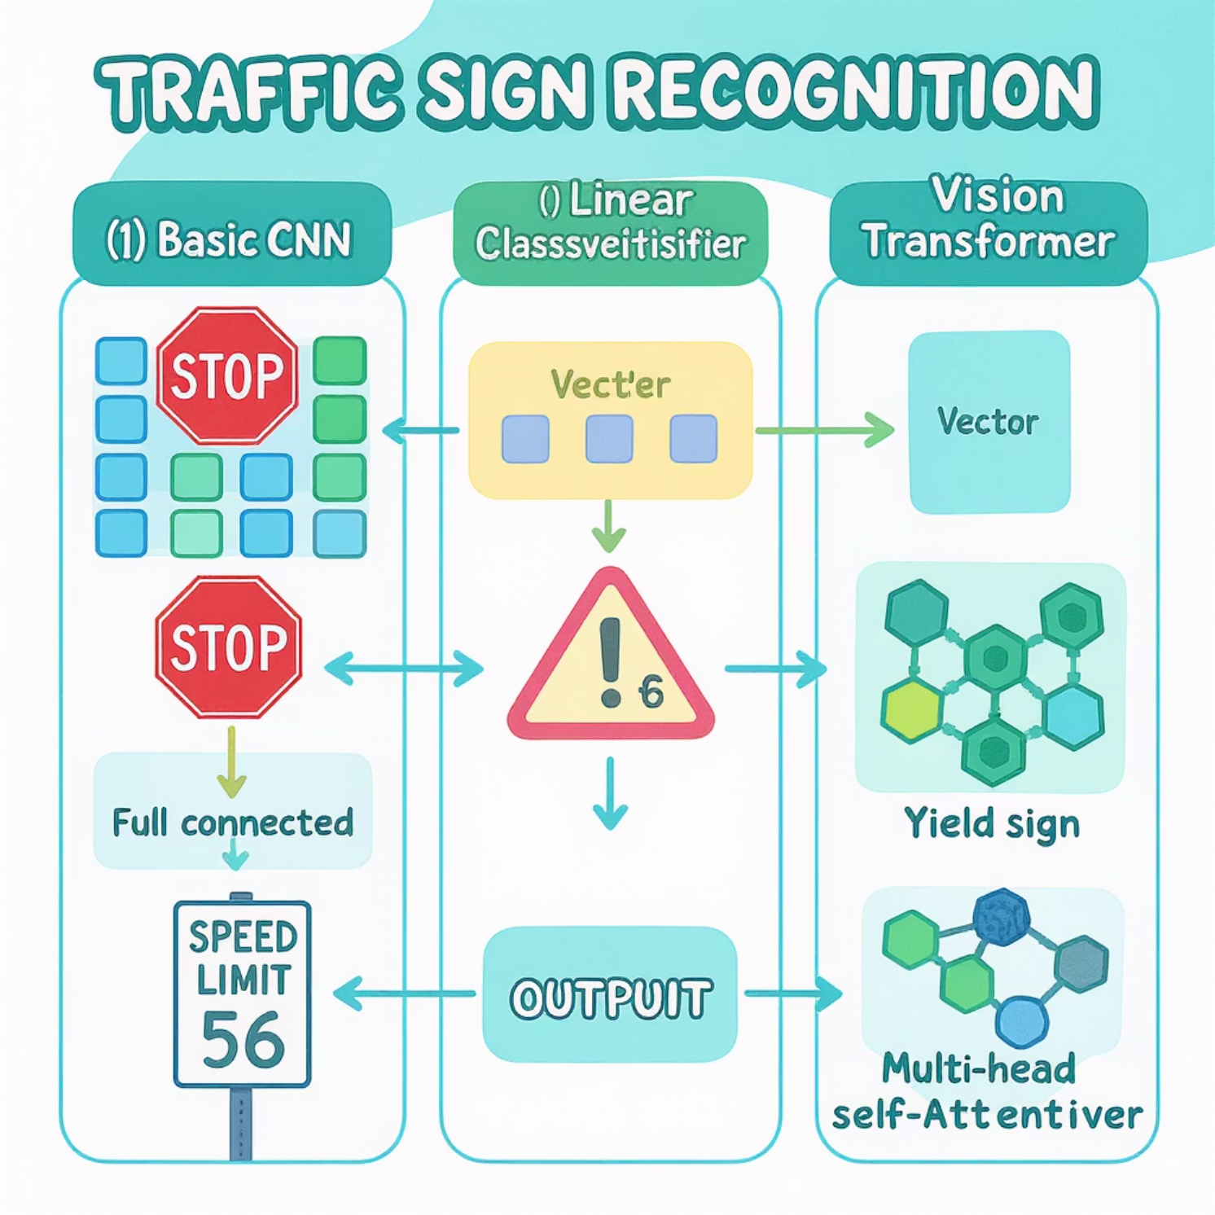



Problem Statement
Imagine a self-driving car approaching an intersection — it must instantly decide whether to stop, slow down, or turn. The only clues? The traffic signs on the road.
Our challenge is to teach a machine to see these signs and understand their meaning, just like a human driver. The model should correctly identify whether it’s a speed limit, stop sign, no entry, or any other rule — and do it in real time.
To tackle this, we use the German Traffic Sign Recognition Benchmark (GTSRB), a dataset of real-world traffic sign images
Models Compared:
Basic CNN
Convolutional Neural Network architecture
Linear Classifier
Simple baseline approach
Resnet50
Deep residual network architecture with skip connections.

Slide 4
Literature Review
Benchmark & Data
GTSRB: 43 classes, ~50k images; real-world variation (scale, blur, lighting, occlusion).
Detection benchmark also released for full-scene images.
.
Known gaps
Class imbalance → hurts rare signs.
Fine-grained confusions (e.g., nearby speed limits).
Small/occluded signs, motion blur, glare.
Generalization beyond GTSRB.
What’s been tried
Early CNNs: multi-scale conv nets establish strong baselines.
Multi-Column DNNs (MCDNN): ensemble of CNNs reaches ~99.4% on GTSRB.
Transfer Learning: VGG/ResNet fine-tuning achieves ~95–99% depending on layers unfrozen, augmentation, and schedule.
Inception (+ Spatial Transformer): reported ~99.8% at the time.
Efficiency Models: MobileNet targets on-device inference.
Vision Transformers (ViT): competitive with large-scale pretraining.
Our positioning
Compare a compact 64×64 CNN, ResNet-50 transfer, and an MLP baseline.
Stratified split, balanced oversampling (train only), and targeted augmentations.
Evaluation: macro/micro metrics, row-normalized confusion matrix, per-class counts, error gallery.

Slide 5
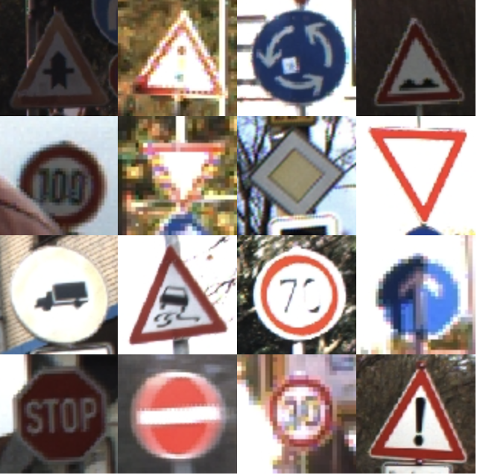
Dataset: German Traffic Sign Recognition Benchmark (GTSRB)
51,839
43
Total Images
Classes
Labeled traffic sign images from German roads
Different types of traffic signs
39,209
12,630
Training Images
Testing Images
Used to train the models
Used to evaluate performance
The GTSRB dataset includes variations in lighting, angles, and backgrounds,
making it challenging and realistic for real-world applications.

Slide 6
Data Analysis – Data and Preprocessing Basics
Dataset
GTSRB: 43 classes, 51,839 RGB images (Train 39,209, Test 12,630)
Real-world variation: scale, blur, illumination, occlusion, background clutter
Loaded via torchvision.datasets.GTSRB()
Splits & Sampling
Stratified 80/20 split from train → validation (preserve class ratios)
Train only: class oversampling to mitigate imbalance
(no oversampling in val/test to keep evaluation honest)
Resizing
Custom CNN / MLP: 64×64
ResNet-50 (transfer): 224×224 (ImageNet-compatible)
Interpolation: bilinear, antialias=True when downsampling

Slide 7
Data Analysis – Data Augmentation
Normalization (why?)
Stabilizes training, faster convergence, comparable pixel scales
64×64 pipeline (GTSRB stats):
mean=[0.3403,0.3121,0.3214], std=[0.2724,0.2608,0.2669]
ResNet-50 (ImageNet stats):
mean=[0.485,0.456,0.406], std=[0.229,0.224,0.225]
Augmentation (train only)
Geometric: rotations (±15°), translation (≤10%), shear (±10%), scale (0.9–1.1)
Color: jitter (brightness/contrast/saturation ±20%, hue ±0.02)
Goal: mimic real driving variation without destroying sign legibility
Sanity Checks (EDA)
Class frequency bar chart → confirms imbalance (min vs max counts)
One sample per class grid → quick visual audit of variety/quality
Verified: all labels in [0, 42], no missing classes in splits

Slide 8

Methods
CNN
Architecture (64×64 input)
3 × Conv Blocks: Conv → BatchNorm → ReLU → MaxPool → Dropout(0.25)
Classifier head: Flatten → Linear(256·8·8→512) → ReLU → Dropout(0.5) → Linear(512→43)
Activation (ReLU)
Applied after each conv layer.
Keeps only positive responses → fast training, helps avoid vanishing gradients.
Encourages sparse feature maps (only strong patterns activate).
Pooling (MaxPool 2×2)
Downsamples feature maps to halve H×W each block.
Increases receptive field (sees more context per neuron).
Adds translation invariance (small shifts don’t change the max).
Reduces compute and overfitting.
Feature Learning (hierarchical)
Block 1 (shallow): edges, colors, simple blobs.
Block 2 (mid): corners, circles/triangles (sign shapes), stripe patterns.
Block 3 (deep): pictograms & numerals (e.g., “60/80”), combined shape + color band cues.
Final MLP mixes these features to output 43-class logits.
Normalization & Regularization
BatchNorm: stabilizes activations → higher, safer learning rates.
Dropout (0.25 in blocks, 0.5 in head): prevents co-adaptation → better generalization.
Weight decay + data augmentation (rot/affine/color) further reduce overfitting.
Why this works for traffic signs
Signs are highly structured (strong edges, distinct shapes, color bands).
Convolutions + ReLU capture these local patterns, pooling provides robustness to small shifts/scale.
Compact depth at 64×64 gives an excellent accuracy–latency trade-off for deployment.
Limitations (CNN-only)
Less capacity than very deep nets/ensembles; may miss rare fine-grained distinctions under severe blur/occlusion without stronger augmentations or more data.

Slide 9
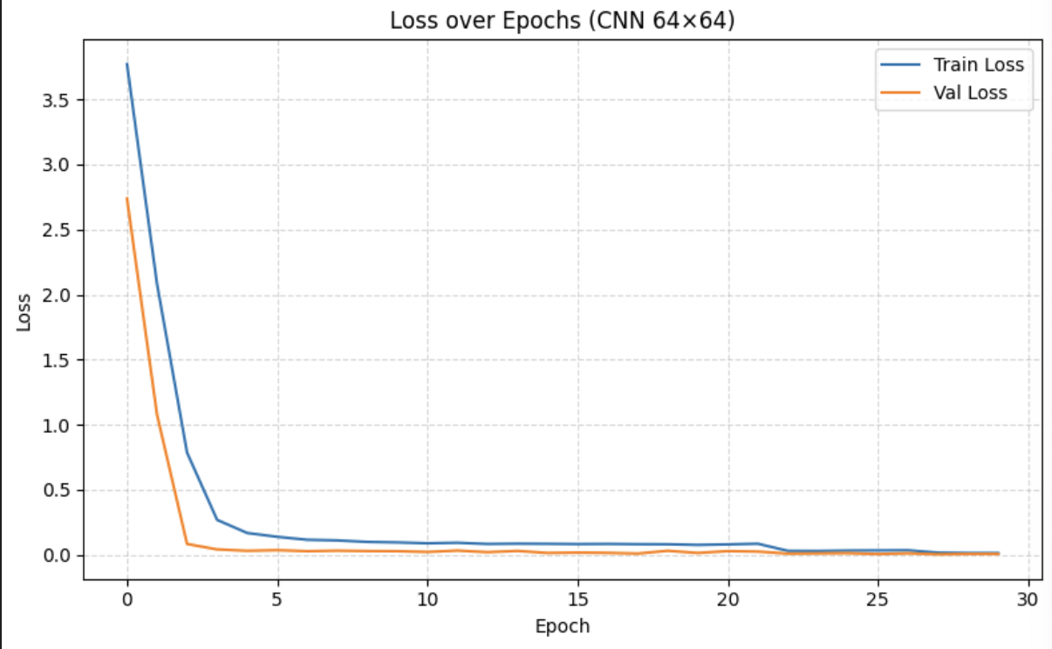
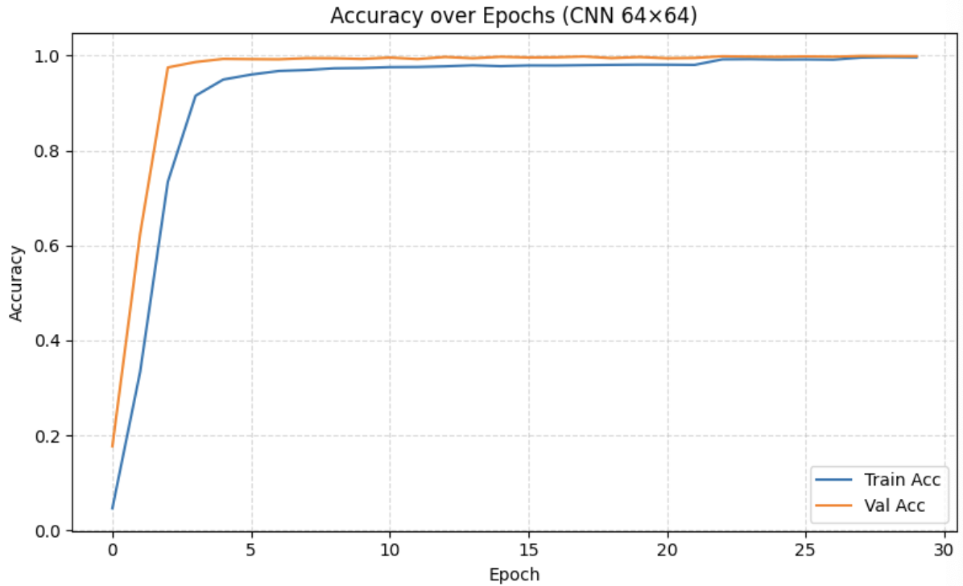
Convolutional Neural Network (CNN)
The CNN converges quickly: training and validation loss fall sharply in the first few epochs and are near zero by about 8–10 epochs. Validation accuracy climbs to ~99% by roughly 6–8 epochs and then plateaus, closely tracking the training accuracy. The tight overlap between train and validation curves suggests good generalization with no clear signs of overfitting; after the early phase, further epochs provide only marginal gains.

Slide 10

Methods
Linear Model
Architecture (ours, 64×64 input)
Flatten: 3×64×64 = 12,288 pixels → 1D vector
FC stack: 12288 → 2048 → 1024 → 512 → 256 → 43
Each hidden layer: BatchNorm → ReLU → Dropout (0.2–0.3)
Output: final linear layer → 43 logits (softmax at inference)
Activation (ReLU)
After every fully-connected layer.
Speeds training and mitigates vanishing gradients.
With BatchNorm, allows stable, higher learning rates.
Feature Learning (what it actually learns)
Learns global combinations of pixel intensities, not local patterns.
Lacks a spatial awareness (no kernels sliding over neighbours), so edges/shapes/symbols are not explicitly captured.
First layer is very large (12,288 × 2,048 params) → prone to overfitting on limited data without strong regularization.
No pooling (important):
There’s no MaxPool or downsampling. Small shifts or rotations in the sign can change many inputs, so the MLP isn’t naturally robust to movement or scale.
What it actually learns:
Global mixes of pixel values. It doesn’t naturally learn edges, shapes, or patterns the way a CNN does, because it lost the 2D layout.
Why we include it:
It’s a simple baseline to show why convolutions matter. Comparing MLP vs CNN makes the benefit of spatial features clear.
Main limitations:
Weaker at fine details (e.g., “60” vs “80”).
Sensitive to position, rotation, blur, lighting.
Very parameter-heavy in the first layer → easier to overfit without strong regularization.

Slide 11
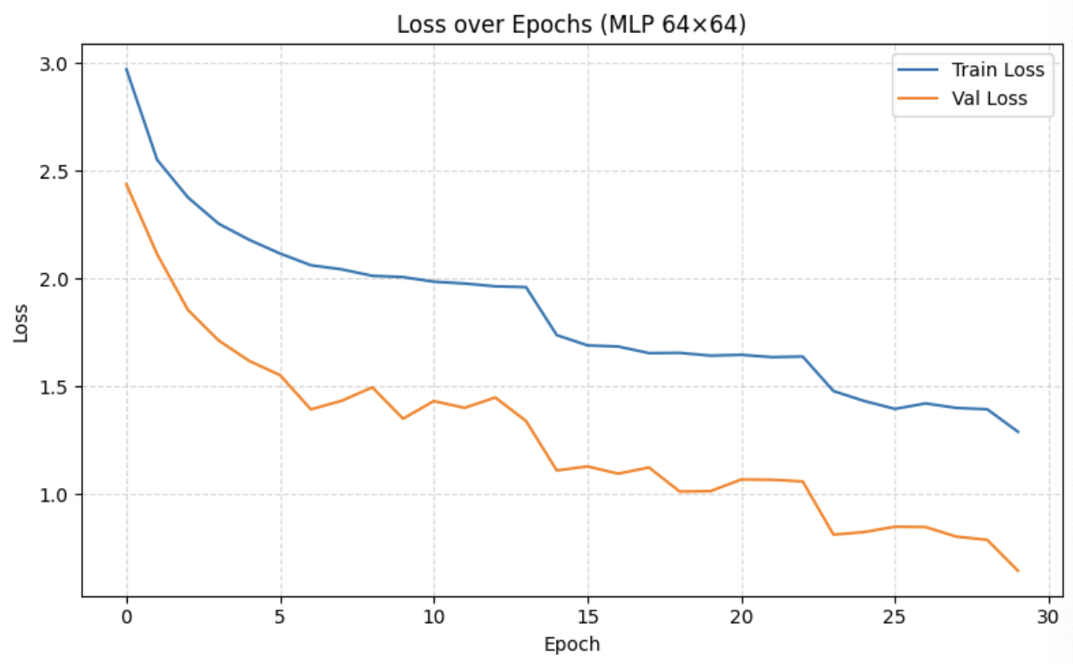
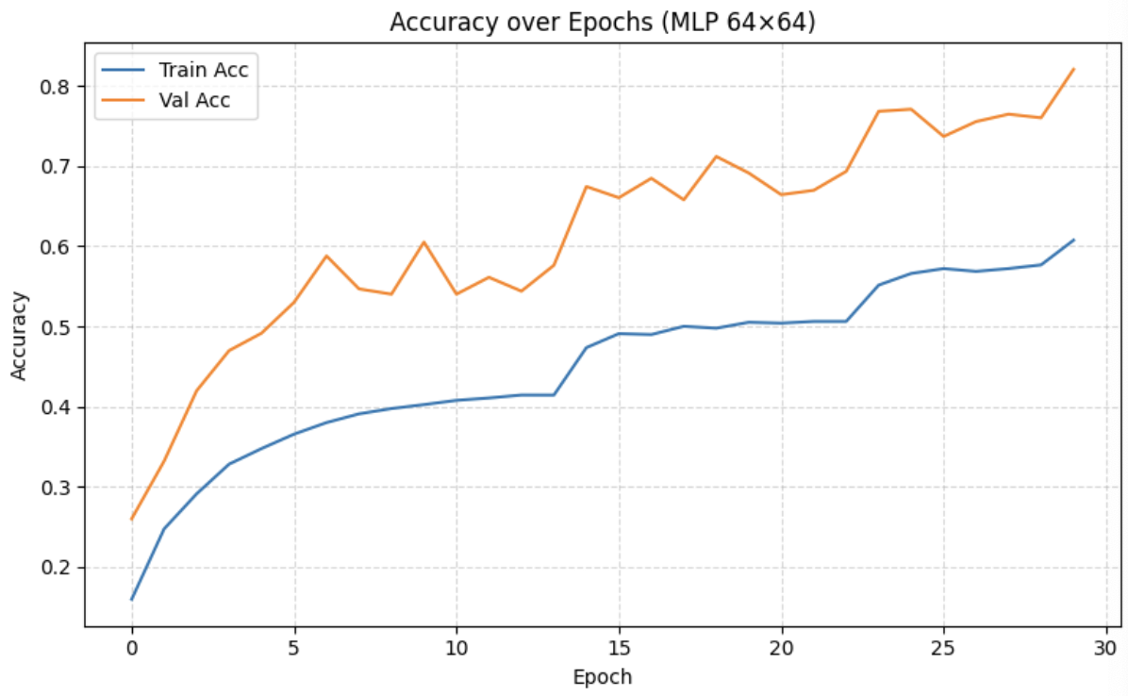
Linear model
The MLP improves steadily but much more slowly than the CNN. Training and validation loss decline throughout the run, with validation loss consistently below training loss, suggesting regularization is effective and there’s no clear overfitting. Accuracy rises from roughly 20% in the first epoch to about 75–80% by the end, though the validation curve is noisier and a clear gap remains between train and validation accuracy. Overall, the model learns, but its ceiling is limited, consistent with a flat, non-convolutional network that can’t exploit spatial structure in images.

Slide 12

Methods
Resnet50
What it is:
A deep convolutional network with skip (residual) connections. We start from a pretrained model (trained on ImageNet) and fine-tune it for 43 traffic-sign classes.
How it processes the image:
Input size: images are resized to 224×224 to match what the pretrained model expects.
Convolutions + BN + ReLU: stacked many times to learn rich visual patterns.
Residual (skip) connections: let the network “jump over” layers so gradients flow easily → stable training even when very deep.
Downsampling: early MaxPool and strided convs slowly shrink the image while increasing feature depth.
Global Average Pooling (GAP): at the end, averages features across the image → a compact vector for the classifier.
Transfer learning (why it helps):
The pretrained model already knows general features (edges, textures, shapes).
We replace the last layer with a head for 43 classes, keep most layers frozen, and unfreeze the last block(s) to learn sign-specific patterns (numbers, pictograms, color bands).
This works well when you don’t have millions of labeled images.
Normalization & transforms:
Use ImageNet mean/std so inputs look like what the model saw during pretraining.
Light augmentations (small rotations/affine, mild color jitter) to improve robustness without distorting signs.
What it actually learns:
Early layers: edges and simple textures.
Middle layers: shapes and parts (circles/triangles, borders).
Late layers: high-level sign cues (digits like “60/80”, pictograms), combining shape + color.
Why choose ResNet-50:
Strong accuracy thanks to deep features + transfer learning.
Residual connections make deep training reliable.
Good generalization with proper fine-tuning.
Main trade-offs / limitations:
Heavier than our custom 64×64 CNN → slower and needs more memory.
Needs careful fine-tuning (which layers to unfreeze, learning rate/schedule).

Slide 13
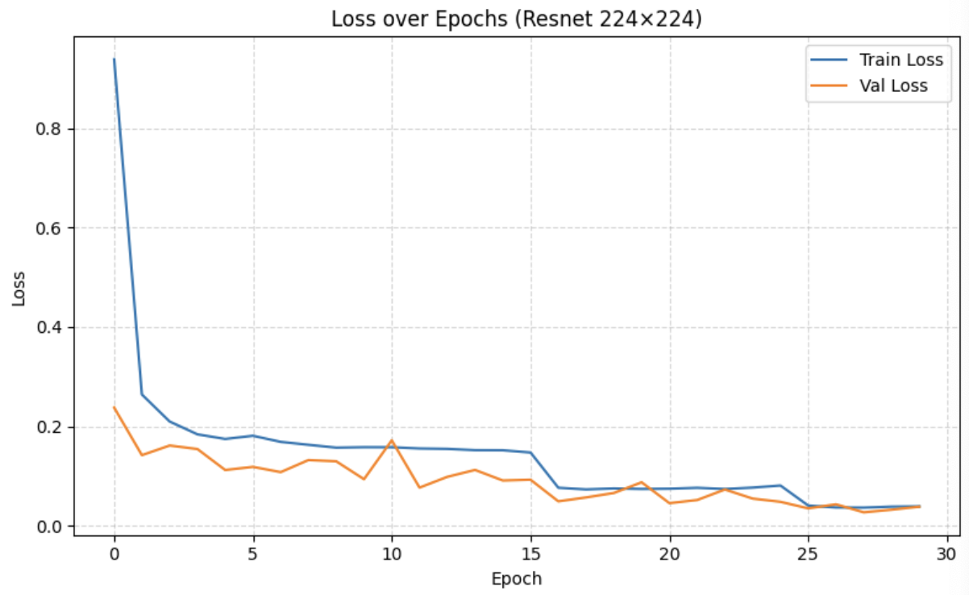
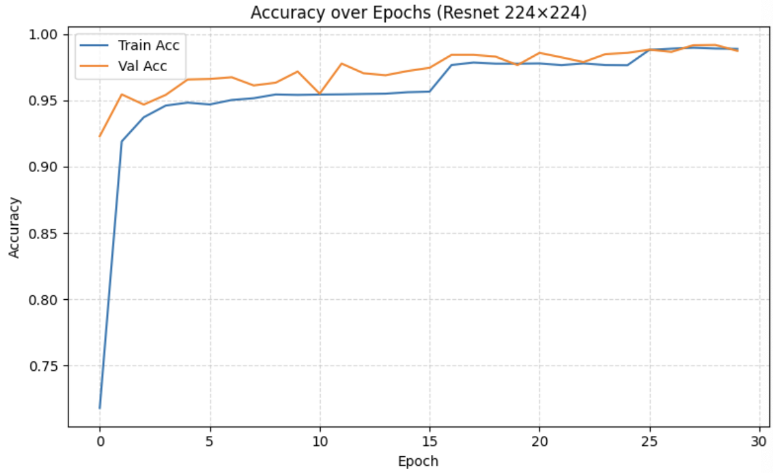
Resnet50
ResNet-50 fine-tuning converges quickly. Training and validation loss collapse within the first few epochs and then taper toward a small value, with the two curves tracking closely, no obvious overfitting. Validation accuracy jumps to 98% after just a handful of epochs and creeps toward 99% as training proceeds, showing the benefit of pretrained features. Minor wiggles in the curves are consistent with the learning-rate schedule, but performance plateaus by 15–20 epochs, indicating the model has effectively adapted to the task.

Slide 14
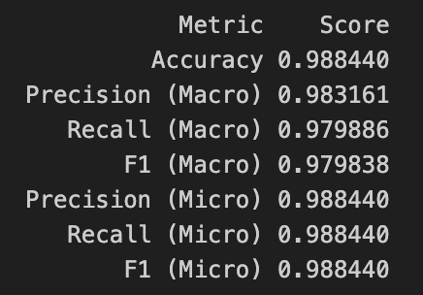
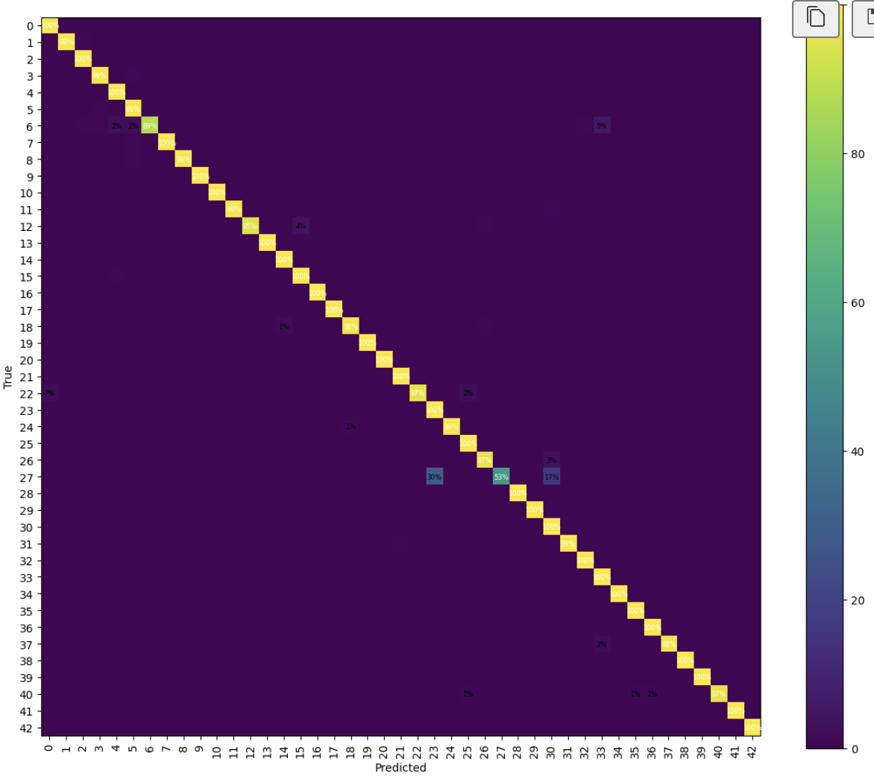
Results - CNN
These results mean the CNN is both accurate and balanced. Macro and micro scores being nearly identical shows it performs consistently across all 43 classes, not just the common ones. High precision and recall imply few false positives and few misses, so the model generalizes well beyond the training set. The remaining mistakes are likely edge cases, visually similar signs (e.g., nearby speed limits), small/blurred signs, or low-light frames, suggesting that further gains would come from stronger augmentation or ensembling, rather than basic tuning.
Confusion matrix (CNN) — The plot is strongly diagonal, showing high per-class recall across all 43 signs. Off-diagonal cells are sparse and low, indicating only a few mix-ups. The errors that do appear are mostly between visually similar classes (e.g., neighbouring speed-limit signs), with no single class being a consistent source of confusion, result of balanced, well-generalized performance.

Slide 15
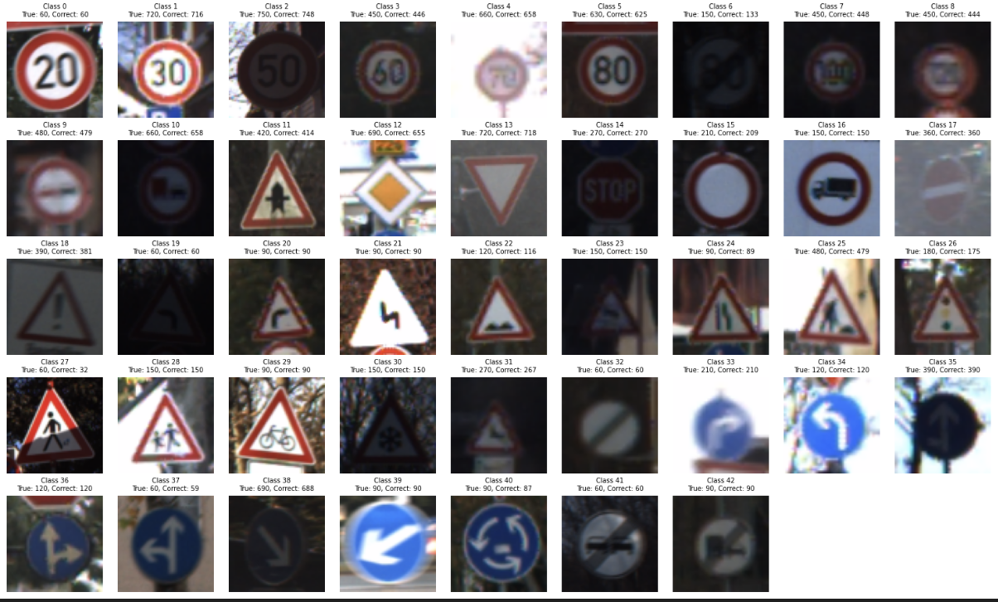
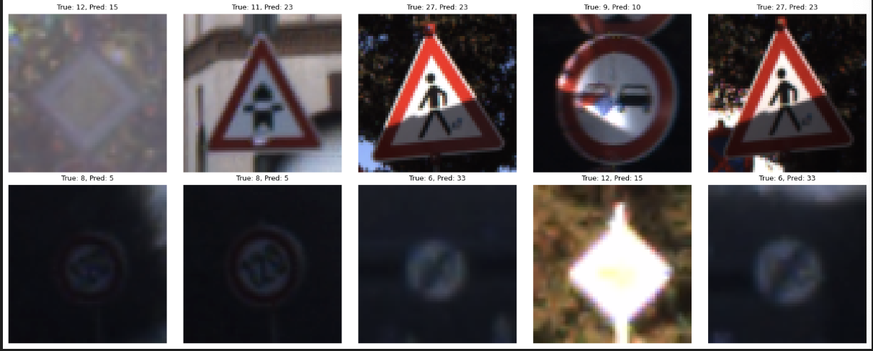
Per-class grid:
Most classes are near-perfect (True ≈ Correct); several are perfect (e.g., IDs 17, 23, 28, 30, 33, 39, 41–42).
Clear weak spots: ID 27 = 32/60 and ID 6 = 133/150; small drops for 18, 24, 31, 40.
Misclassified gallery:
Errors mostly show heavy blur/low-light/glare, tilt/occlusion, or small/distant signs.
Confusions follow shape groups—triangles and triangles, circles and circles, when digits or signs are unreadable.

Slide 16
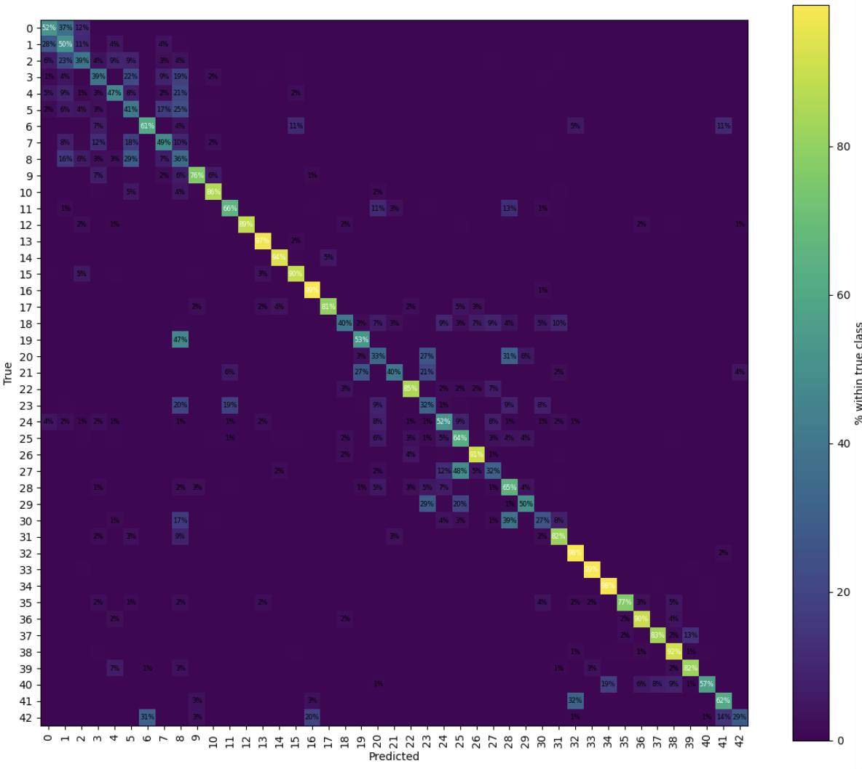
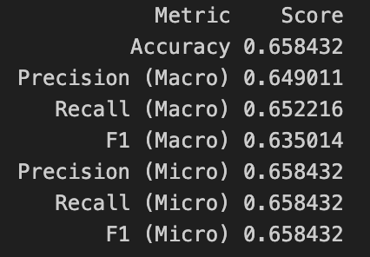
Results - MLP
Performance is much weaker than CNN/ResNet. Macro and micro scores are close, so the model is consistently mediocre across most classes rather than failing on just a few. The lower precision and recall show both many false positives and many misses. This is expected for an MLP that flattens the image and can’t exploit spatial patterns (edges, shapes, digits), so its ceiling sits around the mid-60s.
Confusion matrix (MLP) — The diagonal is faint and there are many off-diagonal cells, meaning frequent mix-ups across classes. Errors cluster among visually similar signs (e.g., nearby speed-limit values, triangular warnings) and when signs are small, blurred, or tilted. No single class dominates the errors—the model lacks spatial bias, so confusion is widespread.

Slide 17
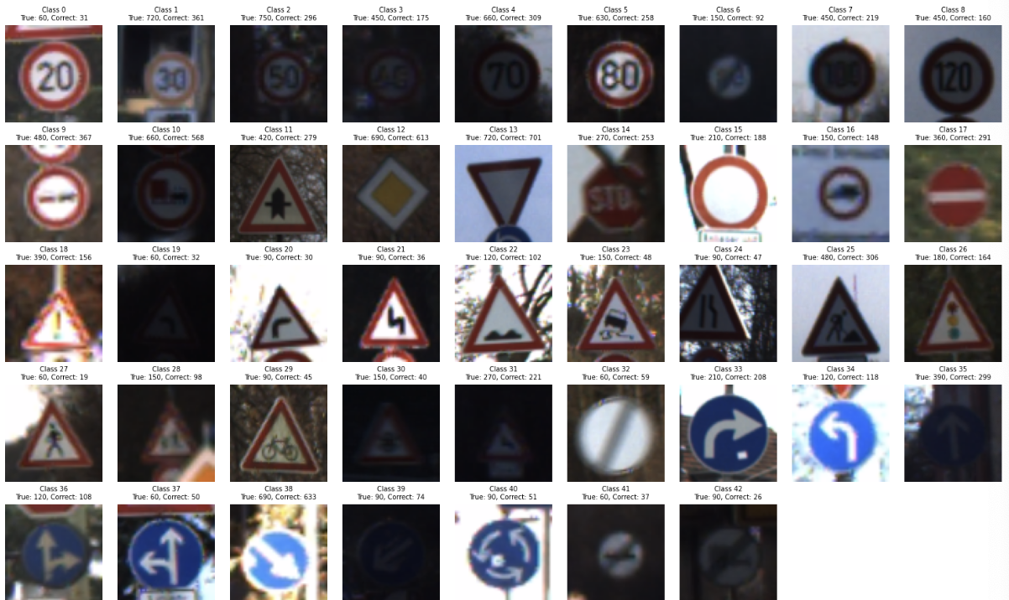
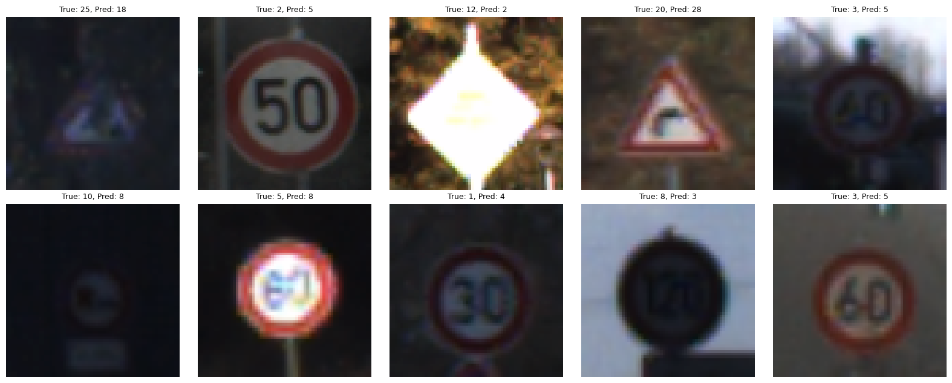
Per-class predictions:
Large gaps for many classes: e.g., 0: 31/60, 2: 296/750, 3: 175/450, 23: 48/150, 27: 19/60, 30: 40/150, 42: 26/90.
Stronger classes: 13, 14, 16, 32–34, 36, 38 (≈90–99% correct).
Systematic weakness on speed limits (misreading the digit), triangular warnings (18,20,21,23,27,29–31), and blue direction signs (40–42).
Misclassified samples:
Many errors are within-shape confusions: 50→80, 60→80, triangles, other triangles, blue circles, other blue circles.
Failures often show low light/blur/overexposure; digits or shapes become unreadable, so the MLP relies on coarse color/shape and guesses the wrong class.

Slide 18
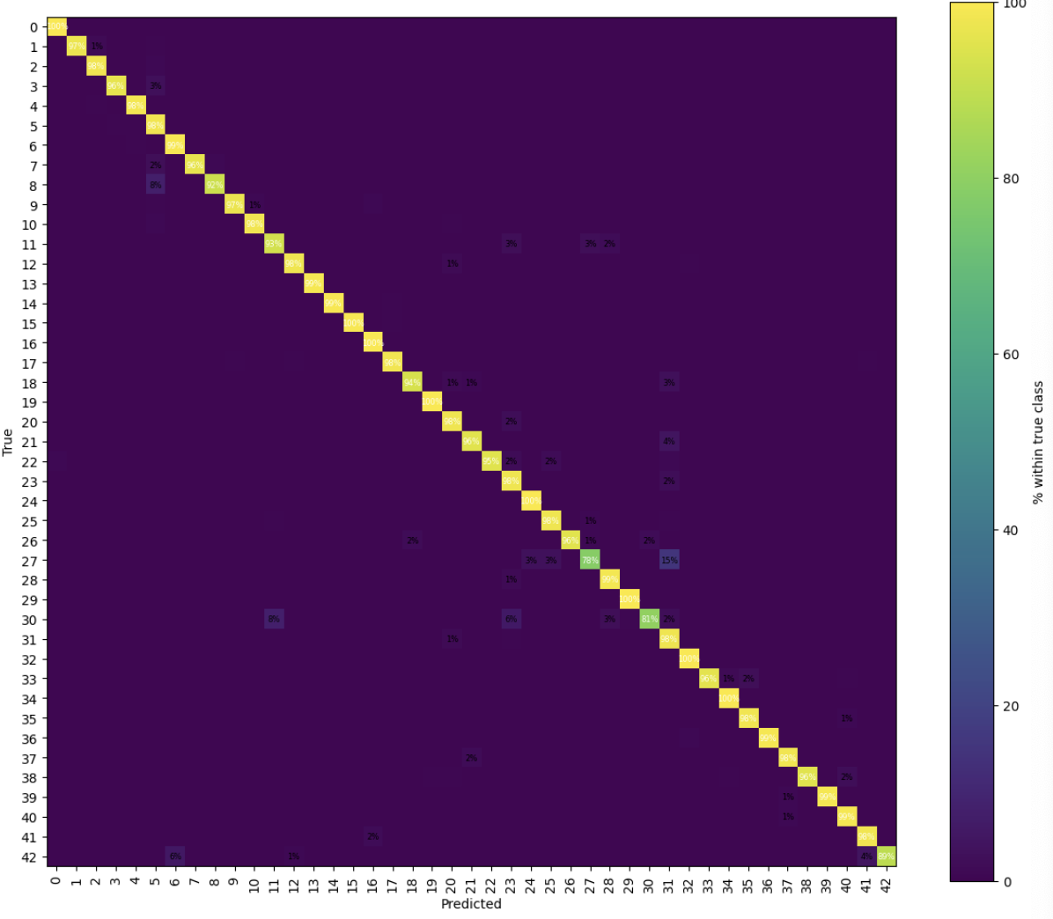
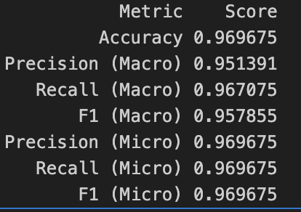
Results - Resnet
ResNet-50 performs strongly and consistently. Macro and micro scores are very close, which means the model is balanced across all 43 classes, not just the common ones. The high precision and recall show few false alarms and few misses, reflecting good transfer from ImageNet pretraining. The small gap to the CNN suggests more fine-tuning or stronger augmentations could squeeze out a bit more performance.
Confusion matrix (Resnet) — The plot is sharply diagonal, indicating high per-class recall. Off-diagonal errors are rare and low, mostly between visually similar signs (e.g., neighboring speed-limit values). There’s no single problematic class, pointing to well-balanced generalization.

Slide 19
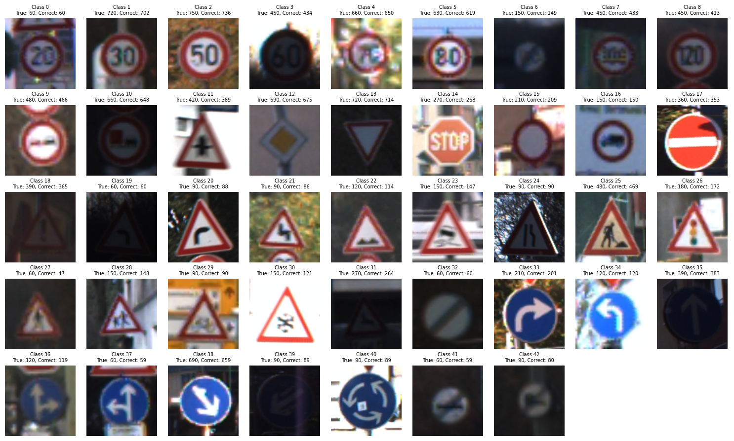
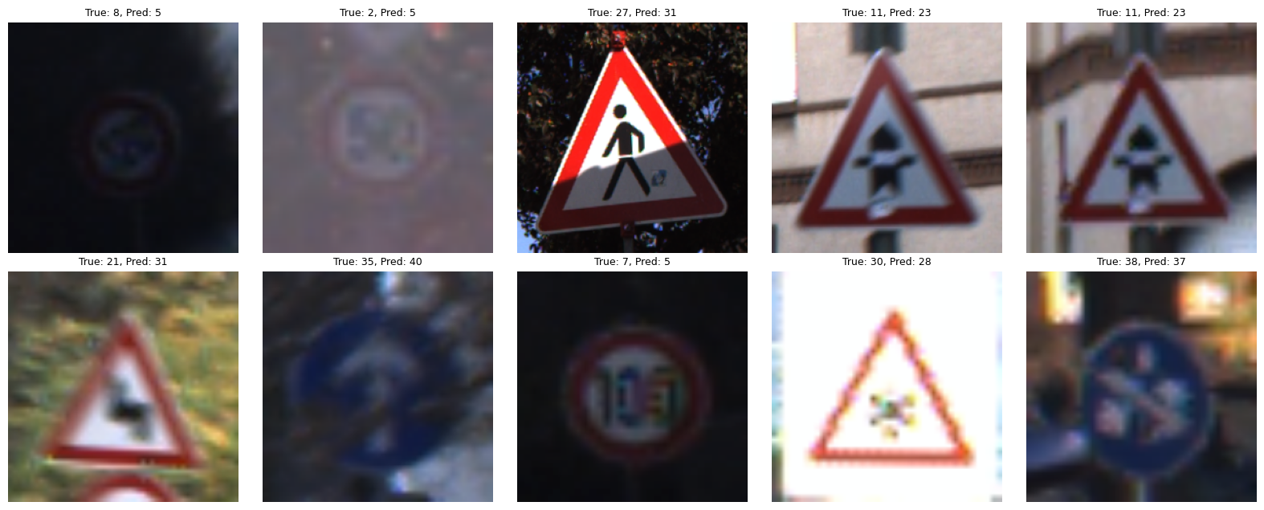
Per-class predictions:
Mostly near-perfect; many classes are 100% or ≥98% (e.g., 0, 16, 24, 29, 32, 34, 36–37, 39–41).
Noticeable dips: 27 → 47/60 (~78%), 30 → 121/150 (~81%), 42 → 80/90 (~89%), plus lighter drops for 11, 15, 8.
Weak spots align with fine-grained digits (speed limits) and some triangular warnings.
Misclassified examples (right):
Errors are mostly within the same shape family:
  Speed limits: 2→5, 7→5, 8→5 (digit confusion under blur/low light).
  Triangles: 11→23, 21→31, 30→28
  Blue signs: 35→40.
Root causes: low light, glare, blur, occlusion, making digits/pictograms hard to read.

Slide 20
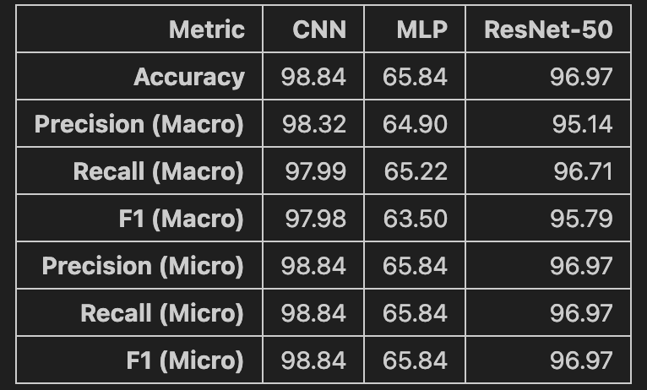
Discussion
Model trade-offs
CNN (98.84%) gives the best accuracy with a light 64×64 pipeline → fast and edge-friendly.
ResNet-50 (96.97%) is close behind and more robust to variation, but needs larger inputs (224×224) and more compute.
MLP (65.84%) lags because it ignores image geometry; useful only as a baseline.
Why feature learning matters
The big gap between MLP vs CNN/ResNet shows that spatial features (edges, shapes, digits) are essential for traffic signs, raw pixels alone aren’t enough.
Role of augmentation
Mild rotations/affine shifts and color jitter improved generalization and reduced overfitting by exposing the models to blur, tilt, shadows, glare seen in real driving.
Imbalance handling
Stratified split + class-balanced sampling in train kept macro ≈ micro scores for CNN/ResNet, indicating balanced performance across frequent and rare classes.
Error patterns & limits
Remaining mistakes cluster among visually similar signs (e.g., nearby speed limits; triangular warnings).
Hard cases: low light, motion blur, occlusion, very small signs.
Practical takeaway
For this task, a compact CNN offers the best accuracy–latency trade-off; ResNet-50 is a good choice when compute allows and further fine-tuning/augmentation can be applied.
Presenter: Zahra Donyavi (zxxxxxxx)

Slide 21
Conclusion – AI eyes on every sign for a safer drive every time
We set out to teach machines to see and understand traffic signs by testing three distinct approaches.
Our Convolutional Neural Network (CNN) emerged as the top performer, achieving 98.9% accuracy with efficient computation.
ResNet50 followed closely with 96.9% accuracy, delivering excellent results through deep residual learning, though potentially requiring more computational resources.
The linear classifier highlighted the limitations of shallow, non-hierarchical models for this task.
Key Takeaways:
Deep learning delivers — CNNs and Resnet-based architectures are highly effective for traffic sign recognition.
CNNs strike the balance between accuracy, speed, and deployability for real-time systems.
Data preprocessing and augmentation are essential for robust, generalizable models.
Future Work:
Test extensively in real-world conditions — rain, fog, glare, snow, and partial occlusions.
Optimize architectures for edge deployment with real-time inference on in-vehicle hardware.
Explore domain adaptation to ensure consistent performance across different regions and sign designs.

Slide 22

Thank You
Thank you for your attention!

