Slide 1



COVID-19 Detection in Chest CT Scans
Iraklis Spyrou
Multimodal ML

Slide 2
Purpose of this project
Implement and compare three deep-learning models (Custom CNN, ResNet18, ViT-B/16) for COVID-19 vs. non-COVID classification on chest CT slices.
Evaluate their diagnostic performance using accuracy, precision, recall and macro F1 on a balanced 2,482-slice dataset.
Apply SmoothGradCAM++ to generate visual heatmaps that highlight model attention regions.
Quantitatively assess explanation fidelity with the MoRF (Most Relevant First) protocol and AOPC (Area Over the Perturbation Curve).
Derive insights into how model capacity and transfer learning affect both performance and explainability in limited-data medical imaging contexts

Slide 3
Data and Pre-processing
Dataset • SARS-COV-2 CT-Scan (Kaggle) – 1252 COVID / 1230 non-COVID 2D slices • Class-wise split: 70 % train, 15 % validation, 15 % test
Pre-processing • Resize to 224 × 224 pixels • CNN inputs: convert to single-channel grayscale → tensor → normalize (mean = 0.5, std = 0.5) • ViT inputs: replicate grayscale into 3 channels → tensor → normalize with ImageNet stats (mean = [0.485, 0.456, 0.406], std = [0.229, 0.224, 0.225])
Data Augmentations (training only) • Random horizontal flip (p = 0.5) • Random rotation (± 10°)

Slide 4
Models’ Architecture
CustomCNN
~1.2 M parameters, built from scratch
Four 3×3 Conv–BatchNorm–ReLU blocks (channels: 32→64→128→256)
Each block followed by 2×2 max‐pooling
Global average pooling → Dropout (p=0.3) → 2‐unit classifier
ResNet18
~11.2 M parameters, pretrained on ImageNet
First 7×7 conv modified for 1-channel input
Original 1000-way head replaced with 2-class linear layer
Fine-tuned end-to-end on CT data
ViT-B/16
~86 M parameters, pretrained on ImageNet-1K
16×16 patch embedding; position embeddings retained
Grayscale slices replicated to 3 channels for input
Final 1000-class head swapped for 2 logits

Slide 5
Training Phase
Asset | Setting
Learning Rate | 1x10-4
Optimizer | AdamW
Loss | BCE
Batch Size | 32
Epochs | CustomCNN: up to 70 ResNet18 and ViT: up to 20
Early Stopping | 7 epochs without val loss improvement

Slide 6
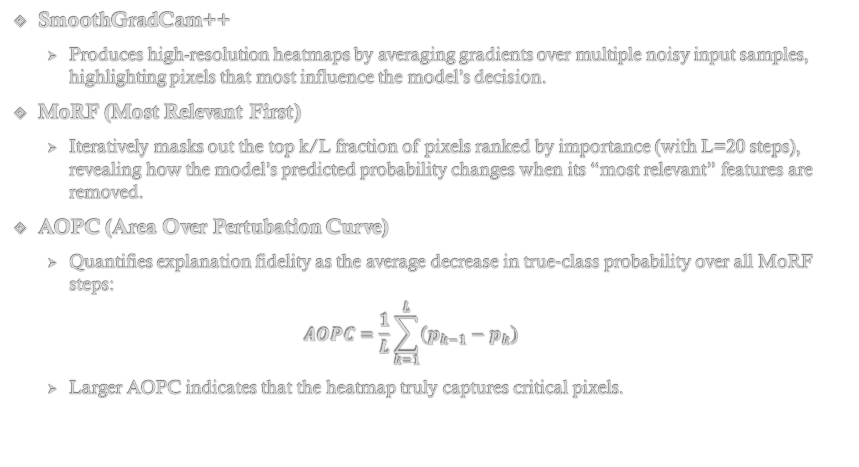
Explainability Techniques
SmoothGradCam++
Produces high-resolution heatmaps by averaging gradients over multiple noisy input samples, highlighting pixels that most influence the model’s decision.
MoRF (Most Relevant First)
Iteratively masks out the top k/L fraction of pixels ranked by importance (with L=20 steps), revealing how the model’s predicted probability changes when its “most relevant” features are removed.
AOPC (Area Over Pertubation Curve)
Quantifies explanation fidelity as the average decrease in true‐class probability over all MoRF steps:
$$AOPC=\frac{1}{L}\sum_{k=1}^{L}{\left(p_{k−1}−p_{k}\right)}$$
Larger AOPC indicates that the heatmap truly captures critical pixels.

Slide 7
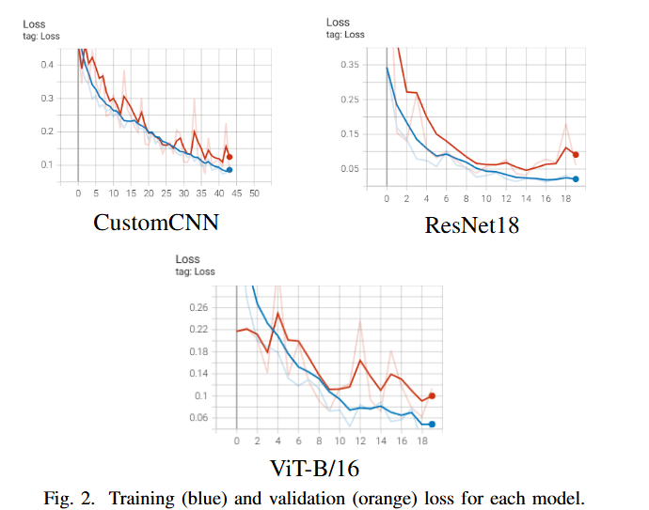
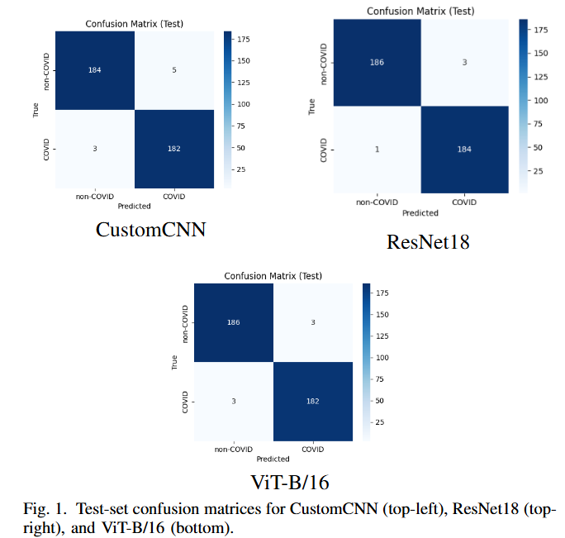
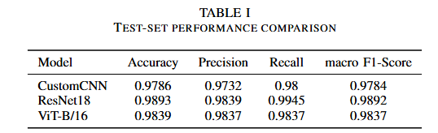
Loss Curves and Classification Results

Slide 8
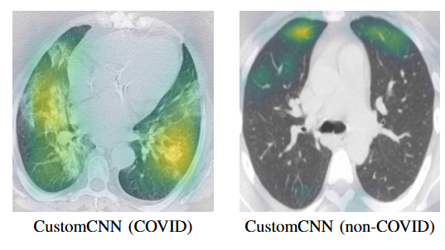
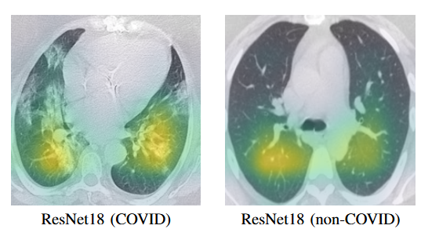
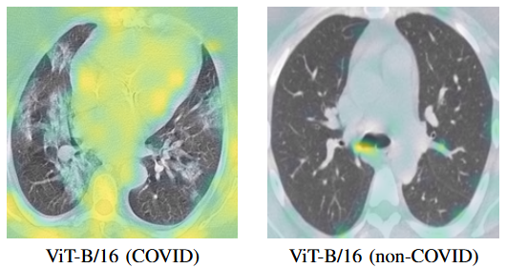
GradCam Visualizations

Slide 9
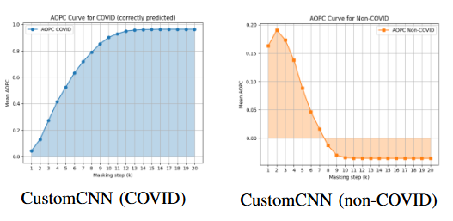
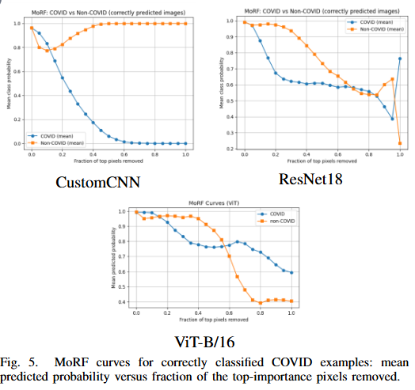
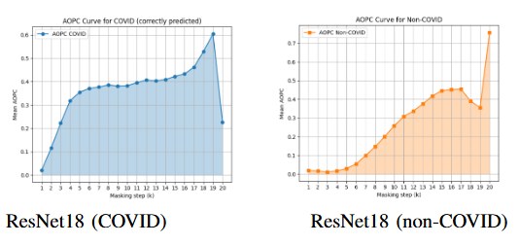
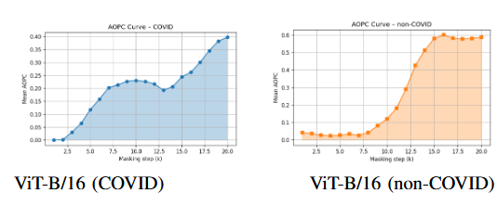
MoRF/AOPC

Slide 10
Conclusions and Take-Aways
Transfer learning excels: ResNet18 achieves the highest accuracy (98.9 %) and most precise, localized explanations, converging in under 20 epochs.
Custom CNN holds its own: CustomCNN reaches 97.9 % accuracy—just 1 % below ResNet18—and its heatmaps correctly highlight COVID lesions, showing that even a small, purpose-built model can be competitive.
Explainability confirmed: SmoothGradCAM++ aligns with clinical findings, and MoRF/AOPC metrics quantitatively verify that models rely on genuine pathology, not spurious cues.
Model-specific limitation: The lightweight CustomCNN, due to its limited capacity, learned only COVID-positive patterns and failed to capture explicit non-COVID cues, leading to one-sided decision behavior.
Next steps: self-supervised CT pretraining, multi-class disease classification, and ensembling to further boost performance and robustness.

Slide 11


