Slide 1
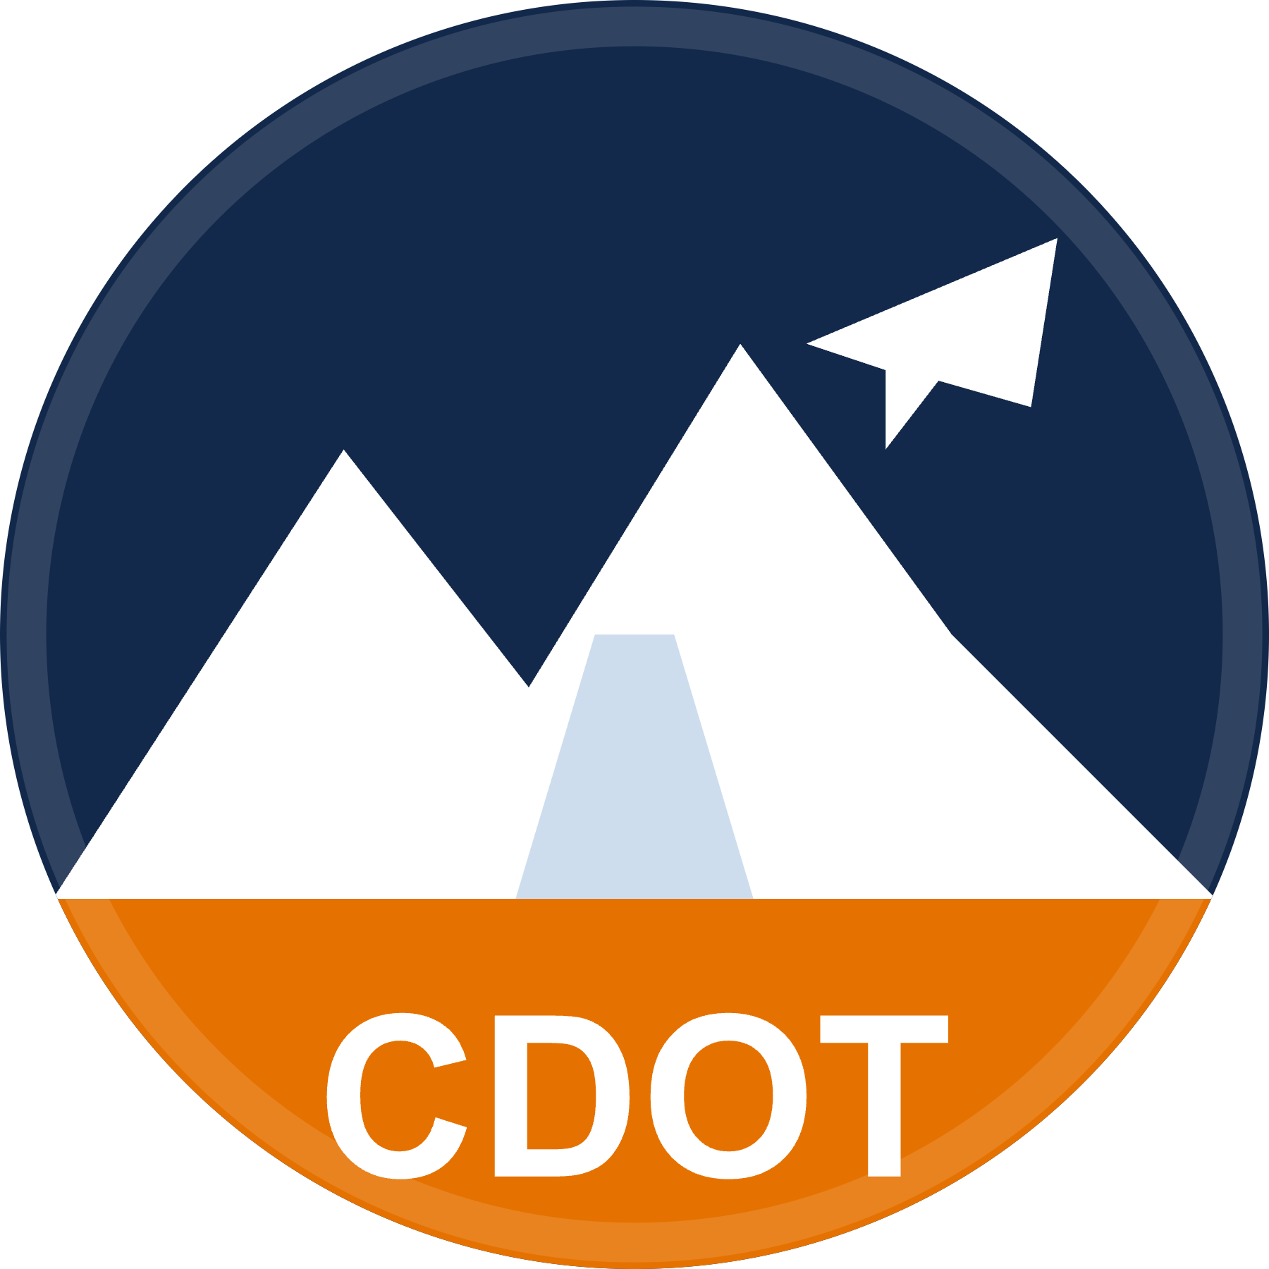
CDOT Compass
INTELLIGENT CAREER NAVIGATION PLATFORM
Find your way
across CDOT.
Helping employees discover opportunities, build relationships,
and navigate careers across CDOT.
Sonia Irakoze
Staff Bridge Intern · CDOT Innovation Challenge
LIVE DEMO
cdot-compass.vercel.app

Slide 2
THE PROBLEM
The opportunities were everywhere.
They just weren't easy to find.
Some of the best parts of my internship happened in conversation — at lunch, at a networking event, in passing. That's how I heard about a mentor in another division, an exciting field day out on an active project site, a project that could use a fresh set of eyes.
CDOT already offers so much of this. It's just spread across emails, resource sites, Teams, networking events, and the people who happen to know — so for a new intern, a lot comes down to who you talk to.
I kept wondering how much I might be missing simply because I didn't know where to look.
WHERE THE INFORMATION LIVES TODAY
Email
Resource websites
Teams
Networking events
Hallway conversations
In someone's memory
Individual employees
CDOT Compass · Innovation Challenge Prototype
02

Slide 3
WHY IT MATTERS
When discovery is hard, everyone loses.
I
Interns
Spend weeks figuring out what already exists.
N
New employees
Onboard slower without a clear map of the org.
R
Rotational engineers
Struggle to find their next-best rotation.
M
Mentors
Stay invisible to the people who need them.
M
Managers
Can't easily surface their team's work.
C
CDOT
Misses chances to put talent where it thrives.
The real cost: CDOT may unintentionally miss the chance to connect talented people with the divisions where they'd thrive.
CDOT Compass · Innovation Challenge Prototype
03

Slide 4
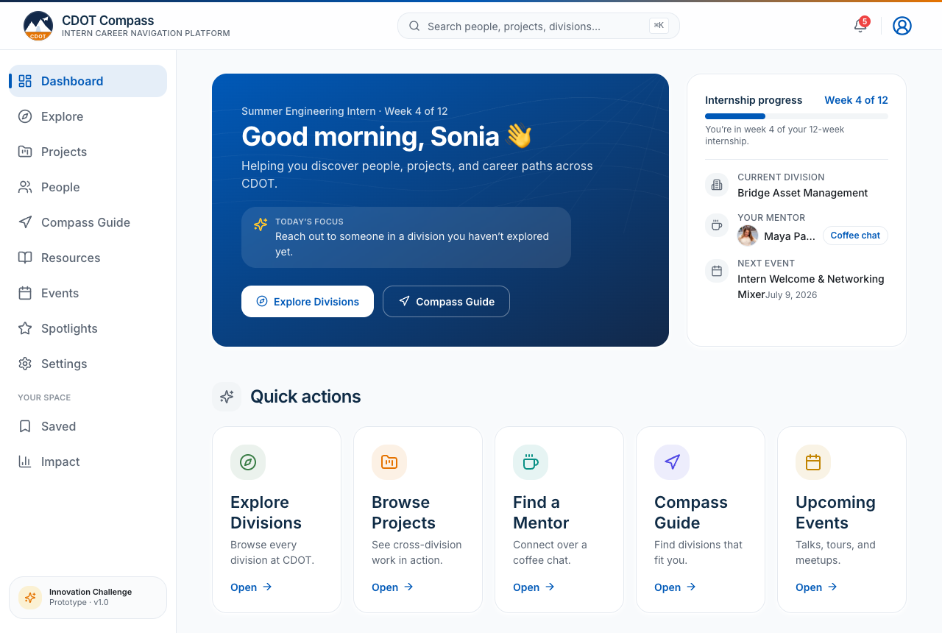
THE SOLUTION
One place to discover everything
CDOT already offers.
CDOT Compass doesn't create new programs. It makes the people, projects, and pathways that already exist
visible, searchable, and easy to act on.
B
Explore divisions
P
Discover projects
M
Find mentors
→
Career pathways
☕
Networking & coffee chats
★
Resources & events
✦
Personalized discovery
A personalized home base — recommendations, saved items, and progress at a glance.
CDOT Compass · Innovation Challenge Prototype
04

Slide 5
KEY FEATURES
Everything an intern needs, in one app.
B
P
▦
→
Explore Divisions
Browse every division and what they do.
People Directory
Find colleagues, mentors, and their work.
Project Explorer
See cross-division work and phases.
Compass Guide
Explainable, rules-based recommendations.
☕
⌘
★
▲
Coffee Chat & Shadow
Copy-ready outreach in two clicks.
Global Search ⌘K
Jump to anything, instantly.
Resources & Events
Guides and meetups with calendar export.
Executive Impact
A leadership view of engagement.
CDOT Compass · Innovation Challenge Prototype
05

Slide 6
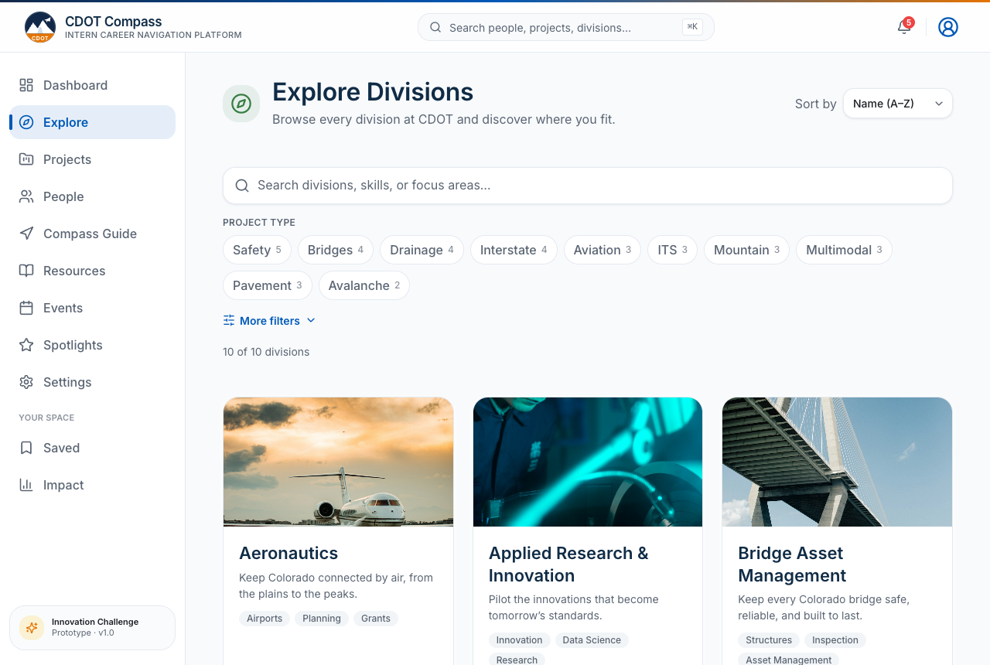
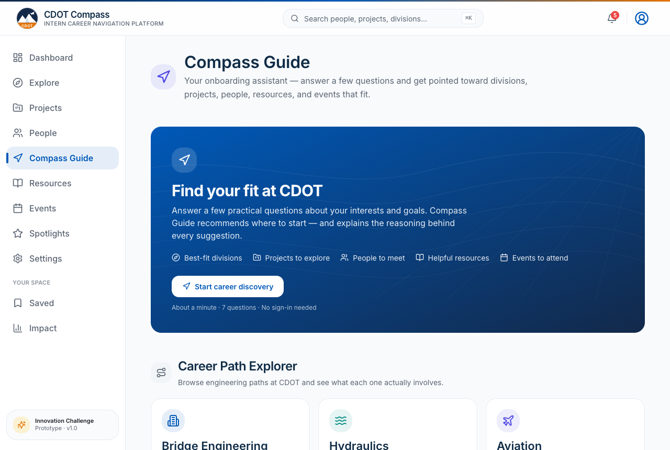
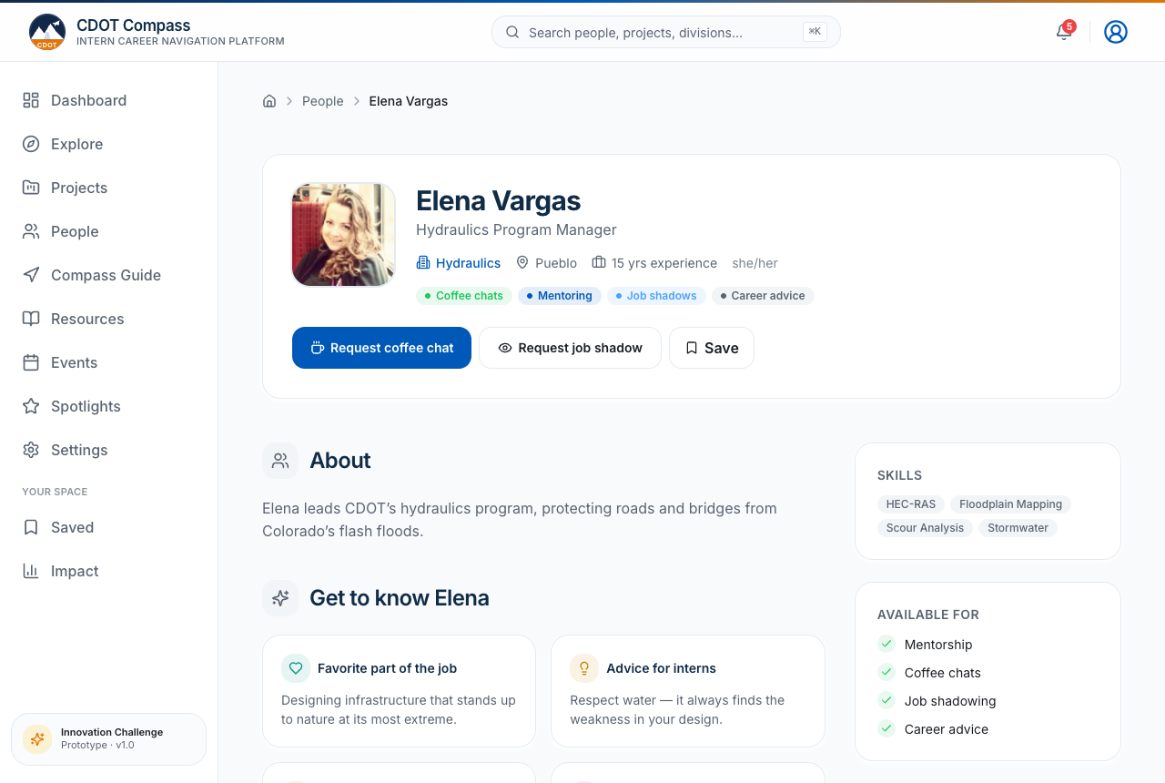
PROTOTYPE WALKTHROUGH
A real, working product — not a mockup.
1. Explore
Every division at a glance, filterable by focus area.
2. Compass Guide
Answer a few questions; get explained recommendations.
3. Profiles
See a person's work, skills, and how to reach them.
CDOT Compass · Innovation Challenge Prototype
06

Slide 7
EXPECTED IMPACT
What better discovery unlocks.
✓
Faster onboarding
Weeks of orientation compressed into minutes.
✓
Better knowledge discovery
Hidden expertise becomes findable.
✓
Cross-division collaboration
Teams connect beyond their silo.
✓
Stronger mentorship
Mentors and mentees actually find each other.
✓
Internal mobility
People see where they could grow next.
✓
Employee engagement
Belonging from day one.
✓
Talent retention
Growth paths people want to stay for.
CDOT Compass · Innovation Challenge Prototype
07

Slide 8
FUTURE ROADMAP
Where CDOT Compass could go next.
⚑ PLANNED — NOT IN THE CURRENT PROTOTYPE
Personal accounts
Sign in to keep your own saved items, history & progress — the demo opens to a shared profile today.
Mobile app
An installable app so Compass travels with you on your phone.
AI Career Match
Recommend mentors, divisions & projects from your goals — in plain language.
Personalized recommendations
Suggestions that learn from your activity and interests.
Knowledge graph
A living map of how people, projects & skills connect.
Skills matching
Surface the people and teams who have what you're building.
Project recommendations
Internal openings matched to your strengths.
Learning pathways
Guided growth tracks toward each career goal.
CDOT Compass · Innovation Challenge Prototype
08

Slide 9
Every opportunity already exists.
CDOT Compass simply makes it
easier to discover.
cdot-compass.vercel.app
Sonia Irakoze · Staff Bridge Intern

