Slide 1
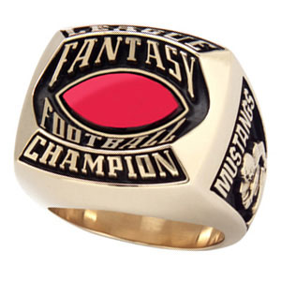
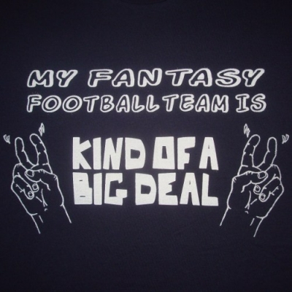
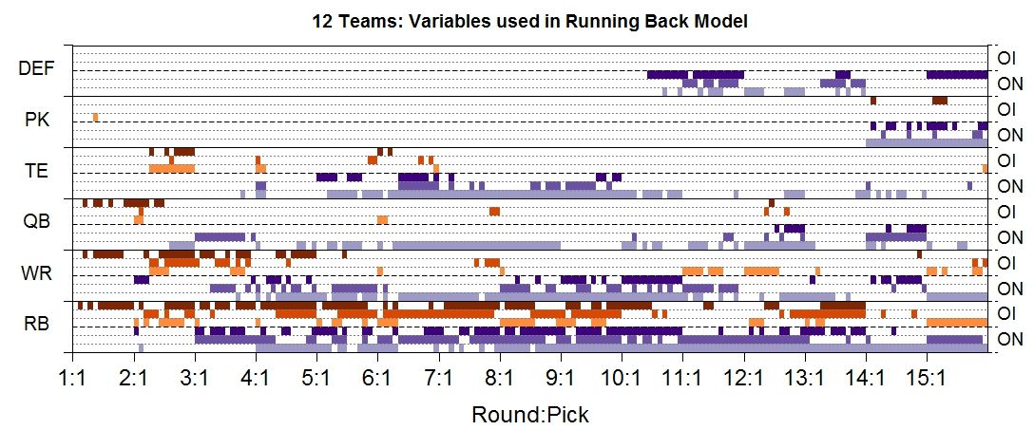
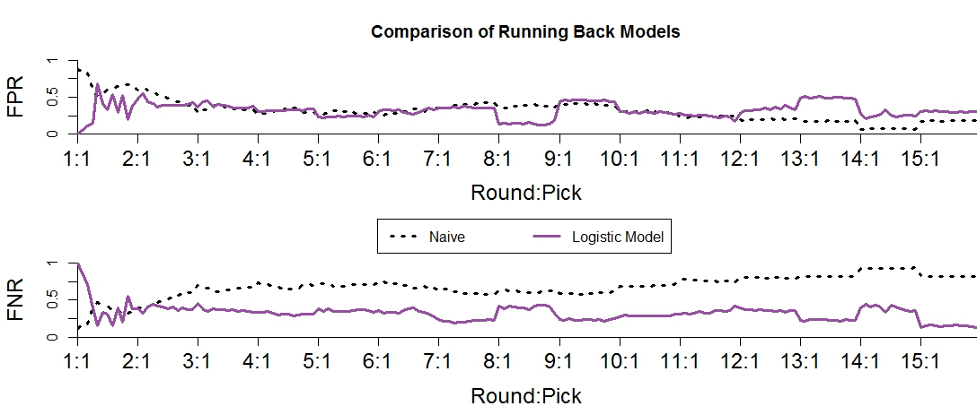
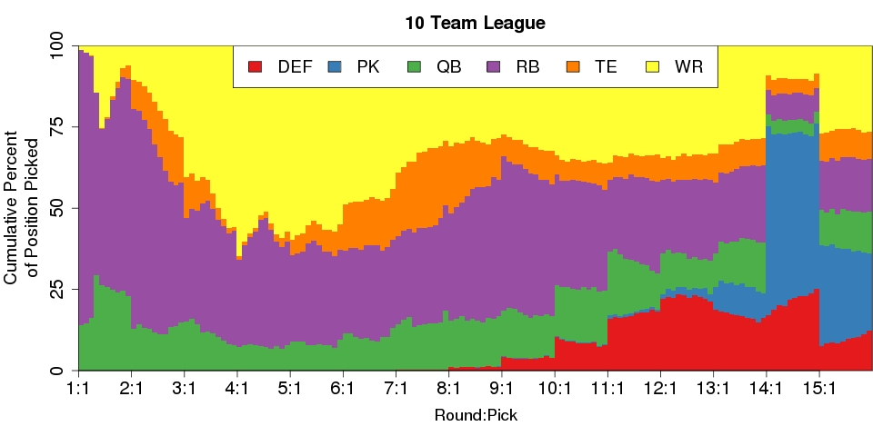
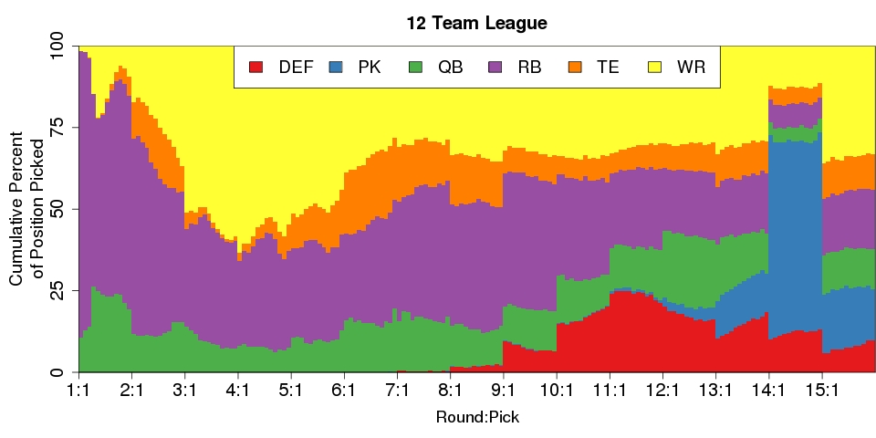
Predicting Owner Tendencies in Fantasy Football Drafts
Ivan Ramler¹, Juan Chang², and Nobu Yamanashi³
St. Lawrence University
¹Department of Mathematics, Computer Science, and Statistics
²Mathematics & Economics Double Major, Class of 2014
³Mathematics-Economics Combined Major, Class of 2011
http://2.bp.blogspot.com
http://101tees.com
Goals of the Project
Main Objective: Develop a method for predicting owner tendencies in Fantasy Football Drafts
Sub-Objective: Have undergraduate students work on interesting larger research projects
Features
Uses player positions instead of individual players
e.g., Adrian Peterson and Arian Foster are both just viewed as running backs and would be interchangeable with each other
Determine a set of covariates that can be used to describe the draft up to the current pick
Easily applicable year-to-year
The Data
Mock drafts from www.fantasyfootballcalculator.com
15 round snaking draft, starting lineup of 1QB, 2 RB, 3 WR, 1 TE, 1 Defense, 1 Kicker
Keep only drafts with at least 75% human drafters
8, 10, 12, and 14 team leagues are available
10 and 12 are the most popular
Figure 1: Overall draft percentages broken down by position and pick in the draft. Left graph is for 10 team leagues and the right is for 12 team leagues. General tendencies for both size leagues were similar with running backs being heavily picked very early, wide receivers being picked predominantly in rounds 3 through 6, and a steady trickle of quarterbacks being picked throughout the draft (except round 14). Top tier tight ends appear early (rounds 2 and 3) and then are steadily picked from mid-round 5 and on. Team defenses started being picked in rounds 9 and 10 (typically when most owners had filled their other starting lineup slots) and kickers dominating round 14 (the second to last round).
Acknowledgements
Partial funding for labor and materials on this project are provided by the Ronald E. McNair Postbaccalaureate Achievement Program and the National Science Foundation under Grant No. 0959713. Any opinions, findings, and conclusions or recommendations expressed in this material are those of the author(s) and do not necessarily reflect the views of the National Science Foundation or the Ronald E. McNair Postbaccalaureate Achievement Program
Logistic Regression Models
For each pick in a draft, a binary logistic regression model is used to predict the probability of a specific position being selected. Explanatory variables based on several factors related to the owner's need (ON) and other owners' influences (OI) are used. Each of the six position has the following 6 variables for a total of 36 potential explanatory variables.
ON.(Position).(number of previous rounds) - The total number of (Position) drafted by the owner in one, two, or all previous rounds
OI.(Position).(number of previous rounds) - The total number of (Position) drafted by all other owners in one, two, or all previous rounds
Building the logistic regression model:
Build 36 simple logistic regression models. Keep the best 10 (based on likelihood values) for consideration in the multiple logistic regression model.
Use best subsets (with AIC as the criterion) to determine the final model. Implemented through the bestglm package in R.
Naïve Model
Use p (the observed proportions of each position picked at a specific spot in the draft) to predict what will happen in the "current draft."
E.g., at pick 40, approximately 30% of all selections were Running Backs – naïvely implies a 30% chance that prediction will be a Running Back
Ignores what happens in the current draft
Ignores covariate (ON, OI) information
Similar to intercept only model
Realistic only if no information can be gained from ON and OI
Used as a benchmark for evaluating the performance of the logistic regression models.
Assessing Logistic Regression Models
Compare False Positive and False Negative Rates for logistic regression model to naïve model
Naïve model:
By definition, FPR = p and FNR = 1 - p
Results
Figure 2: Displays which of the 36 ON and OI variables are used in each logistic regression model (by pick in the draft) for running backs. In the early parts of the draft other owners influence the selection more than the owner's need. In the mid-to-late rounds a mixture of owner's need and other owner's influence tend to be important predictors. Wide receiver models (not shown) are similar, but essentially reversing the importance of RB and WR variables.
Figure 3: A comparison of False Positive and False Negative rates between the logistic regression models and the naïve model. FPRs remain fairly close to the naïve model but show a substantial improvement in the FNR after the first round. Similar results hold for Wide Receiver and Quarterback models.
Summary
Logistic Regression models work well even after minimal information from a draft is obtained
Greatly reduces False Negative Rate over naïve model while maintaining similar False Positive Rate
Future Research
Develop a model to simultaneously classify predictions into 1 of the 6 positions
Apply general methodology to 2013 season

