Slide 1
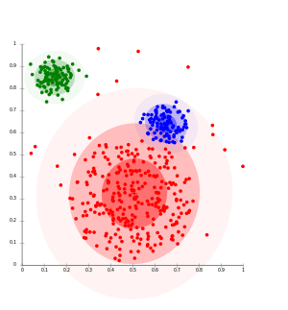

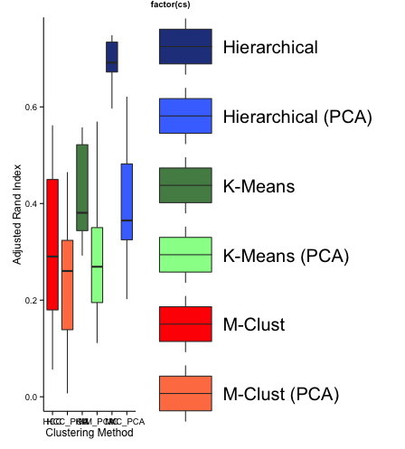
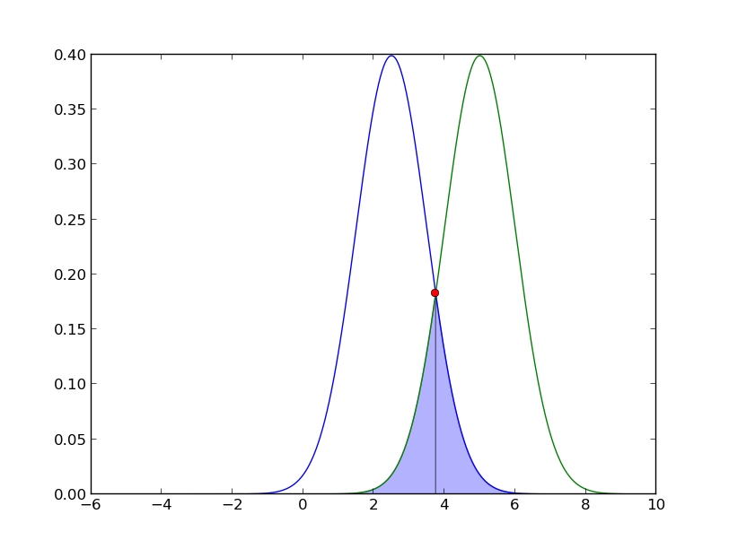
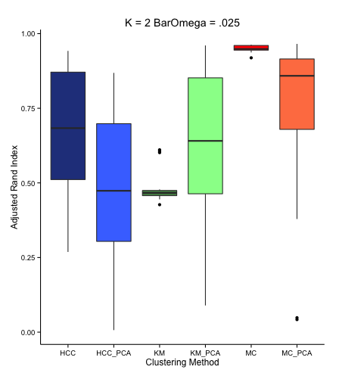
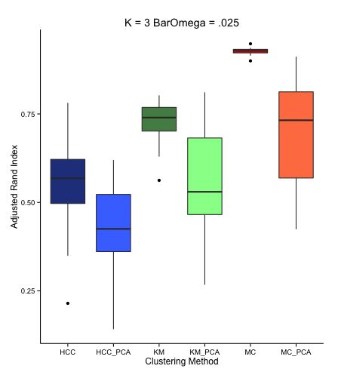
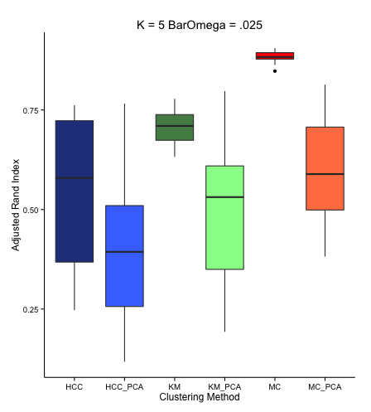
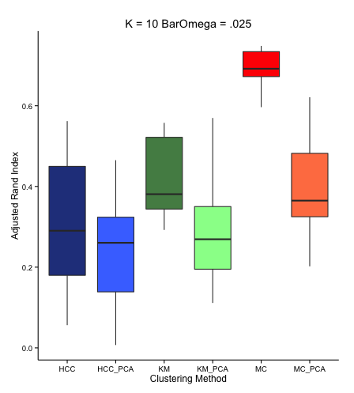
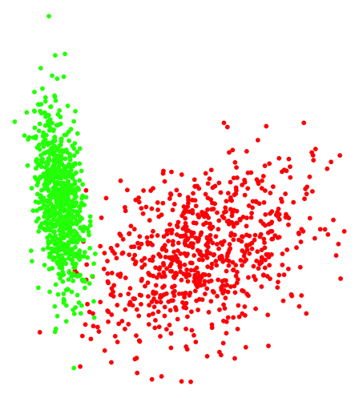
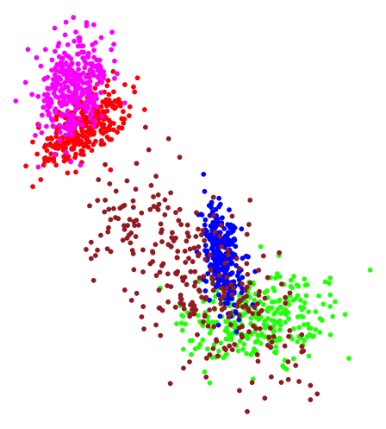
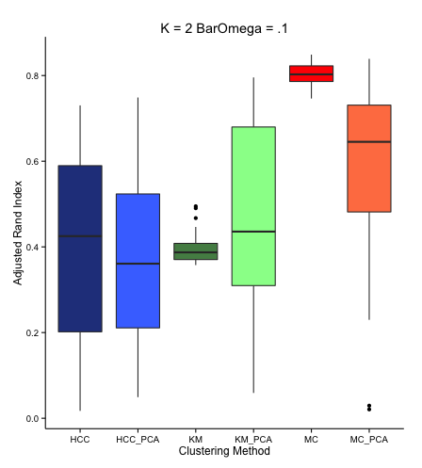
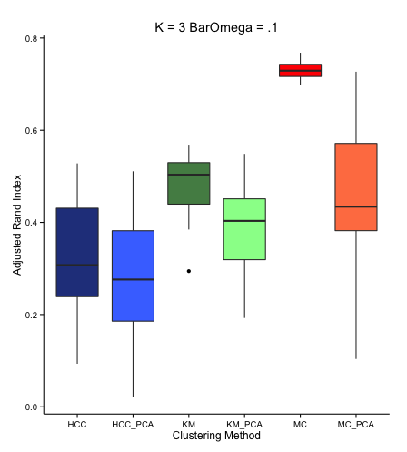
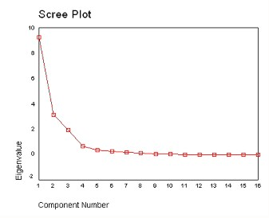
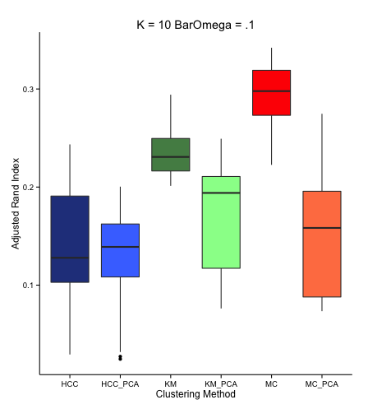
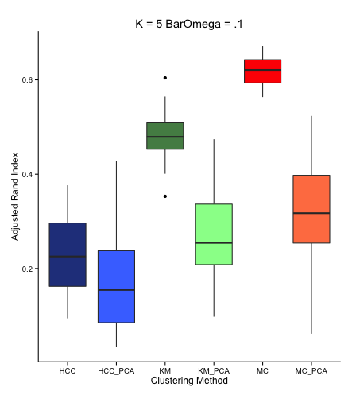
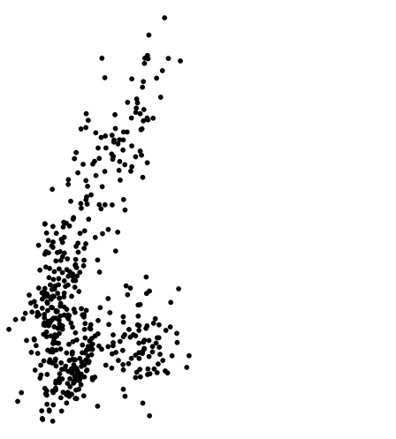
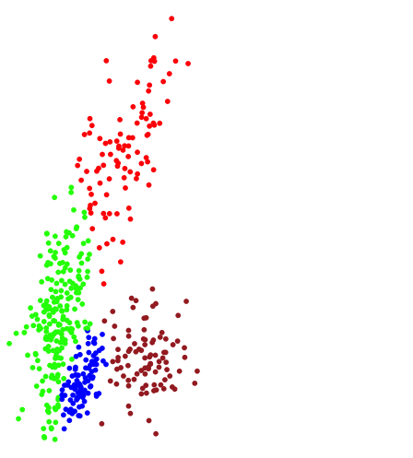







The Effect of Principal Components Analysis on the Accuracy of Clustering Algorithms
By Kersey Reed
Faculty Advisor: Ivan Ramler
Department: Mathematics/Statistics
Motivation
Method
Results
In empirical studies it is fairly common practice to use principal components analysis (PCA), or its close relative factor analysis, to simplify large ‘real world’ data sets. In a study conducted by Giovanni Luzzi, Yves Flucker, and Sylvian Weber, factor and cluster analysis are used in an attempt to determine what variables define a person’s welfare status as above or below the poverty line.
In order to preform my analysis I used the statistical program ‘R’ to generate 160 different Gaussian mixture distributions of varying complexity. I was able to do this by controlling the number of dimensions, components, and the level of average pairwise overlap between components in the “MixSim” package.
The below box plots summarize the adjusted rand scores for each of our clustering methods with and without PCA
It is clear that M-Clust (without PCA) is the best performing algorithm (as expected)
In almost all cases applying PCA has a negative effect on the accuracy of each algorithm
K-Means and Hierarchical clustering methods’ performance are much worse than that of M-Clust
Applying PCA degrades M-Clust’s performance to roughly that of both K-Means and Hierarchical clustering
Purpose & Goals
Possible Mixture Characteristics
Dimensions: $P ε \{2, 3, 4, 5\}$
Components: $K ε \left\{2, 3, 5, 10\right\}$
Average Overlap: $\overline{ω} ε \left\{.025, 0.100\right\}$
For each possible combination of values for P, K, and $\overline{ω}$ 20 different data sets were generated and then clustered using K-Means, Hierarchical, and M-Clust clustering techniques with and without a prior PCA.
Simulate Gaussian mixture distributions and determine what effect (positive or negative) the implementation of PCA has on different clustering methods.
Identify what the ideal clustering method (with or without PCA) would be given a unique Gaussian mixture distribution.
Principal Components Analysis
Pairwise Overlap
$ω_{1|2}$ is defined in MixSim as the probability that a point from distribution 1 be misclassified as being from distribution 2
$ω_{12}= ω_{1|2}+ω_{2|1}$ where $ω_{12}$ is the total overlap between distribution 1 and 2
Average overlap is then simply the average total overlap between all mixture components
Dist. 1
Dist. 2
$$ω_{2|1}$$
$$ω_{1|2}$$
What is Principal Components Analysis?
Principal components analysis is a statistical technique that analyzes variance between correlated variables in hope of finding uncorrelated variables known as “Principal Components”
The goal of this is to explain the maximum amount of variance between variables with the fewest number of components
These components are linear combinations of the original variables
The components are used in place of the original variables in order to reduce the size of a data set
Defining the “Complexity” of a Distribution
Complexity will increase as the number of dimensions, components, and the level of average overlap increase
$$K=2, P=2, \overline{ω}= .025$$
A less complex clustering problem (left) vs. a more complex one (right)
$$K=5 , P=2, \overline{ω}=0.10$$
Cluster Analysis
What is Cluster Analysis?
Cluster analysis takes a data set and attempts to cluster “more similar” data points together
These clusters can be used to identify specific characteristics or trends within each cluster of data
Some common clustering algorithms
K-Means
Hierarchical
M-Clust (Model Based Clustering)
Each cluster of data resulting from this method is represented by a normal distribution
It utilizes expectation maximization in an attempt to find the optimal number of clusters
Selecting the Number of Principal Components
In applying PCA there needs to be a commonly defined “stopping rule” to provide the correct number of components to extract
The ‘paran’ package in R utilizes a scree plot of the eigenvalues associated with a component and ignores components with eigenvalues less than 1
Before Clustering
After Clustering
Determining Clustering Accuracy
In determining the accuracy of the clustering methods we compare the original (true) cluster IDs to the new IDs determined after clustering
I used the adjusted rand index to “score” the clustering results and thus measure the clustering accuracy
M-Clust
Since M-Clust finds clusters represented by normal distributions and we are generating normally distributed mixture models, M-Clust without PCA should be the best performing algorithm
Based on our results we can observe what effect PCA has on M-Clust and the difference in clustering accuracy between M-Clust and the other algorithms
Conclusion
In conclusion applying PCA before clustering (at least with normally distributed data) may not the best idea. It is clear that M-Clust on its own is the best clustering option and that PCA only serves to hinder its performance.
Thus, as is convention in many empirical studies, using PCA prior to clustering is not a good idea.
It is clear to see that it would be best to replace traditional clustering methods (K-means & Hierarchical Clustering) with more recent and accurate techniques such as model based clustering

