Slide 1
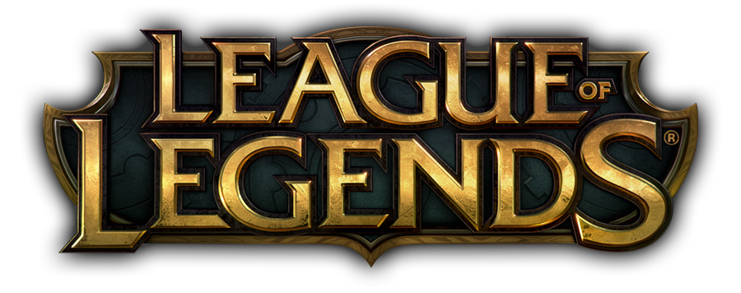

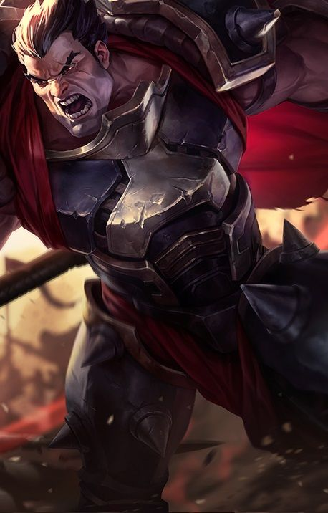
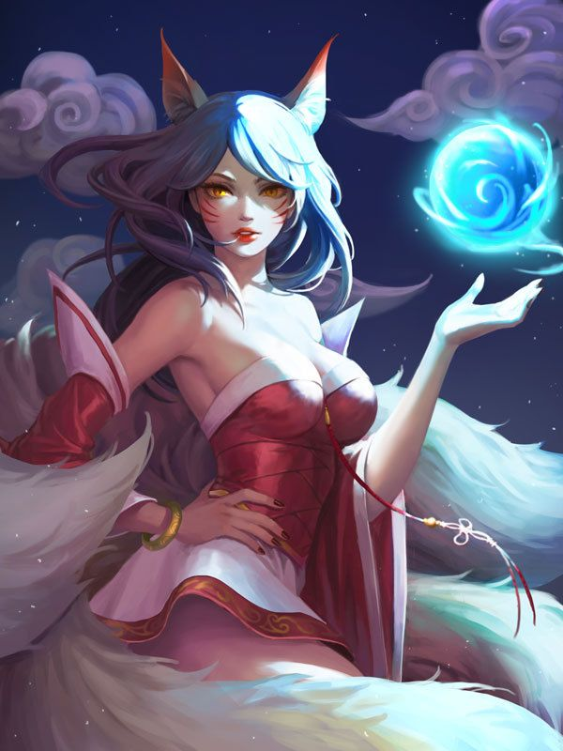
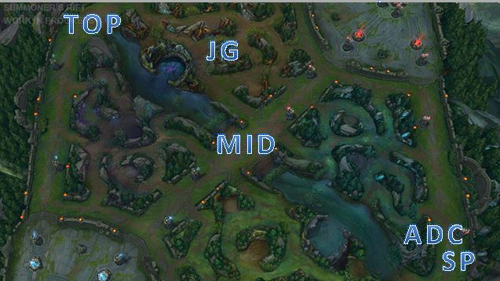
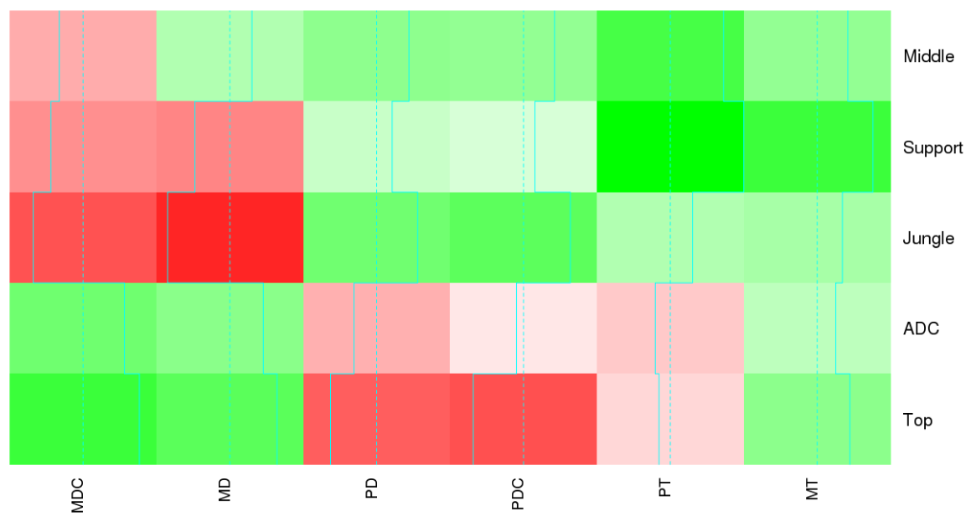

Gender Bias in League of Legends
Sarah Strong
Advisor: Ivan Ramler
1. Introduction
Video games are influential forms of media due to their interactive and repetitive nature
Several reoccurring themes in video games
Male characters outnumber female characters
Males are usually the playable/main character
Females are frequently portrayed as sexual objects while the men are muscular and powerful
Males more likely to use weapons
3. Research Question
Is there a systematic gender bias between champions in the way male and female champions are created and played?
5. Results
The roles of Jungler and Support:
Females deal more magic damage and get more kills and assists
Males deal more physical damage and crowd control while also taking the majority of both magical and physical damage
ADC and Top:
Females both deal and take more physical damage
Males deal and take magic damage as well as kill more minions
Middle:
Females have more kills, assists, minions killed and crowd control
Males deal and take both physical and magic damage
Figure 2. Example of male and female champion
4. Methodology
Data drawn from ranked game statistics from 2015
Analyzed 851,324 games
128 champions sorted into 42 female, 48 male, 37 monsters and 1 unknown
Evaluated 13 end game statistics which contributed to overall success
Created linear models for each statistic using role and gender as predictors
Example of a linear model:
$$Magic Damage Dealt=β_{0}+β_{1}JG+β_{2}Mid+β_{3}SP+β_{4}Top+β_{5}Male+β_{6}JG:Male+β_{7}Mid:Male+β_{8}SP:Male+β_{9}Top:Male$$
Used predicted estimates to find gender differences in each role for every statistic
Example of comparison:
$$Male Jungler−Female Jungler= \left(β_{0}+β_{1}+β_{5}+β_{6}\right)−\left(β_{0}+β_{1}\right) = β_{5}+β_{6}$$
Figure 1. Map of Summoner’s Rift
2. League of Legends Background
Fantasy-themed multiplayer online battle arena game
10 players are assigned to two teams of five to battle on a map called “Summoner’s Rift”
Goal of the game is to get to the other team’s side and destroy their nexus
Each player takes on one of five roles
Top and Middle guard their respective lanes alone
ADC and Support work together in the bottom lane
Jungler battles non-player characters in the jungle and assists teammates with “ganking”
Players select an avatar, called a champion, to take on their chosen role
Over 100 champions to choose from each with different abilities and skills
Figure 3. Heatmap showing gender differences for damage statistics - green signifies males having a higher estimate and red signifies females being higher
6. Future Research
Compare results to data from 2018/2019
Look for similar trends in other design aspects besides end game statistics
Expand to other MOBA games
Gain qualitative player feedback

