Slide 1


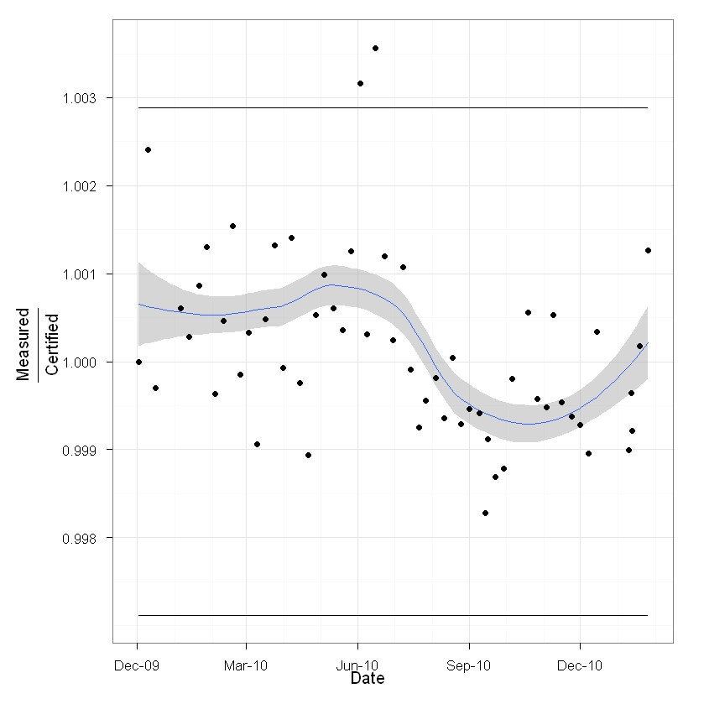
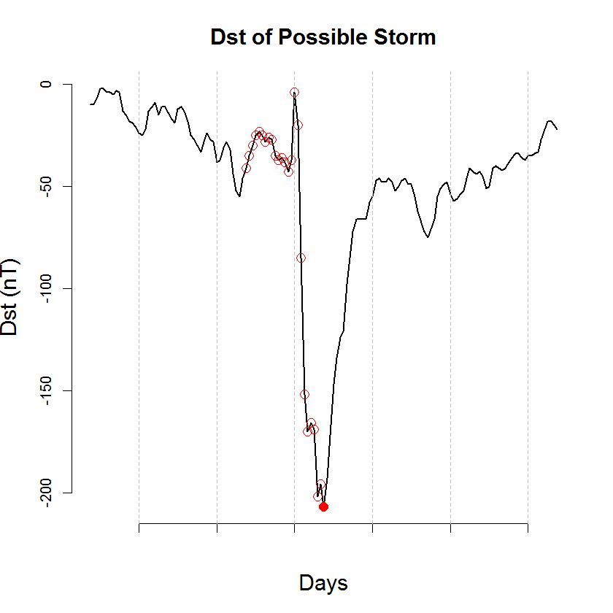
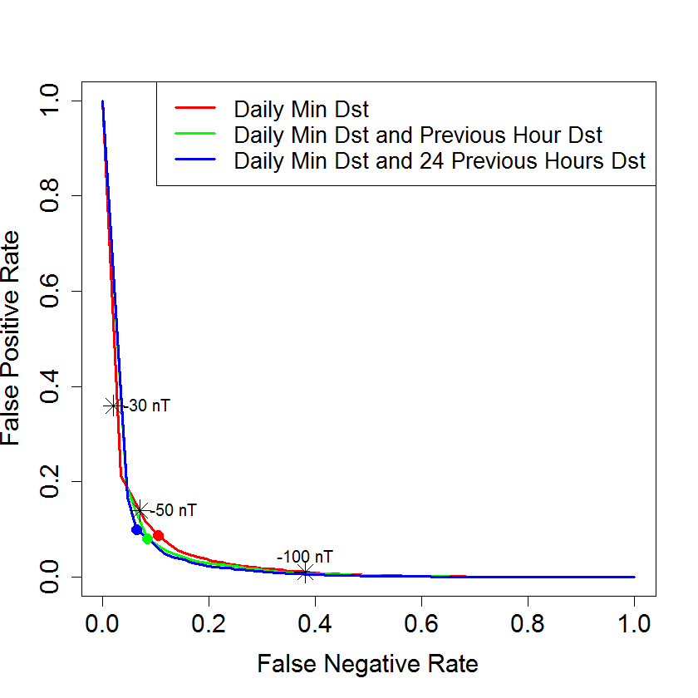
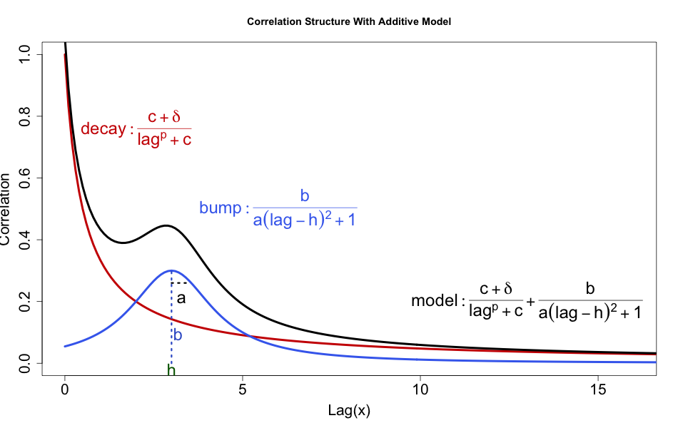
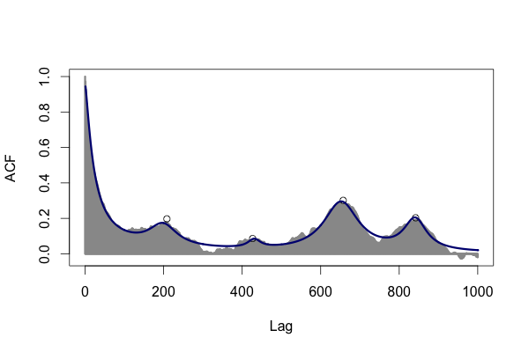
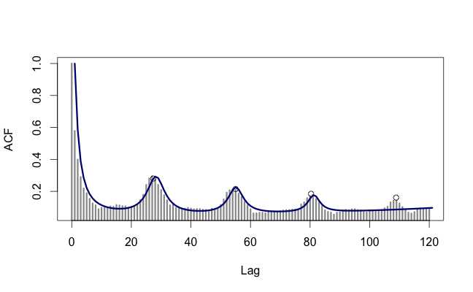
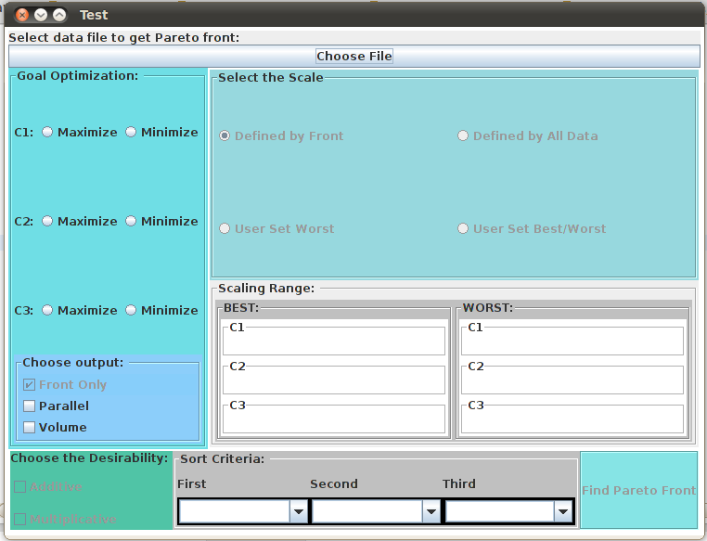
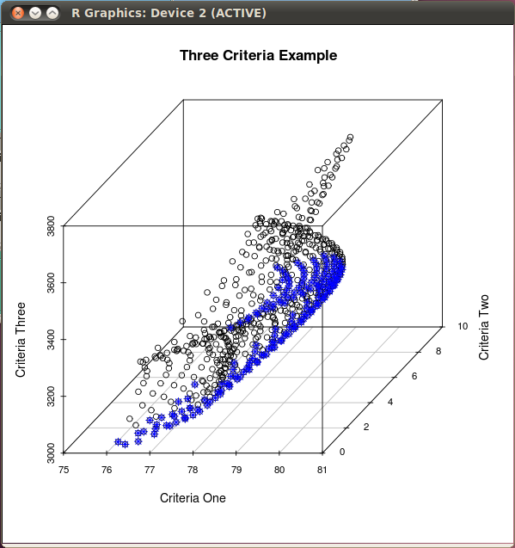
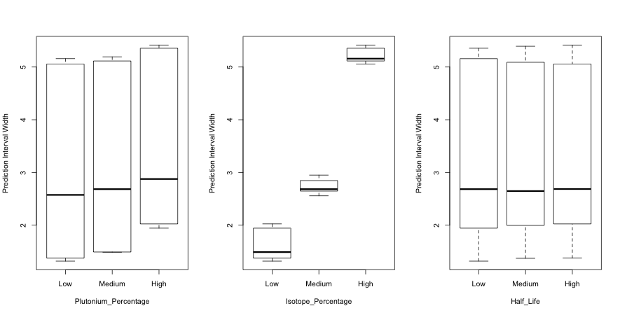

Advice for Using Faculty Connections to Create
Research Opportunities for Undergraduates
Ivan Ramler and Jessica Chapman
St. Lawrence University
St. Lawrence University
Small Liberal Arts College in Northern New York
Approximately 2,400 students
Department of Mathematics, Computer Science, and Statistics
14 Faculty, 30 – 50 Seniors each year
Student Research
Summer Fellowship: Semi-competitive summer research program where students conduct research under the guidance of a faculty mentor.
Senior Year Experience: Individual capstone project
Los Alamos National Laboratory
National Research Lab located in Los Alamos, New Mexico
Most well know for its role in developing the first atomic bombs
Statistical Sciences Group (CCS-6)
Provides statistical consulting to other groups at LANL
Conducts research in statistical sciences
SLU – LANL Connection
Project ideas/origination: Projects that were low-priority for the lab (i.e., they didn’t have time to work on them).
Trips to LANL
2012 – 1 student: visited at the beginning of summer. Mainly brainstorming with LANL statisticians
2013 – 4 students: At the end of July (at the end of SLU Fellow program), each student presented to CCS-6 and discussed with LANL mentor about additional work for their capstone projects.
General Advice and Tips
Where to find projects?
Grad school friends/colleagues in industry/research labs
Try to use “low priority” projects
What to expect?
Keep expectations low
These projects can be hard for undergrads
We considered it a great success if they decided to go to grad school
Especially if they got into a better program because of the project!
Spilt larger projects across students/years
Allows students to explore statistical topics that may only be tangentially related to the original project
Using Bayesian Statistics for
Plutonium Management Models
In this project, the student learned aspects of Bayesian statistics (in particular the Metropolis-Hastings algorithm) to model the heat being given off by plutonium that is being monitored by the lab.
$$Measured=Certified⋅β⋅(1+ε)$$
$$M\sim N\left(C⋅β, Σ\right)$$
$$β\sim N\left(1,0.1\right), ε\sim N(0,1/τ)$$
$$τ\sim Gamma\left(1.5, 0.001\right)$$
$$Σ_{ij}=σ_{i}σ_{j}ρ_{ij}, { σ}_{i}=C_{i}/τ$$
$$ρ_{ij}=cor(M_{i},M_{j})$$
An Interactive Program for
Modeling Autocorrelation Using
Sums of Rational Functions
This project involved developing an interactive program through the use of the statistical software language R that allows the user to explore and fit nonlinear models to the autocorrelation structure of time series data. The method was applied to several datasets, including weather patterns, Disturbance Storm Time Index (DST) values, and electron flux patterns.
Understanding Uncertainty in Predicting the Lifetime of Plutonium Fuel Cells
This student developed a simulation based study to identify and estimate the impact of potential sources of error in predicting the uncertainty in the lifetime power supply of Plutonium fuel cells (such as those used by NASA to power deep-space satellites).
Initial Mass: Inconsistencies in
precision of measurements
Overall Proportion of Plutonium:
Variability in the estimated proportion of Pu in the fuel cell
Isotope Proportions: Variability in
measuring how much of each Pu isotope is in the fuel cell
Half-lives: Varying the precision of the estimated half-life for each Pu isotope
Improving the Statistical Methods for Classifying Geomagnetic Storms
This student used Disturbance Storm Time (DST) Index values to find a more statistically justified method for classifying events as geomagnetic storms. Previous methods used only “threshold values” to determine storms; this student constructed logistic regression models using hourly DST values to predict storms.
A Java Graphical User Interface to an R Pareto Front Library
Student created software that allow users to implement R code for Pareto front optimization without needing to know or (directly) use R. The software made use of Java’s JRI library to run R inside Java applications.
Acknowledgements
Dr. Christine Anderson-Cook and Dr. Brian Weaver of the Los Alamos National Laboratory for agreeing to be the LANL mentors
Katherine Abramski, Kathryn Christensen, Kerrin Ehrensbeck, Sarah Koallick, and Chelsey Legacy (our students who did all the hard work!)
Dr. Ed Harcourt (Computer Science, St. Lawrence University) for co-mentoring the Java GUI project
SLU Fellowship Donors: Daniel and Mrs. Ann Sullivan, Jack and Sylvia Burry, the Phelps Family, and Donald K. Rose

