Slide 1
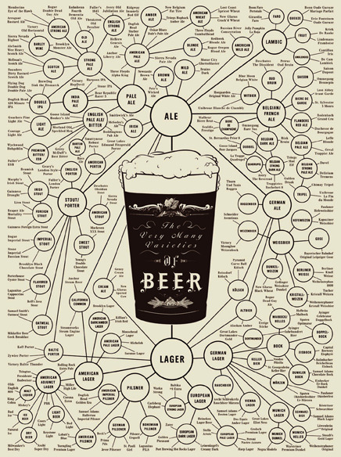
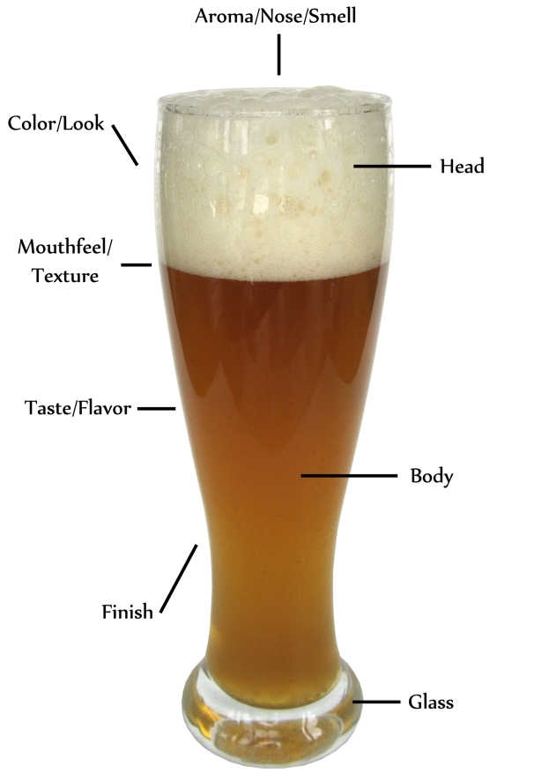
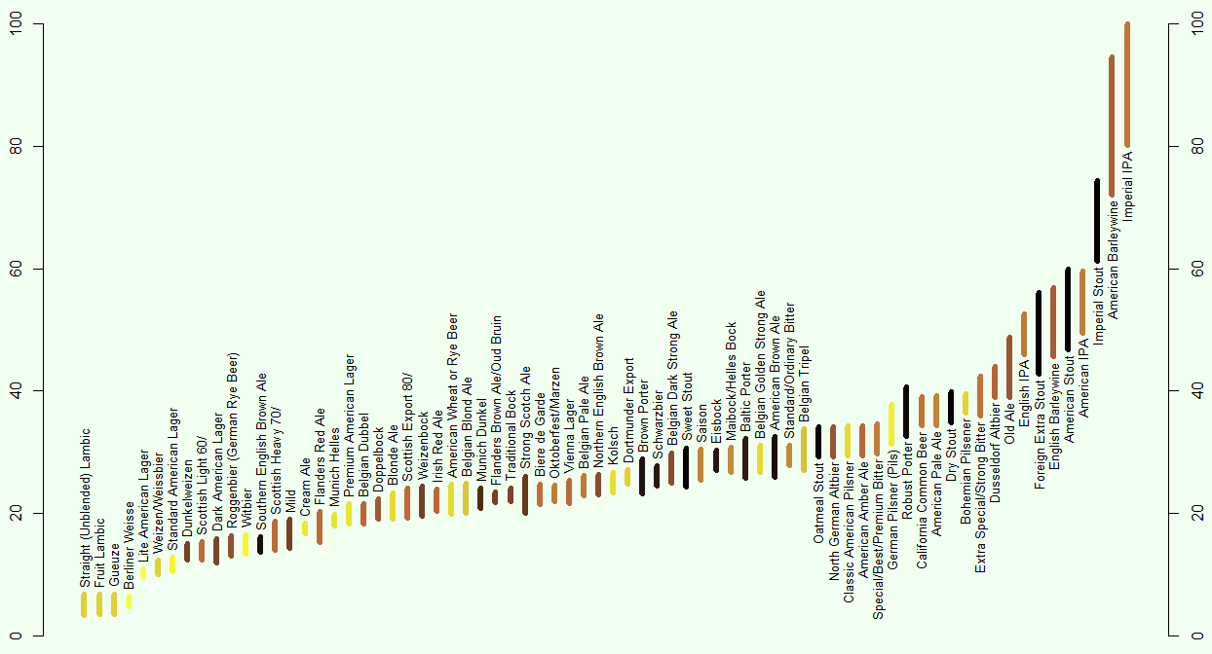
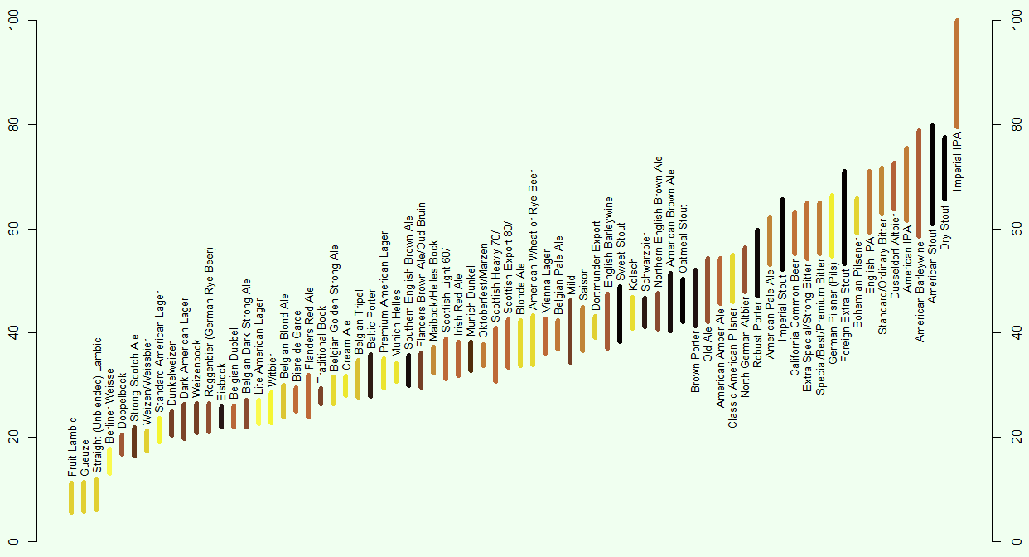
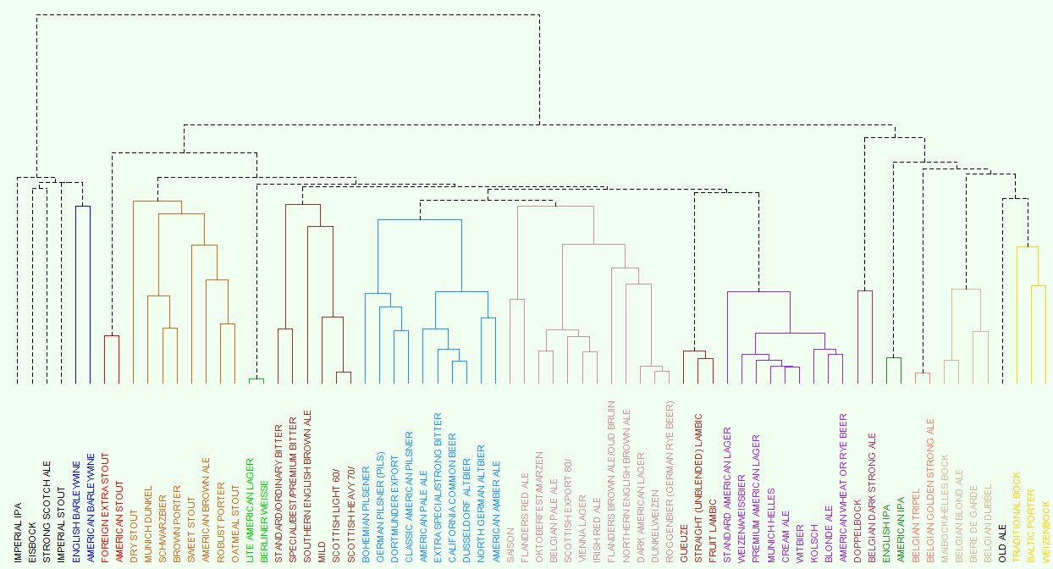

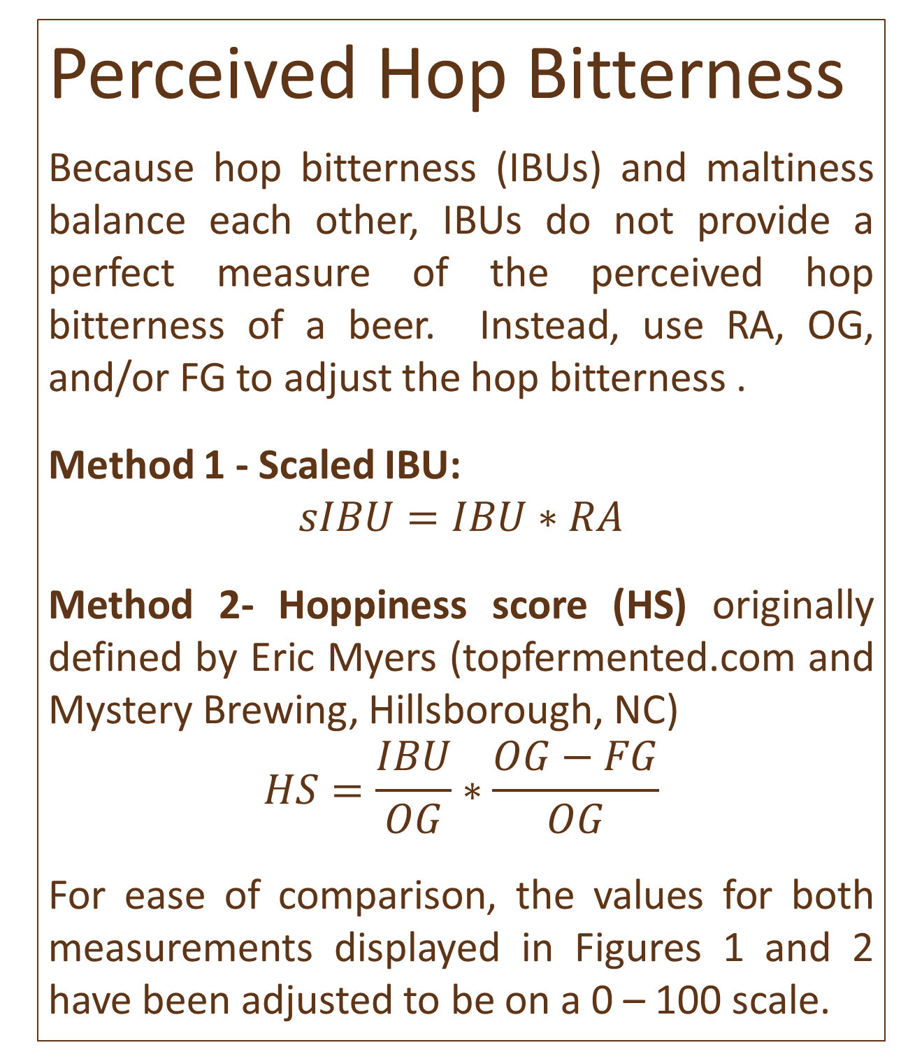
An Analysis of Beer Styles
Ivan Ramler, St. Lawrence University
Images in top left and right corners are copyrighted by Pop Chart Lab, Inc. and are for sale at www.popchartlab.com.
Sensory Components of Beer
Taste: The flavor of the beer and the
most important, but not only, sense
related to beer.
Smell: Flavors you sense by breathing
in the aromas of the beer.
Sight: Color of both the body (liquid)
and head (foam) of the beer.
Touch: The mouthfeel of the beer can
range from crisp to creamy and can influence the palate
immensely.
Finish: The finish is the “feeling” left in your mouth after you have swallowed. For example, a long and cloying, or short and crisp sensation.
Highlights of the BJCP data
Interval style – the BJCP gives an interval for each key statistic that would be considered consistent with the style.
Correlated Variables – Many of the variables are highly correlated with each other.
Table 1: Pairwise correlations based on midpoints of the sub-style intervals.
Simulating Individual Beers
To incorporate both the interval information and correlation between variables, simulation was used to create an observation (i.e., a single beer from a one sub-style) from a 5-dimensional Normal distribution with mean vector equal to the midpoint of the interval for each of the five variables, standard deviations equal to the 1/6 of the range of the interval, and correlations as displayed in Table 1. Each of the 72 sub-styles are represented once in the simulated dataset and a total of 10,000 datasets were simulated. These simulated datasets were used in the following two analyses.
1) Ranking the perceived hop bitterness of a beer style.
2) Using a cluster analysis to group seemingly similar styles together.
 | FG | ABV | IBU | SRM
OG | 0.77 | 0.97 | 0.53 | 0.24
FG |  | 0.65 | 0.49 | 0.46
ABV |  |  | 0.49 | 0.18
SRM |  |  |  | 0.34
http://definitionale.com/2010/09/08/the-anatomy-of-a-beer
Beer Statistics
The Beer Judge Certification Program (BJCP; http://www.bjcp.org) has defined different “main-styles” of beer (e.g., Stout, Pilsner, and Sour Ales) as well sub-styles within each main style (e.g., Dry Stouts, Oatmeal Stouts, Imperial Stouts). They provide a database of “key statistics” that represent beers that are considered consistent with the style.
OG: The original gravity of a beer is the specific gravity (relative density compared to water) before fermentation.
FG: The final gravity of a beer is the specific gravity after fermentation.
ABV: The percent alcohol by volume of the beer after fermentation
IBU: The International Bittering Units is a measure of the bitterness of beer from the amount of hops used during the brewing process.
Does not take into account the gravity of the beer (hop bitterness is less noticeable in high gravity beers)
SRM: The Standard Reference Method is used to measure color intensity and darkness of the beer.
Low values (< 5) are yellow (like straw) in color (e.g., light American lagers like Bud Light).
High value (> 30) are very dark brown to black in color (e.g., Guinness and other stouts).
Foreground of this poster is SRM = 1 while the background is SRM = 20.
Perceived Hop Bitterness
Because hop bitterness (IBUs) and maltiness balance each other, IBUs do not provide a perfect measure of the perceived hop bitterness of a beer. Instead, use RA, OG, and/or FG to adjust the hop bitterness .
Method 1 - Scaled IBU:
$$sIBU=IBU∗RA$$
Method 2- Hoppiness score (HS) originally defined by Eric Myers (topfermented.com and Mystery Brewing, Hillsborough, NC)
$$HS=\frac{IBU}{OG}∗\frac{OG−FG}{OG}$$
For ease of comparison, the values for both measurements displayed in Figures 1 and 2 have been adjusted to be on a 0 – 100 scale.
Figure 1: Scaled IBUs (mean +/- one standard deviation) for the simulated beers sorted by sub-style. Colors correspond to the average SRM of the sub-style.
Figure 2: Hoppiness score (mean +/- one standard deviation) for the simulated beers sorted by sub-style. Colors correspond to the average SRM of the sub-style.
Grouping Similar Beer Styles
For each simulated dataset use hierarchical clustering (with complete linkage) and a large number of clusters to get a set of cluster classifications. This provides a way to determine which beers are considered very similar to each other.
Obtain a second set of classifications using a smaller number of clusters to determine a broader sense of similarity between beers.
For each pair of sub-styles, combine the results from steps 1 and 2 together by calculating the proportion of clusterings where the pair belong to the same cluster. This is then used as the similarity matrix for a second stage clustering.
Use hierarchical clustering (with complete linkage) based on the similarity matrix obtained from step 4. The results of this clustering are displayed in Figure 3.
Other Beer Statistics
OE: The original extract is the mass (grams) of sugar in 100 grams of wort (unfermented beer). Calculated from the OG.
FE: The final extract is the mass (grams) of sugar in 100 grams of beer after fermentation is complete. Calculated from FG.
Real Attenuation (RA): The percent of sugars converted to alcohol and CO₂ from the yeast in a beer. Generally, high numbers indicate the beer will be maltier while low values indicate the beer will be drier.
$$RA=1−(0.1808 OE+0.8192FE)/OE$$
Figure 3: Results for cluster analysis of beer styles. Colors (other than black) denote clusters, while black observations are not classified in a cluster with other beers. Fourteen clusters and five singletons were identified.

