Slide 1
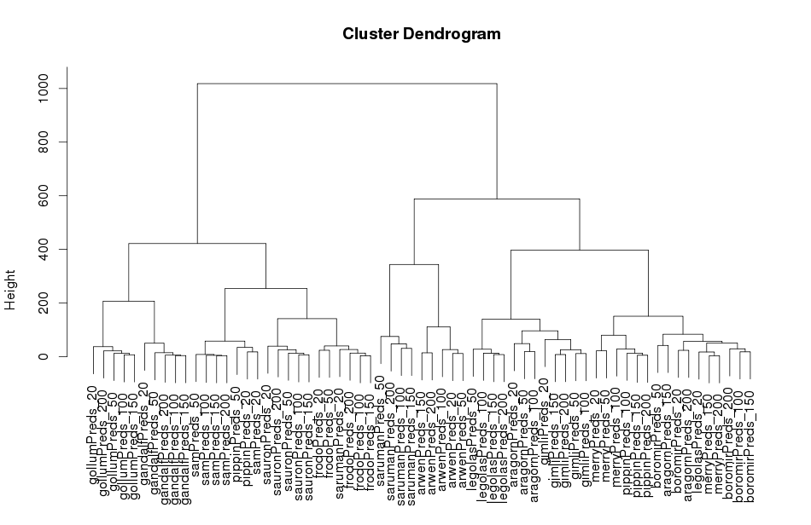
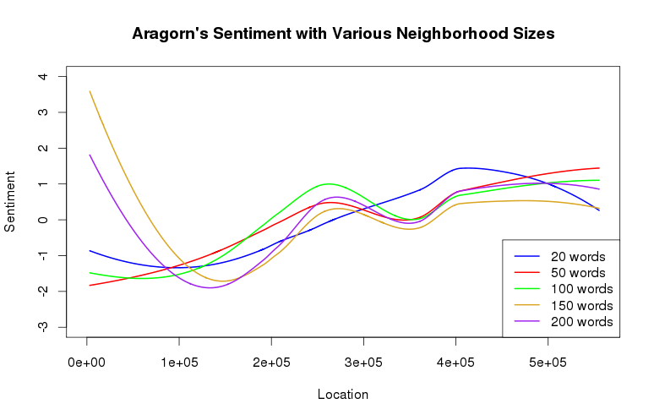
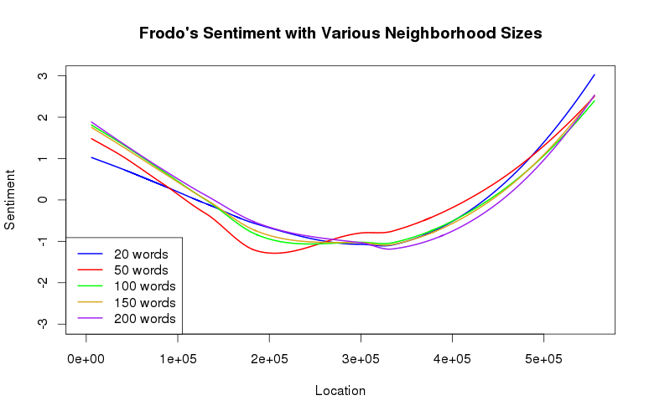
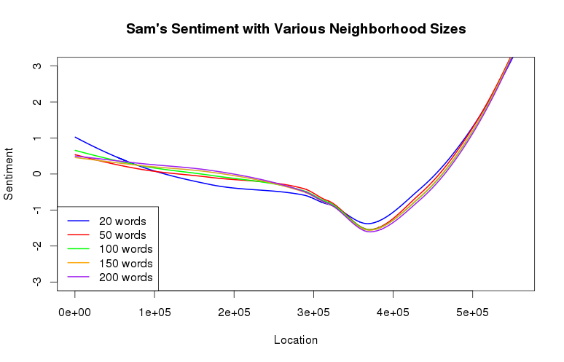
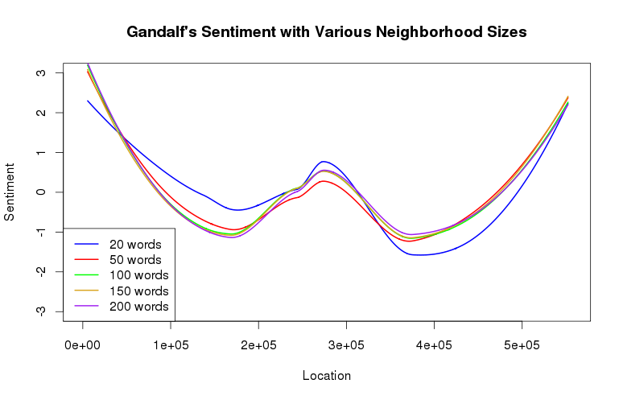
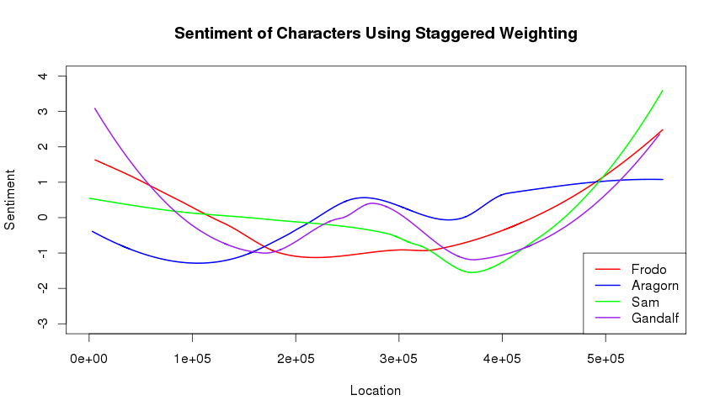
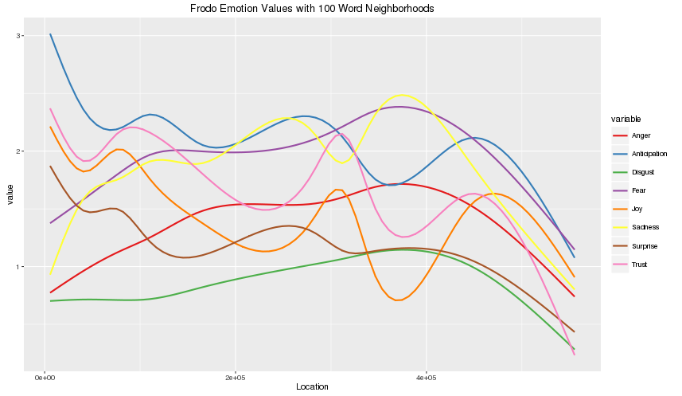
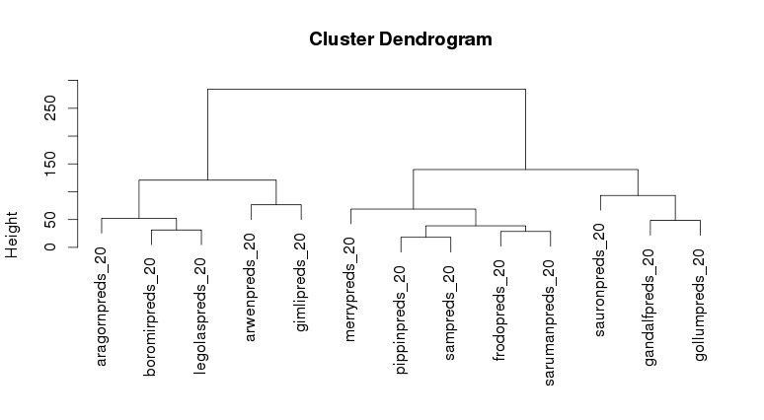
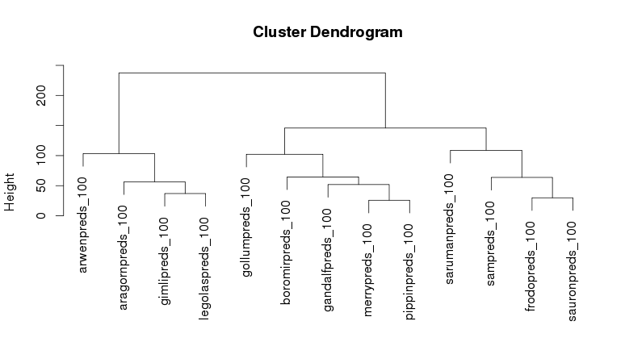
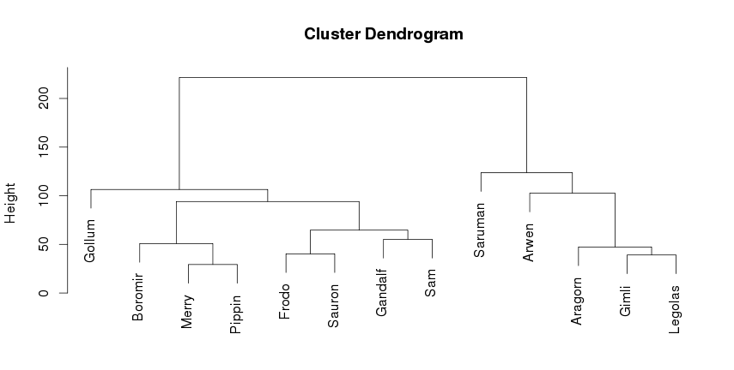
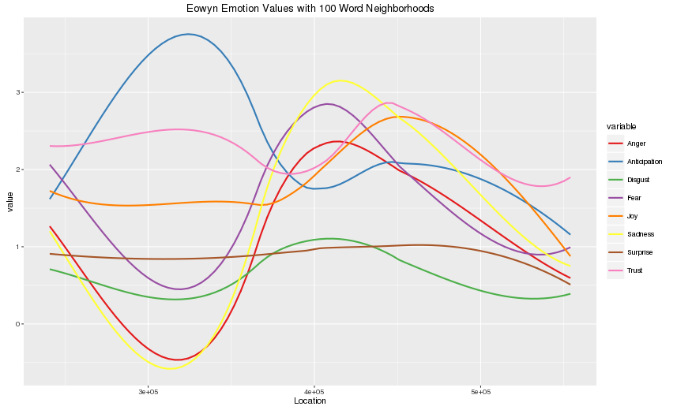
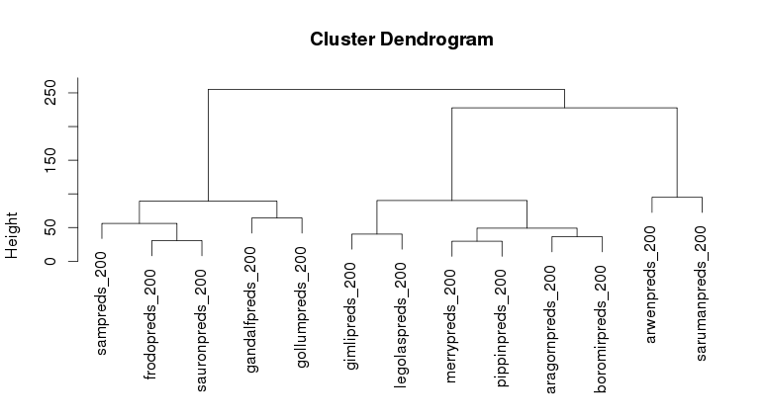
Sentiment Analysis of Individual Characters in The Lord of the Rings
Julia Holter
Objectives
To compare the sentiments of characters in Tolkien’s legendarium
To evaluate methods of comparing the sentiments of various characters
Limitations of This Method
Not very good at accurately capturing what would be happening when a character is not mentioned for long periods of time (hence the illogical negative scores)
Not normalized, so because Frodo is mentioned more than Eowyn, most of his emotion scores are higher
Cluster Analysis of All Neighborhoods
Sentiment Analysis
An evaluation of the sentiment of words (a positive word, like “happy”, gets a positive score)
Using the Syuzhet Package on R, you can also look at more specific emotions: Joy, Sadness, Fear, Surprise, Anger, Disgust, Anticipation, and Trust using Saif Mohammad’s NRC Emotion lexicon
Uniform Weighting
Each word in a particularly sized neighborhood has the same weight
Character Neighborhoods
Found all locations of a specific character (ex. Whenever Frodo was mentioned by
name)
Then found a window of length n around that location (ex. 50 words before Frodo was mentioned and 50 words after)
Sentiment analysis of that neighborhood
Staggered Weighting
The closer a word is to the mention of the character, the more weight it gets
Within 25 words of the character mention, the sentiment score has a weight of 1; from 25 to 50 words of the character mention, the sentiment score has a weight of 0.5; from 50 to 75 words of the character mention, the sentiment score has a weight of 0.25
Character Analysis with 100 Word Neighborhoods
These graphs were formed using the Syuzhet and GGplot2 R packages
Hierarchical Cluster Analysis
Hierarchical analysis of groups of data –gives us a dendrogram
Shows how similar specific clusters are
Future Research
Developing a Normalized weighting scale for sentiment analysis of the neighborhoods (so that the closer a word is to the mention of the character, the more weight it’s given
Broadening the research to the rest of Tolkien’s legendarium: how does the sentiment of The Lord of the Rings differ from The Hobbit, The Silmarillion, or any of Tolkien’s lesser known children’s stories?
Experimenting with neighborhoods where the character mention is not the center (for example, looking at the fifty words after a character is mentioned)
A more in depth study of the differences between Tolkien’s characters based on gender—are the sentiments and/or emotions different? How can we fairly compare the two when there are so many more men than women in Tolkien’s work?

