Slide 1
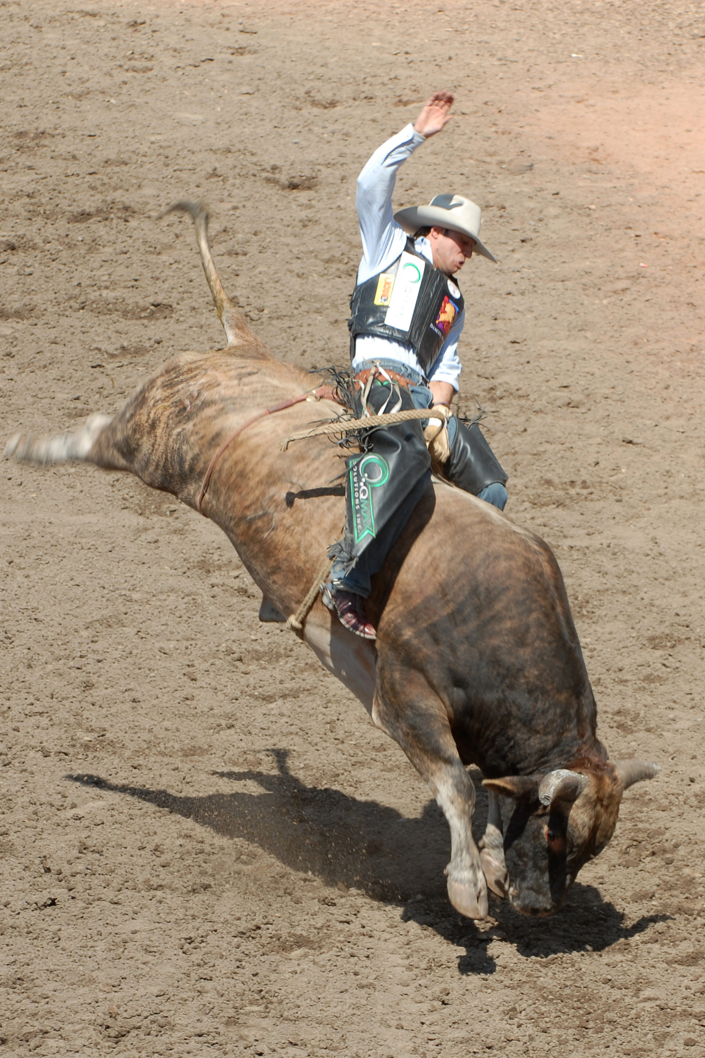

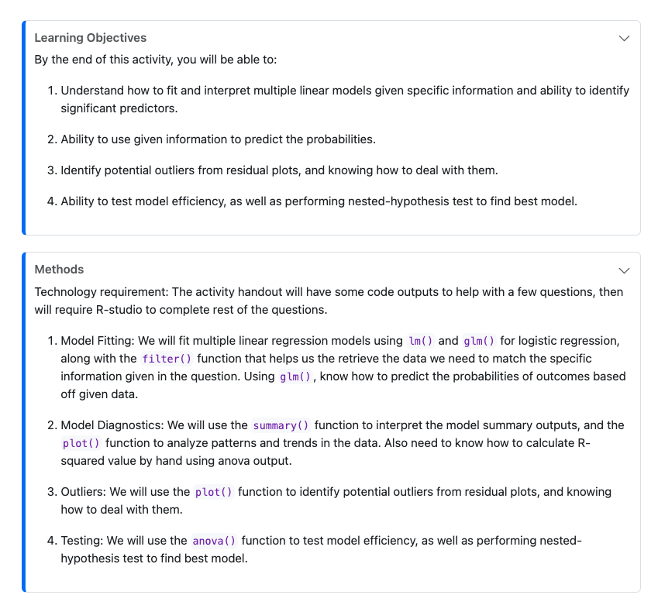
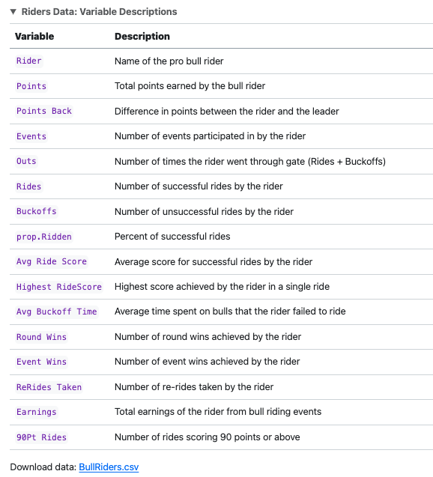
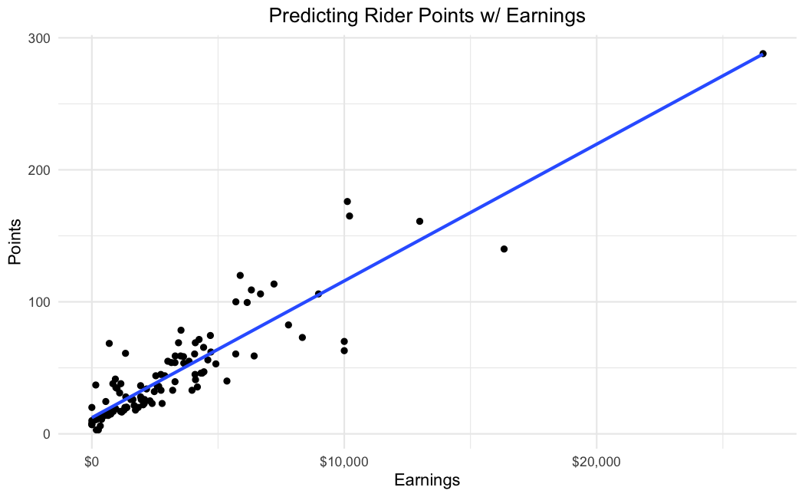
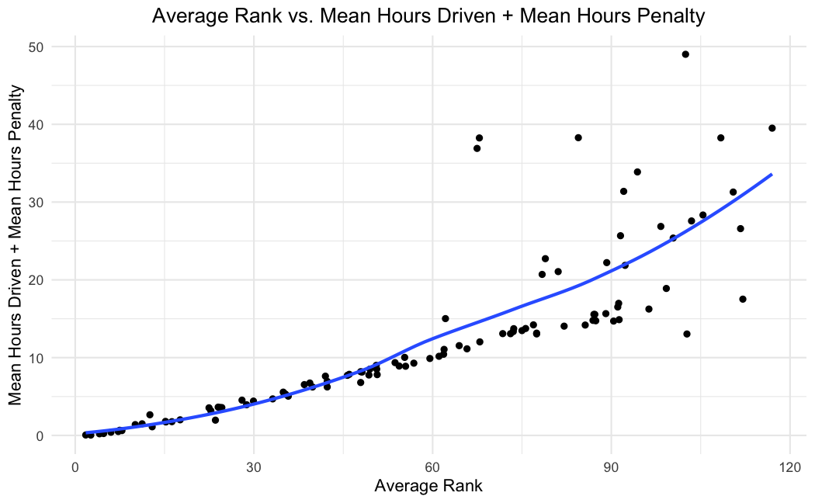
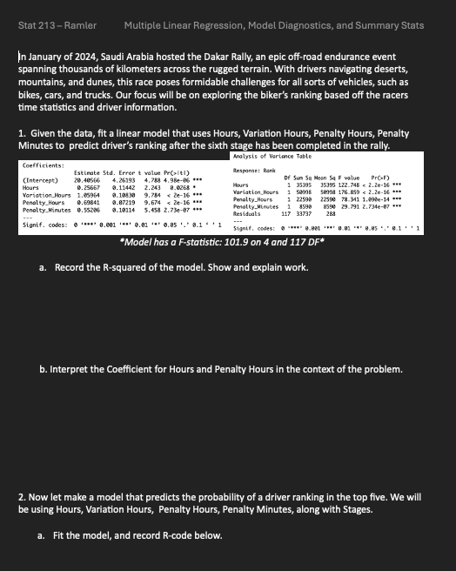


SCORE Network: Exploring Unusual Sports
Matthew Maslow (Data Science)
Advisor: Professor Ivan Ramler
What is SCORE?
Professional Bull Riding
The 2024 Dakar Rally
Funded by the National Science Foundation
Acquires, cleans, manipulates, and documents sports data to create educational resources for data science
What is a Module?
1. Introduction
Summary of the sport and concepts that will be in handout
Provides learning objectives and methods
What is it?
Sport that requires a unique combination of skill, strength, and courage
Riders must stay on a bucking bull as long as they can, using only one hand to hold on while the bull tries to throw them off.
Score based on their performance, and the bull is also scored based on how well it bucks.
What is it?
Annual off-road endurance event that typically spans over two weeks and covers thousands of kilometers across challenging terrain, and the most recent rally took place in Saudi Arabia.
Participants, including motorcyclists, drivers, and truckers, compete in various categories, facing extreme conditions like deserts, mountains, and dunes, making it one of the toughest motor-sport events in the world.
2. Data
Summary of dataset, with variable descriptions
Supplies data file and source
What will be learned
This dataset’s analysis encompasses linear regression, identification of influential points, hypothesis testing, and variable transformation.
In this dataset, we will explore the data from the 2023 season of the PBR league, Touring Pro Division, to understand the factors that contribute to a rider's success and the performance, and the same for the bulls
3. Materials
Class handouts and answer keys
What will be learned
For this investigation, we will be looking at the motorist statistics for all 12 stages of race.
This dataset’s analysis will exemplify data visualization, uncovering patterns and insights within the race dynamics.
4. Conclusion
Summarize the takeaways and learning objectives from the sports application handouts

