Slide 1

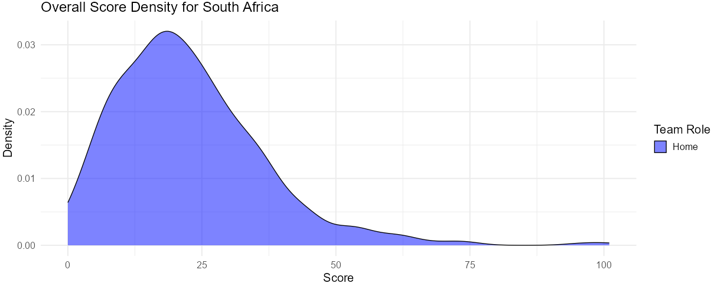
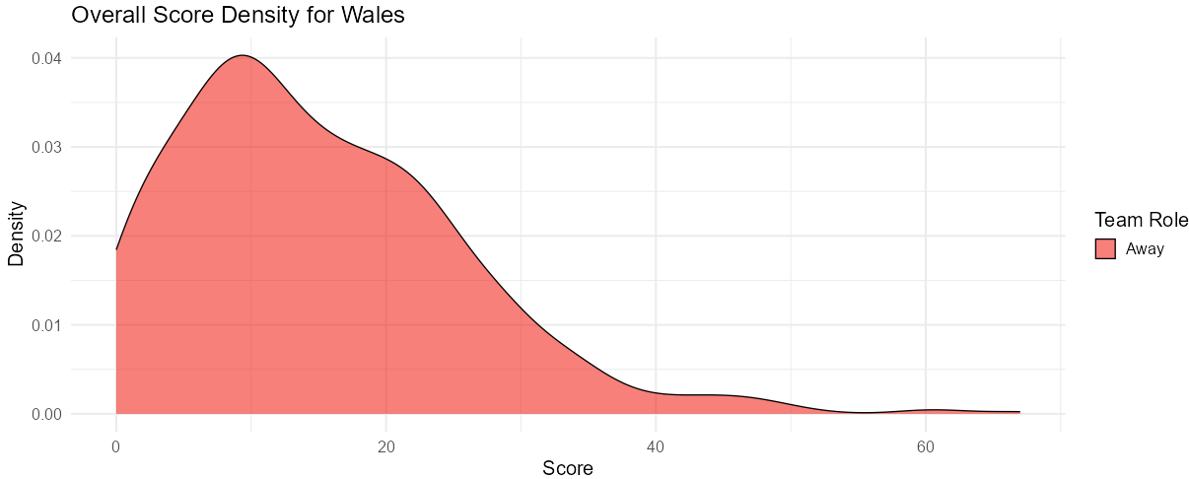
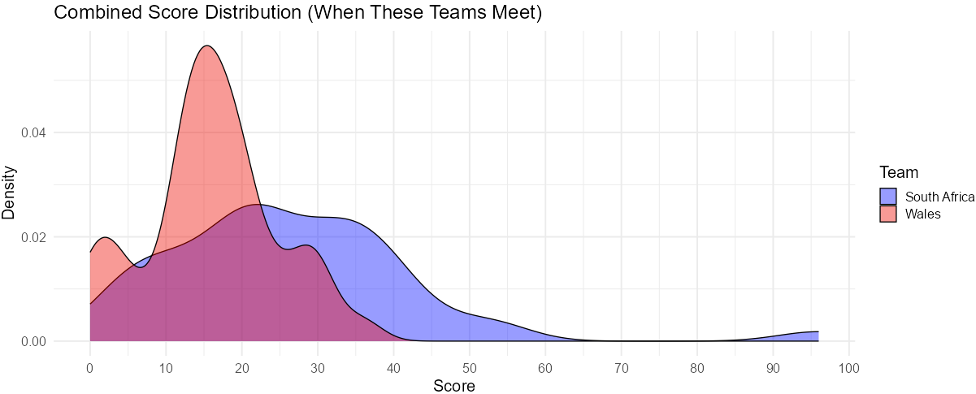
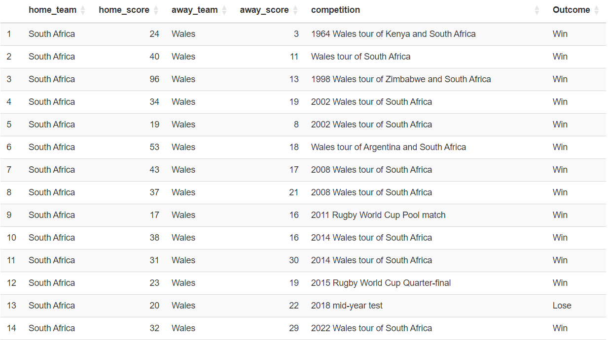
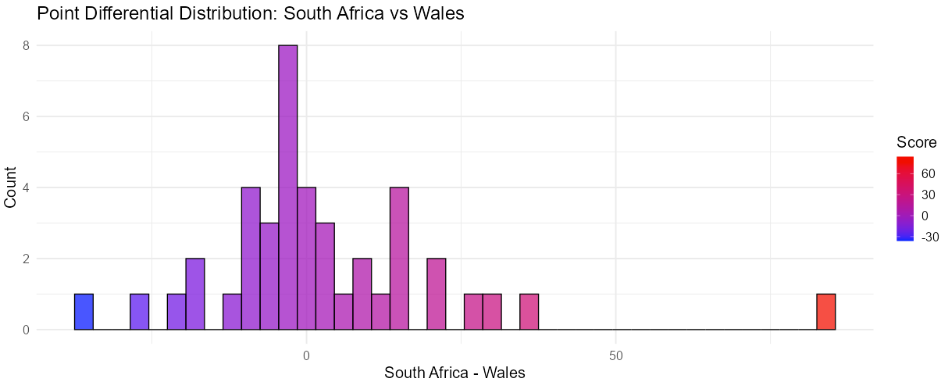
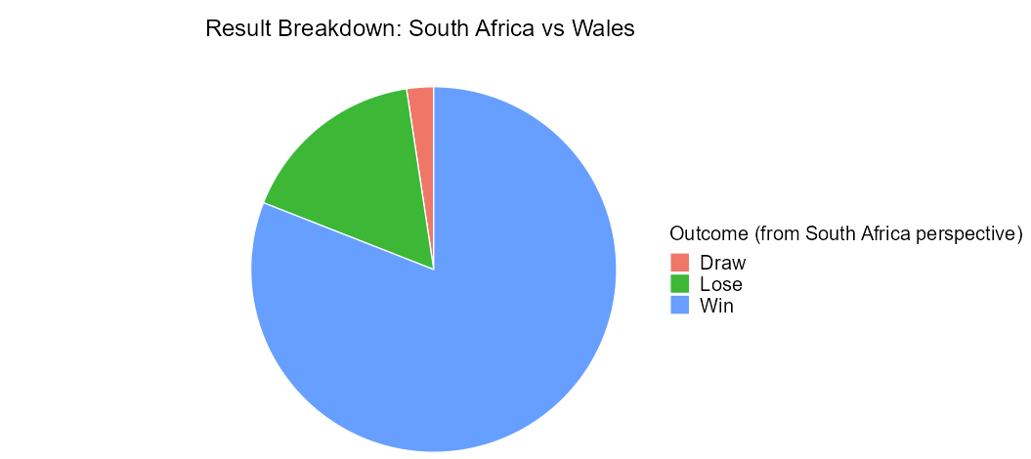
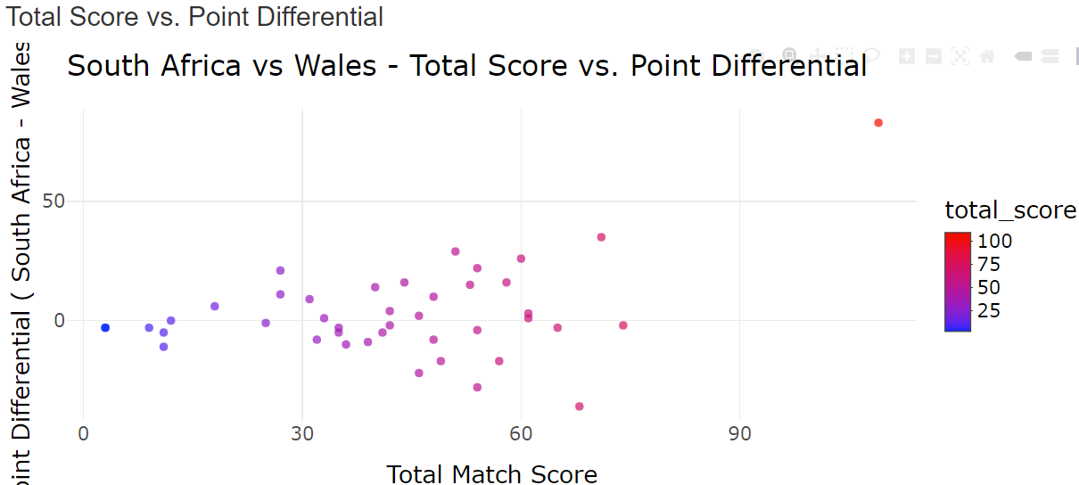
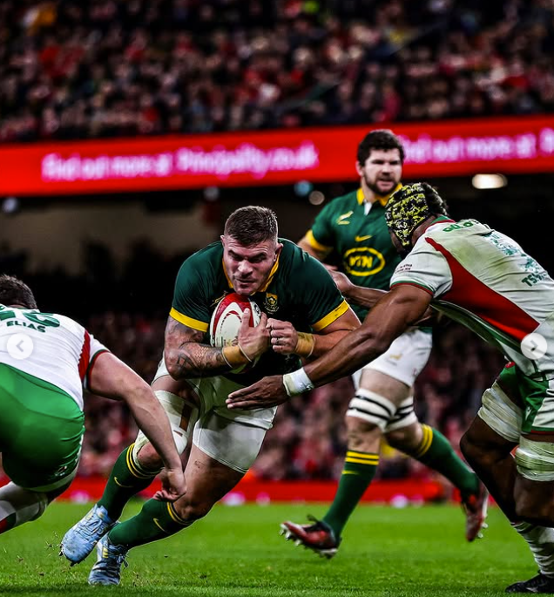
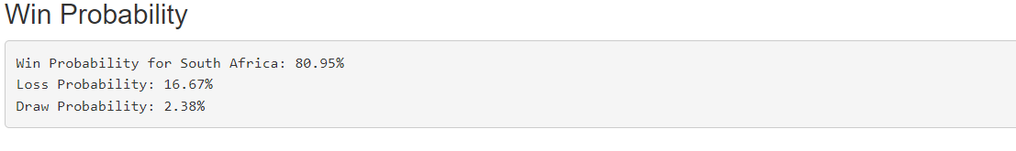
Rugby Union Results Exploration
Ali du Plessis ’25 (Statistics & Economics)
Advisor : Ivan Ramler
Department: Statistics
What is Rugby Union?
Example Analysis: South Africa vs Wales
Densities
Rugby Union is a historic international sport dating back to the 1800s, known for its longstanding rivalries among mostly Commonwealth nations.
Fig. 1 & 2 show distributions of all of SA & Wales scores they have achieved throughout history against all the Rugby Union teams.
The Fig. 3 shows, that in head-to-head matchups, Wales’s scores peak sharply around 15 points, indicating a narrow and lower scoring range.
SA’s scores are spread more evenly between 20 and 40 points when facing Wales, resembling a uniform distribution and suggesting more consistent high scoring against Wales.
Fig. 1: SA Score Distribution across all matches throughout History.
Project Overview
1. Project Summary
Investigates historic Rugby Union rivalries using statistical visualizations based on past match results.
Identifying trends to team performance predict through an interactive online tool built in Shiny.
Fig. 2: Wales Score Distribution across all matches throughout History.
2. Data
From Kaggle, covering international matches from 1871 to 2023.
Contains ~ 2,700 matches with multiple variables
Point Differential
Fig. 3: Combined Score Distribution when these teams played each other.
Fig. 4 shows most values to the right of 0, indicating that SA has won more matches and often by larger margins, while Wales’s wins are fewer and closer.
Entertainment Scale – Fig. 6
Fig. 4: Point Differential Distribution of SA (minus) Wales.
Points far to the right represent high scoring matches.
Points high along the Y-axis represent matches with large point differentials.
This graph can be seen as an entertainment scale to see which matches were most entertaining.
A point like this can be seen on Fig. 6 and has been marked.
Together, these visuals provide a strong foundation for making intuitive, data-driven predictions about which team is more likely to win — based on history, not just hype.
Fig. 5: Pie Chart of Historic Win/Loss/Draw in terms of SA’s Perspective.
3. Shiny App
Users can select any two teams to view dynamic, matchup-specific visualizations.
Visuals include density plots, point differentials, pie charts, and interactive scatterplots for deeper insights.
Fig. 6: Total Score vs Point Differential.
Potential Uses
Developed into a SCORE module to help students understand how visualizations highlight different aspects of matchups.
Though focused on rugby, this approach applies to other sports or to compare the effectiveness of two products for certain business applications.
Fig. 7: Probabilities Between 2 Teams.

