Slide 1

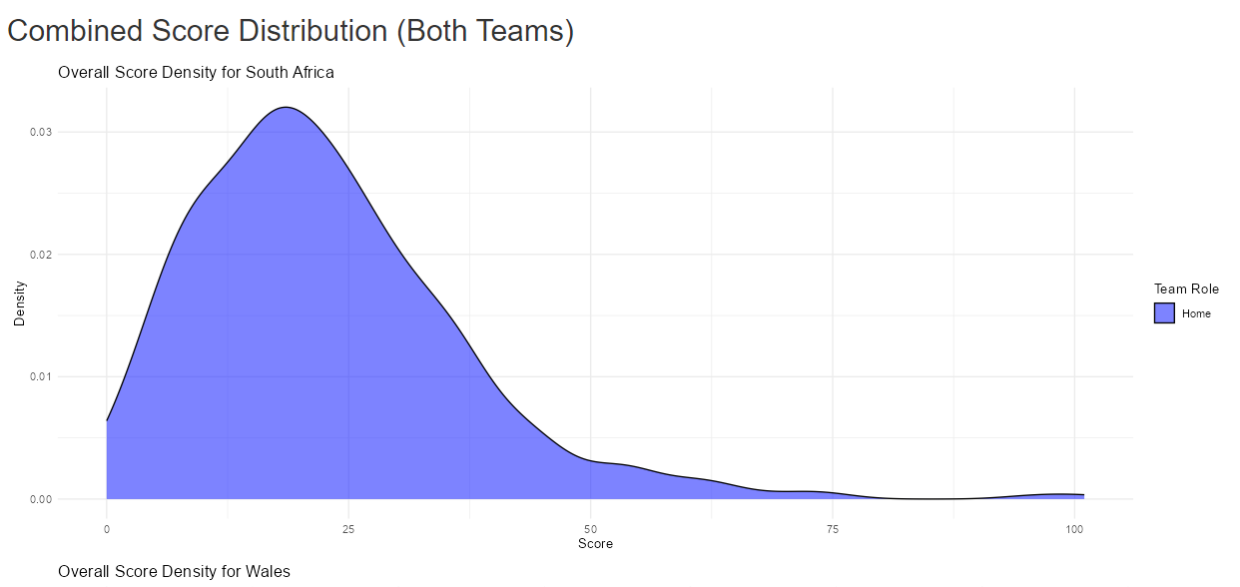
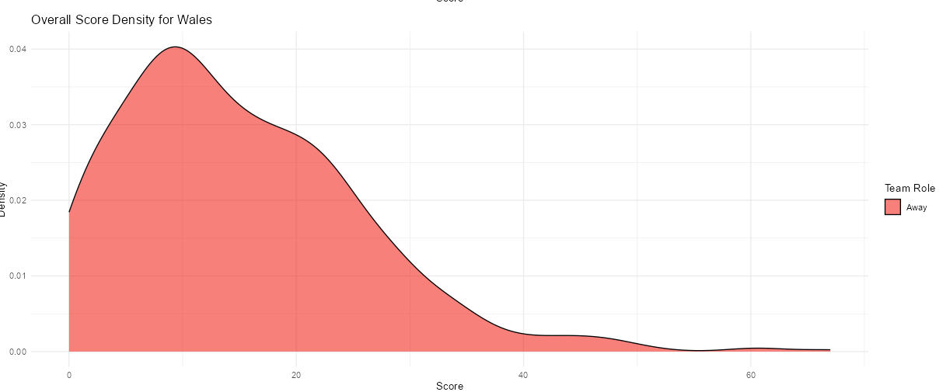
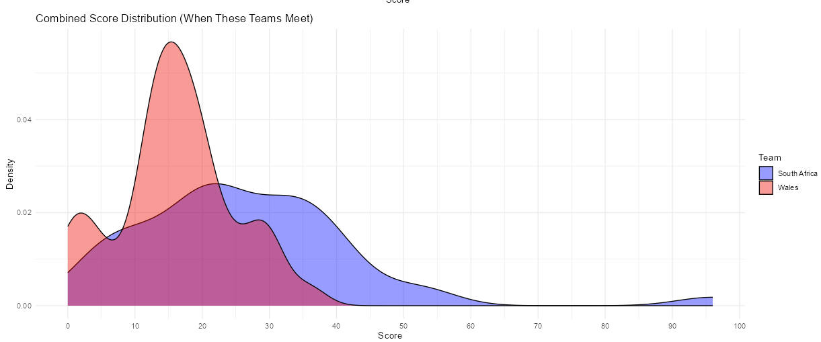
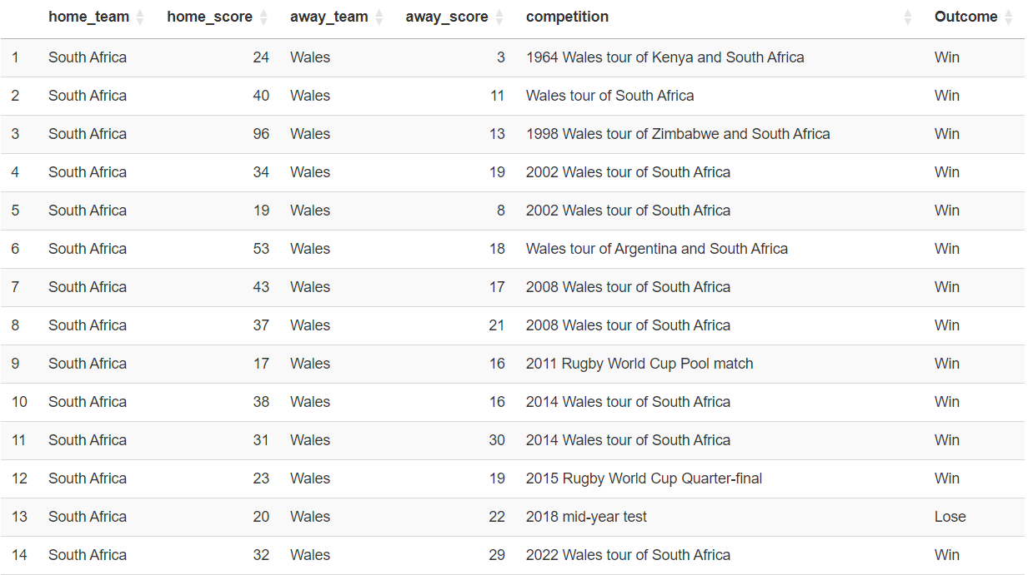
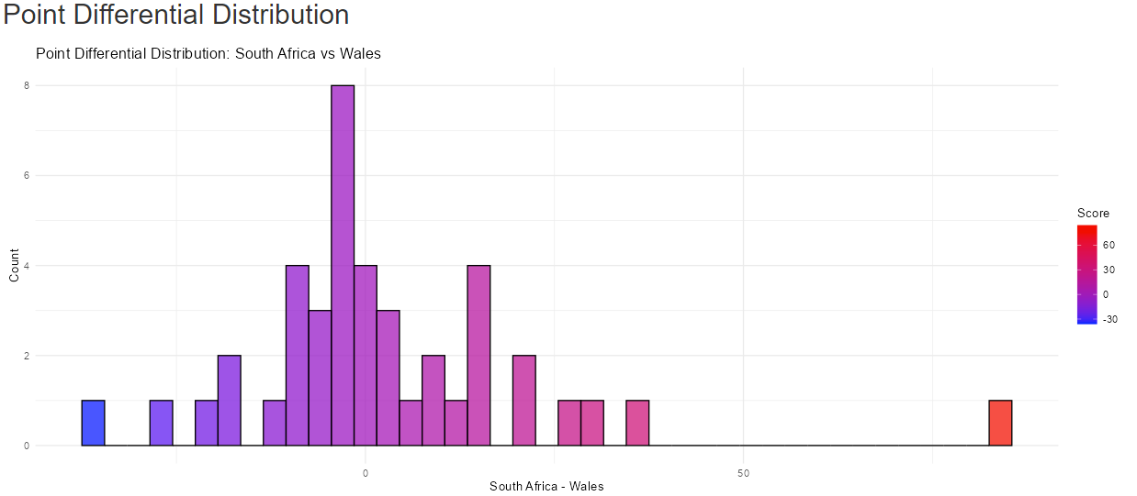
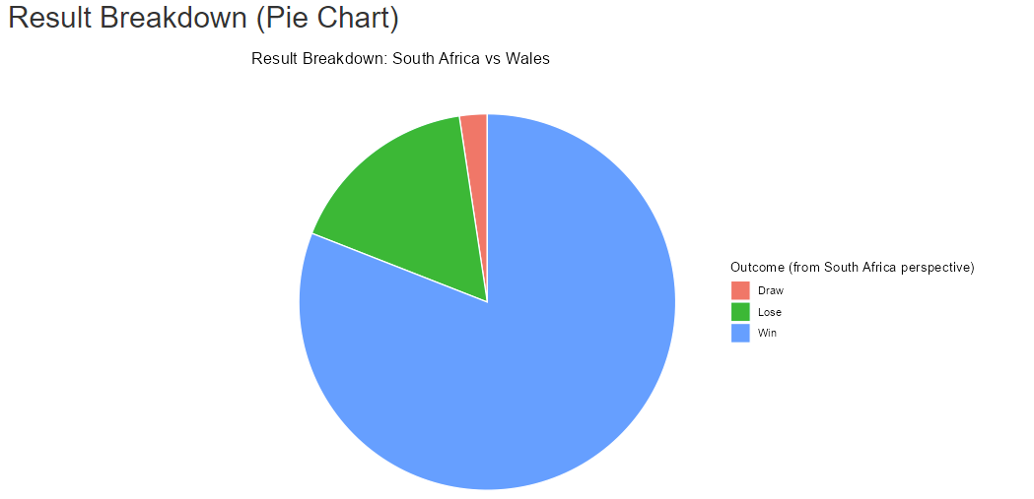
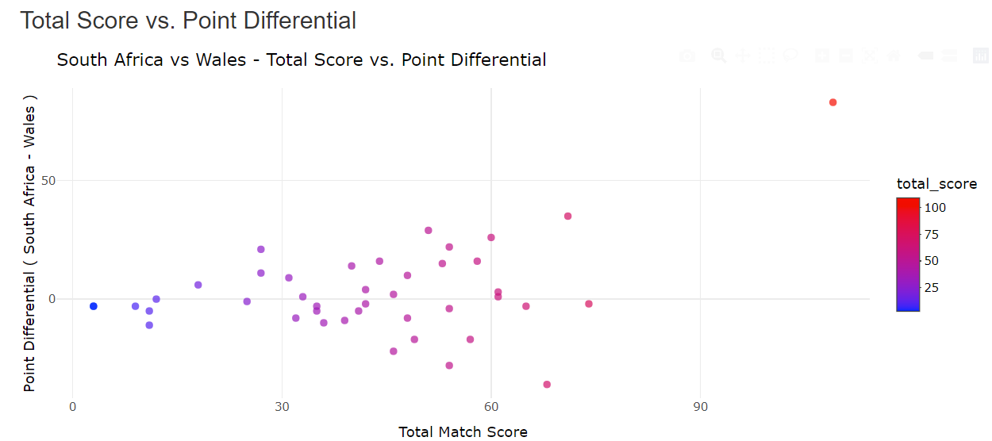
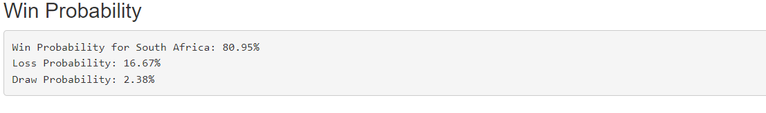
Rugby Union Results Exploration
Ali du Plessis ’25 (Statistics)
Advisor : Ivan Ramler
What is Rugby Union?
Example Analysis: South Africa vs Wales
Densities
These density graphs shows distribution of all of SA & Wales scores they have achieved throughout history against all the Rugby Union teams.
The combined density shows, that in head-to-head matchups, Wales’s scores peak sharply around 15 points, indicating a narrow and lower scoring range.
South Africa’s scores are spread more evenly between 20 and 40 points when facing Wales, resembling a uniform distribution and suggesting more consistent high scoring against Wales.
Rugby Union is a historic international sport dating back to the 1800s, known for its physical gameplay, strategic scoring, and longstanding rivalries among mostly Commonwealth nations.
South Africa Score Distribution across all matches throughout History.
Project Overview
1. Project Summary
Investigates historic Rugby Union rivalries using statistical visualizations based on past match results.
Focuses on identifying trends and patterns to better understand team performance and inform predictions through an interactive online tool built in Shiny.
Wales Score Distribution across all matches throughout History.
Point Differential
The point differential distribution shows most values to the right of 0, indicating that South Africa has won more matches and often by larger margins, while Wales’s wins are fewer and closer.
2. Data
From Kaggle, covering international matches from 1871 to 2023.
Contains approximately 2,700 matches with variables like team names, scores, dates, and match context.
Combined Score Distribution when these teams played each other.
Total Score vs Point Differential – Entertainment Scale
Points far to the right represent high scoring matches.
Points high along the Y-axis represent matches with large point differentials.
This graph can be seen as an entertainment scale to see which matches were most entertaining.
Point Differential Distribution of South Africa (minus) Wales.
Conclusion & Future Application
Density plots reveal consistent scoring trends and highlight how teams typically perform, giving a clear picture of offensive strength over time.
Point differential histograms illustrate the competitiveness of a rivalry, with skewed distributions pointing to one team's dominance in head-to-head matchups.
Together, these visuals provide a strong foundation for making intuitive, data-driven predictions about which team is more likely to win — based on history, not just hype.
This project was also developed into a SCORE module to help students build intuition around how different graphical summaries can highlight various dimensions of a matchup.
While focused on rugby, the same framework can be applied to other sports to explore matchups and trends, or even extended to fields like business or public health where historical patterns guide decision-making.
Pie Chart of Historical Win/Loss/Draw in terms of South Africa’s Perspective.
3. Shiny App
Users can select any two teams to view dynamic, matchup-specific visualizations.
Visuals include density plots, point differentials, pie charts, and interactive scatterplots for deeper insights.
Total Score vs Point Differential Scatter Plot.
Win/Loss/Draw Probability Between 2 Teams.

