Slide 1
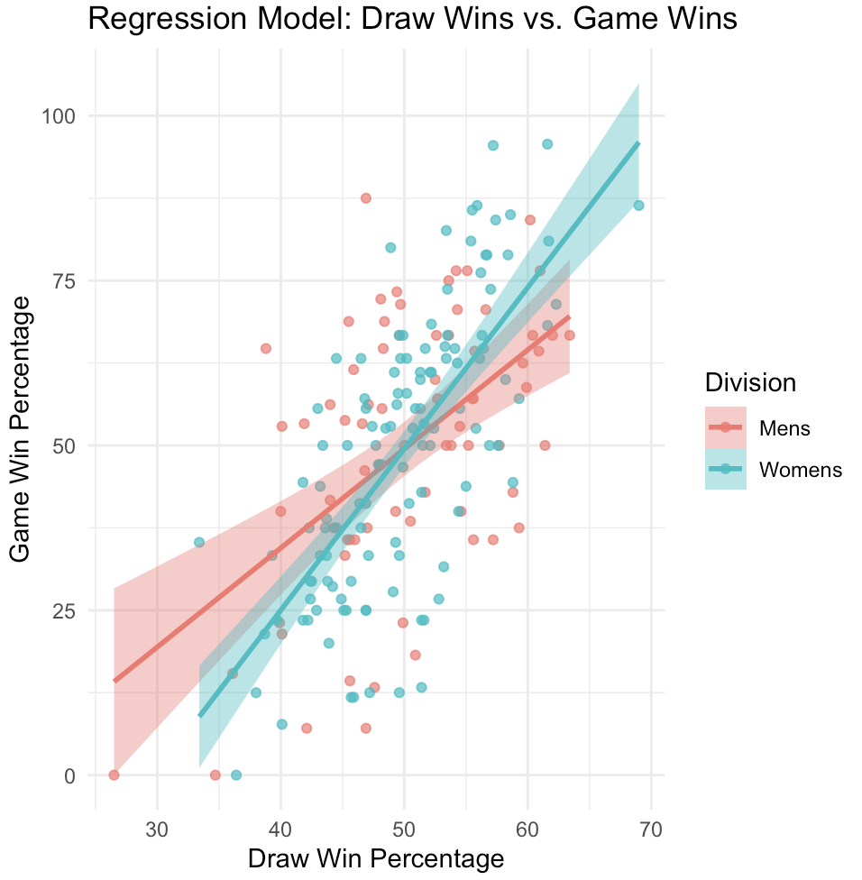
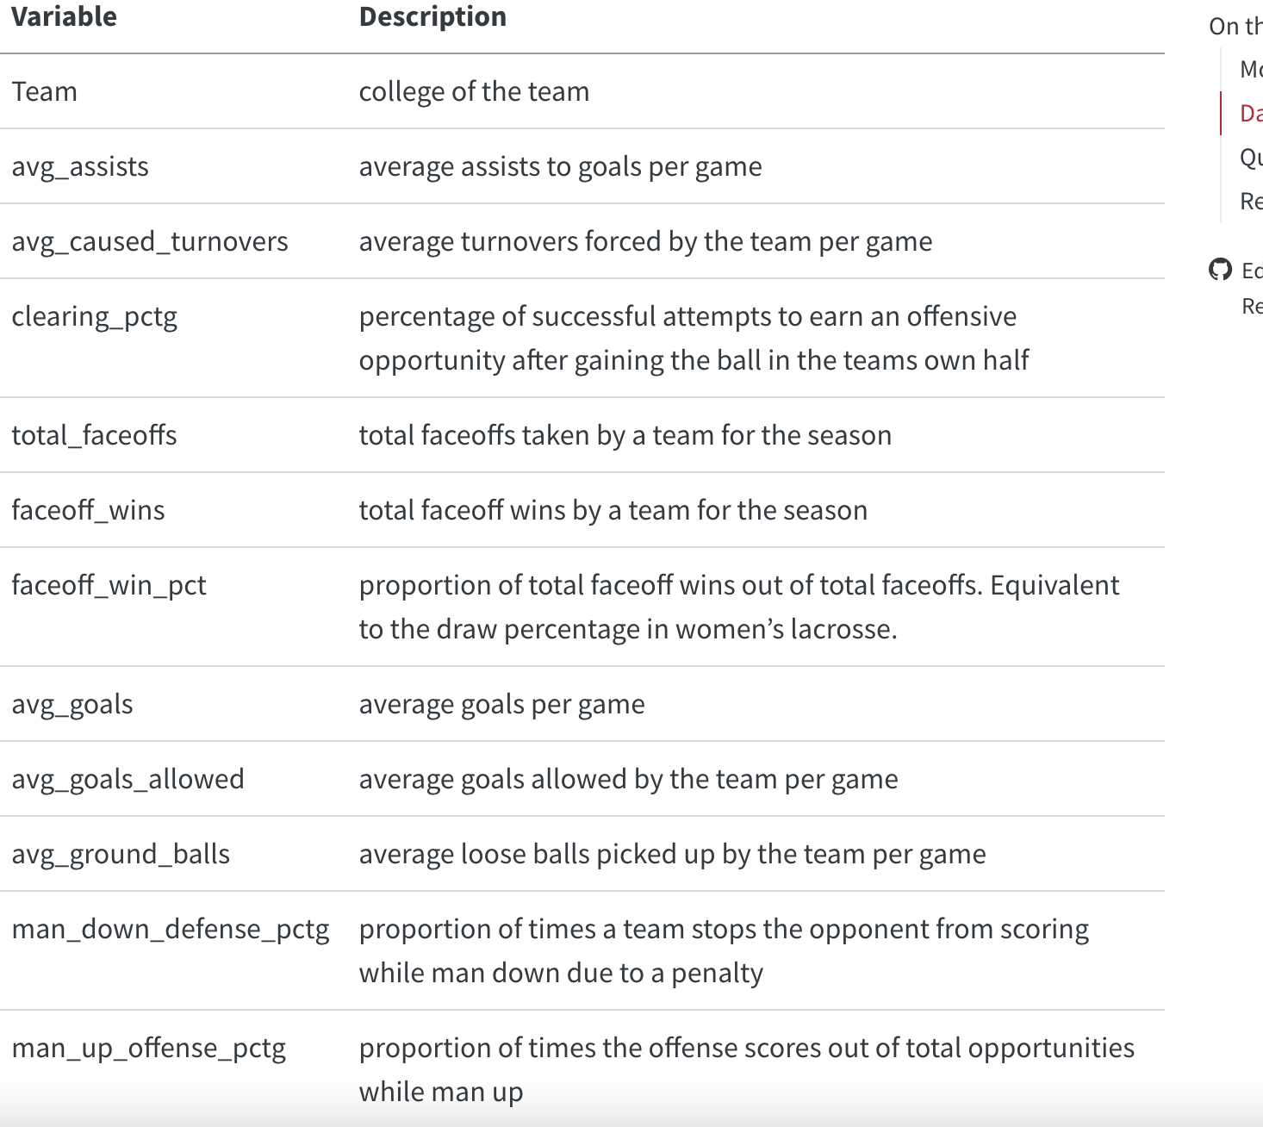
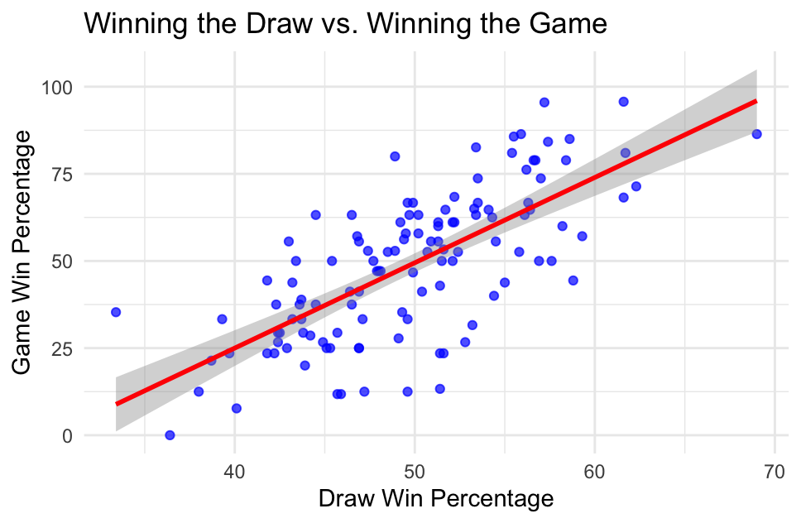
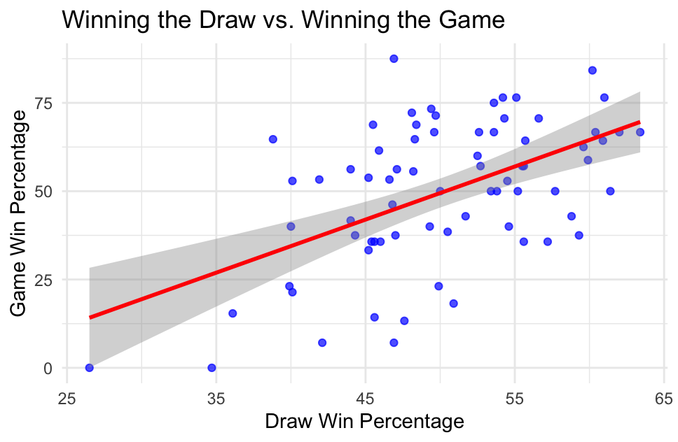
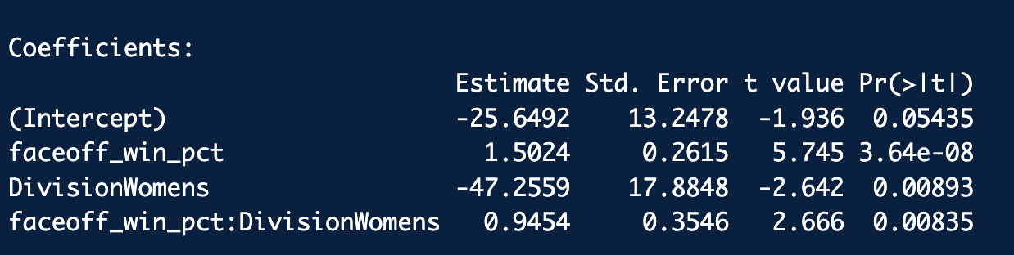
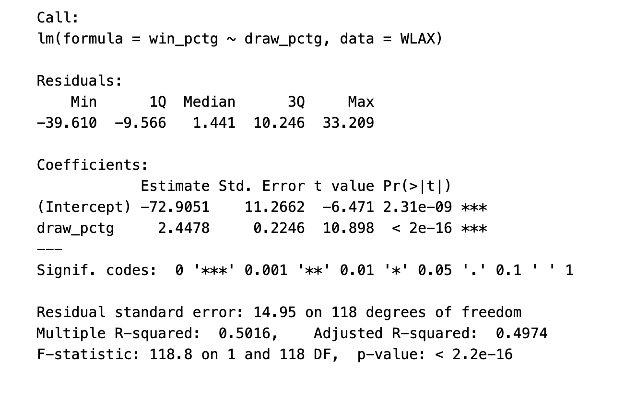
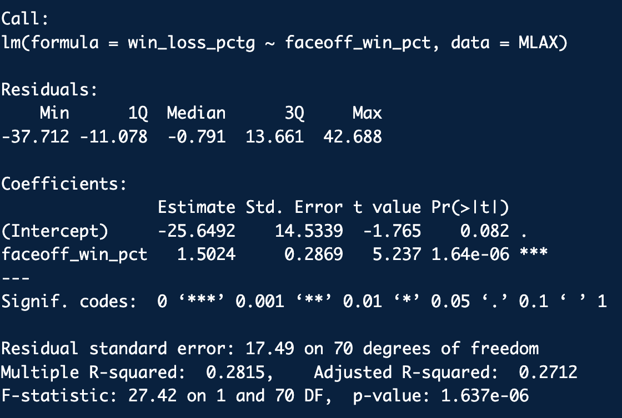
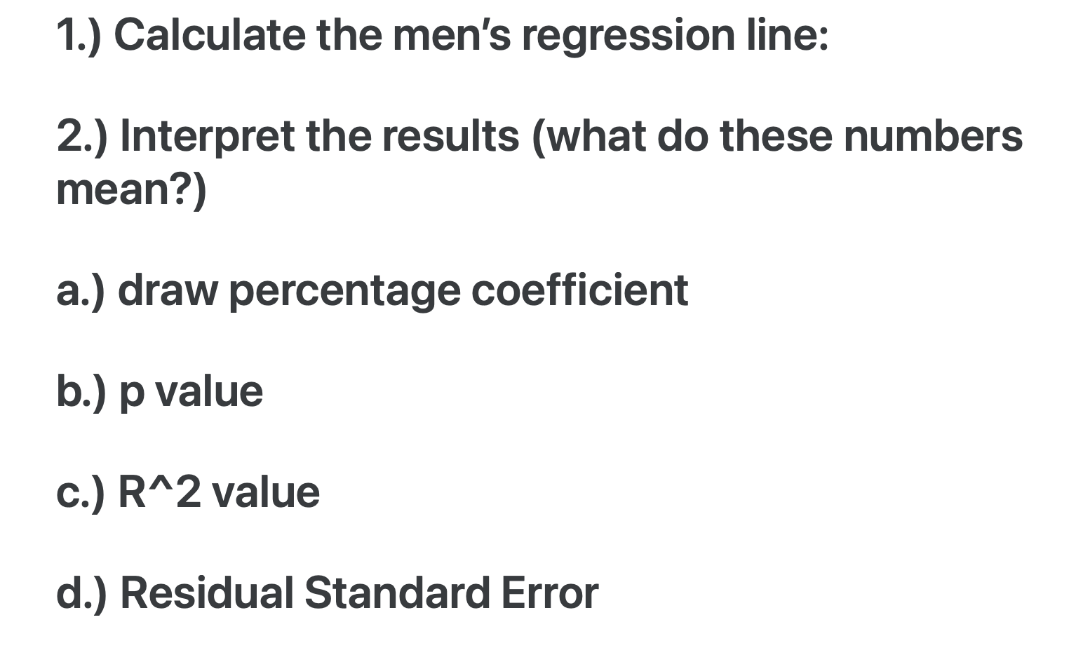
SCORE Network: Impact of Draws/Faceoffs Division I Lacrosse
Jill Tyrrell ’25 (Statistics)
Advisor: Professor Ivan Ramler
What is SCORE?
Logistic Regression Plots Division I Lacrosse
Interaction Model
- The SCORE Network is an NSF-funded national network focused on developing and distributing Sports Content for Outreach, Research, and Education in the fields of statistics and data science.
Step 1: plot the regression models for women and then men
1. Introduction
Summary of the sport and concepts that will be in handout
Provides learning objectives and methods
Women
Men
2. Data
Summary of dataset, with variable descriptions
Supplies data file and source
What are we looking at?
regression model and lines of game win percentage and draw/face off win percentage for both men and women
3. Materials
Class handouts and answer keys
Conclusions
a.) How do the regression lines differ for men's and women's lacrosse?
The women's slope is steeper, depicting that draw win percentage has a stronger impact on game with percentage compared to the men.
The interaction term (β = 0.9454, p = 0.0084) shows that the effect of winning faceoffs/draws is stronger for women’s teams than for men’s teams.
For every 1% increase in draw win percentage, women’s win percentage increases by (1.5024 + 0.9454 = 2.4478%), while men’s win percentage increases by only 1.5024%.
b.) Which division (men's or women's) seems to show a stronger relationship between draw wins and game wins?
The women division shows a stronger relationship due to their steeper slope and higher R^2 value
c.) What does this tell you about the importance of winning faceoffs/draws in lacrosse games?
Overall, winning the draw/faceoff in the women division is more crucial and important to the games overall outcome than in the men division
4. Conclusion
Summarize the takeaways and learning objectives from the sports application handouts
Interpret these results (what do these numbers mean?)
a.) draw percentage coefficient (2.4478):
for every 1% increase in draw win percentage, game win percentage increases by 2.4478 %
b.) p value (p ≈ 0)
depicts that draw percentage significantly affects win percentage
c.) R^2 value (R^2= 0.5016)
the model explains 50.16% of the variation in win percentage
d.) Residual Standard Error (RSE = 14.95)
on average, the model's predictions are off by about 14.95 units
What are we looking at?
- In both the men’s and women’s game, gaining possession of the faceoff (men’s) or draw control (women’s) is a crucial factor in determining success.
- Analyzing faceoff data can provide students with a realistic application to regression modeling by looking into how much of an impact winning the draw/face-off has on the final results of a lacrosse game for both men and women.

