Slide 1
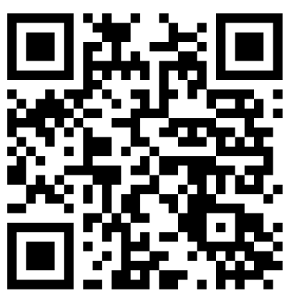
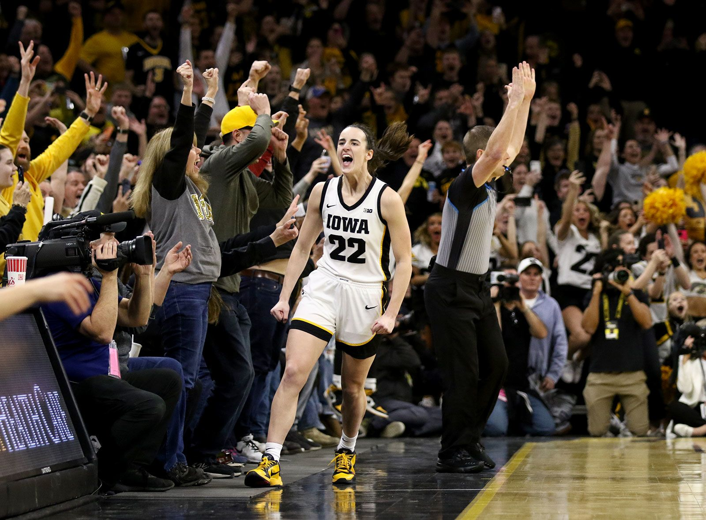
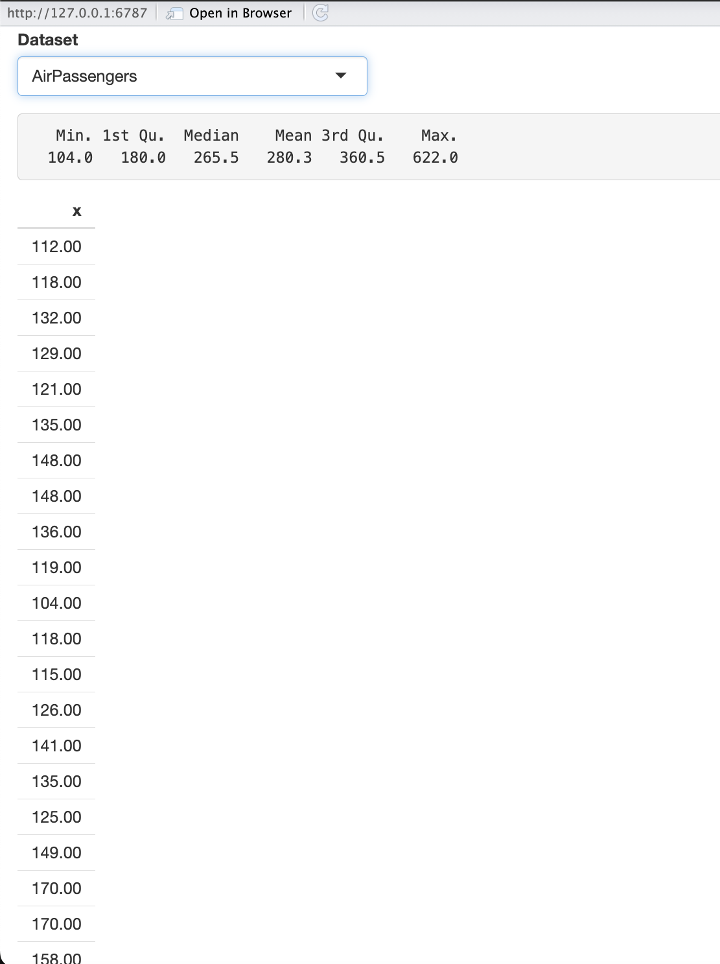
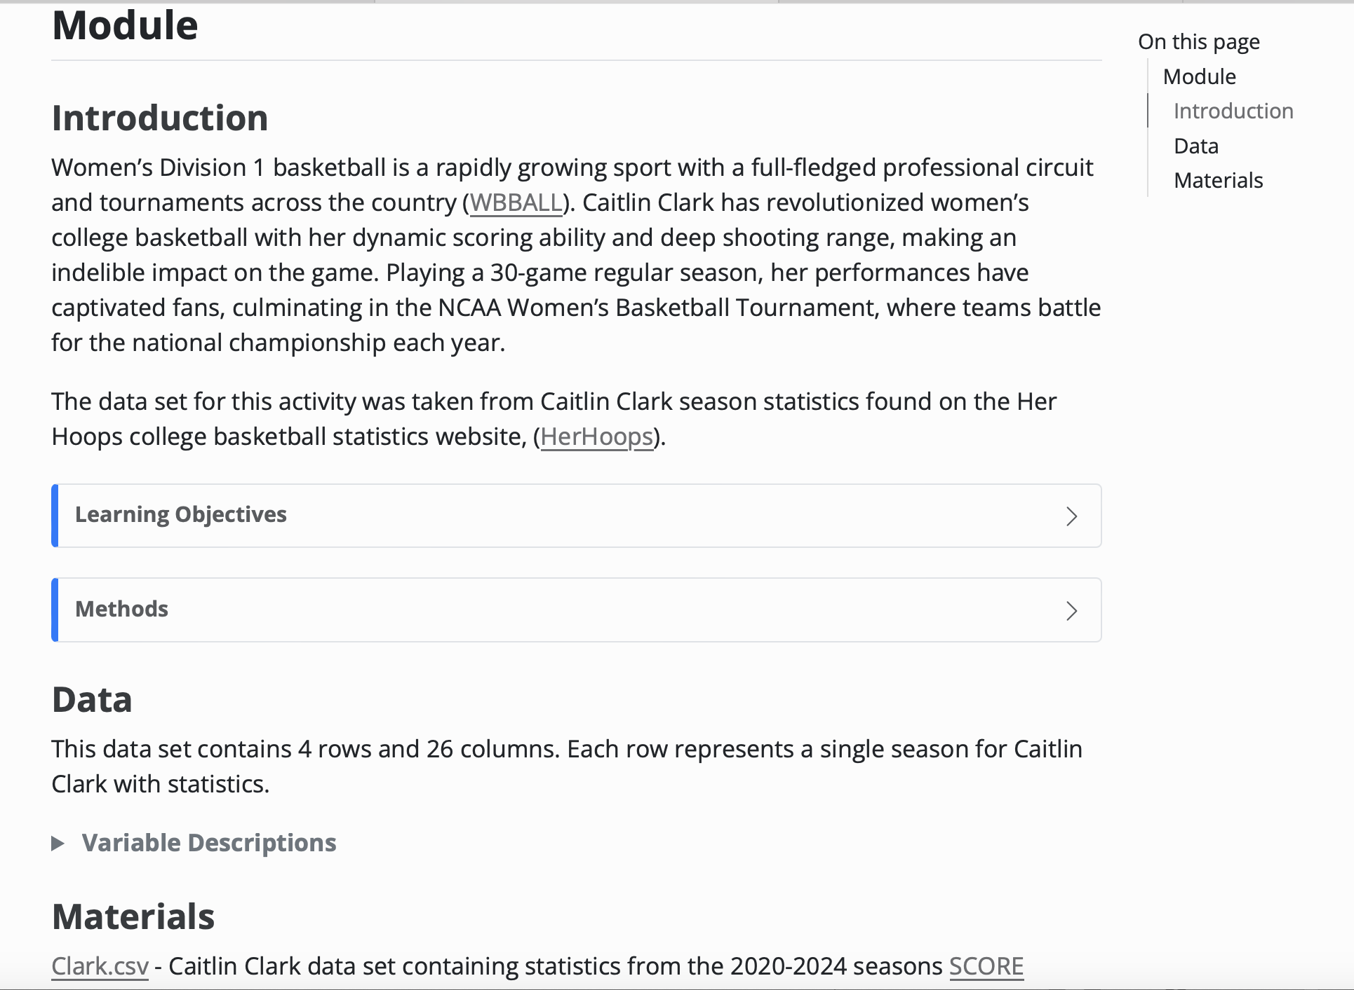
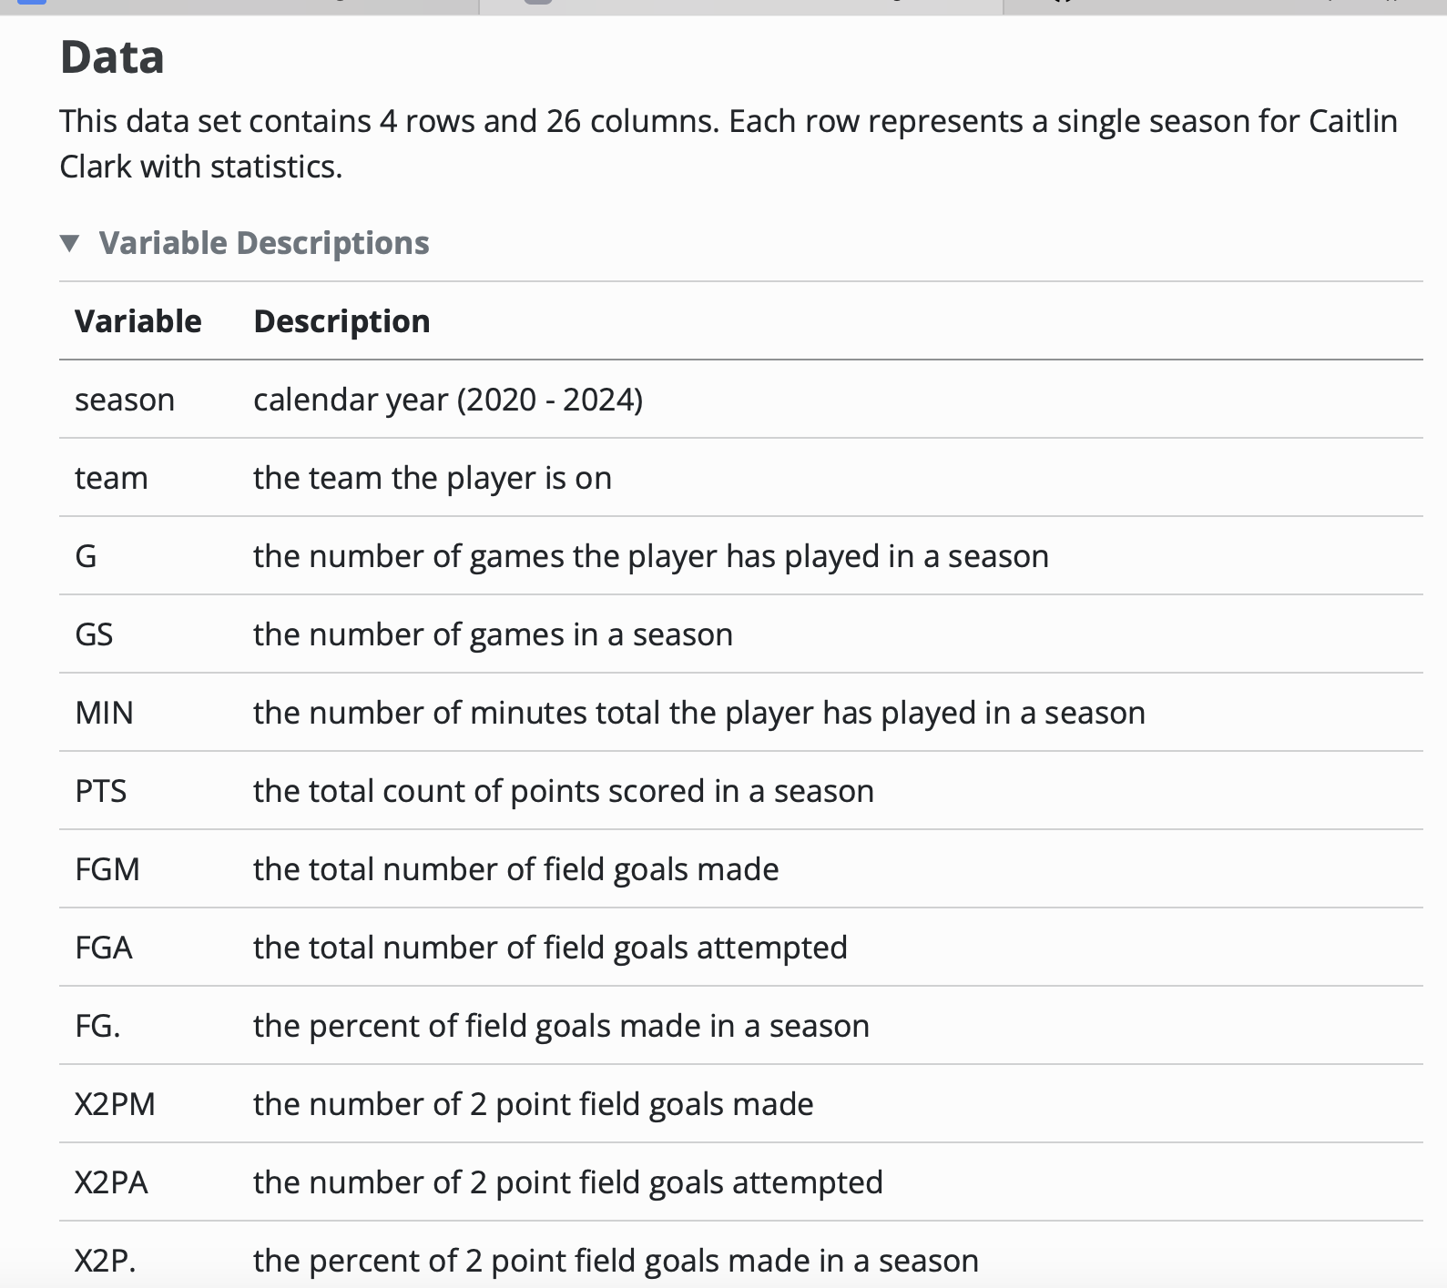
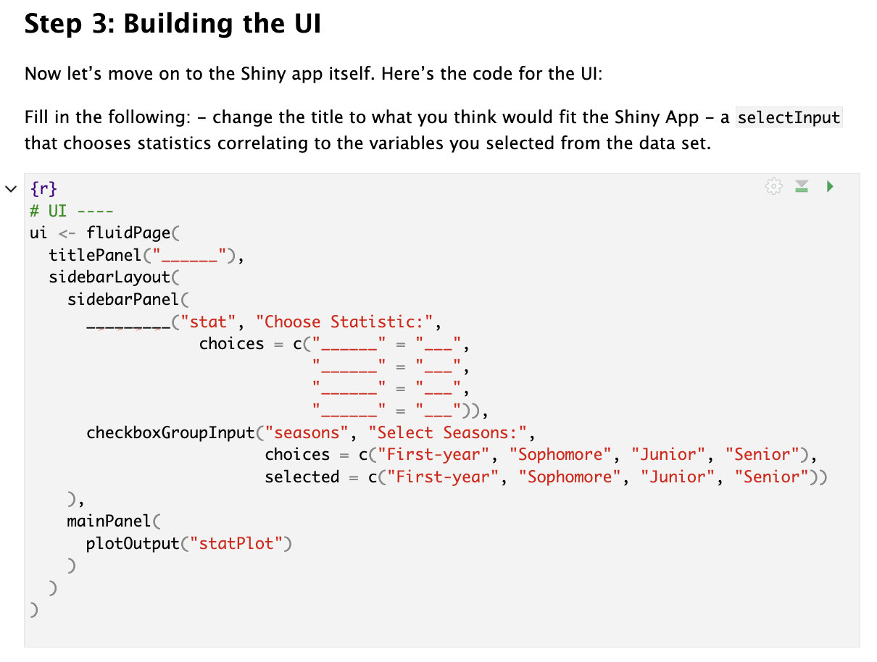
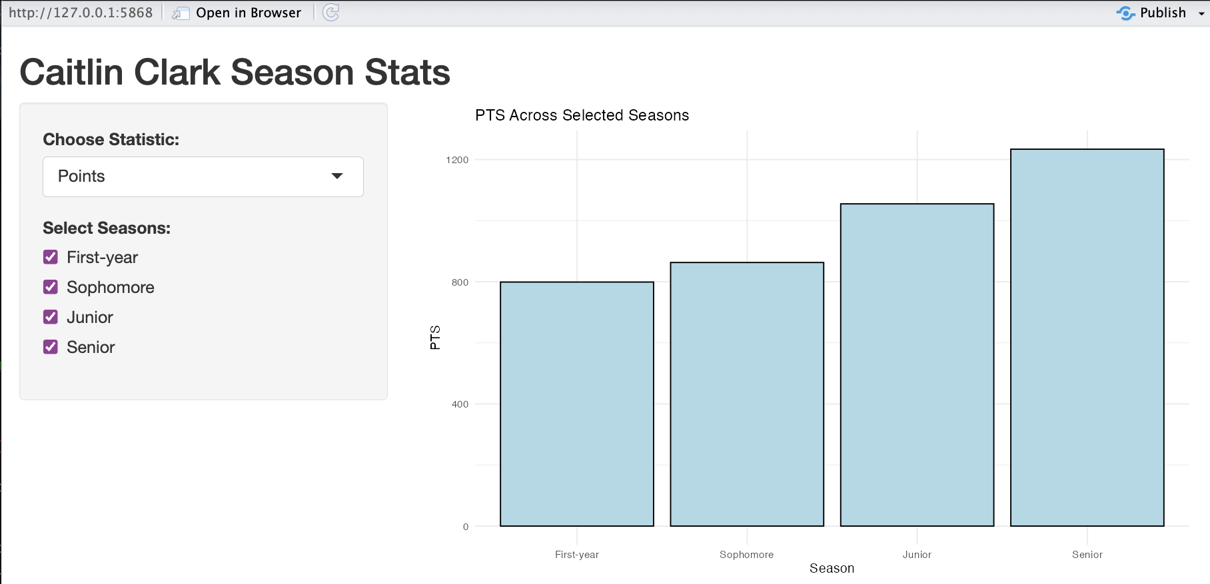
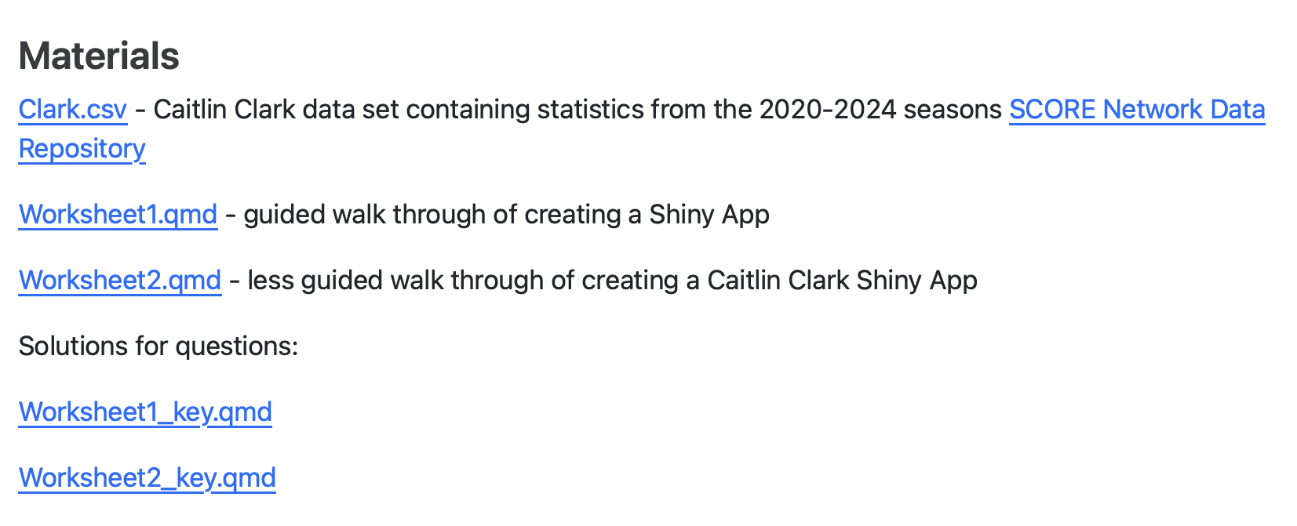
SCORE Network: Building a Shiny App
Abigail Sikora ’25 (Statistics)
Advisor: Professor Ivan Ramler
What is SCORE?
NCAA Women’s Basketball
Worksheet 1
Funded by the National Science Foundation
Acquires, cleans, manipulates, and documents sports data to create educational resources for data science and statistics
Student will follow along and run a simple Shiny app to see how UI and server work
Steps:
Add a dropdown and outputs to display dataset
Build the app piece by piece and describe how it responds
What is a Module?
1. Introduction
Summary of the sport and concepts that will be in handout
Provides learning objectives and methods
https://media.cnn.com/api/v1/images/stellar/prod/240215172544-01b-caitlin-clark-celebrates-record-021524.jpg?c=original
Who is Caitlin Clark?
Standout college basketball player for Iowa
NCAA’s all-time leading scorer
Inspired a new generation with her style and competitiveness
Worksheet 2
This is the first SCORE Module that walks students through how to make a Shiny App
2. Data
Summary of dataset, with variable descriptions
Supplies data file and source, (herhoops.com )
3. Materials
The module contains class handouts and worksheet keys
4. Conclusion
Summarize the takeaways and learning objectives from the sports application handouts
What will be learned
The student will understand the structure and components of a Shiny App
They will create an interactive visualization with dynamic outputs on their own by integrating R packages and following the steps of the worksheet
They will interpret outputs from the Shiny App and report what they find
Worksheet 1 should be completed before doing worksheet 2
Load and clean Caitlin Clark’s game stats for use in a Shiny app
Build a UI with dropdowns and checkboxes to select stats and seasons
Write server code to generate a bar plot based on user selections

