Slide 1

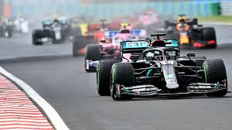
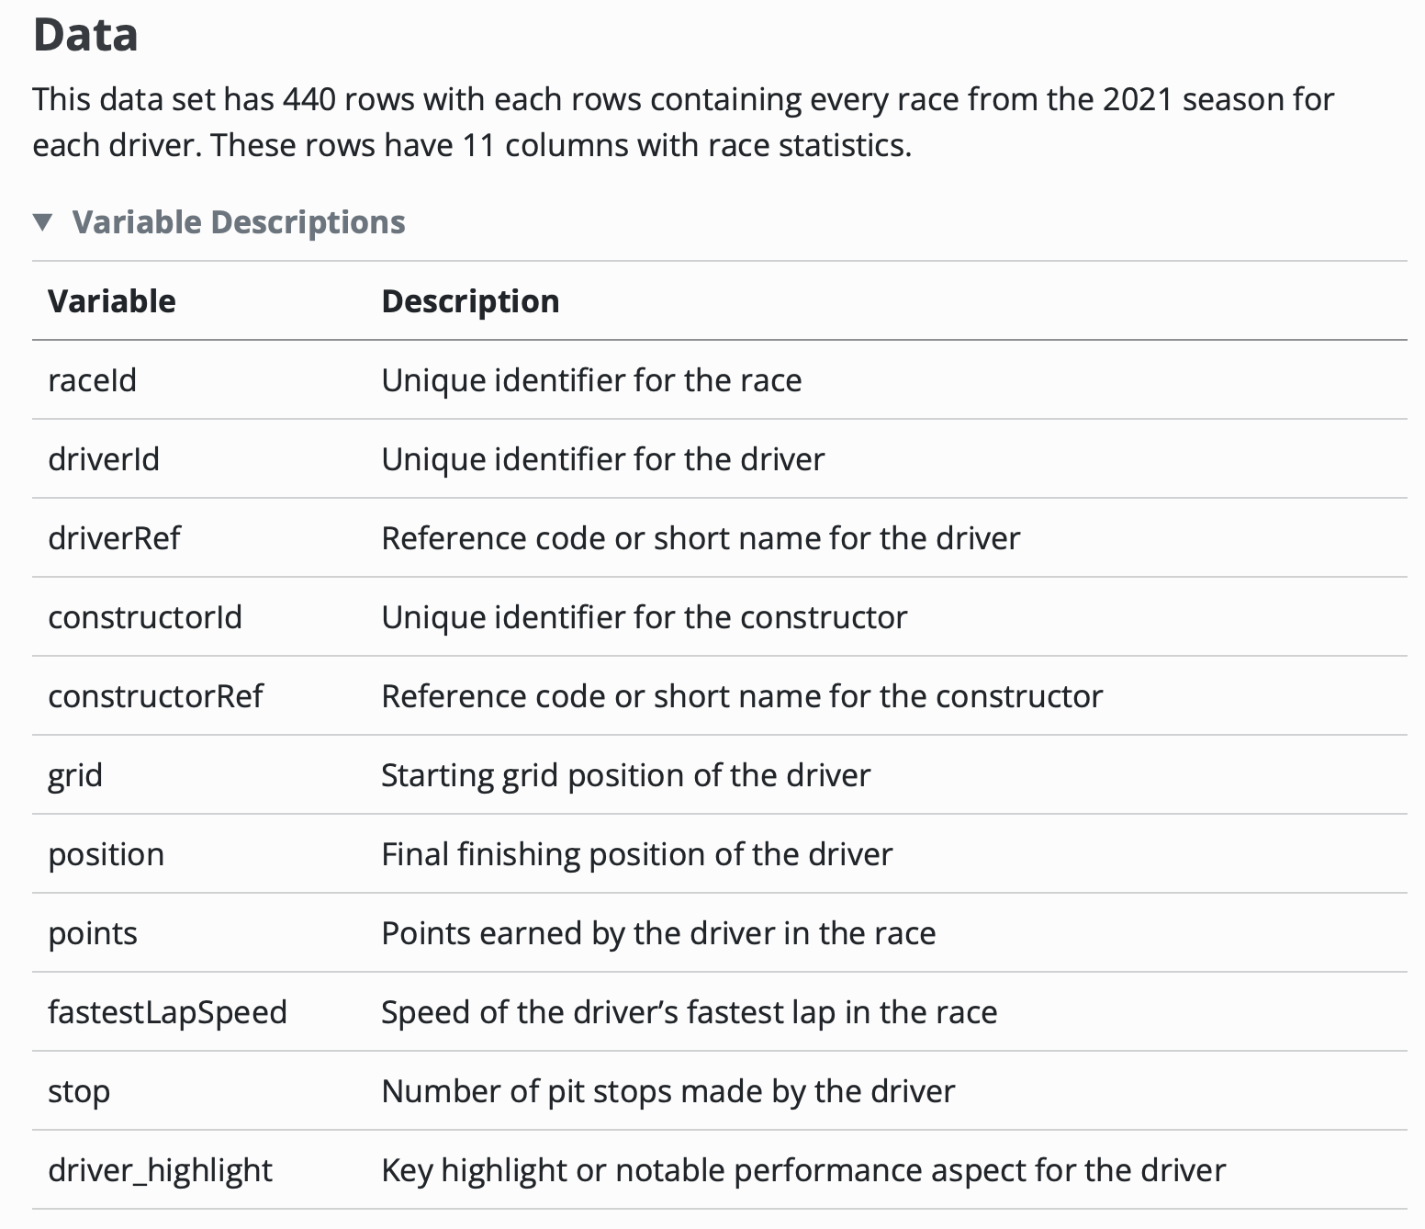
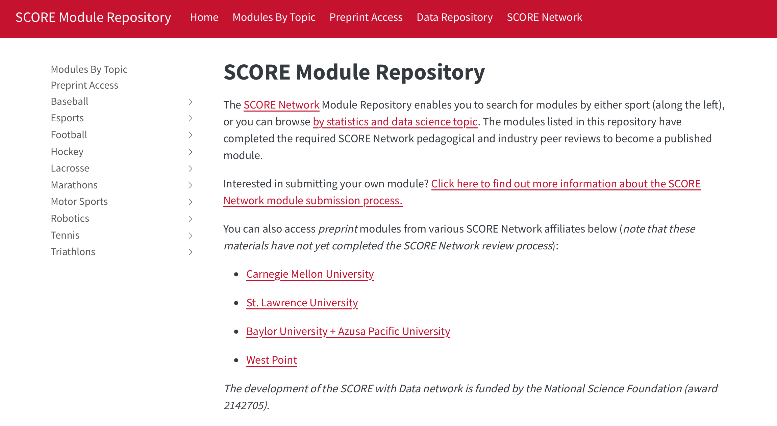
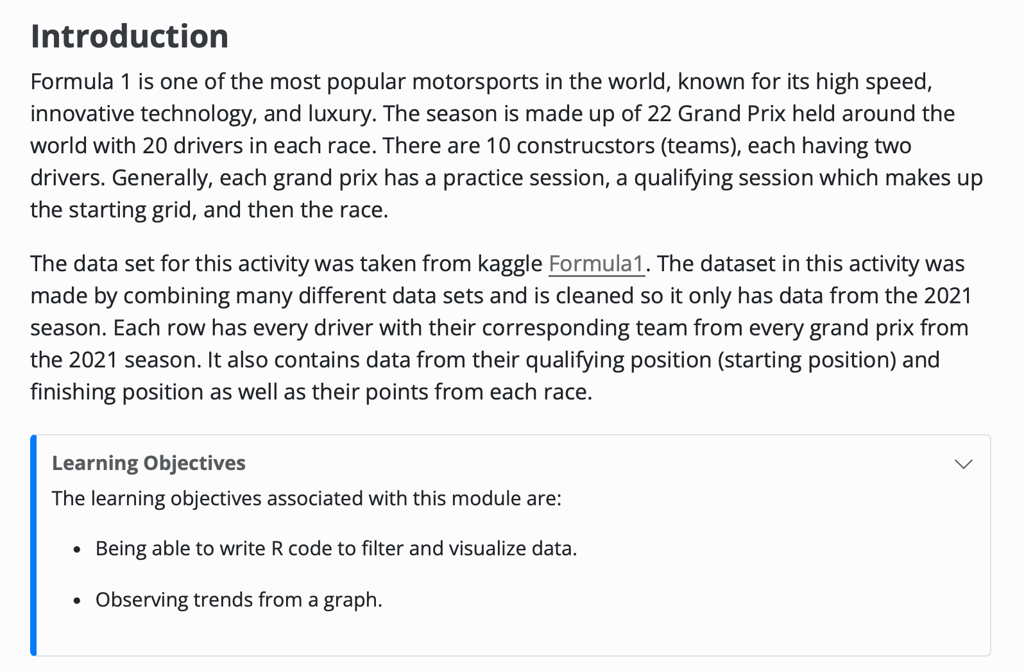
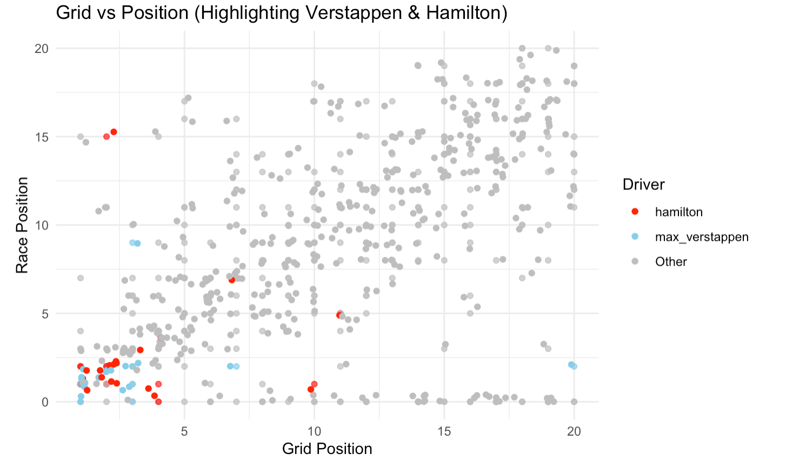
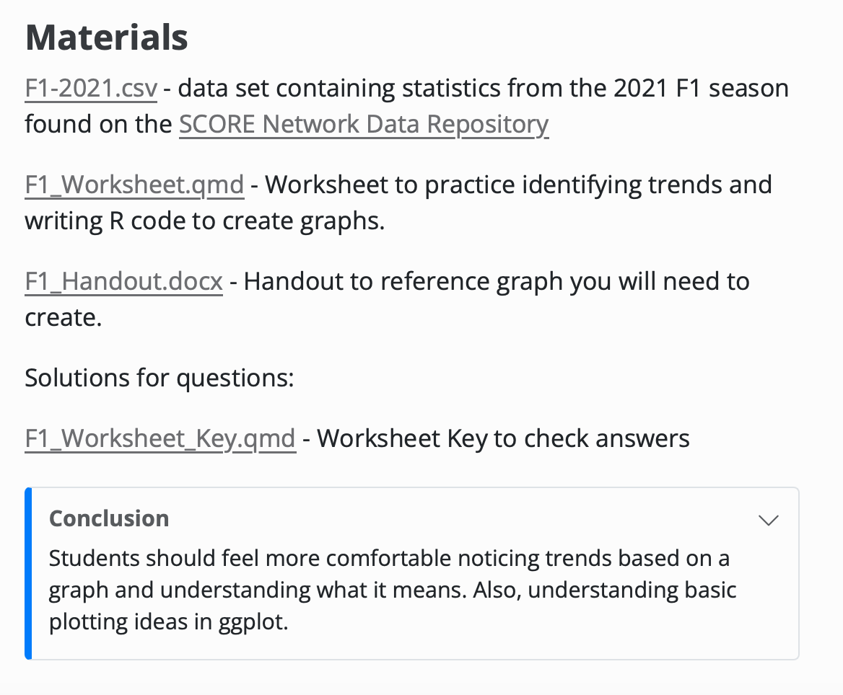
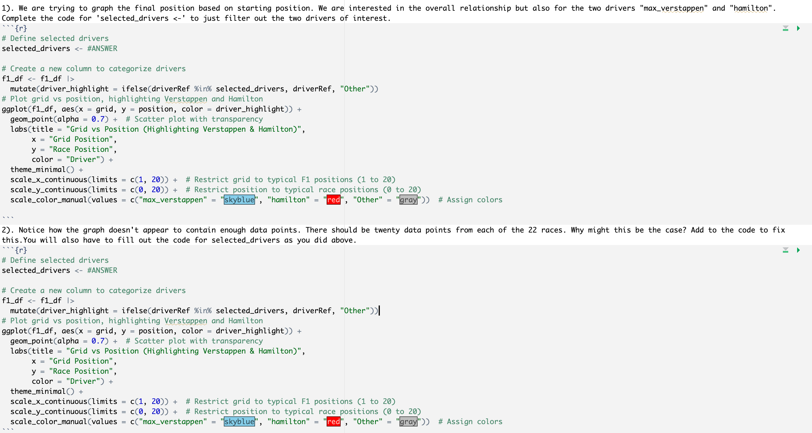

SCORE Network: Visualizing F1 Data
Charlie Gartner ’25 (Statistics)
Advisor: Ivan Ramler
What is SCORE?
Professional Bull Riding
The 2024 Dakar Rally
What is SCORE?
Formula 1 (F1) Racing
What is SCORE?
Making the Module
Funded by the National Science Foundation (award 2142705)
Acquires, cleans, manipulates, and documents sports data to create educational resources for data science
Funded by the National Science Foundation (award 2142705)
Acquires, cleans, manipulates, and documents sports data to create educational resources for data science
Collaboration in the SCORE Network allows for practice with finding and wrangling data, making regressions, visualizations, etc. that are then shared in the form of a module to further student learning.
1. Introduction
Summary of the sport and concepts that will be in the handout
Provides learning objectives and methods
2. Data
Summary of dataset, with variable descriptions
Supplies data file and source
3. Materials
Data file(s), worksheet, handout, and answer key.
4. Conclusion
Summarize the takeaways and learning objectives from the sports application worksheet.
Funded by the National Science Foundation (award 2142705)
Acquires, cleans, manipulates, and documents sports data to create educational resources for data science
Started with many data sets containing data from 1950 to 2024.
Filtered out for only the 2021 season with the divers that competed during that season.
Joined all of the data sets into one data frame to work easily with the data.
What is a Module?
What is it?
Motorsport that combines elite driving skill, strategic decision making, and cutting-edge technology.
Drivers race in a series of Grand Prix around the world, competing for the FIA World Champtionship.
Points are awarded based on finishing position at each race. The driver and constructor with the most points at the end of the season win the respective Championships.
What will be learned?
Visualizing 2021 F1 data to observe trends using ggplot
Filtering data and creating graphs in order to see relationships between variables and for particular drivers.
What is it?
Sport that requires a unique combination of skill, strength, and courage
Riders must stay on a bucking bull as long as they can, using only one hand to hold on while the bull tries to buck them off
Rider Score based on ride performance, and the bull is scored based on how well it bucks
Introduction which describes F1 and what the module is going to entail.
The worksheet has users filter the data and notice flaws in the given code that needs to be corrected
What will be learned
This dataset’s analysis encompasses linear regression, identification of influential points, hypothesis testing, and variable transformation
Analyzing 2023 PBR Touring Pro Division data to grasp factors influencing rider and bull performance
What will be learned
For this investigation, we will be looking at the motorist statistics for all 12 stages of race.
This dataset’s analysis will exemplify data visualization, uncovering patterns and insights within the race dynamics
QR code for this module

