Slide 1
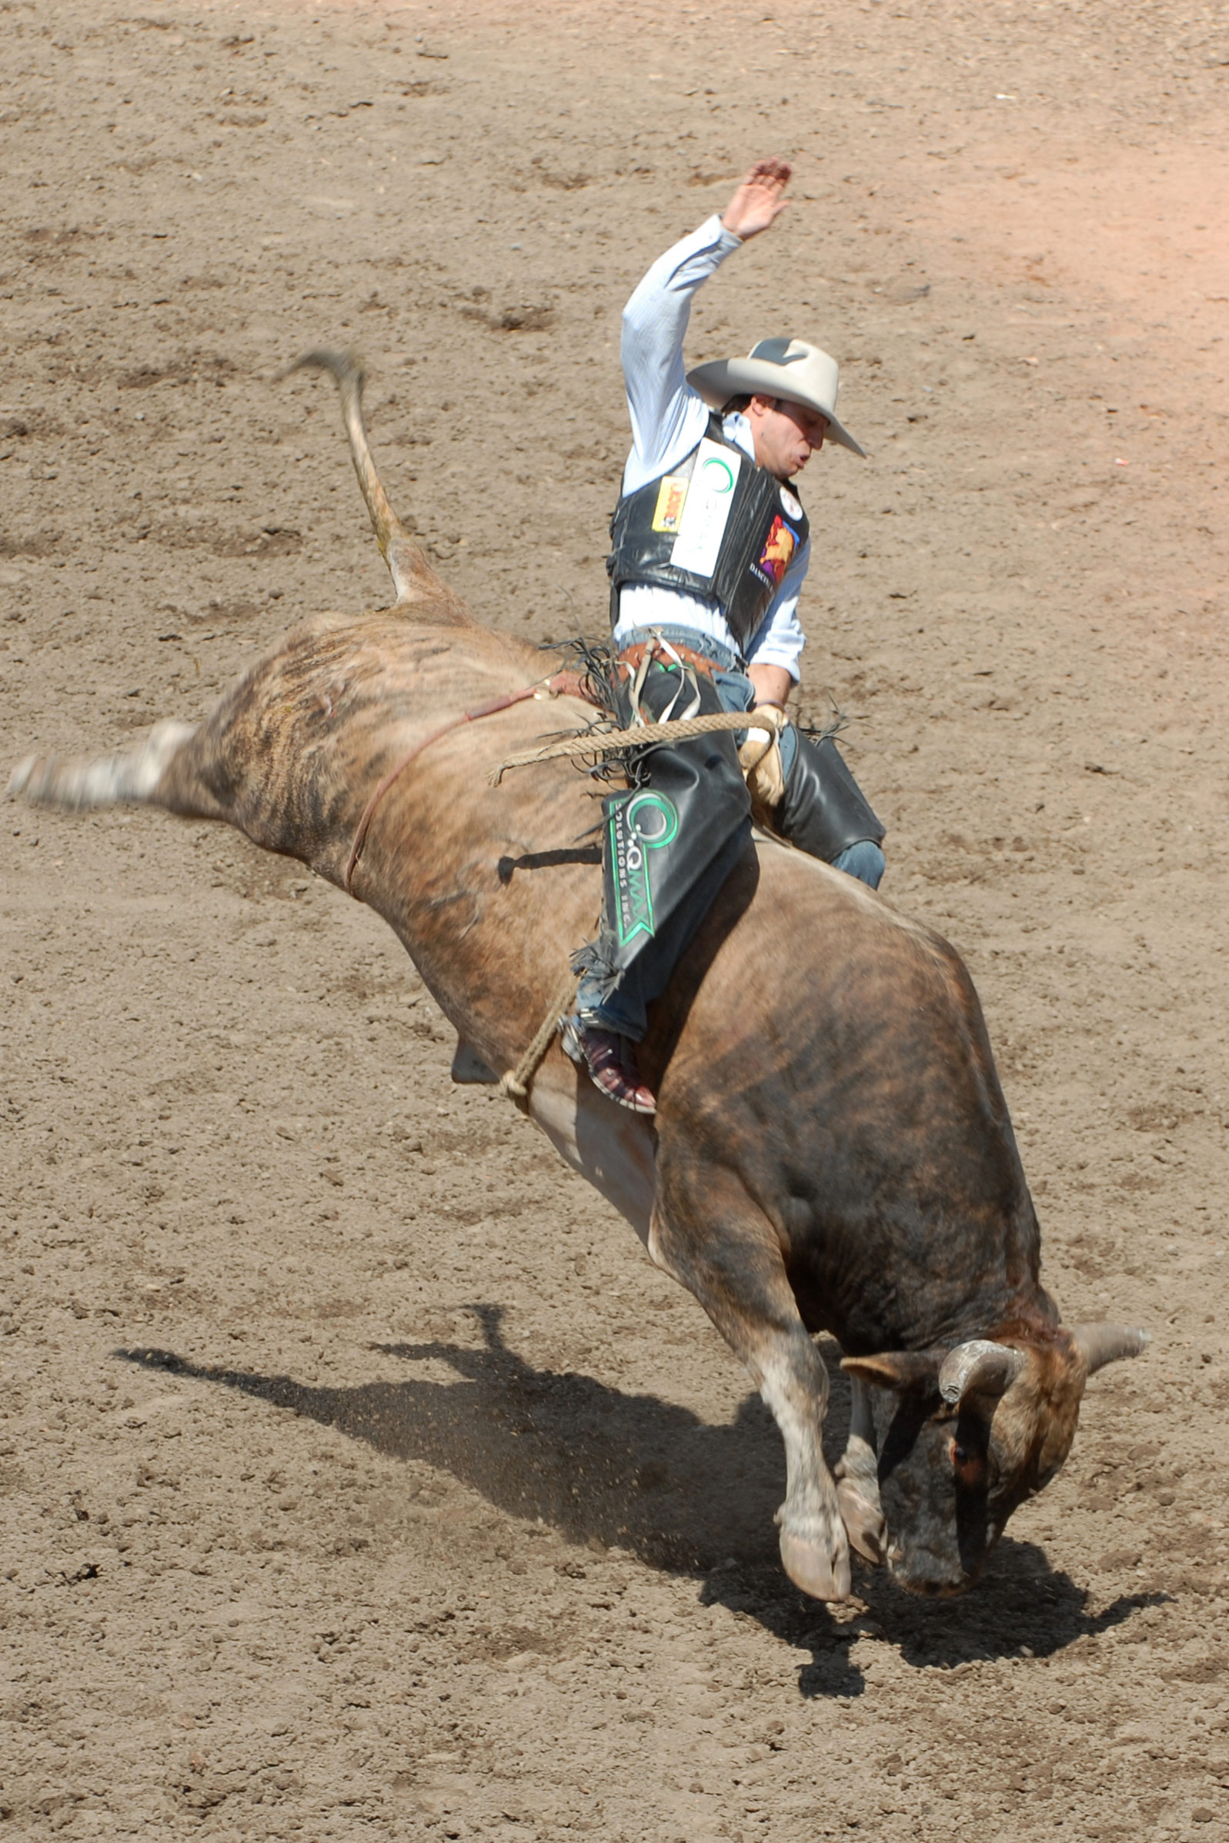

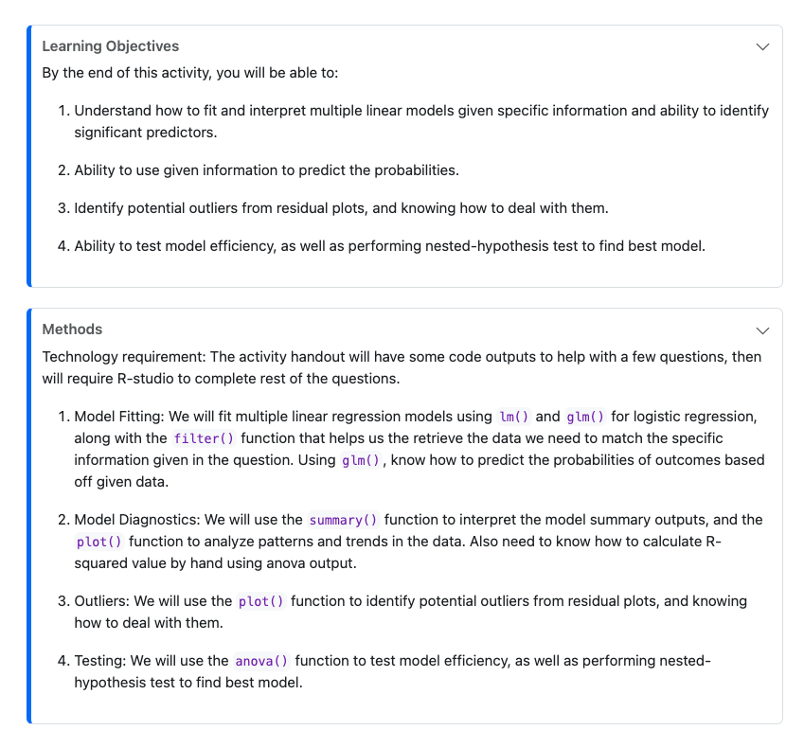
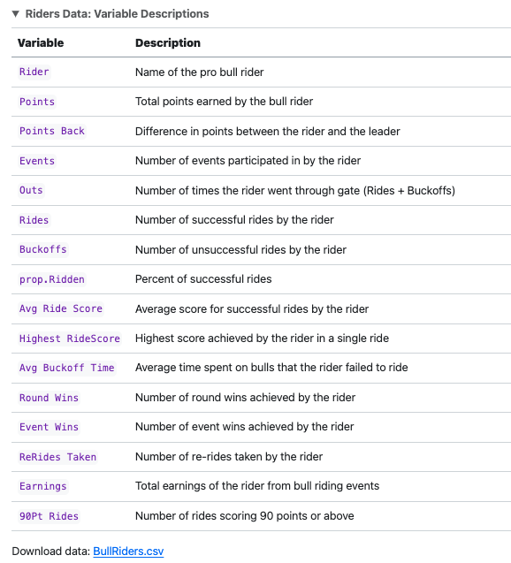
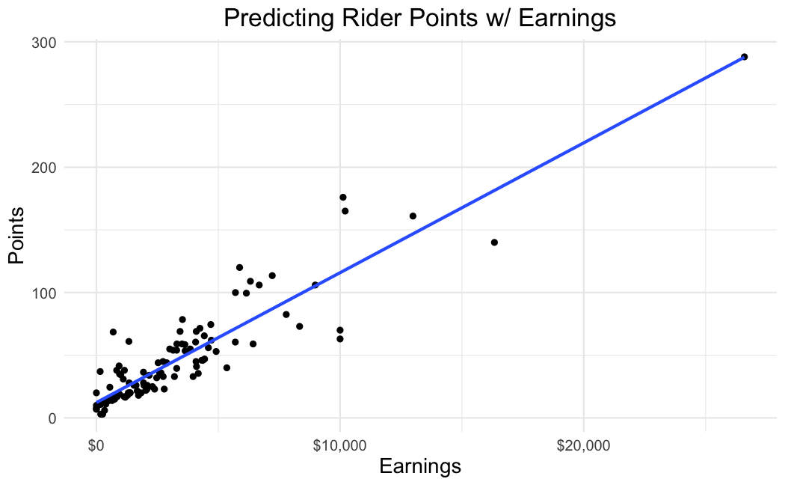
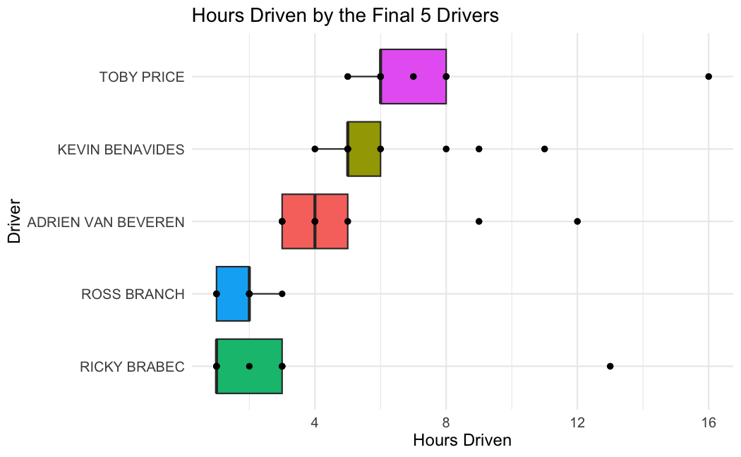
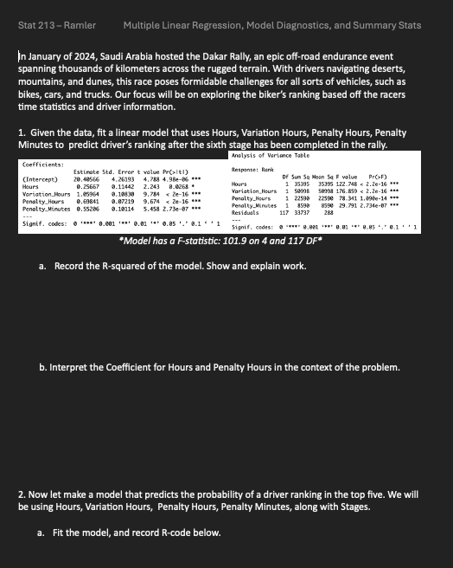


SCORE Network: Exploring Unusual Sports
Matthew Maslow ’24 (Data Science)
Advisor: Professor Ivan Ramler
What is SCORE?
Professional Bull Riding
The 2024 Dakar Rally
Funded by the National Science Foundation (award 2142705)
Acquires, cleans, manipulates, and documents sports data to create educational resources for data science
What is a Module?
1. Introduction
Summary of the sport and concepts that will be in handout
Provides learning objectives and methods
What is it?
Sport that requires a unique combination of skill, strength, and courage
Riders must stay on a bucking bull as long as they can, using only one hand to hold on while the bull tries to buck them off
Rider Score based on ride performance, and the bull is scored based on how well it bucks
What is it?
Annual off-road endurance event, recently in Saudi Arabia, spans a few weeks, and covering thousands of kilometers.
Motorcyclists, drivers, and truckers compete in extreme conditions, making it one of the world's toughest motor-sport events.
2. Data
Summary of dataset, with variable descriptions
Supplies data file and source
3. Materials
Class handouts and answer keys
What will be learned
This dataset’s analysis encompasses linear regression, identification of influential points, hypothesis testing, and variable transformation
Analyzing 2023 PBR Touring Pro Division data to grasp factors influencing rider and bull performance
What will be learned
For this investigation, we will be looking at the motorist statistics for all 12 stages of race.
This dataset’s analysis will exemplify data visualization, uncovering patterns and insights within the race dynamics
4. Conclusion
Summarize the takeaways and learning objectives from the sports application handouts

